Slide 1
Aerodynamics of Thrust and Drag

Slide 2
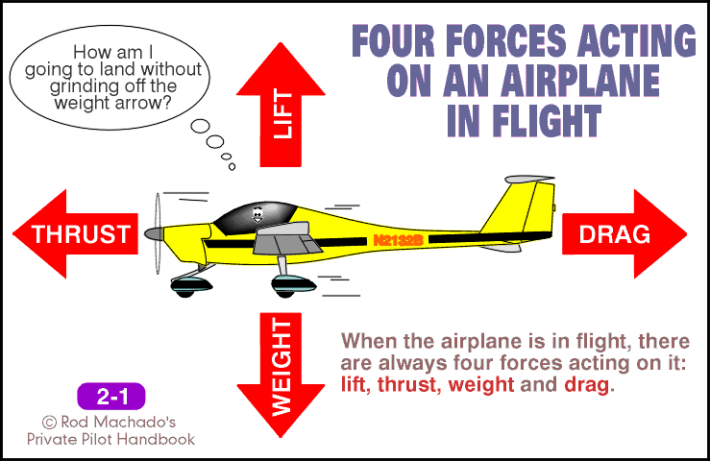
The Four Forces Revisited

Slide 3
The Four Forces Revisited
The forward force produced by the powerplant/propeller. It opposes the force of drag.

Slide 4
The Four Forces Revisited
Rearward force caused by disruption of airflow by the wing, fuselage, and other protruding surfaces. Drag opposes thrust.

Slide 5
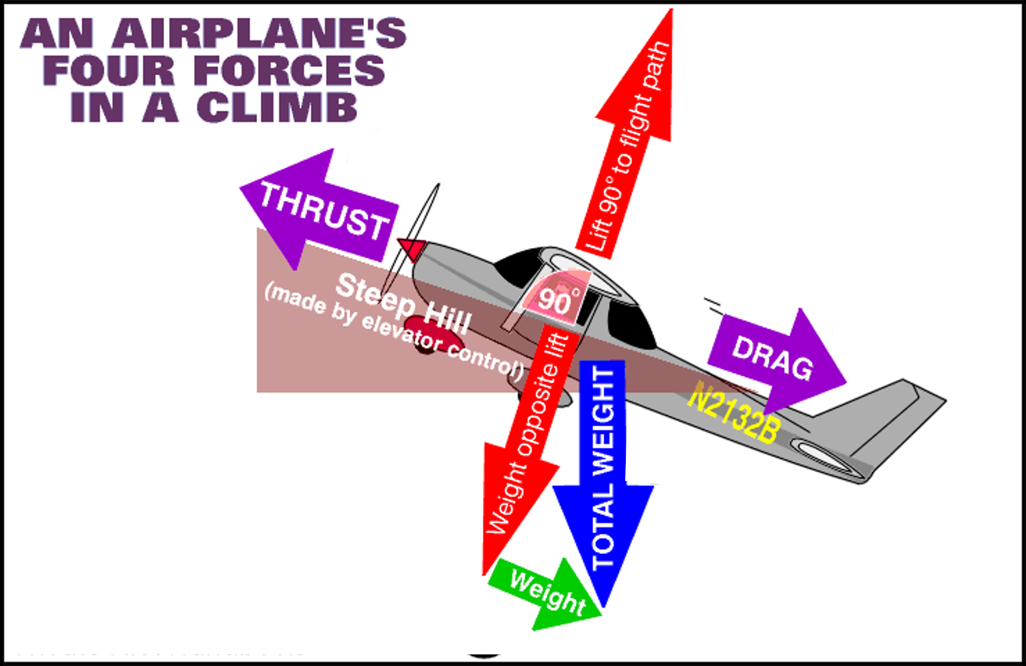

Slide 6
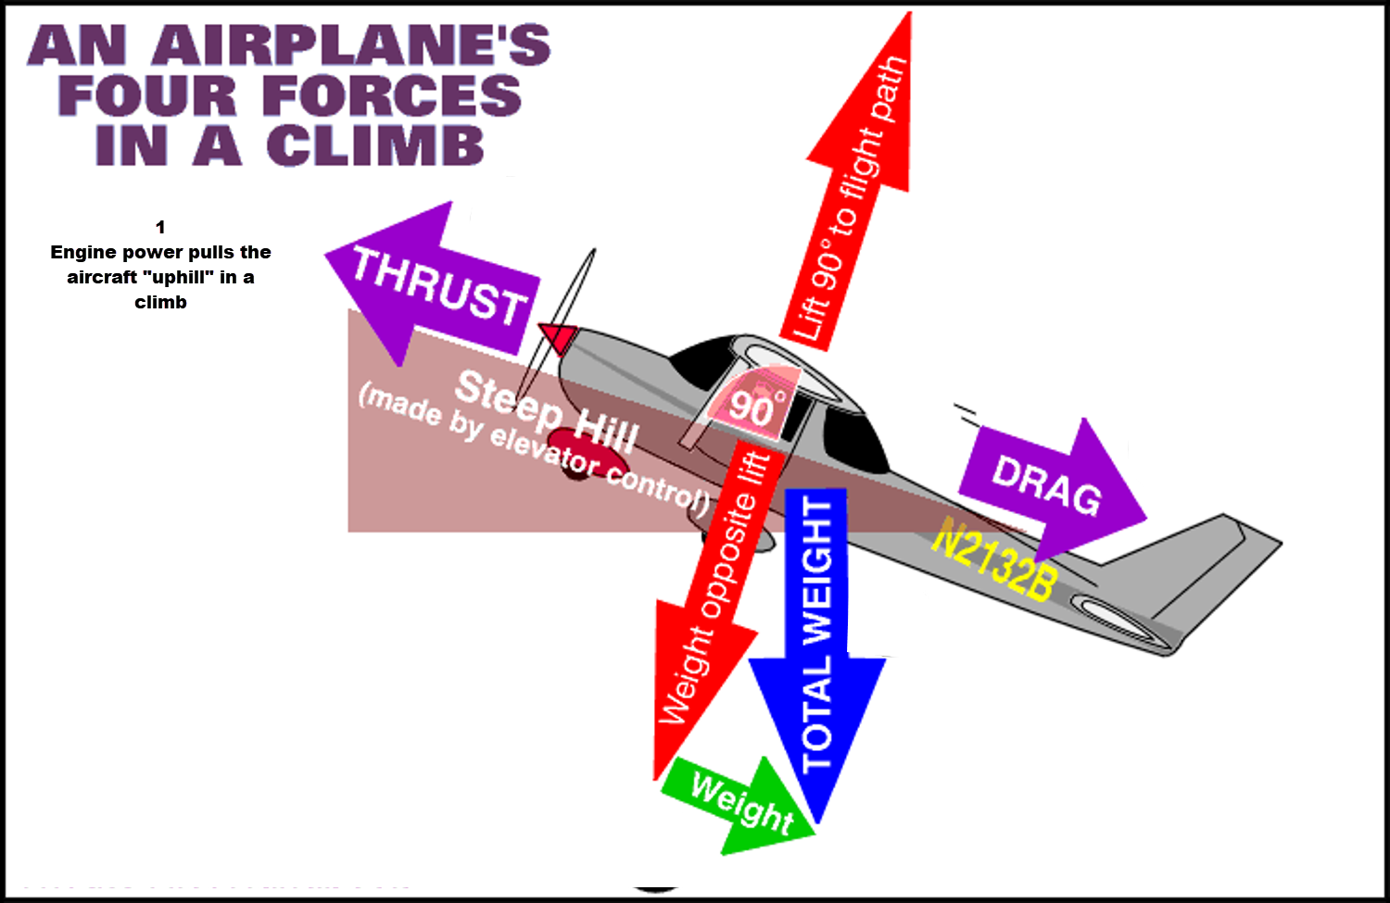

Slide 7
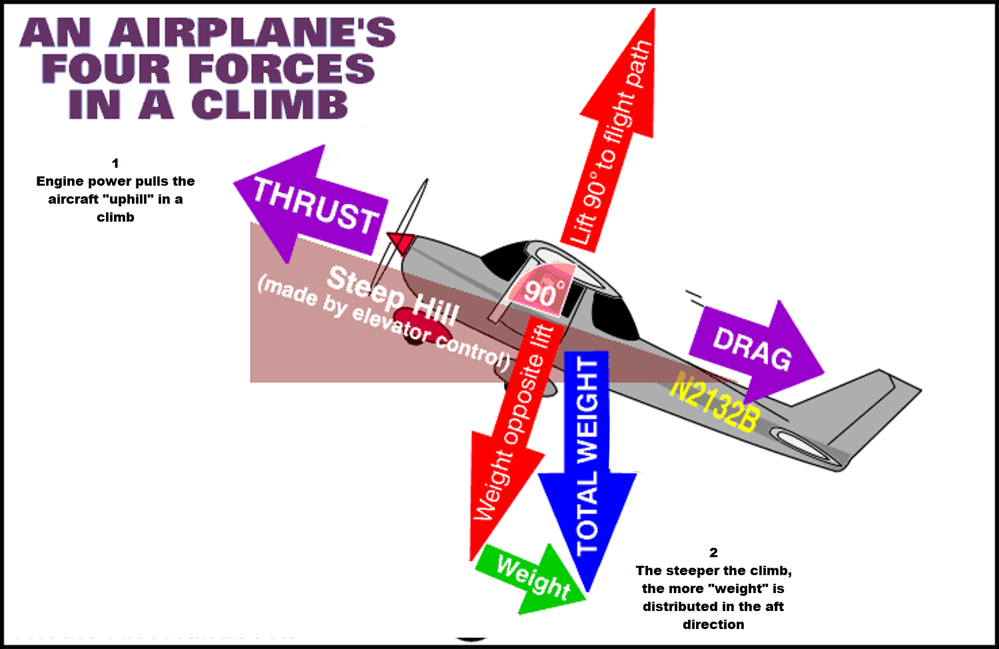

Slide 8
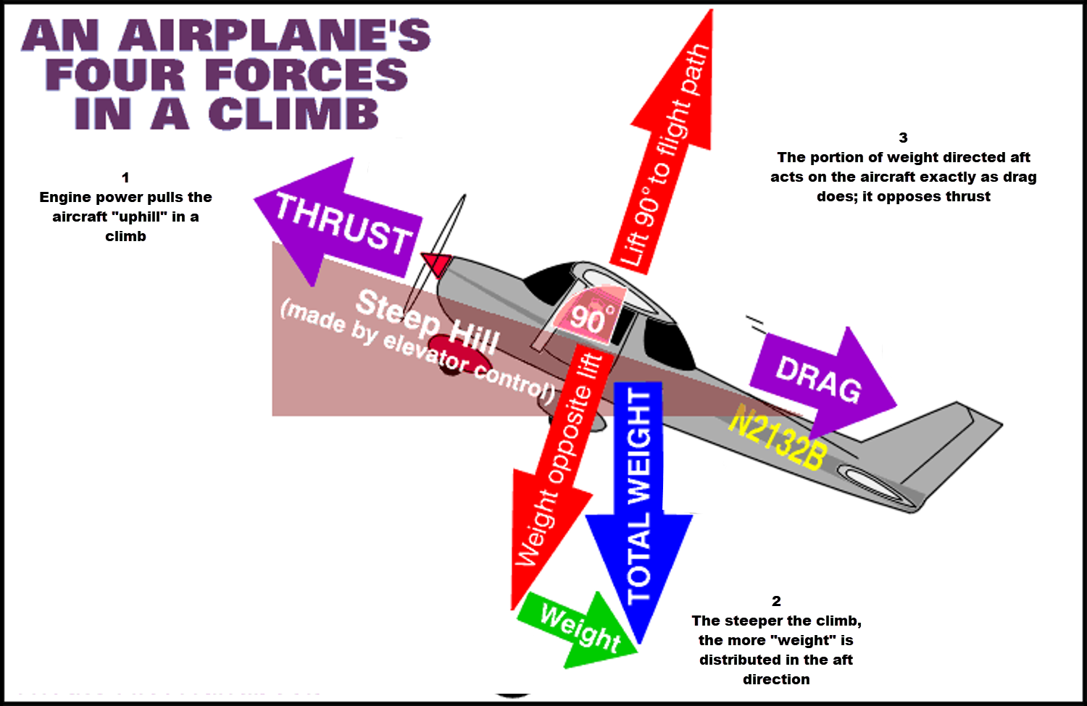

Slide 9
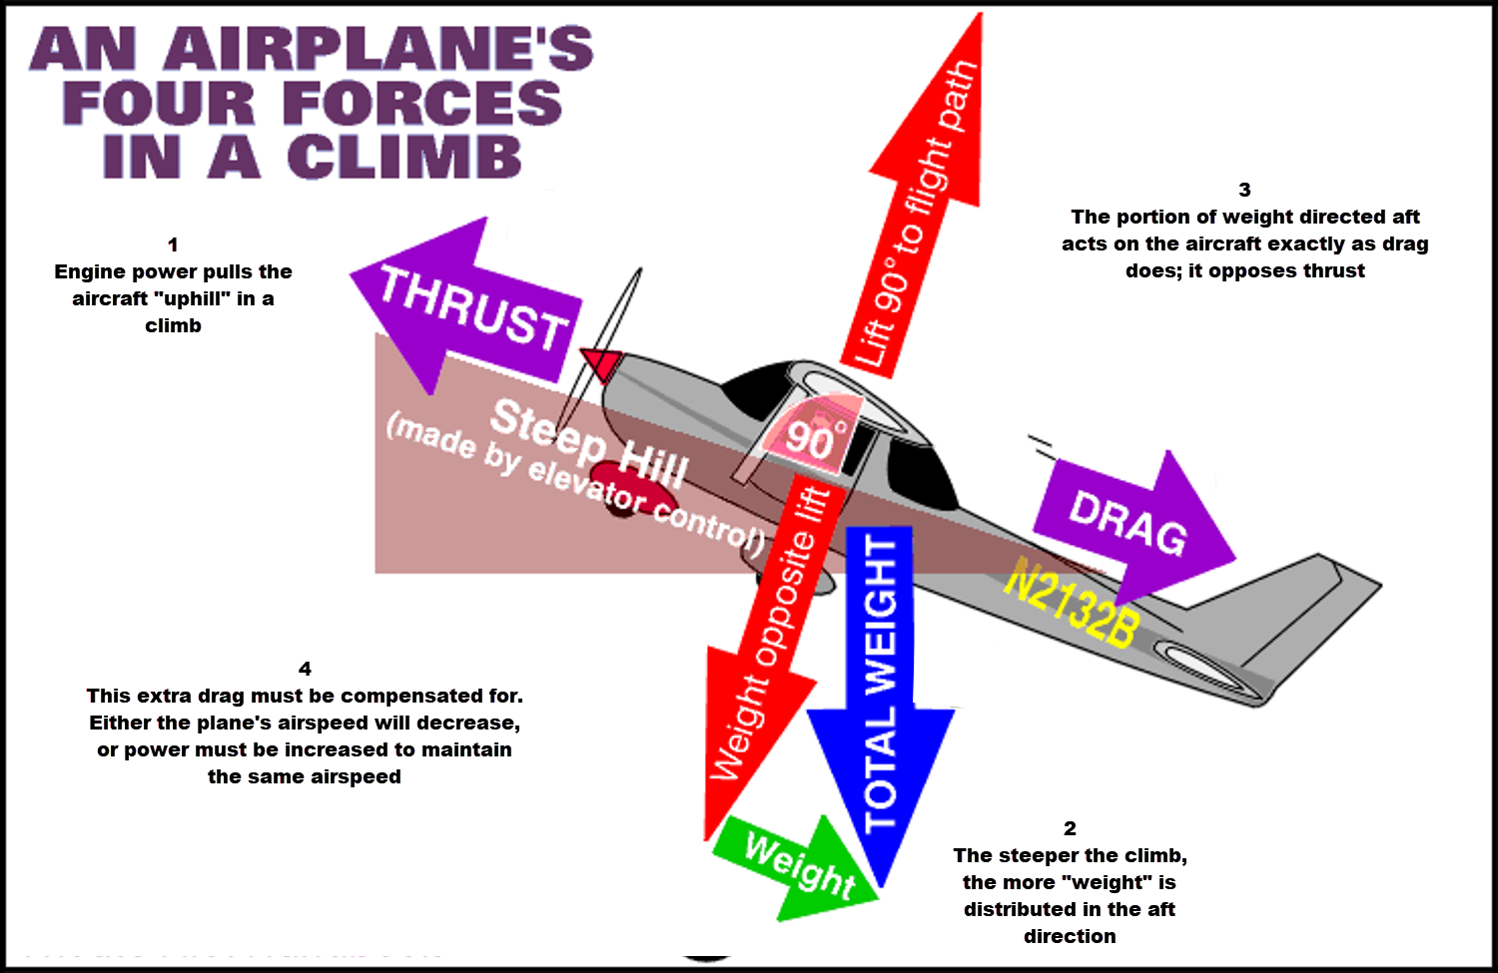

Slide 10
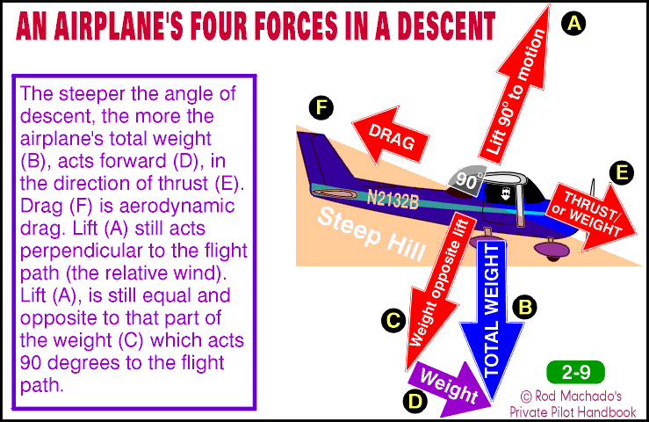

Slide 11
Thrust
Propellers as wings
Effects of producing thrust

Slide 12
Propellers
Aircraft propeller consists of:
  Two or more blades***
  A central hub to which the blades are attached
Aircraft propellers are
  Rotating wings
  Act like airfoils
  Create the thrust that pulls/pushes the aircraft forward

Slide 13
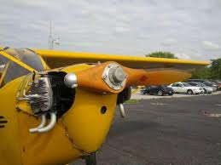
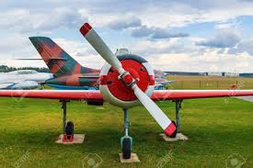
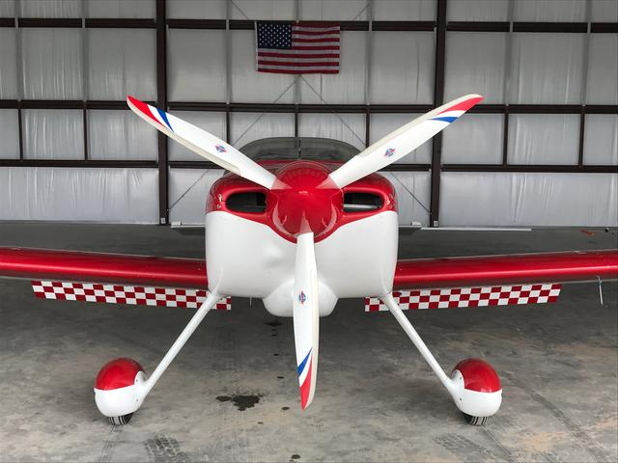
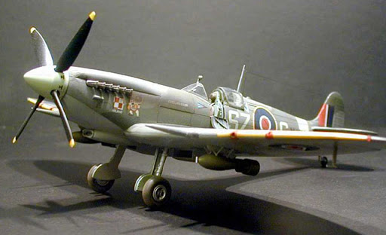
Propeller configurations

Slide 14
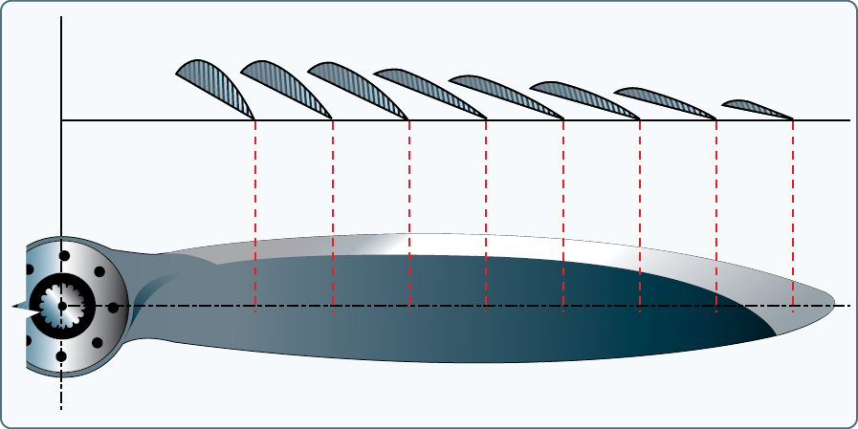
Airfoil sections of propeller blade

Slide 15
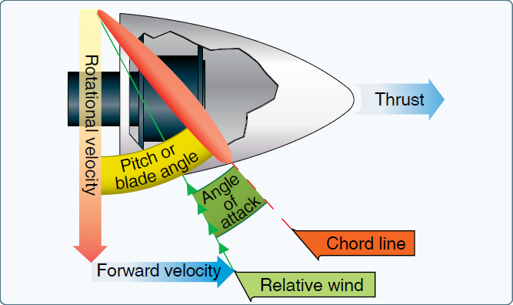
How a propeller cuts the air

Slide 16
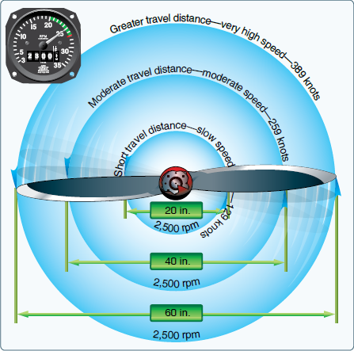
Propeller “twist” creates a constant angle of attack even though the tips are moving much faster than the hub.

Slide 17

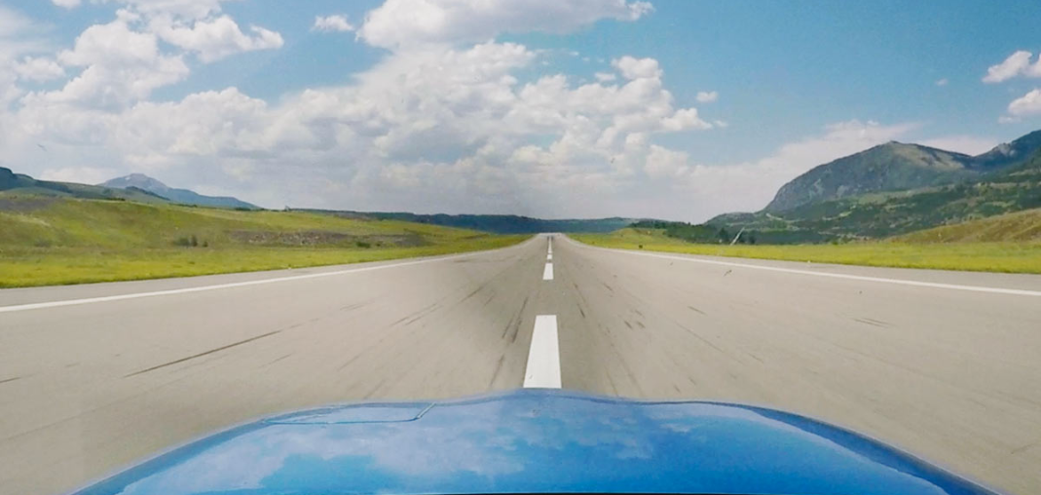
Propellers and Torque Tendencies
Torque is the tendency of an aircraft to turn, due to these four factors:
Torque of the engine and propeller
Corkscrewing of the slipstream
Gyroscopic action of the propeller
Asymmetric loading of the propeller (P-Factor)

Slide 18
Propellers and Torque Tendencies
Torque is the tendency of an aircraft to turn, due to these four factors:
Torque of the engine and propeller
Corkscrewing of the slipstream
Gyroscopic action of the propeller
Asymmetric loading of the propeller (P-Factor)
On most general aviation aircraft in the US the engine driveshaft and propeller turn clockwise from the point of view of pilot seated in the cockpit. The following assumes this is so.

Slide 19
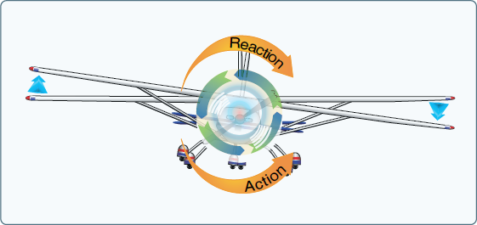
Torque Reaction: Newton’s 3rd Law
Counter-reaction to clockwise action of engine/propeller puts more weight on left wheel, creating more friction. This causes plane to veer left.

Slide 20
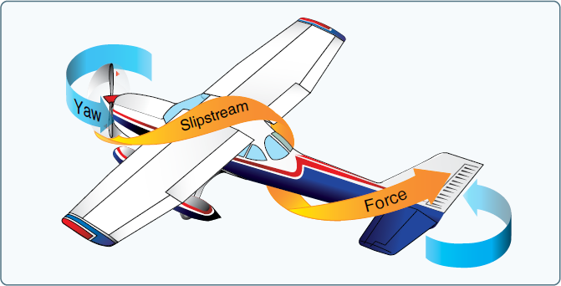
Spiralling Slipstream
Slipstream from propeller corkscrews in same direction as rotation of propeller. Air strikes left side of vertical fin. This causes plane to veer left.

Slide 21
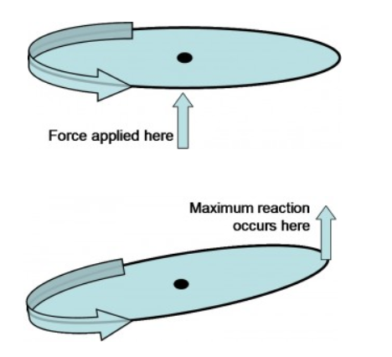
Gyroscopic Action
Spinning engine and propeller are, in effect, a big gyroscope
Gyroscopes exhibit the behavior that when a force is applied that affects the rotating edge, the maximum reaction to that action occurs 90 degrees later in the direction of rotation

Slide 22
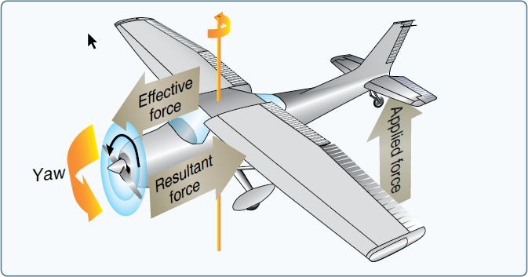
Gyroscopic Action
Changing the plane of rotation of the propeller (for instance when raising the tail during the takeoff roll) applies a force at the top of the rotation. The reaction occurs 90 degrees ahead, at the 3 o’clock position. The right side of the spinning propeller is forced forward, pushing the nose to the left.

Slide 23
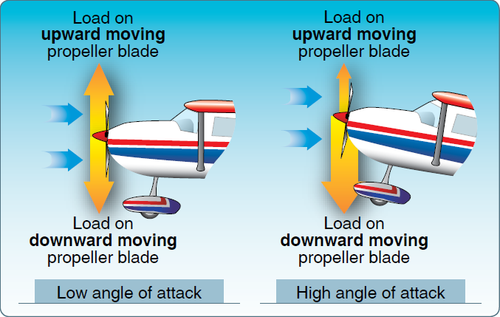
Asymmetric Loading (P-factor)

Slide 24
Asymmetric Loading (P-factor)
Downward moving blade (right side) creates more thrust

Slide 25
Drag
PARASITE DRAG
INDUCED DRAG

Slide 26
Definitions:
Parasite Drag: that rearward force, opposing thrust, that is not a byproduct of producing lift
  Displacement of air by body of aircraft
  Turbulence in the airstream
  Hindrance of air moving over the surface of the aircraft
Induced Drag: that rearward force that is produced as a necessary condition of developing lift

Slide 27
Parasite drag comes in three forms:
  Form drag
  Interference drag
  Skin friction

Slide 28
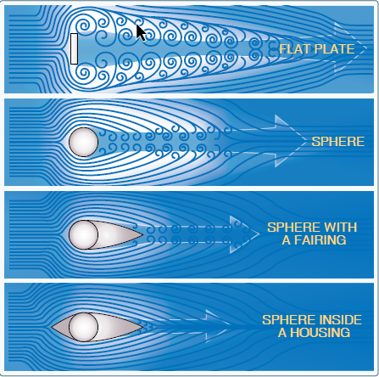
Form drag: generated by the airflow around the aircraft’s shape

Slide 29
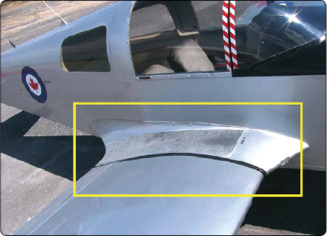
Interference drag: generated by intersection of airstreams that create eddy currents.

Slide 30
Skin friction drag: resistance to movement caused by friction of air molecules against the surface of the aircraft.
Anything that makes the surfaces smoother reduces friction drag:
Flush rivets
Removal of protruding irregularities
Smooth glossy finishes, such as paint
Removal of dirt

Slide 31
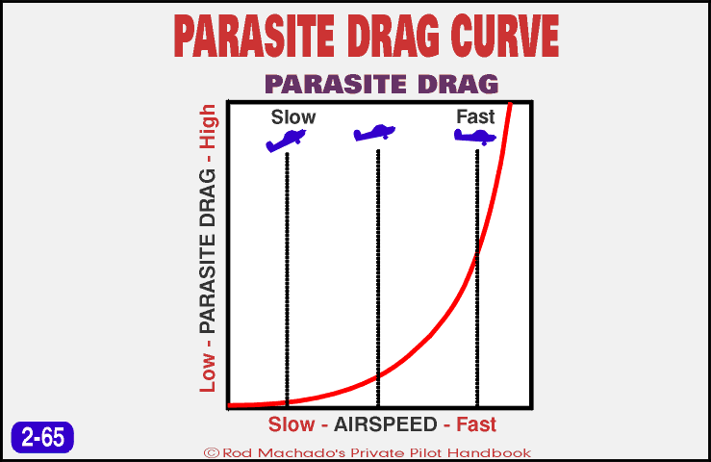

Slide 32
Induced Drag
No system that performs work is 100% efficient. This includes airfoils.
The act of producing lift necessarily also produces drag as a byproduct

Slide 33
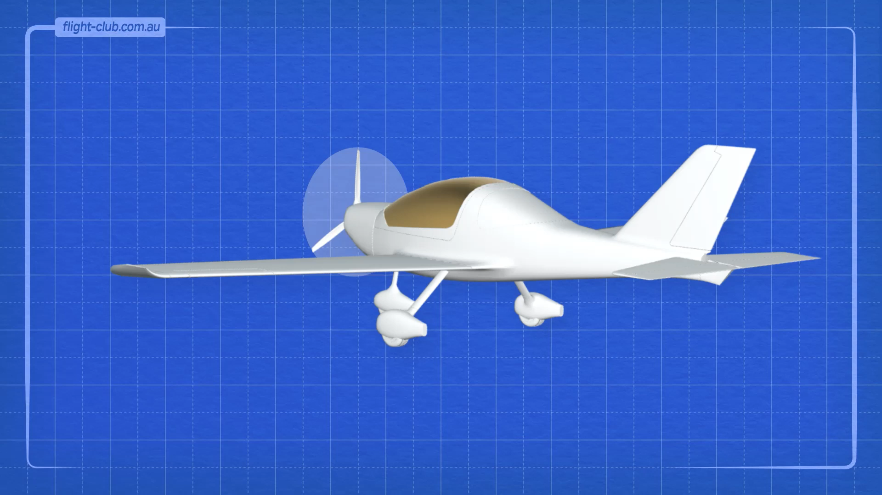

Slide 34
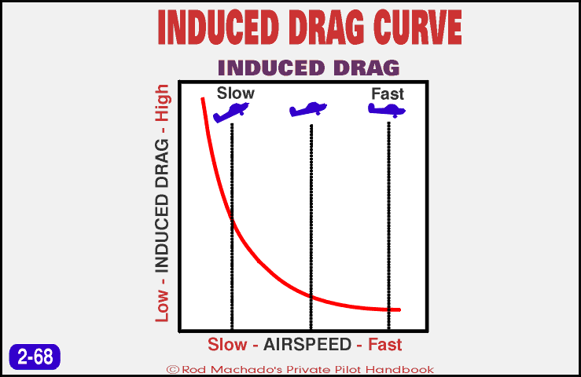

Slide 35
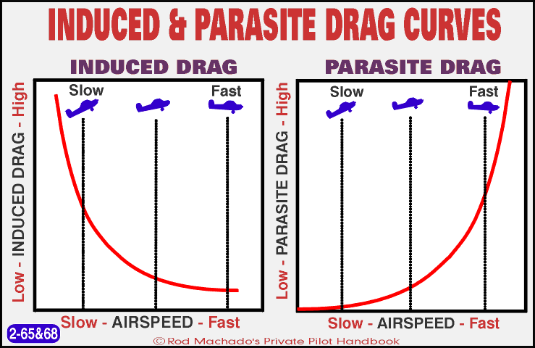

Slide 36
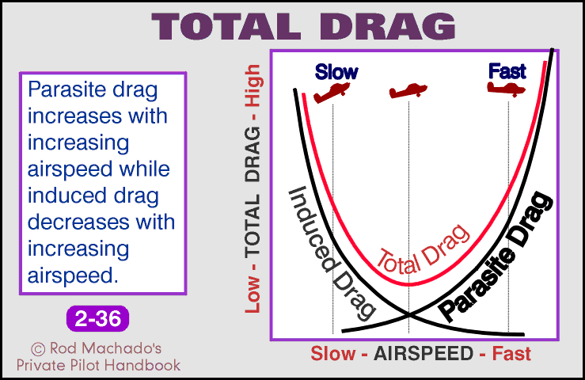

Slide 37
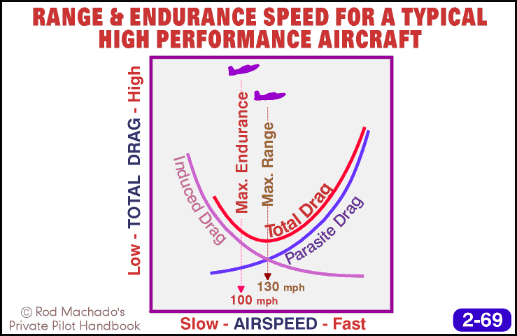

Slide 38
The Four Forces Again
V Speeds
Factors affecting performance

Slide 39
Aerodynamic Speeds
 | Name | Definition | Example Value (C-172)
Vx | Best angle of climb | Greatest gain in altitude per distance travelled over ground | 53 mph
Vms | Minimum sink rate | Least altitude lost per unit of time | 60 mph
Vbg | Best glide | Least altitude lost per distance travelled over ground | 65 mph
Vy | Best rate of climb | Greatest gain in altitude per unit of time | 73 mph

Slide 40
Some comparisons
Minimum Sink (powered) |  | Best glide (unpowered)
Aircraft | Ratio | Aircraft | Ratio
House sparrow | 4:1 | Northern flying squirrel | 2:1
Wright Flyer | 8:1 | Air Canada Flight 143 (Gimli Glider) | 12:1
Herring gull | 10:1 | Hang glider | 15:1
Airbus A320 (cruise) | 20:1 | Great frigatebird | 22:1
Rutan Voyager | 27:1 | Eta glider | 70:1

Slide 41
Some other measures
Name | Calculation | Characteristics as measure +
Wing loading | Gross weight/wing area | Higher max cruise speed Greater stability in turbulence Higher stall speed Longer TO/landing distance
Power loading | Gross weight/ horsepower | Lower fuel consumption Greater endurance Lower cruise speed Longer takeoff roll Lower climb rate
Carson speed | Best glide speed * 1.32 | Cruise speed that delivers best fuel economy

Slide 42
Stability
Axes of stability
Static vs dynamic stability

Slide 43
Stability: Definitions
Stability is the way a body reacts in response to a disturbance of its equilibrium.
In an aircraft, this means its tendency to correct for changed conditions and to return to or to continue on the original flight path.
It is primarily an aircraft design characteristic.

Slide 44
Stability: Relevance
If an aircraft is to be useful, it must be safely controllable without exceeding the pilot’s strength or requiring exceptional flying ability.
If an aircraft is to fly straight and steady along any arbitrary flight path, the forces acting on it must be in static equilibrium.
There are two types of stability:
  Static
  Dynamic

Slide 45
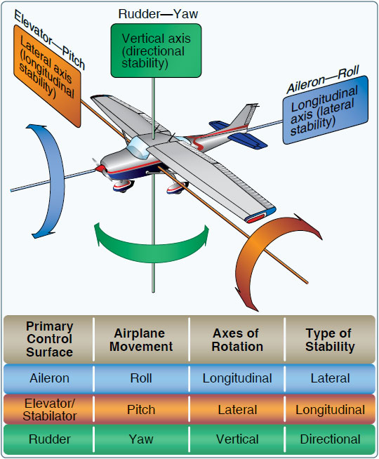
Axes
of Stability

Slide 46
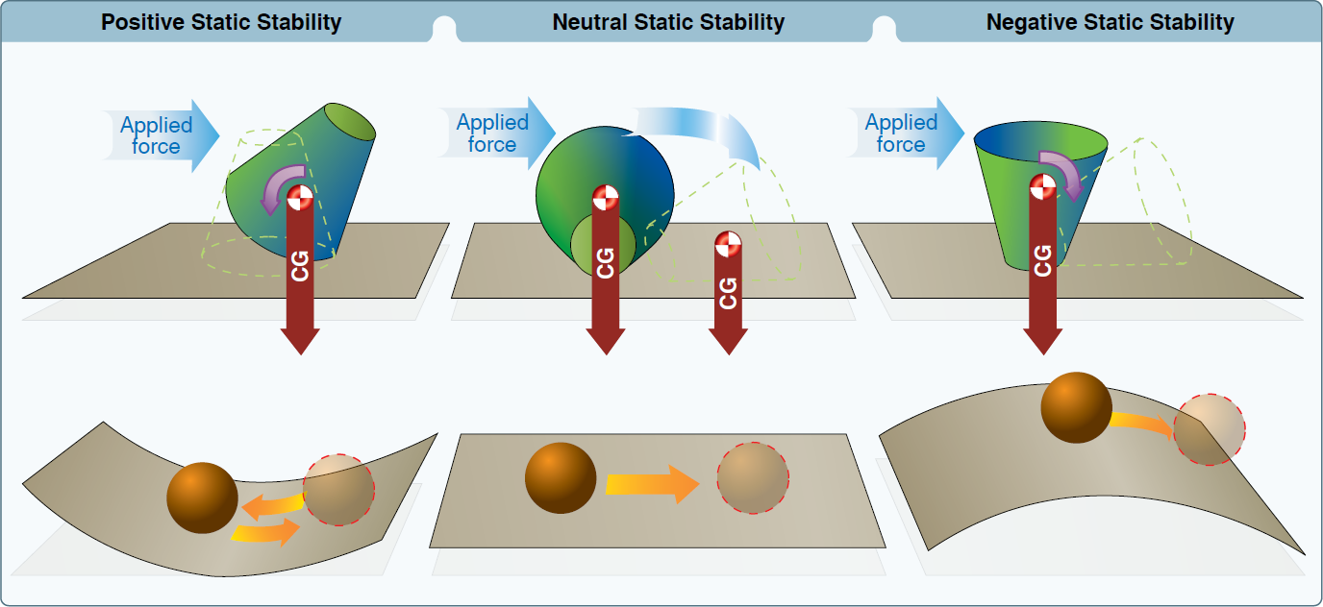
Positive static stability The initial tendency of the aircraft to return to the original state of equilibrium after being disturbed | Neutral static stability The initial tendency of the aircraft to remain in a new condition after its equilibrium has been disturbed | Negative static stability The initial tendency of the aircraft to continue away from the original state of equilibrium after being disturbed

Slide 47
Dynamic Stability
Dynamic stability refers to the aircraft response over time when disturbed from a given pitch, yaw, or bank
Dynamic stability is only considered in a system that already exhibits positive static stability

Slide 48
Dynamic Stability
Positive: the motion of the displaced object decreases in amplitude and returns toward the equilibrium state.
Neutral : once displaced, the displaced object neither decreases nor increases in amplitude.
Negative: the motion of the displaced object increases and becomes more divergent.

Slide 49
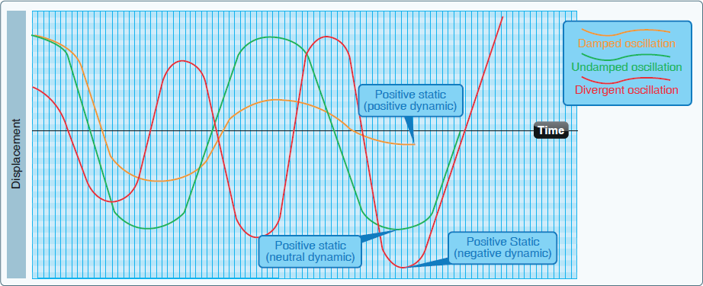

Slide 50
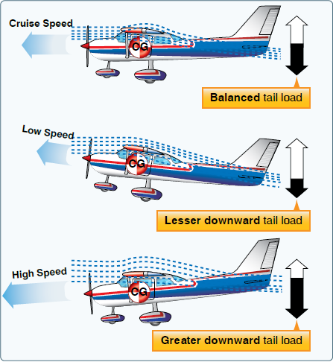
Longitudinal Stability
(Pitch)
If nose is raised, airspeed slows and downwash over tail is decreased, causing nose to fall again.
The opposite happens if the nose is lowered.

Slide 51
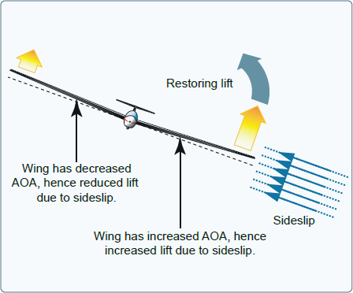
Lateral Stability (Roll)
Dihedral angle built into wings corrects a roll disturbance. The low wing has a greater angle of attack, creates more lift, and the plane levels itself.

Slide 52
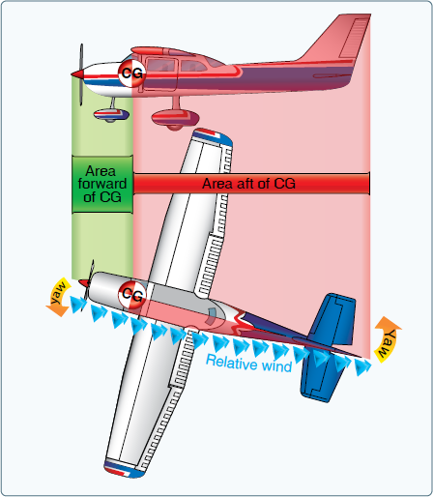
Directional Stability (Yaw)
The vertical tail surface and side of the fuselage aft of the center of gravity counteract a yaw disturbance and push the nose back to its original heading, in much the same way a weathervane orients itself to the relative wind.

Slide 53
Next Session: Feb 9
Quiz: Aerodynamics of Lift
Presentation: Flight Instruments
Reading:
  Machado Chapter 5
  Pilot’s Handbook Chapter 8

