Slide 1
Aeromedical Factors & Certification

Slide 2
Medical Certificates:
Who Needs One?
PRIVATE PILOT:
Must hold at least a third class medical certificate
or
have a BasicMed endorsement from a doctor
SPORT PILOT:
Medical not required.
Current valid driver’s license suffices as a ‘medical certificate.’
You are self-certifying your medical fitness to act as PIC

Slide 3
Medical Certificates: Who Needs One?
PRIVATE PILOT:
Must hold at least a 3rd Class medical certificate
or
complete the BasicMed process and abide by its restrictions
SPORT PILOT:
Medical not required. Current valid driver’s license suffices as a ‘medical certificate.’
You are self-certifying your medical fitness to act as PIC.
Please note:
You may not act as PIC if you held an FAA medical which is currently in a status of deferral, denial, suspension, or revocation. Such a status must be rectified with the FAA before either option can be exercised.
Notes:
No Notes

Slide 4

Two interlocking options:
Sport pilot vs private pilot
Traditional 3rd class medical vs BasicMED
Private
3rd Class
BasicMed
Sport
US Driver’s License
Notes:
So when we consider the situation of each of our four test pilots, what their goals are, and what their limitations, there are essential two axes of decisionmaking – do I attempt to fly under the privileges of my private pilot certificate, or do I become a sport pilot, and accept the greater restrictions on what and where I can fly? If I am determined to fly as a private pilot, do I attempt to retain the third class medical or do I fly under the provisions of BasicMed, along with its greater restrictions on what I can fly (but not where, really)

Slide 5
The Third Class Medical Certificate
Must be issued by an FAA certified Aeromedical Examiner (AME).
Comprehensive physical exam Close attention paid to medications taken List of disqualifying conditions & medications is available
Under 40 at time of exam: Good until the last day of the month in which the medical was issued Five years later. | 40 and older at time of exam: Good until the last day of the month in which the medical was issued Two years later.

Slide 6
What is allowed under BasicMed?
PIC of any compliant aircraft
VFR and IFR under 18,000 feet
Flight instruction
Safety Pilot
Notes:
And as a pilot flying under BasicMed privileges you are allowed to be PIC of any aircraft that is compliant with the rules we already discussed. You can fly VFR day, VFR night, or IFR if you hold an instrument rating. You cannot fly for compensation or hire, but you can flight instruct. This is an area that there is a lot of confusion about, and if you go onto pilot discussion internet forums you will find people who will swear on their mother’s graves that you *must* have a class 2 medical to flight instruct, because you’re getting paid for it. That has actually never been the case, even before BasicMed. It *is* true that a prerequisite for flight instructing (unless you are only instructing in light sport aircraft) is a commercial rating. But the FAA has *always* defined instruction to be a separate activity from flying for compensation or hire. You could always instruct on a third class medical, and you can now instruct on BasicMed.

Slide 7
BasicMed: How It’s Changed
Before PL 118-63 | After PL 118-63
Aircraft authorized with no more than six occupants | Aircraft authorized with no more than seven occupants
Maximum takeoff weight no more than 6000 lbs | Maximum takeoff weight no more than 12,500 lbs
Flight altitude no more than 18,000 MSL | No change
Airspeed no more than 250 knots | No change
Within the United States (or with permission of foreign country) | Mandated to expand list via diplomacy
Notes:
OK, so you decide you don’t want to put up with that. What are you giving up if you go with BasicMed instead? There are some things you can’t do under BasicMed that you would have be able to do as a private pilot with a 3rd class medical. These mostly restrict the size and performance of the aircraft you can fly.
The gist of the BasicMed restrictions is that you a restricted to aircraft with a gross takeoff weight of no more than 6,000 lbs, that was certificated for no more than six occupants. So all of your standard piston single engine GA aircraft, and some light twins, are allowed under this rule – Cessna 172s and 182s, 206s, 310s, Piper Cherokees, Malibus, Beech Bonanzas and Barons, etc, When BasicMed was first passed in 2016, the letter of this restriction – which was not the actual intention of the FAA – meant that certain Piper PA-32s and -34s, which are Cherokee Sixes, Senecas, etc – which had allowance for an optional seventh seat on the type certificate – were excluded from BasicMed. This situation was fixed in 2018 with a supplemental type certificate for these aircraft.
The next couple of lines detail operation limitations that the pilot has to adhere to. Note, though, that these do not refer to the physical limits of the aircraft. You can fly an aircraft with a service ceiling higher that 18000 feet, or that has a permissible operating airspeed greater than 250 knots. You as the pilot are just not allowed to exceed those limits.
And the last restriction has to do with the fact that the BasicMed rule is purely an FAA rule; it is not endorsed by ICAO. So it’s up to other individual countries to decide whether to accept it or not. The Bahamas were very quick to announce that they would accept it, and about a year later Mexico also signed on. Unfortunately, it is still the case that Canada does not accept BasicMed. So if you want to fly from the lower 48 to Alaska, you have to make sure you won’t need a fuel stop in Canada.

Slide 8
Who is eligible for BasicMed?
Have held a valid medical on or after July 15, 2006
  In 2006 a 3rd class for a pilot under 40 was good for three years, not five (this was changed in 2008)
  If you were younger than 40 at the time of your last medical, it could have been issued as early as July 1, 2003
  If you were 40 or over, it could have been issued as early as July 1, 2004
Notes:
You are eligible for BasicMed if you have held a valid FAA medical at any point on or after July 15, 2006. This does mean that if you have never in the past held a medical, or you did but it expired prior to that date, you will have to successfully pass one FAA medical exam. That done, you can then switch to flying under BasicMed privileges and never have to get another FAA medical.

Slide 9
Who is eligible for BasicMed?
That medical must still be ‘in good standing’
  Expired is OK
  Cannot have been denied, suspended, or revoked
  If currently deferred, must wait for OK City’s ruling
Notes:
You are eligible for BasicMed if you have held a valid FAA medical at any point on or after July 15, 2006. This does mean that if you have never in the past held a medical, or you did but it expired prior to that date, you will have to successfully pass one FAA medical exam. That done, you can then switch to flying under BasicMed privileges and never have to get another FAA medical.

Slide 10
Who is eligible for BasicMed?
Have not developed in the meantime any of the conditions listed by the FAA (14 CFR 68.9):
Mental health disorder:
  Severe personality disorder, psychosis, bipolar disorder; substance dependence
Neurological disorder:
  Epilepsy, unexplained loss of consciousness, unexplained loss of nervous system control
Cardiovascular condition:
  Myocardial infarction, coronary heart disease requiring treatment, cardiac valve replacement, heart replacement.
Notes:
You are eligible for BasicMed if you have held a valid FAA medical at any point on or after July 15, 2006. This does mean that if you have never in the past held a medical, or you did but it expired prior to that date, you will have to successfully pass one FAA medical exam. That done, you can then switch to flying under BasicMed privileges and never have to get another FAA medical.

Slide 11
Where Can You Fly Under BasicMed?
United States
Mexico
The Bahamas
The Dominican Republic
Puerto Rico
U.S. Virgin Islands
American Samoa
Commonwealth of the Northern Mariana Islands
Federated States of Micronesia
Guam
Republic of the Marshall Islands
Republic of Palau
Notes:
And as a pilot flying under BasicMed privileges you are allowed to be PIC of any aircraft that is compliant with the rules we already discussed. You can fly VFR day, VFR night, or IFR if you hold an instrument rating. You cannot fly for compensation or hire, but you can flight instruct. This is an area that there is a lot of confusion about, and if you go onto pilot discussion internet forums you will find people who will swear on their mother’s graves that you *must* have a class 2 medical to flight instruct, because you’re getting paid for it. That has actually never been the case, even before BasicMed. It *is* true that a prerequisite for flight instructing (unless you are only instructing in light sport aircraft) is a commercial rating. But the FAA has *always* defined instruction to be a separate activity from flying for compensation or hire. You could always instruct on a third class medical, and you can now instruct on BasicMed.

Slide 12

Where Can You Fly Under BasicMed?
Notes:
And as a pilot flying under BasicMed privileges you are allowed to be PIC of any aircraft that is compliant with the rules we already discussed. You can fly VFR day, VFR night, or IFR if you hold an instrument rating. You cannot fly for compensation or hire, but you can flight instruct. This is an area that there is a lot of confusion about, and if you go onto pilot discussion internet forums you will find people who will swear on their mother’s graves that you *must* have a class 2 medical to flight instruct, because you’re getting paid for it. That has actually never been the case, even before BasicMed. It *is* true that a prerequisite for flight instructing (unless you are only instructing in light sport aircraft) is a commercial rating. But the FAA has *always* defined instruction to be a separate activity from flying for compensation or hire. You could always instruct on a third class medical, and you can now instruct on BasicMed.

Slide 13
Sport Pilot Privileges
United States drivers license
Not necessary to have ever held an FAA medical certificate
If a medical certificate has ever been issued, it must not have been suspended or revoked
If a medical has ever been applied for, the application must not have been denied or still in a deferral status.
Pilot must self-certify before every flight that there is no medical issue compromising safety

Slide 14
What changed with MOSAIC?
Old paradigm:
  Weight limit
  Two place
  Activities such as night flight forbidden
  A/C characteristics either allowed or forbidden
  Speed limit 120 kts
New paradigm:
  Performance based: clean stall speed
  Four place OK but only one passenger
  Add-ons like night flight/RG/complex obtainable via separate endorsement
  Speed limit 250 Kts

Slide 15
Part 61:
Sport Pilots
Sport Pilot Privileges as of Oct 22, 2025
Seats | 4 (airplane) 2 (other)
Occupants | 2
Stall speed clean (V_{s1})* | 59 kts CAS (airplane) 45 kts CAS (other)
Max level flight speed (V_{h}) | 250 kts CAS
Powerplant | N/A
Constant speed propeller | With endorsement
Retractable landing gear | With endorsement
Night flight | With endorsement and 3rd Class/BasicMed
Ratings in additional category/class | Clarified in advisory circular dated 11/14/2025
* Maximum stall speed/minimum steady flight speed without the use of lift-enhancing devices, at maximum certificated takeoff weight and most critical center of gravity.

Slide 16
Medical and Self-Certification Resources
FAA MedExpress
AOPA Medication Checklist
When self-certifying, consider these medications in the same light – do they have the potential, or have they in the past, affected you in a manner that may be unsuited for the safe operation of an aircraft?

Slide 17
Health & Medical Factors Affecting Pilot Performance

Slide 18
Hypoxia: too little oxygen
O2 deficiency in the tissue.
Symptoms are difficult to detect before pilot’s functions are affected.

Slide 19
Types of Hypoxia
Name | Definition | Causes
Hypoxic | Drop of blood oxygen levels because of lack of absorbable oxygen in breathing air | increased altitude pressurization loss
Hypemic | Blood is unable to absorb the required oxygen even at normal pressure | reduced blood volume anemic diseases carbon monoxide poisoning smoking recent blood donation
Stagnant | Loss of blood motion through parts of the body | Pulling excessive Gs
Histotoxic | Toxic matter in the body prevents cellular absorption of oxygen | alcohol (1 oz = 2K’ of alt.) narcotics poisons

Slide 20
Hyperventilation
Excessive rate and depth of ventilation leading to excessive loss of carbon dioxide from the blood.
Can be an unrecognized reaction to stress
Can lead to unconsciousness -- respiratory system overrides breathing to renormalize CO2 fraction

Slide 21
Hyperventilation
Other hyperventilation symptoms:
  visual impairment
  lightheaded/ dizziness
  hot/cold sensations
  muscle spasms
  tingling sensations
Consciously slowing the breathing rate, breathing into a paper bag or talking aloud can help combat or prevent hyperventilation.

Slide 22
Carbon Monoxide
CO is a colorless, tasteless, odorless gas produced during combustion.
CO can enter the cockpit through heating and defrosting ports.
Increase in altitude exaggerates the effects of CO poisoning because of the reduction of oxygen availability.

Slide 23
Carbon Monoxide
If leak is detected, or there is an odor of exhaust fumes, immediate corrective action should be taken, such as turning off heaters, opening air vents / windows, or using supplemental oxygen.
Symptoms of CO poisoning include blurred thinking and vision, uneasiness, dizziness, tightening of the forehead, headache and loss of muscle power (later stages).

Slide 24
Spatial Disorientation
State of temporary confusion resulting from misleading information sent to the brain by various sensory organs.
This happens when you lose outside visual reference and become disoriented, when you are relying on your vision and inner ear perceptions to tell you which way is up.

Slide 25
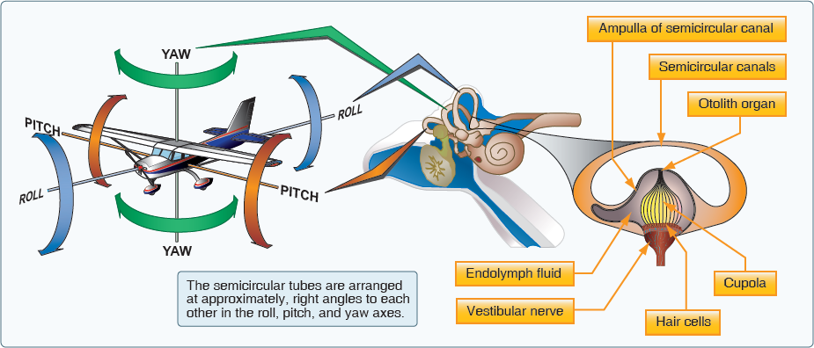
Spatial Disorientation
Semi-circular canal corresponds to sensations of roll, pitch, and yaw
These signals can mislead when disconnected from visual confirmation

Slide 26
Preventing Visual and Vestibular Illusions
Rely on your flight instruments, rather than your sensory perceptions.
Avoid sudden head movements.
If using external visual points, ensure that they are actually fixed points on the ground.
Strobes off in areas of haze / clouds to prevent optical illusions

Slide 27
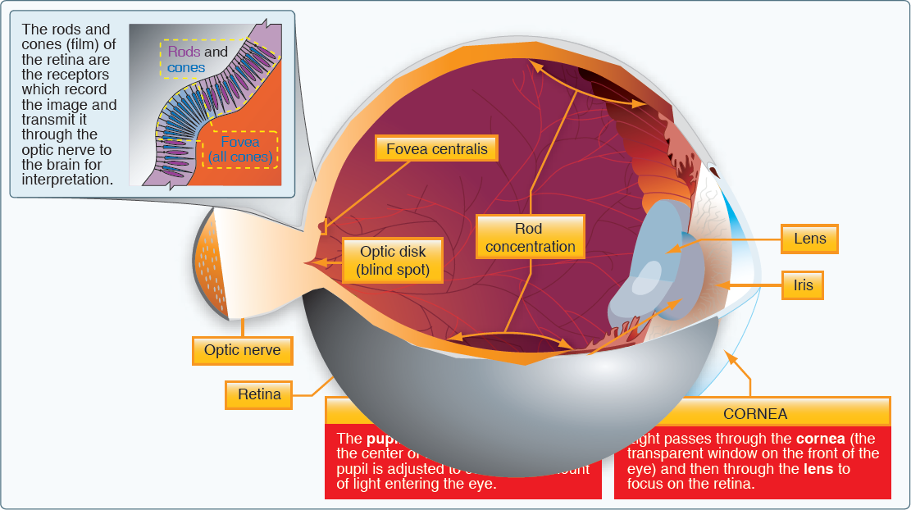
Flight Sight

Slide 28
Flight Sight
Pilots should adapt their eyes for night flight by avoiding bright white lights for 30 minutes prior to the flight.
Off-center viewing is better for spotting traffic at night.
Scanning for traffic in general is best accomplished by bringing small portions of the sky into the central field of vision slowly.
Haze can create the illusion of terrain being farther away than it really is

Slide 29
Alcohol
Even in small amounts, alcohol impairs
judgement
sense of responsibility
coordination
vision
reasoning
attention span
Alcohol also affects the ability of the blood to absorb oxygen - histotoxic hypoxia.

Slide 30
Alcohol
Body requires about 3 hours to rid itself of all alcohol contained in one mixed drink or beer
To act as pilot in command or required crew:
  No less than eight hours “bottle to throttle”
  Blood alcohol concentration less than .04%

Slide 31
Drugs’ Effects on Pilot Physiology
Class | Examples | Potential Effects
Stimulants | Caffeine Amphetamines Nicotine | Anxiety Mood swings Raised blood pressure
Depressants | Motion sickness meds Antihistamines Decongestants Alcohol | Lowers blood pressure Slows motor response Slows reaction time
Miscellaneous OTC/Common Rx | Pain Relief Cough Suppression Muscle Relaxants Sedatives | Judgement Memory Coordination Vision Impaired alertness

