Slide 1
Aeronautical Decision Making (ADM)

Slide 2
ADM is a systematic approach to the mental process used by pilots to consistently determine the best course of action in response to a given set of circumstances.
PAVE
The four fundamental risk elements:
Pilot
Aircraft
enVironment
External Pressures

Slide 3
Risk area | Examples
Pilot | Physical and emotional readiness Total time Recent flight currency
Aircraft | Suitability to mission Recent maintenance Redundancy of systems Weight and balance
enVironment | Weather Terrain
External pressures | Get-there-itis Expectations of passengers Worries over unrelated matters

Slide 4
Risk area | Examples
Pilot | Physical and emotional readiness Total time Recent flight currency
Aircraft | Suitability to mission Recent maintenance Redundancy of systems Weight and balance
enVironment | Weather Terrain
External pressures | Get-there-itis Expectations of passengers Worries over unrelated matters

Slide 5
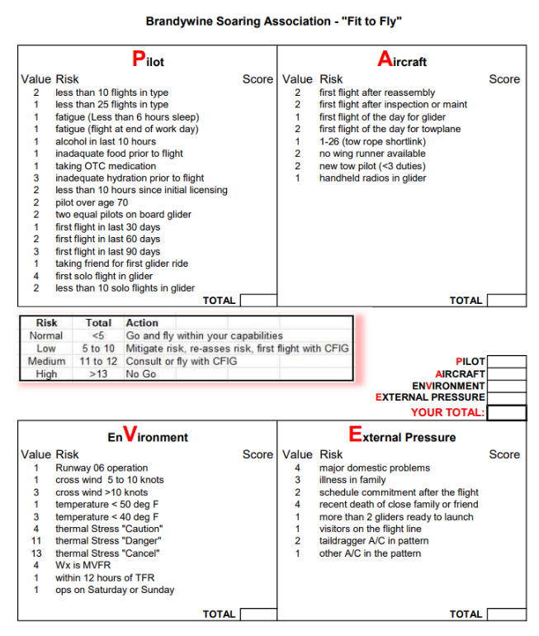

Slide 6
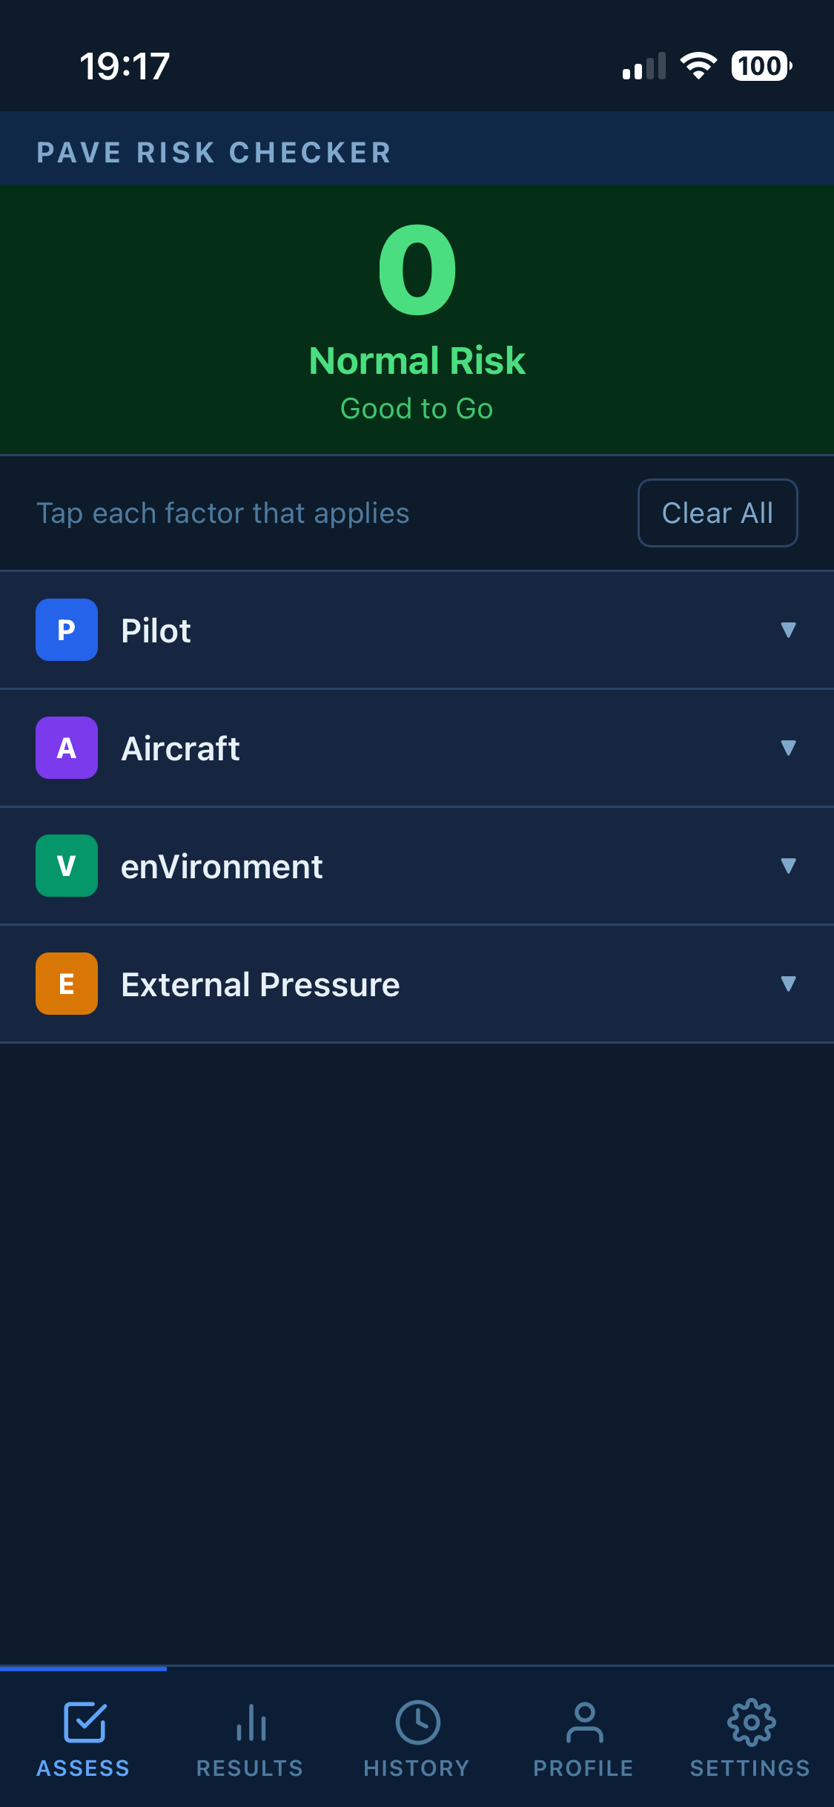

Slide 7
Are You Fit to Fly?
If you were given an aeromedical exam right now, would you pass?
What medications are you on / could be affecting your ability to fly?
Stresses in your life carrying over to the cockpit?
Are you fatigued?

Slide 8
The I’M SAFE Checklist
Illness
Medication
Stress
Alcohol
Fatigue
Emotion (or) Eating

Slide 9
Illness
Even relatively minor illnesses can compromise pilot performance
Respiratory / congestion issues are more serious when taking into account the pressure changes associated with flying

Slide 10
Medication
What medications have you taken recently? This is not just prescription drugs.
Do any of these have the potential to impair your ability to fly?
Do you know how this medication affects you?
Do you know how long it takes for the effects to wear off?

Slide 11
Stress
Are you under a lot of stress in your day-to-day life on the ground? This can carry over to affect your focus in the air.
What about the stress you are under to complete the flight? Do you feel pressured to get to your destination, or do you feel that your passengers are judging you?

Slide 12
Alcohol
How long ago was your last alcoholic beverage?
Are you past the 8 hours ”bottle to throttle” rule?
Is there any chance your blood alcohol content may be at or above .04%?
You don’t have to still be ‘drunk’ for alcohol to affect your cognition – a hangover or associated dehydration can negatively affect your abilities just as much.

Slide 13
Fatigue
How much sleep did you get last night?
Just one night’s interrupted sleep can negatively affect your focus and abilities – multiple nights of missed / interrupted sleep exponentially worsen the effects of fatigue.
Poor eating habits or missed meals also contribute to systemic fatigue

Slide 14
Emotion
Seriously upsetting events like loss of a loved one, job, a move, etc should be fully recovered from before getting back in the cockpit

Slide 15
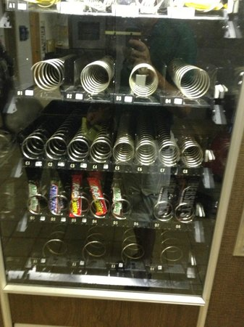
Eating
Neglecting to eat, or assuming you can do it later, is taking a chance
Accommodations at small airports range from pretty good to non-existent
Plan beforehand, and have a nutritious snack in reserve
Plan your hydration strategically

Slide 16
Hazardous
Attitudes and
Antidotes

Slide 17
The first step is recognition: When you hear one of those classic phrases in your head (or feel the associated emotion), label it as hazardous.
Immediately replace it with the antidote (say it out loud if needed).
These attitudes often combine (e.g., impulsivity + macho during a rushed approach, or invulnerability + anti-authority when skipping weather checks).

Slide 18
Anti-Authority
Don’t tell me what to do | Follow the rules. They are usually right.

Slide 19
Anti-Authority
Don’t tell me what to do | Follow the rules. They are usually right.
Ignoring requirements for cross country flight | Student pilot with low hours and only 0.5 hours simulated instrument time flew cross country without instructor endorsement.
 | Conditions deteriorated into IMC. Fatal descent into terrain.

Slide 20
Anti-Authority
Don’t tell me what to do | Follow the rules. They are usually right.
Disregard for checklists and procedures | Business jet crash: crew failed to unlock flight controls or perform the required flight control check during the "After Start" and "Taxi" checklists.
 | Investigation revealed this wasn't a one-off: they had skipped these critical steps on 98% of their previous 175 flights, relying on memory and routine instead of proper challenge-response procedures.

Slide 21
Anti-Authority
Don’t tell me what to do | Follow the rules. They are usually right.
Violating restrctions | Flight crew executed circling approach at night to Aspen airport despite a specific FAA (NOTAM) prohibition due to terrain and descent requirements.
 | 15 passengers and 3 crew all died.

Slide 22
Impulsivity
Do something quickly! | Not so fast. Think first.

Slide 23
Impulsivity
Do something quickly! | Not so fast. Think first.
Wrong control pulled on takeoff | Shortly after takeoff engine began running rough. The pilot in the left seat panicked, grabbed the first knob he saw, and yanked it hard—mistaking it for carburetor heat and instead pulling the mixture control to idle cutoff. The engine quit completely.
 | The airplane crashed into a cemetery a quarter-mile off the runway end, killing both pilots. The mixture knob was found still in the deceased pilot’s hand, pulled so forcefully that the cable detached.

Slide 24
Impulsivity
Do something quickly! | Not so fast. Think first.
Reacting inappropriately to conditions | Go-around (TOGA) mode inadvertently activated. Instead of recognizing the mode change, cross-checking instruments, and calmly responding per procedures, the FO reacted with rapid, inappropriate forward elevator inputs. Aircraft entered steep nose-down descent. Only 32 seconds passed from the mode activation to impact; the crew did not recover.

Slide 25
Macho
I can do it! | Taking chances is foolish

Slide 26
Macho
I can do it! | Taking chances is foolish
Unauthorized aerobatics | CFI ~ 500 hours took two students on a flight and performed spins, barrel rolls, and snap rolls in a Piper Arrow that was not approved for aerobatics. Radar data and wreckage analysis showed the aircraft entered aggressive maneuvers that overstressed the airframe, causing the wing spar to fail in flight.
 | The plane broke apart, killing the instructor and both students.

Slide 27
Macho
I can do it! | Taking chances is foolish
Overestimation of skill level | Tennessee Fly Girl (Jenny Blalock)
 | The NTSB final report highlighted multiple hazardous attitudes, including a macho attitude where she overestimated her own abilities. She pushed her skills and the aircraft beyond safe margins in ways that appeared intended to demonstrate prowess, contributing to the sequence of poor decisions that led to the accident.

Slide 28
Invulnerability
It won’t happen to me. | It could happen to me.

Slide 29
Invulnerability
It won’t happen to me. | It could happen to me.
Continuing an approach as conditions deteriorate | Crew continued approach and landing into severe thunderstorms with winds gusting to 45 knots—exceeding the aircraft’s maximum crosswind limits for a wet runway. Despite clear evidence of deteriorating conditions (heavy rain, lightning, and loss of visual references), they pressed on, believing the hazards wouldn’t affect them.
 | The aircraft overran the runway, killing the captain and 10 passengers. The NTSB highlighted the crew’s sense of invulnerability in continuing despite known severe risks.

Slide 30
Invulnerability
It won’t happen to me. | It could happen to me.
Ag pilot antics | Experienced ag pilot, accustomed to low-level “jumping from field to field,” demonstrated a Thrush aircraft to potential buyers and flew aggressively. He felt invulnerable due to his routine success in marginal conditions and narrowly avoided a serious incident.
 | He later attributed the close call to developing a false sense that hazards wouldn’t catch him. Similar patterns appear in many low-altitude ag and banner-towing accidents where pilots discount risks because “I’ve done this hundreds of times without issue.”

Slide 31
Resignation
What’s the use? | I’m not helpless. I can make a difference

Slide 32
Resignation
What’s the use? | I’m not helpless. I can make a difference
Deferring to other crew | During approach in icing conditions with a flap anomaly, the FO asked the captain, “Should I go around?” The captain said no and to keep descending. Airspeed decayed and stall warnings activated. FO resigned herself to captain’s authority and handed control back instead of insisting on a go-around.
 | The aircraft stalled and impacted short of the runway.

Slide 33
Resignation
What’s the use? | I’m not helpless. I can make a difference
Failing to use all resources | Relatively inexperienced pilot flying complex multi-engine aircraft with his family aboard encountered deteriorating conditions. Instead of taking assertive corrective action (diverting, declaring an emergency, or troubleshooting effectively), he felt overwhelmed and resigned to “whatever happens,”
 | CFIT, killing everyone on board.

