Slide 1
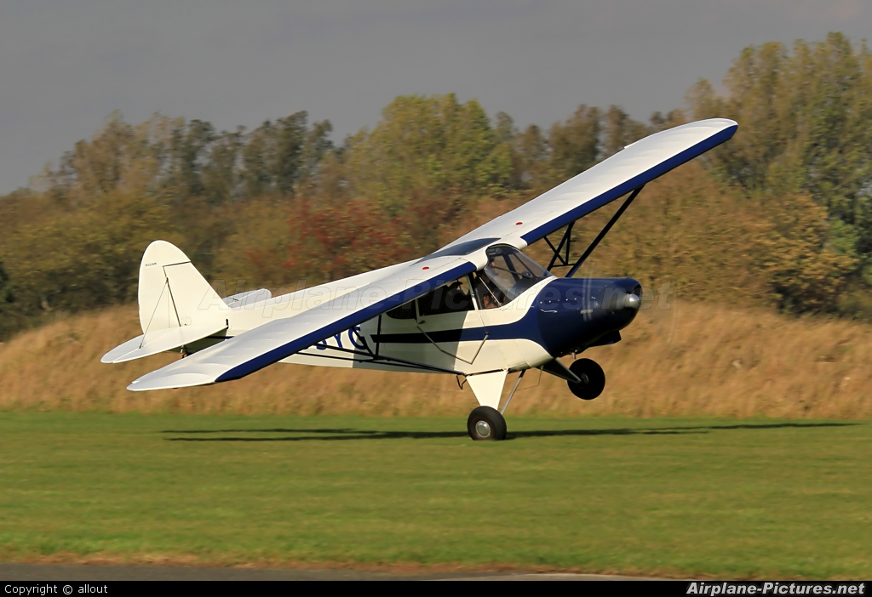
Aircraft Performance

Slide 2
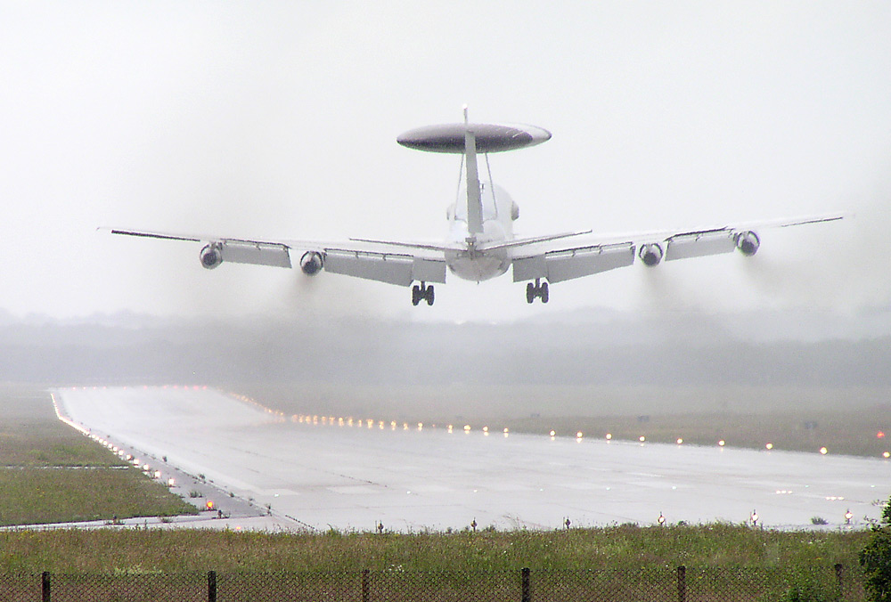
Calculating Crosswinds

Slide 3
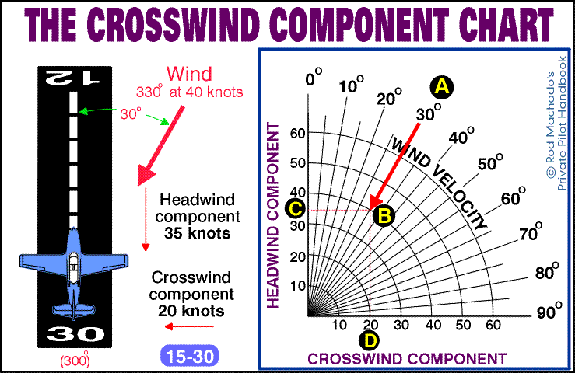
Airplane Performance: Know Before You Go

Slide 4
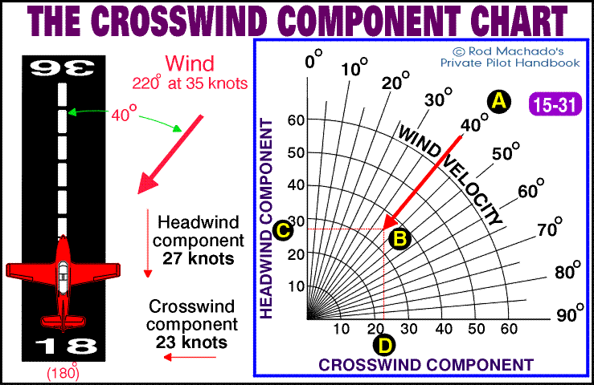
Airplane Performance: Know Before You Go

Slide 5
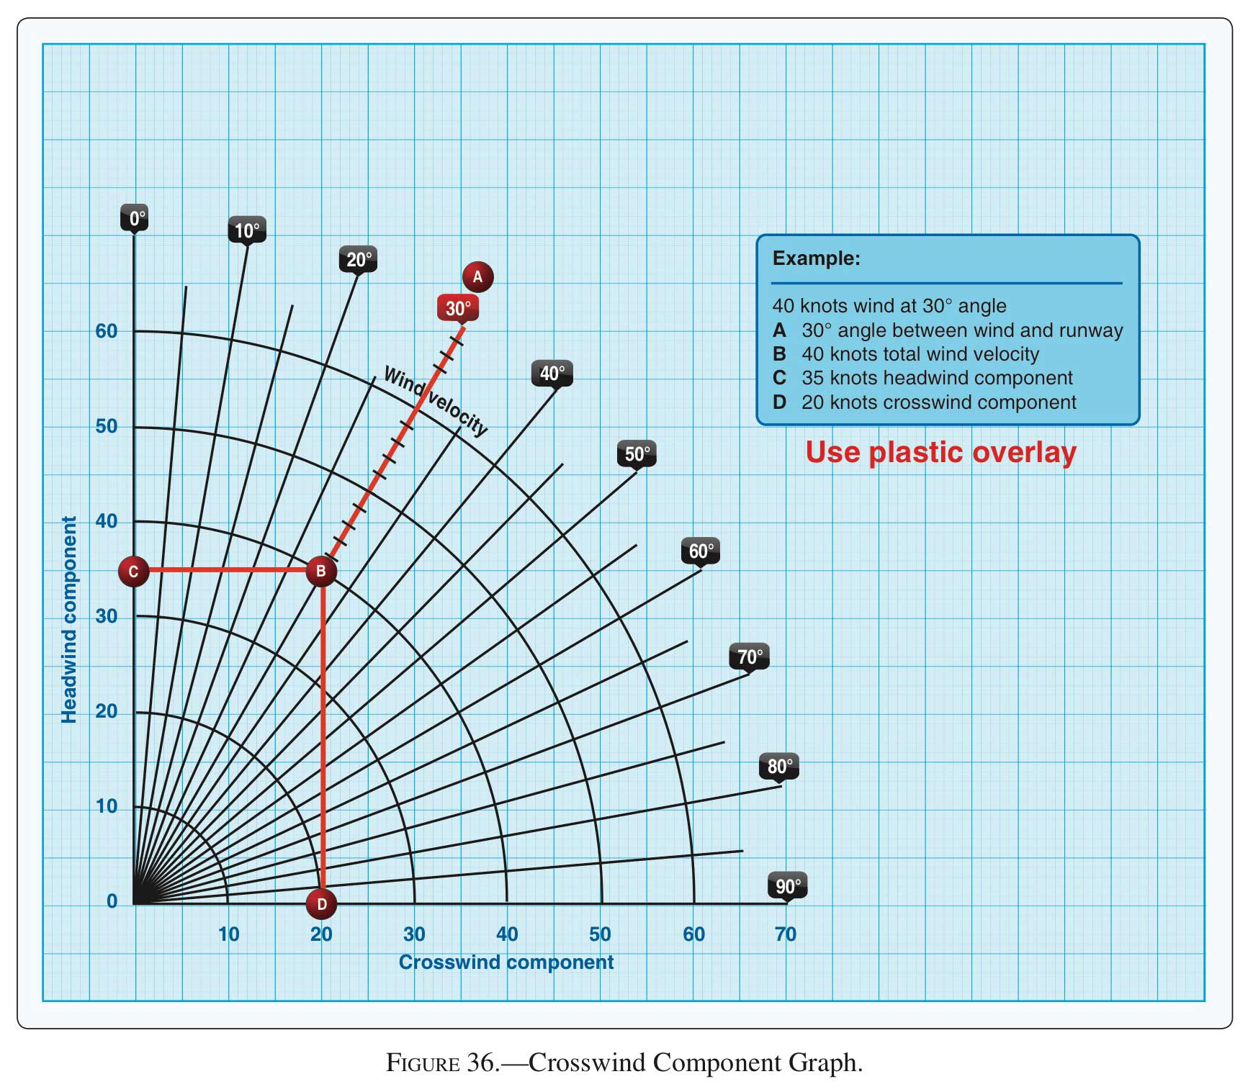

Slide 6
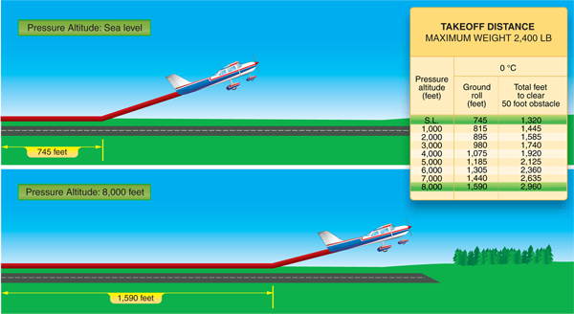
Air Density & Aircraft Performance

Slide 7
The Three “H”s and Air Density
Height | The higher the altitude, the thinner the air – and consequently the fewer the particles to flow over the wing
Heat | Particles moving around more rapidly in heated air are farther apart
Humidity | Moist air is less dense than dry, because water vapor molecules are lighter than air molecules.

Slide 8
Effect of pressure and temperature on density altitude
Field Elevation 0 msl | Pressure 29.65 | Pressure 29.92 | Pressure 30.50
Temperature 32° F | -1,512 | -1,782 | -2,362
Temperature 59° F | 270 | 0 | -580
Temperature 85° F | 1,985 | 1,715 | 1,135

Slide 9
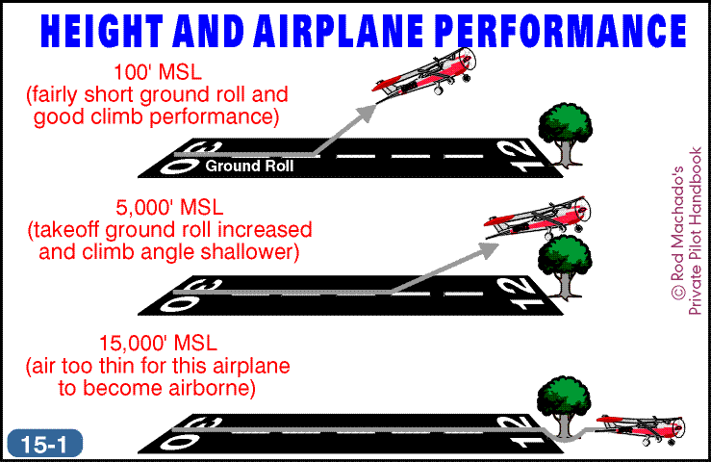
Airplane Performance: Know Before You Go

Slide 10
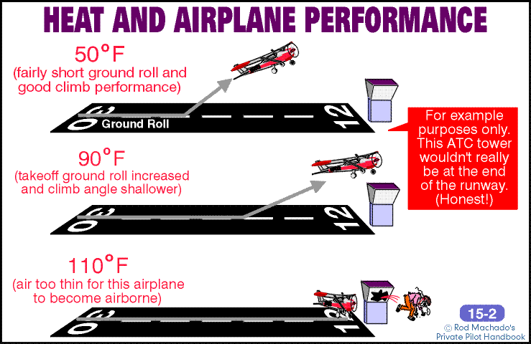
Airplane Performance: Know Before You Go

Slide 11
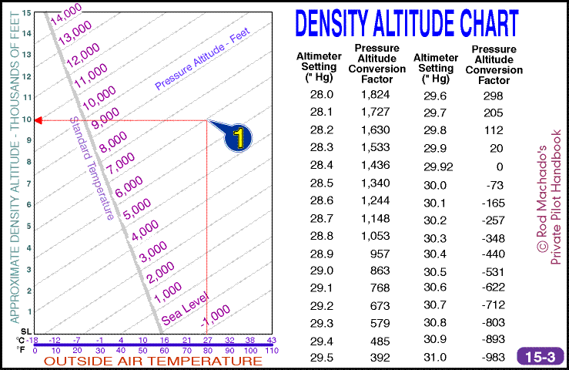
Airplane Performance: Know Before You Go

Slide 12
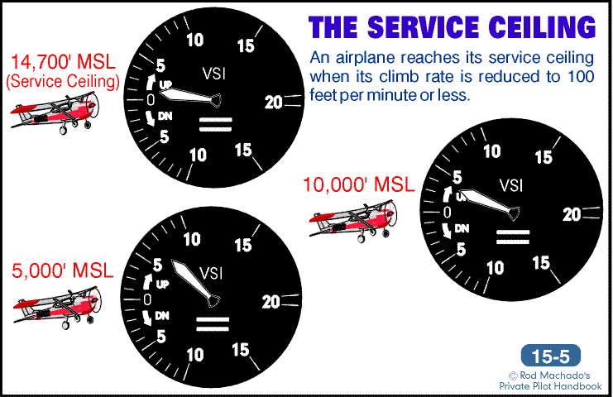
Airplane Performance: Know Before You Go

Slide 13
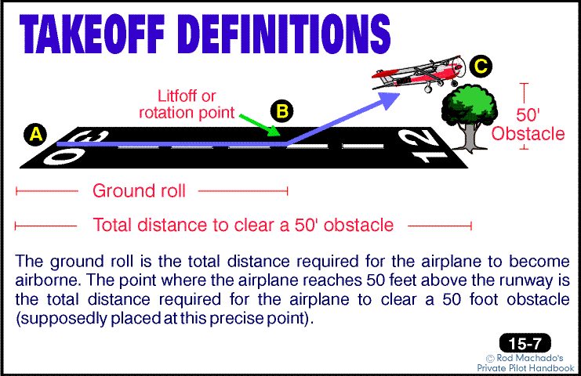
Airplane Performance: Know Before You Go

Slide 14
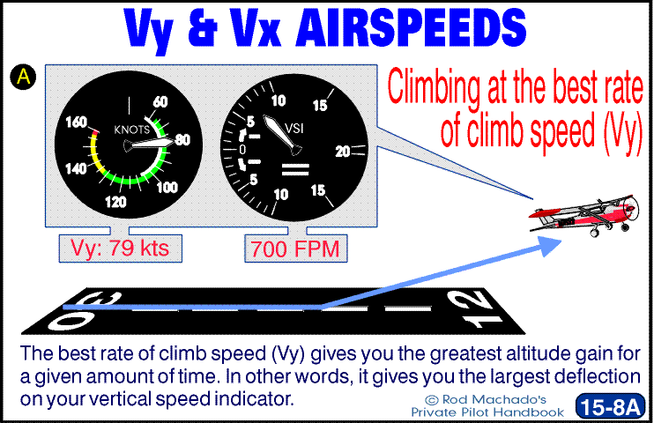
Airplane Performance: Know Before You Go

Slide 15
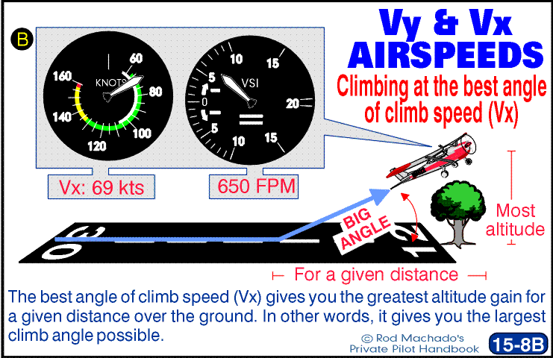
Airplane Performance: Know Before You Go

Slide 16
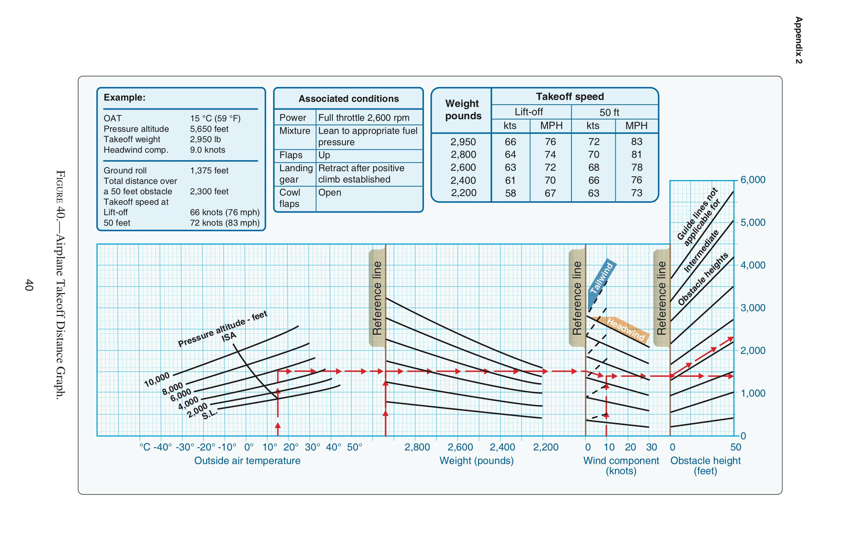
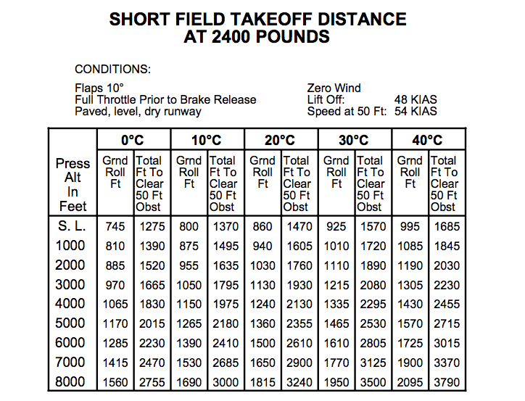
Takeoff Distance Graphs and Charts

Slide 18
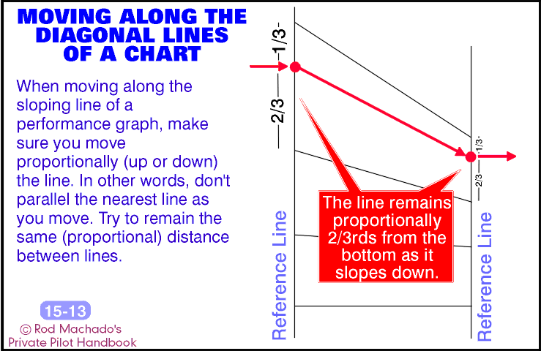
Airplane Performance: Know Before You Go

Slide 19
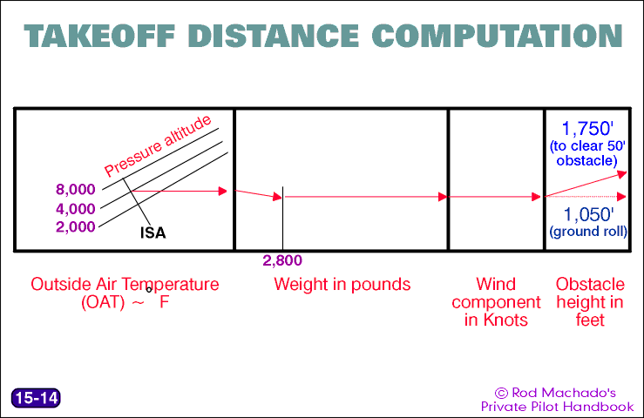
Airplane Performance: Know Before You Go

Slide 20
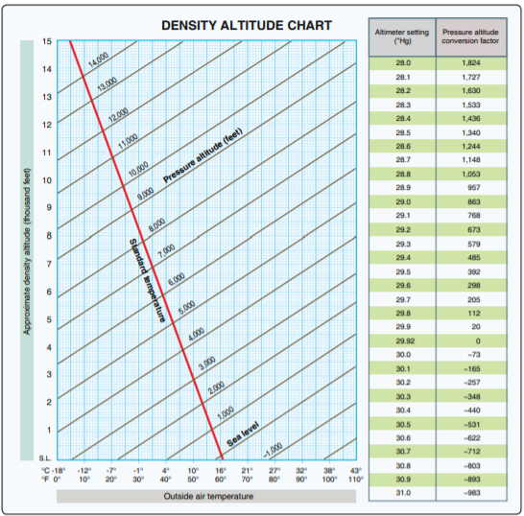

Slide 22


Slide 23
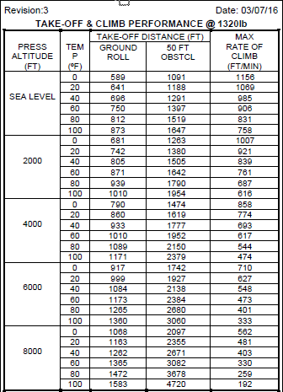
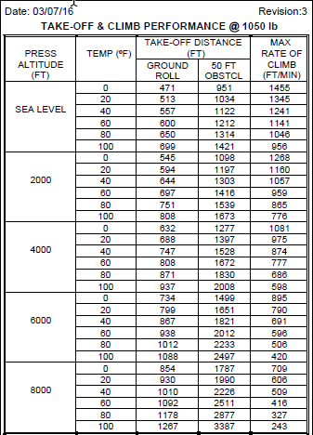

Slide 25
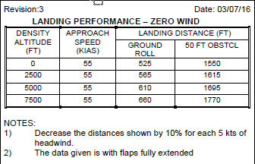

Slide 26
Cruise Performance

Slide 27
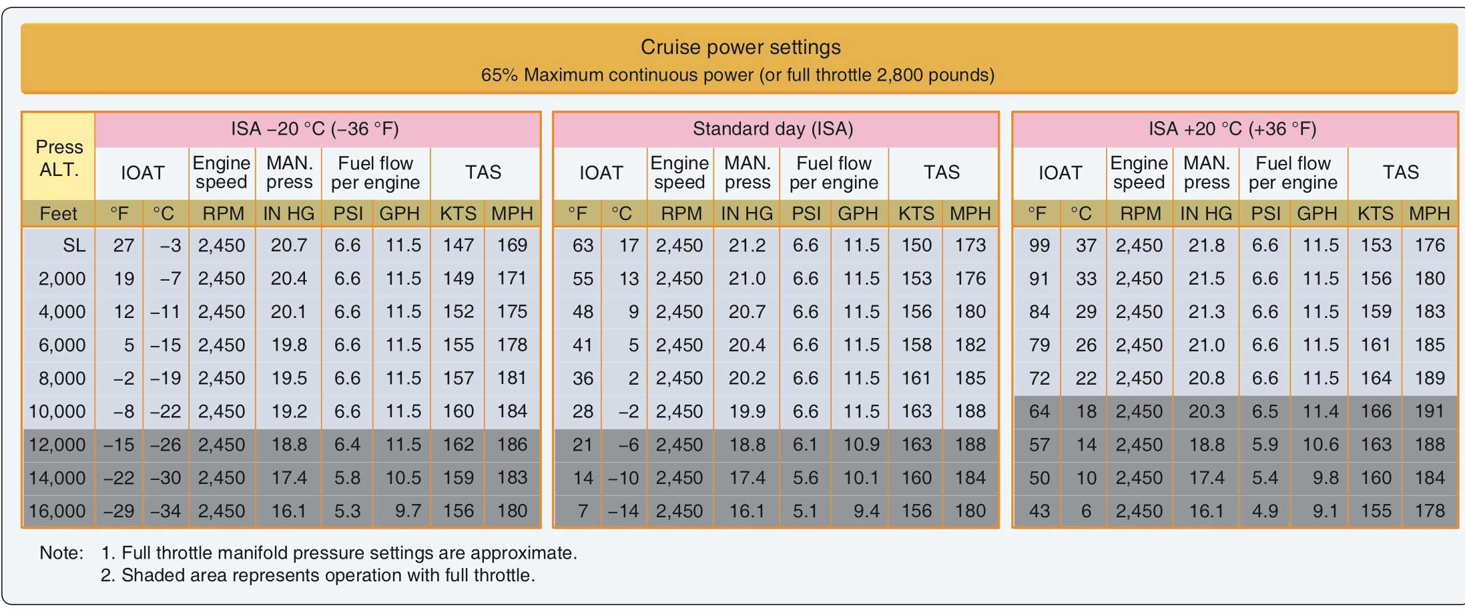
Cruise Power Setting Chart

Slide 28
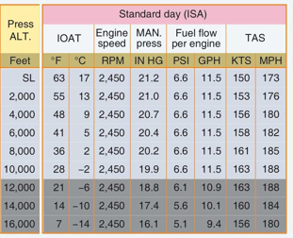



Interpolation example:
PA = 15,000 feet
OAT = standard fuel flow (gph)=
$10.1 − \left\lfloor \frac{10.1 −9.4}{2} \right\rfloor$ $=$
$10.1 − \frac{0.7}{2}$ $=$
9.8

Slide 29
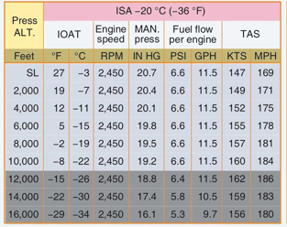
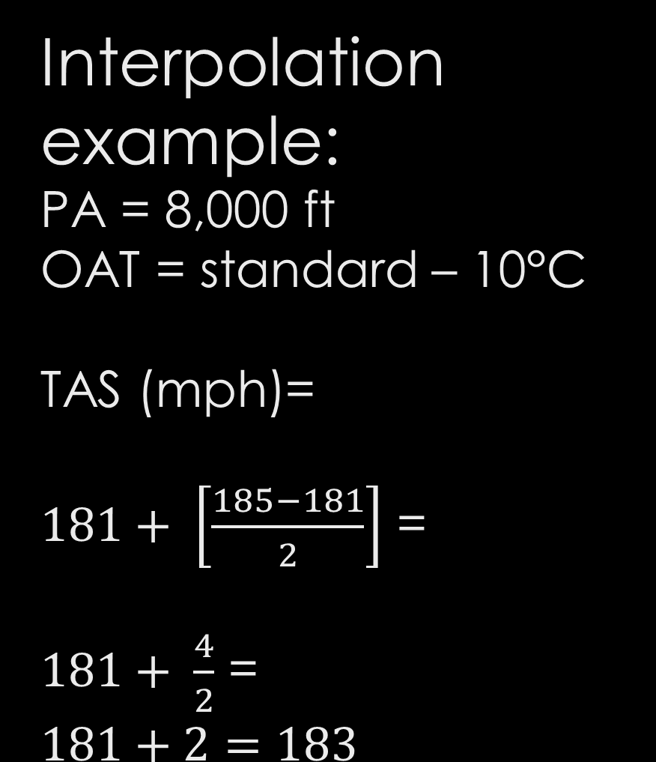
Interpolation example:
PA = 8,000 ft
OAT = standard – 10°C
TAS (mph)=
$181+ \left[\frac{185−181}{2}\right]$ =
$181+ \frac{4}{2}$ =
$$181+2=183$$

Slide 30
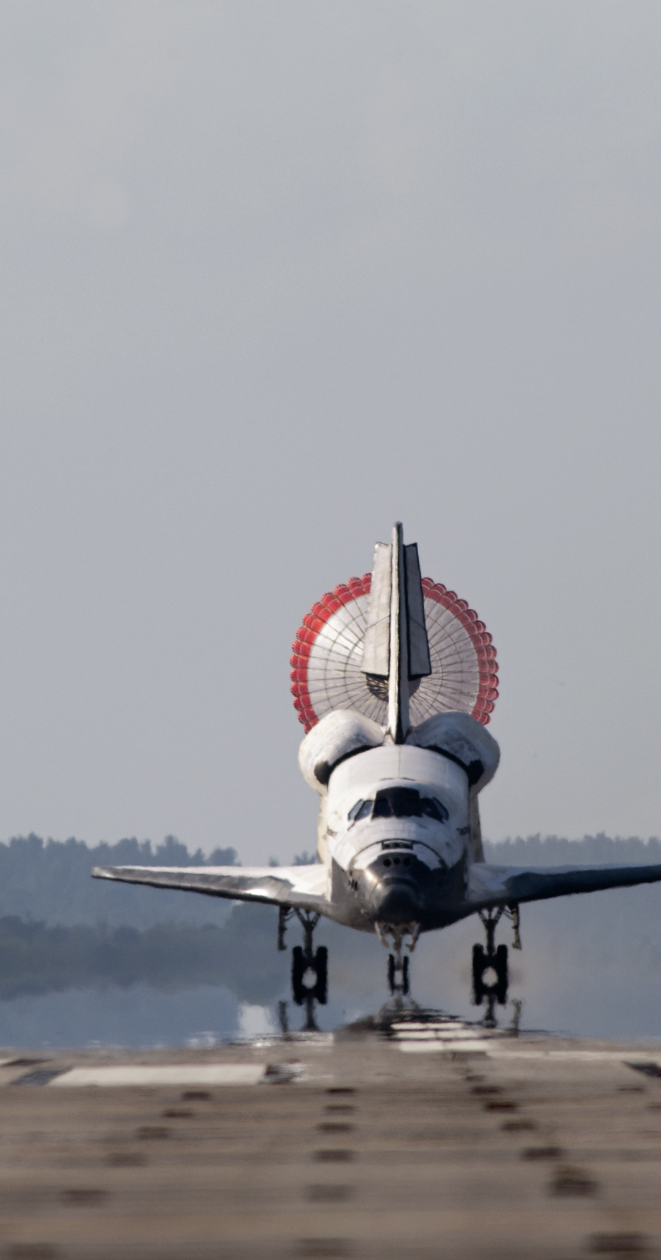
Landing Distance & Other Considerations

Slide 31
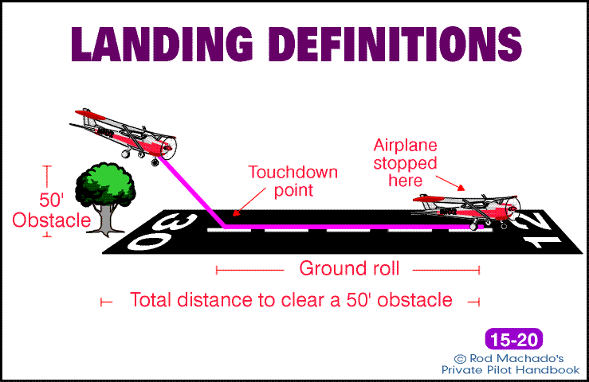
Airplane Performance: Know Before You Go

Slide 32
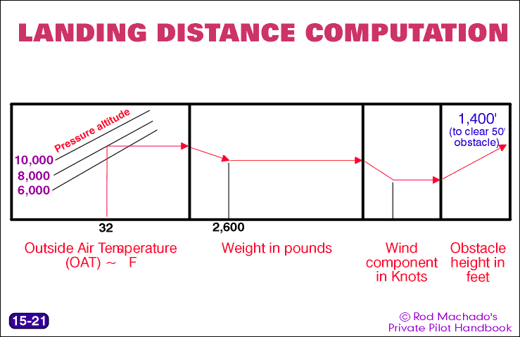
Airplane Performance: Know Before You Go

Slide 33
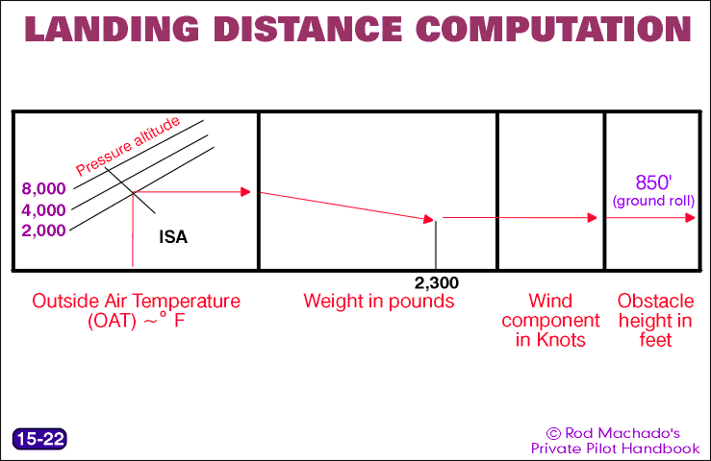
Airplane Performance: Know Before You Go

Slide 34
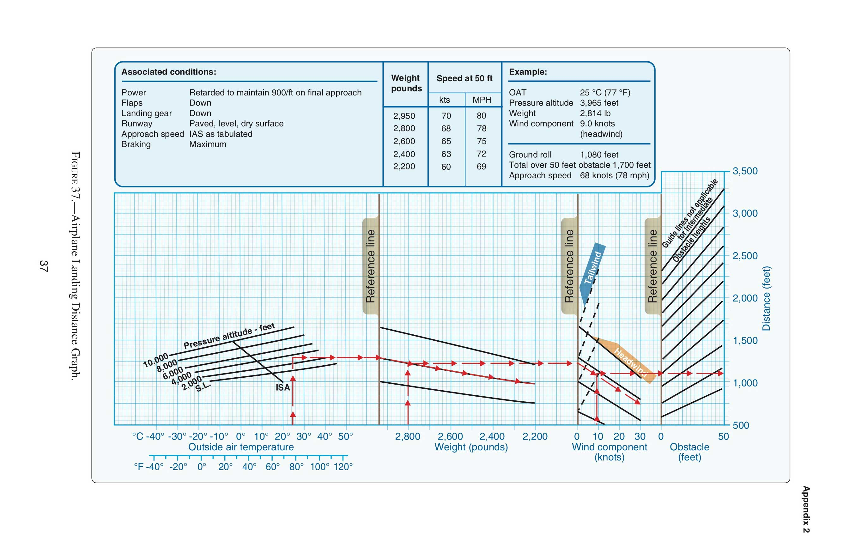
Landing Distance Graph

Slide 35
