Slide 1
Airplane Components
Getting to Know
Your Airplane

Slide 2
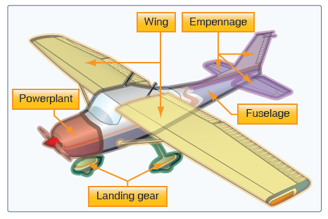
Basic Airplane Components

Slide 3
Basic Airplane Components

Slide 4
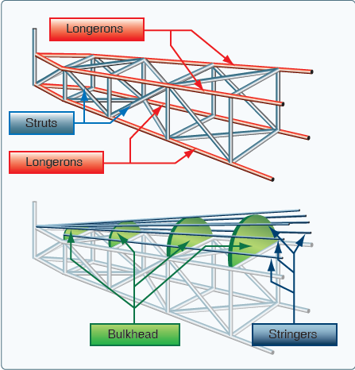
Older Fuselage Design

Slide 5
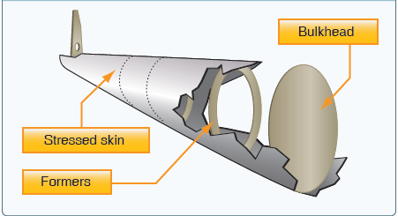
Modern Fuselage: Monocoque

Slide 6
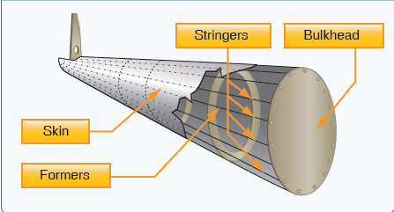
Modern Fuselage:Semi-monocoque

Slide 7
Basic Airplane Components

Slide 8
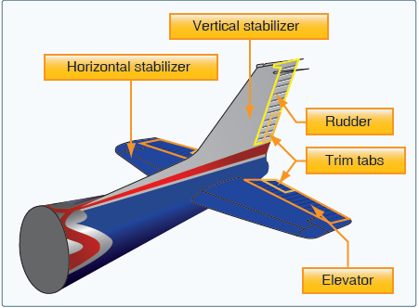
Empennage

Slide 9
Empennage: Stationary

Slide 10
Empennage: Rudder

Slide 11
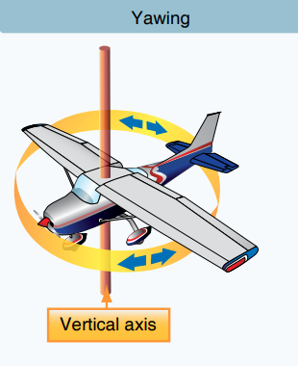
Empennage: Rudder

Slide 12
Empennage: Elevator

Slide 13
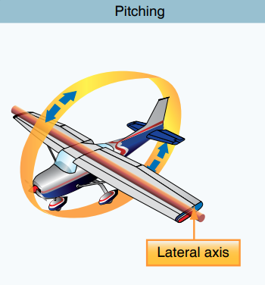
Empennage: Elevator

Slide 14
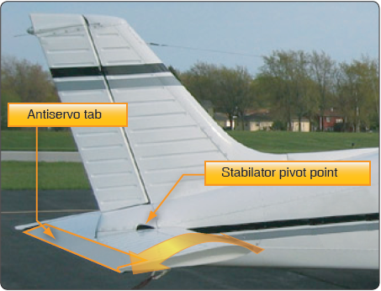
Stabilator vs. Elevator

Slide 15
Basic Airplane Components

Slide 16
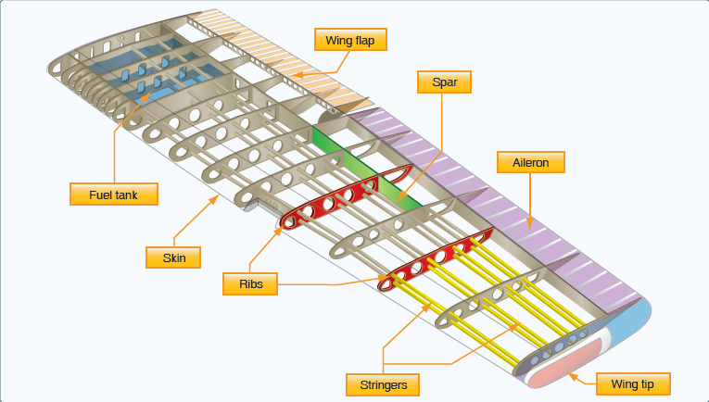
Wings

Slide 17

Wing Configurations: High Wing Monoplane

Slide 18
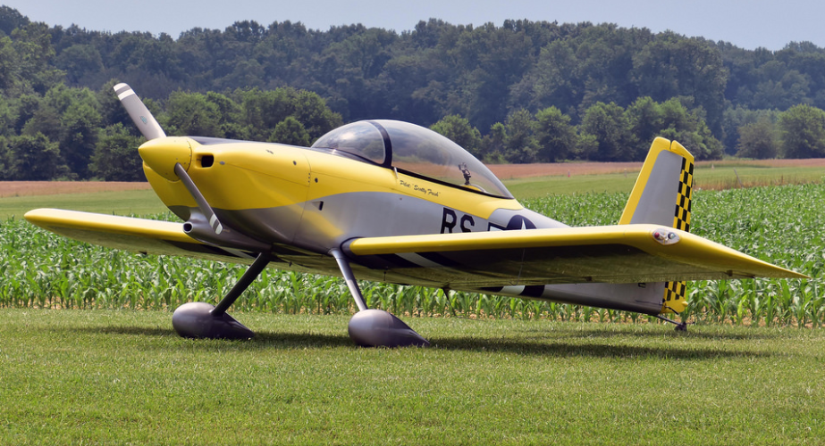
Wing Configurations: Low Wing Monoplane

Slide 19
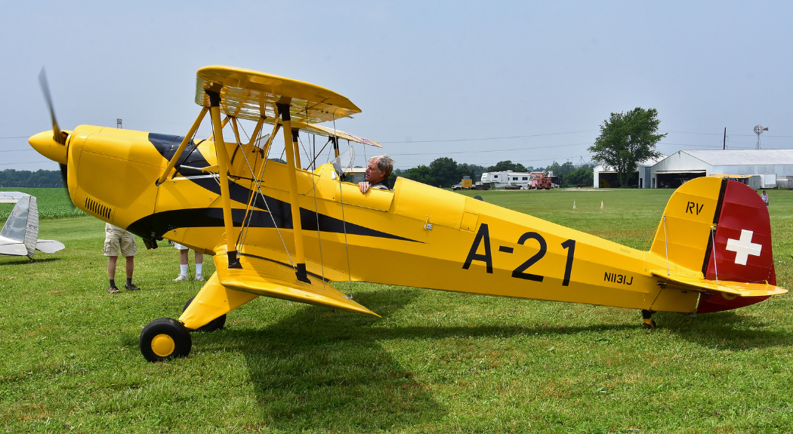
Wing Configurations: Biplane

Slide 20
Wings: Ailerons

Slide 21
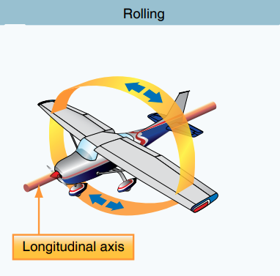
Wings: Ailerons

Slide 22
Wings: Flaps

Slide 23
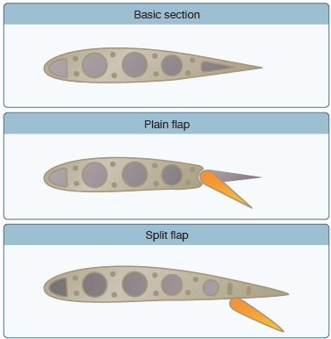
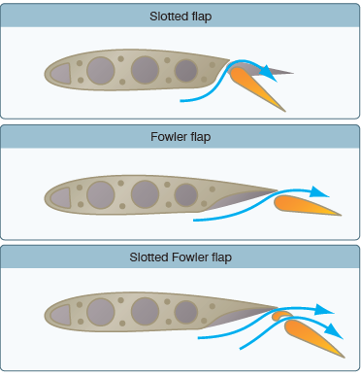
Wings: Flaps

Slide 24
Basic Airplane Components

Slide 25

Landing Gear: Tricycle

Slide 26
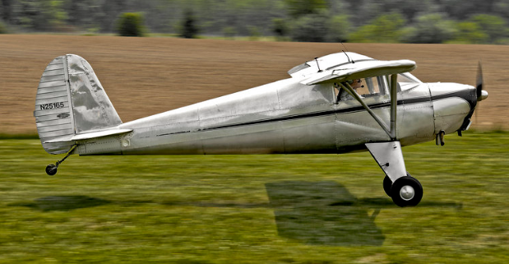
Landing Gear: Tailwheel

Slide 27
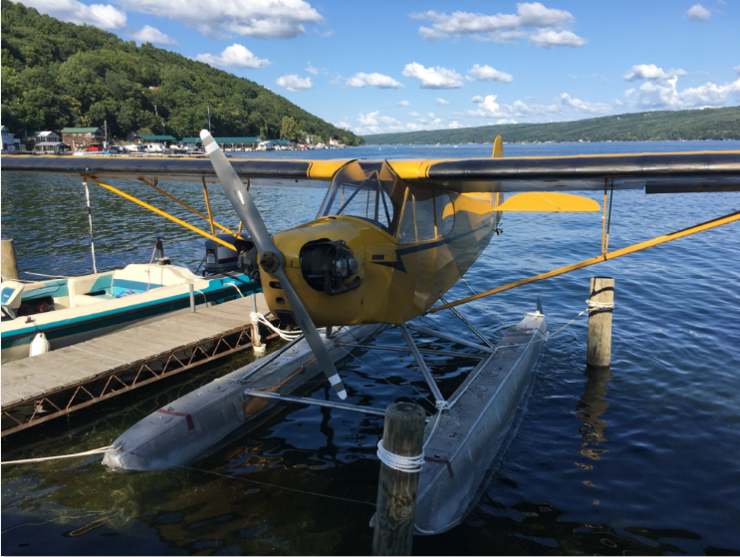
Landing Gear: Floats

Slide 28
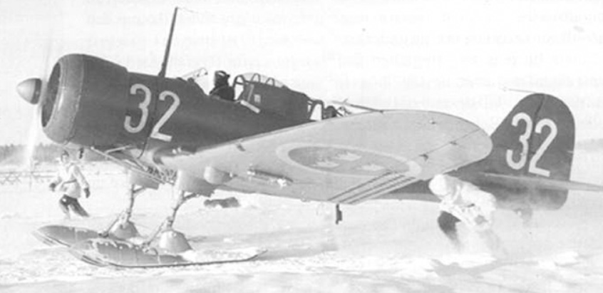
Landing Gear: Skis

Slide 29
Basic Airplane Components

Slide 30
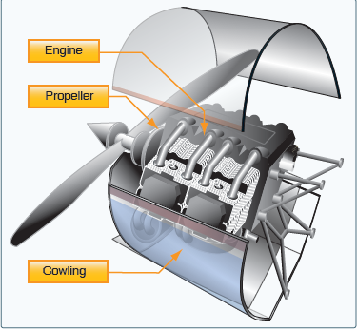
Firewall Forward

Slide 31
