Slide 1
Airport Operations

Slide 2
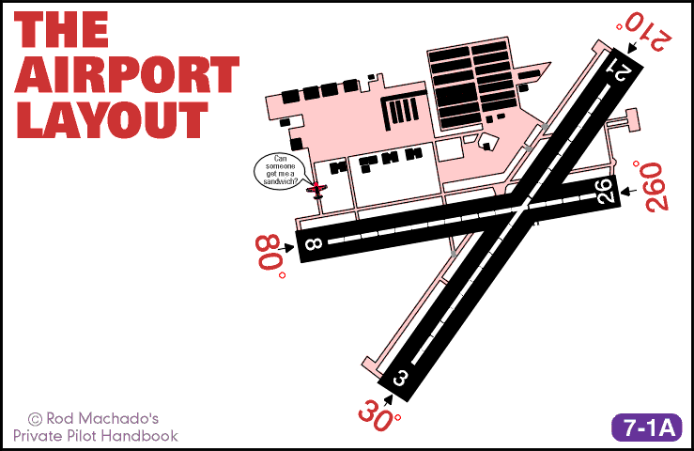
Airport Operations: No Doctor Needed

Slide 3
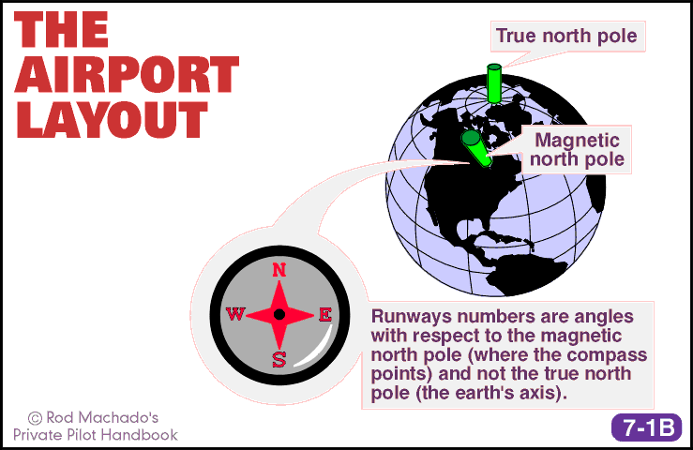

Slide 4
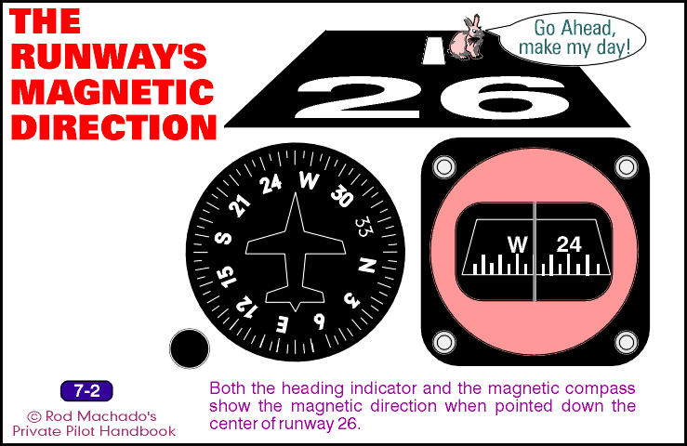

Slide 5
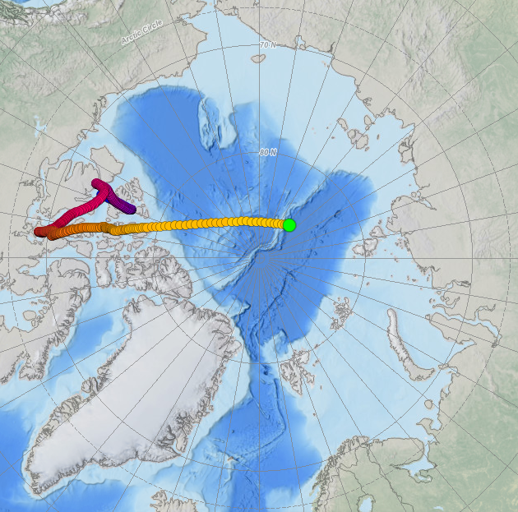
https://www.ncei.noaa.gov/products/wandering-geomagnetic-poles

Slide 6
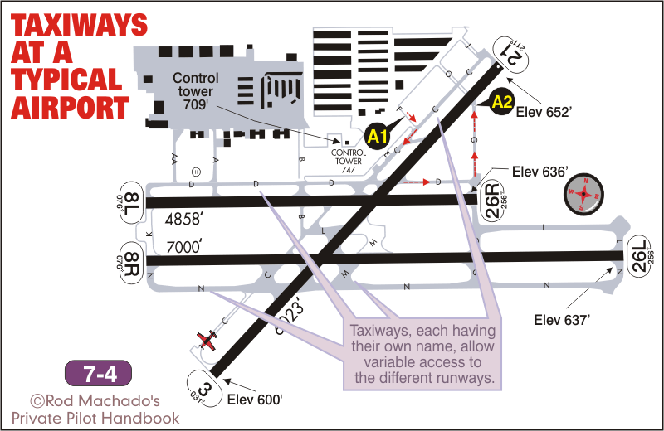

Slide 7
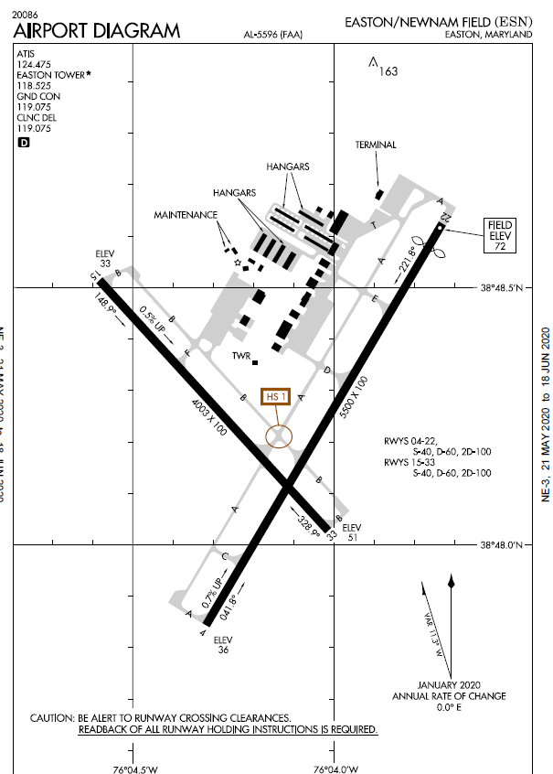
Airport diagram

Slide 8
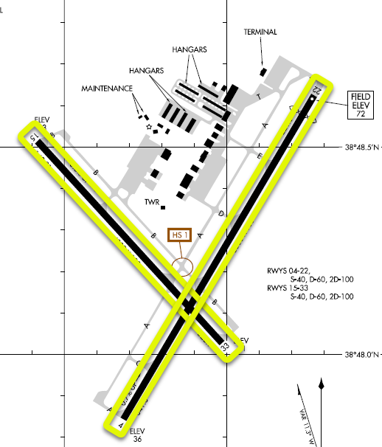
Airport diagram
Runways

Slide 9
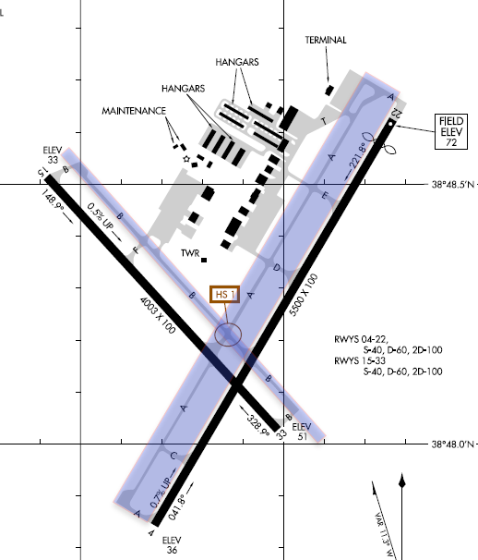
Airport diagram
Taxiways
Hot Spot

Slide 10
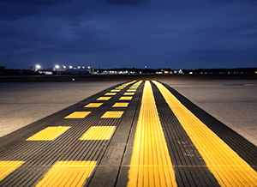
Airport Markings

Slide 11
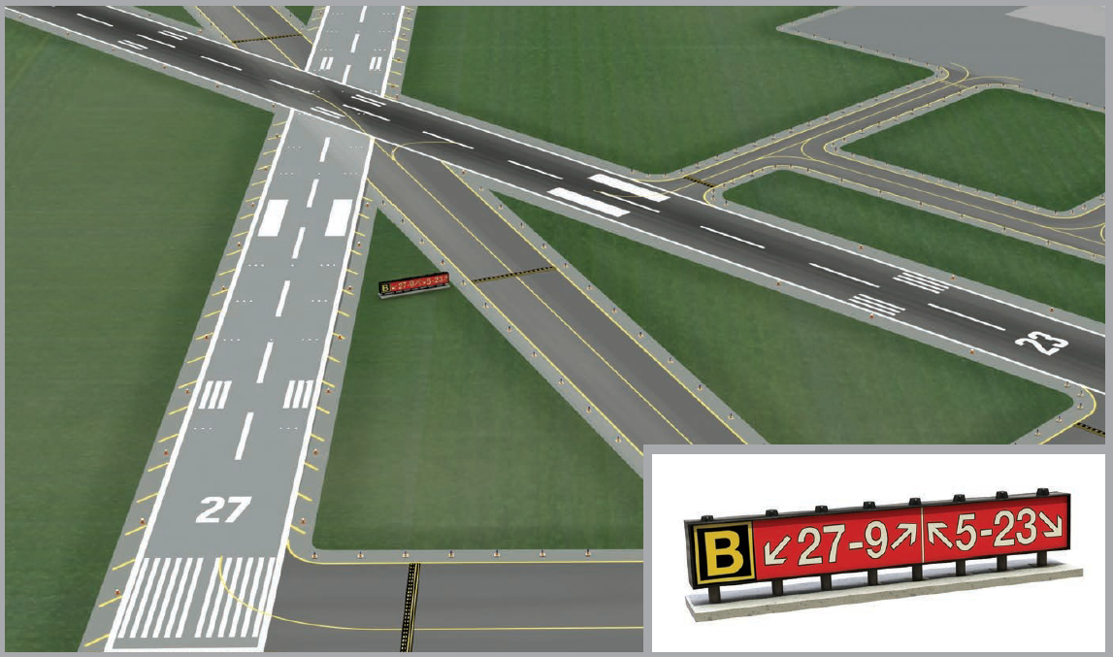
Taxiways

Slide 12
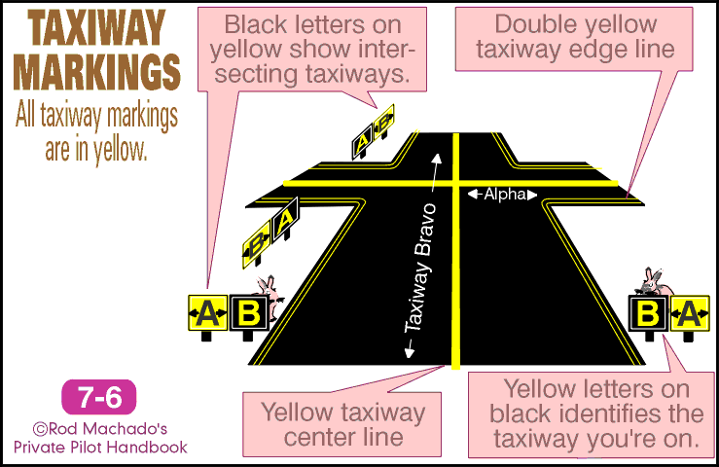

Slide 13
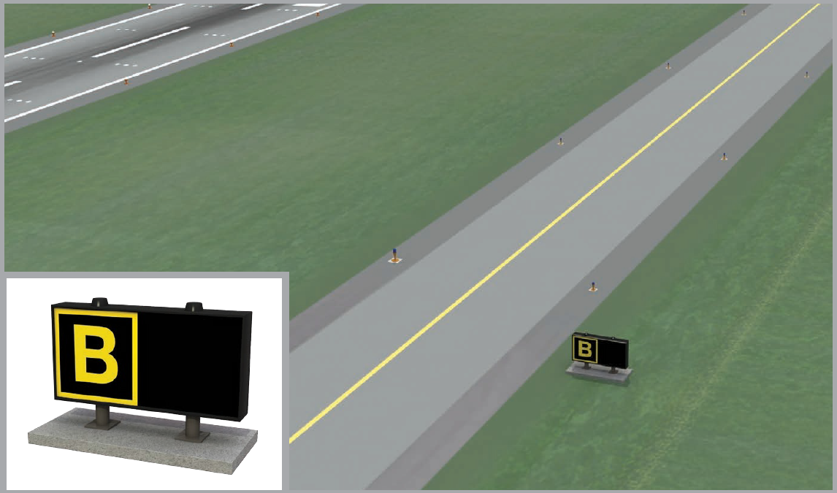
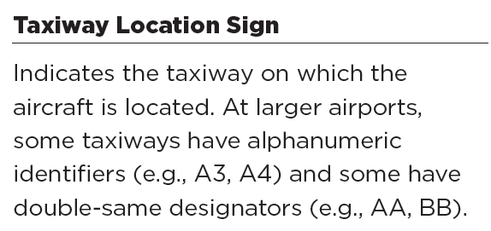

Slide 14
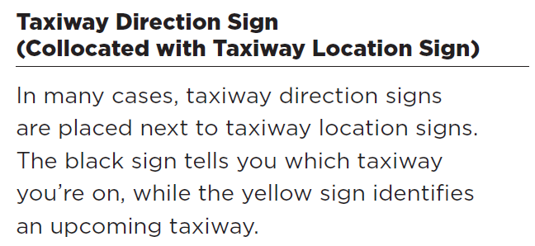
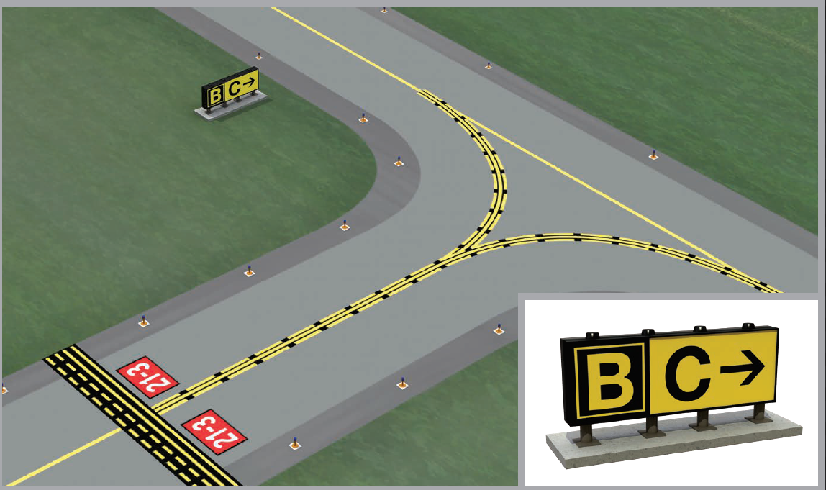

Slide 15
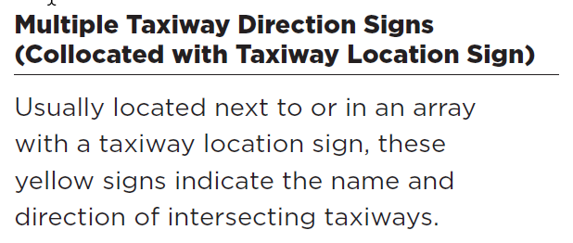
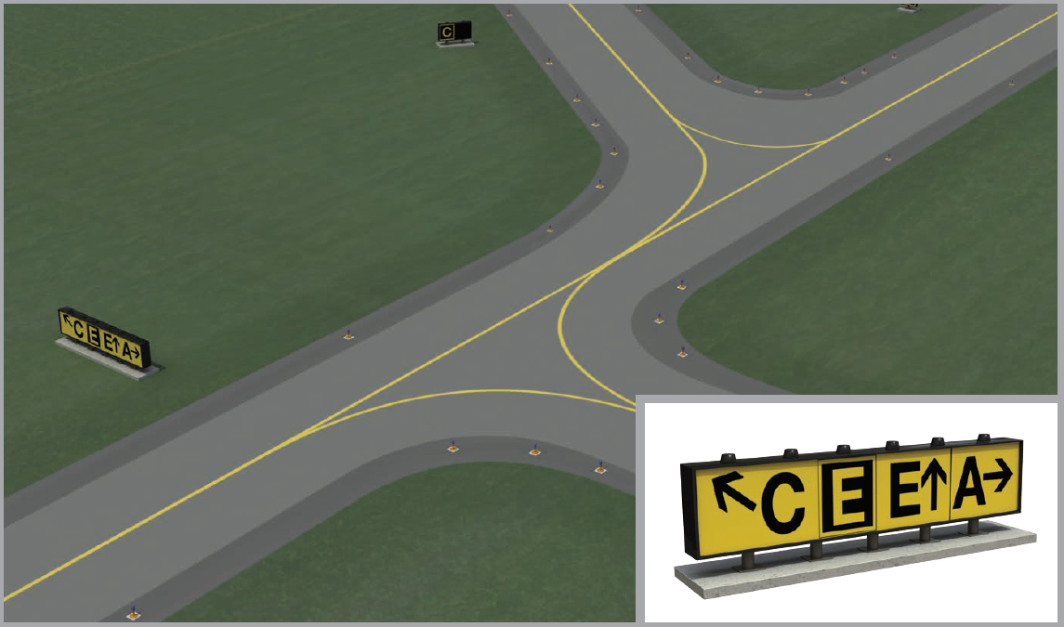

Slide 16
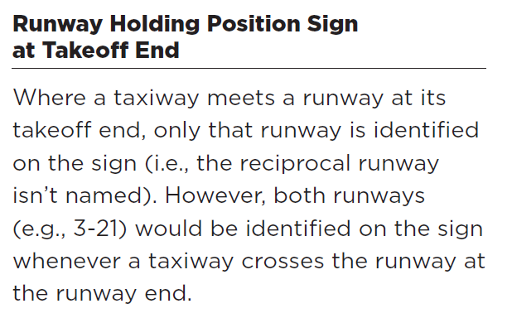
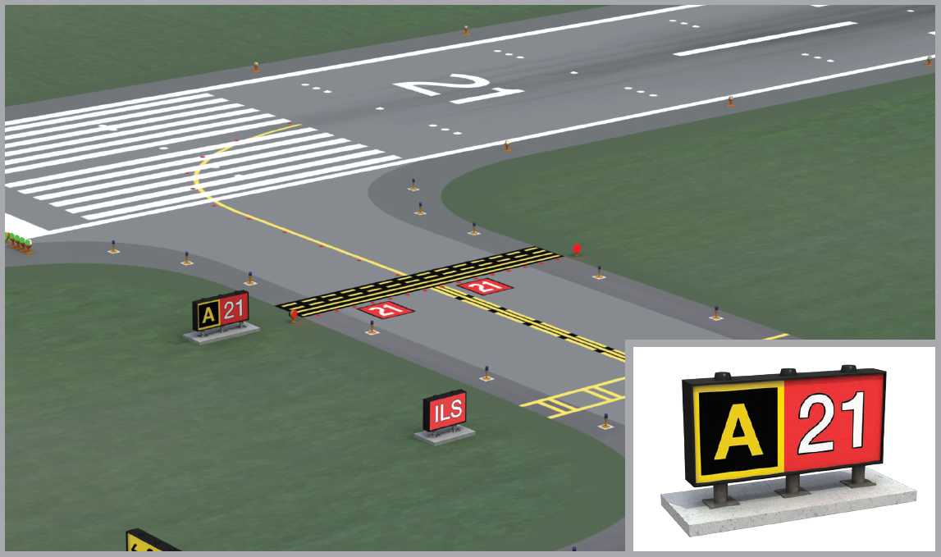

Slide 17
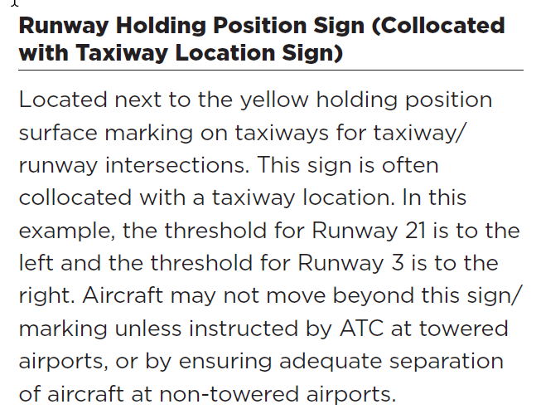
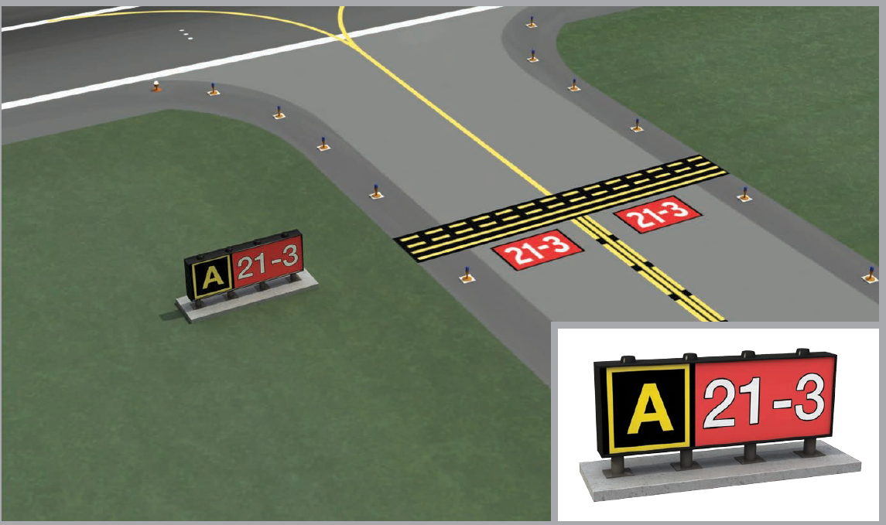

Slide 18
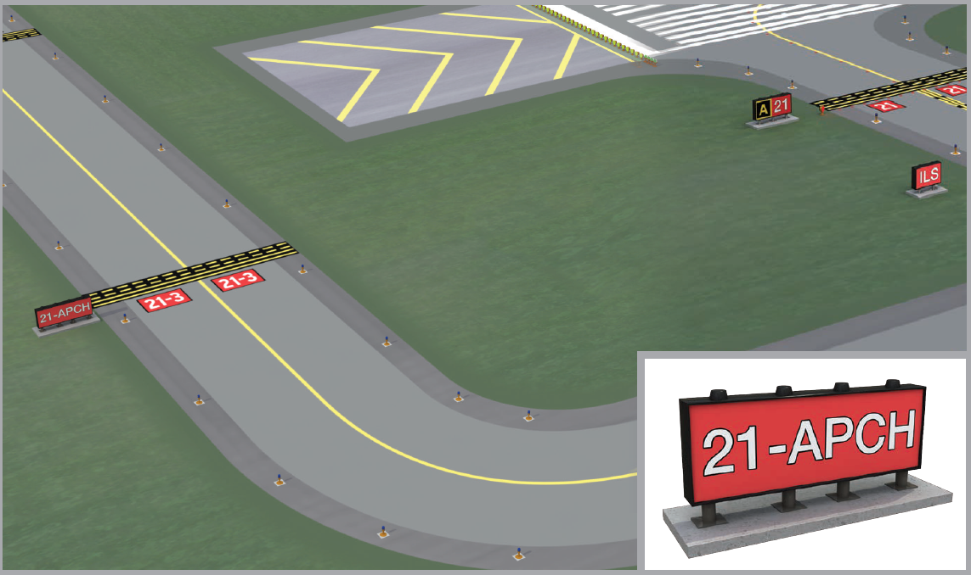
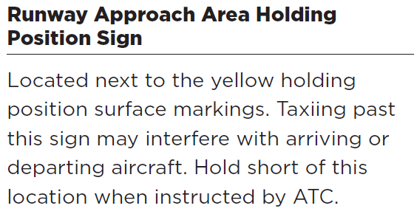

Slide 19
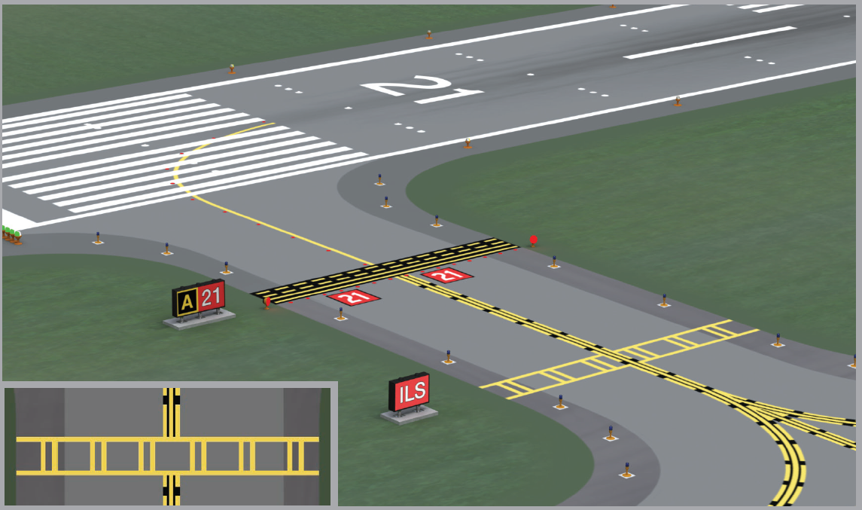
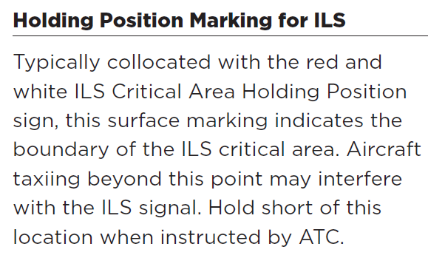
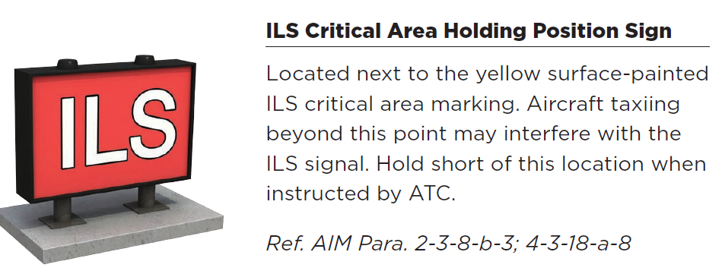

Slide 20
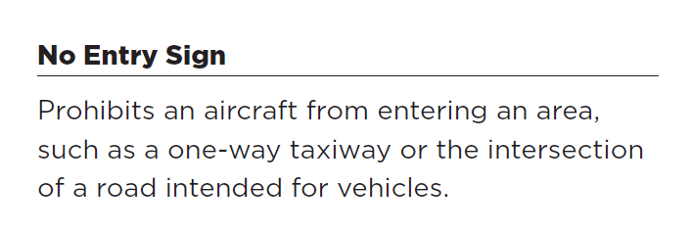
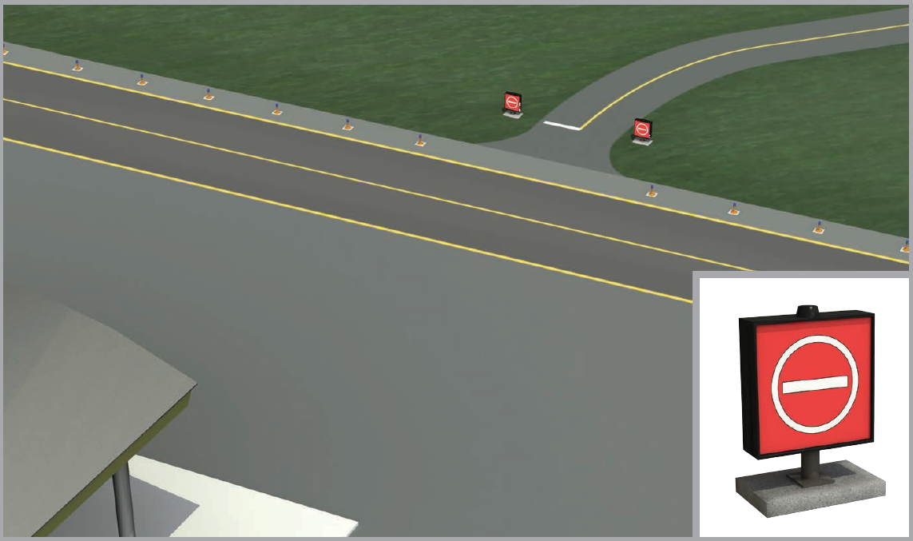

Slide 21
Runways

Slide 22
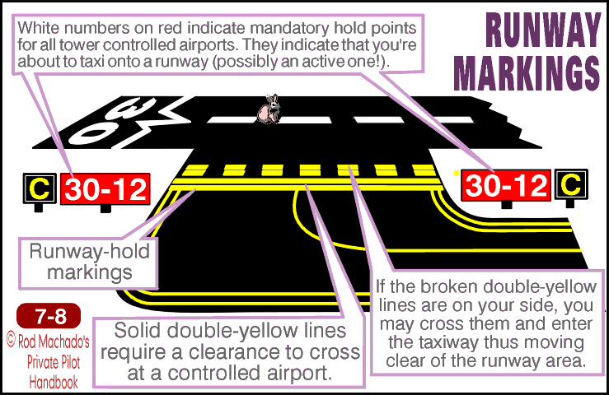

Slide 23
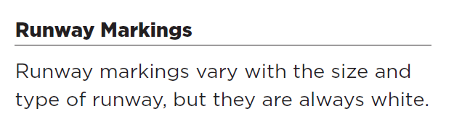
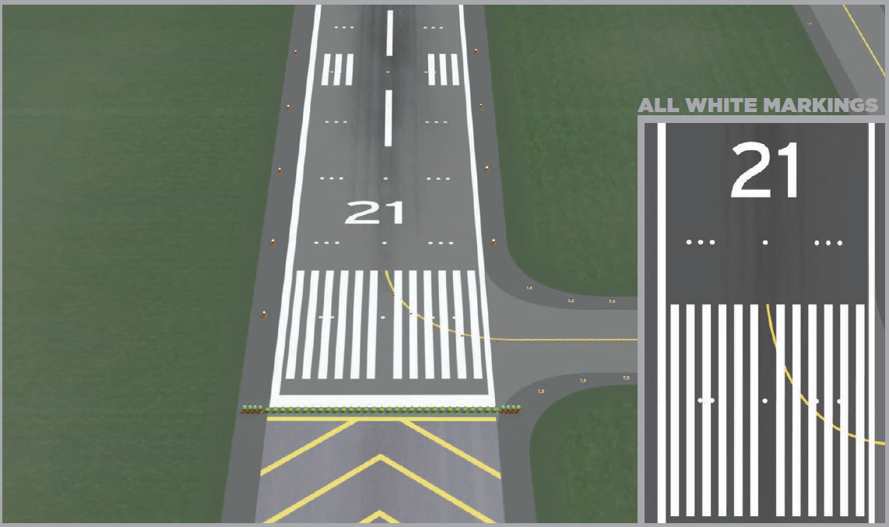

Slide 24
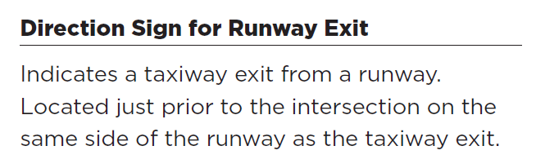
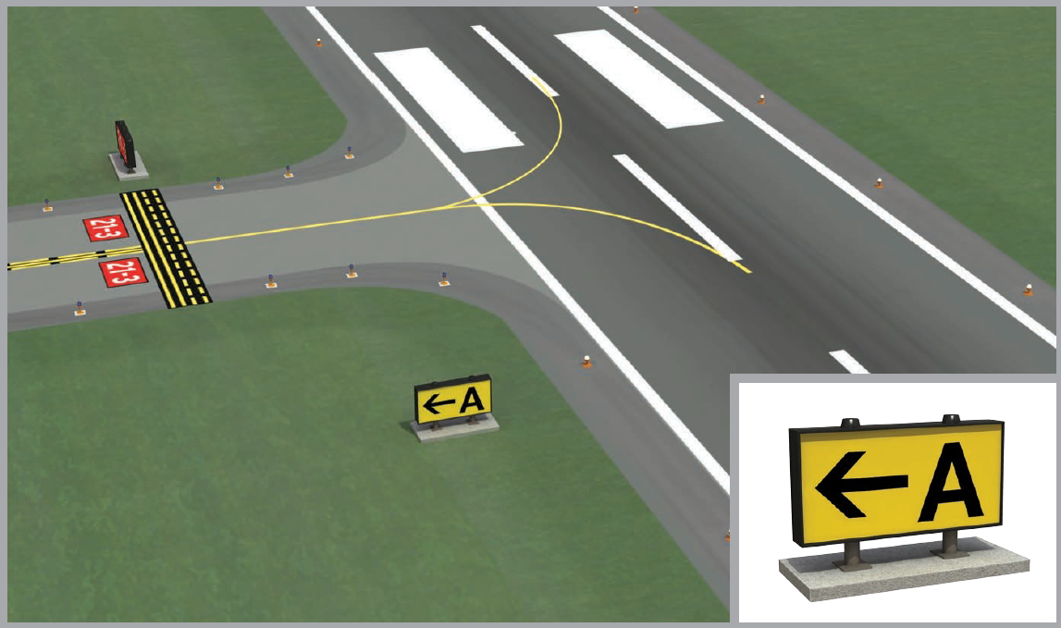

Slide 25
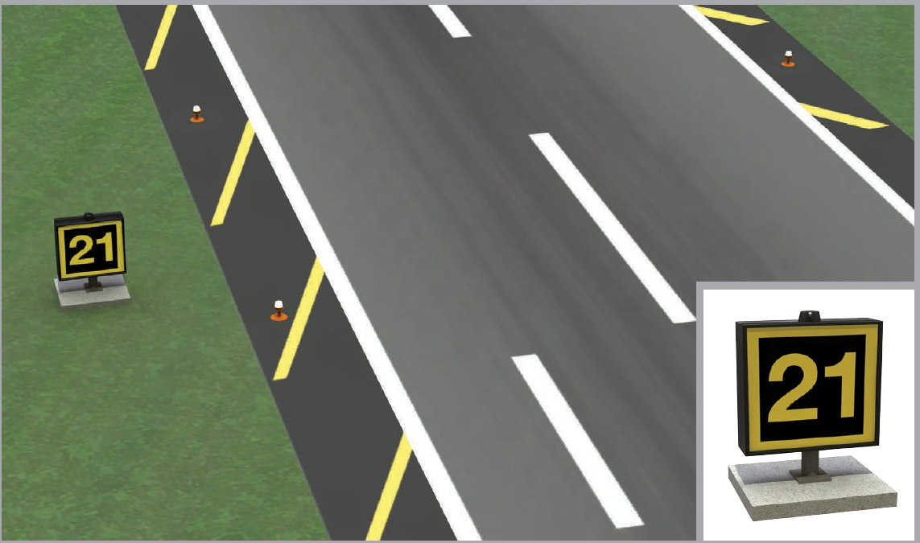
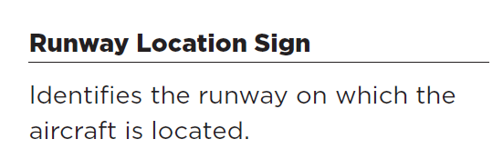

Slide 26
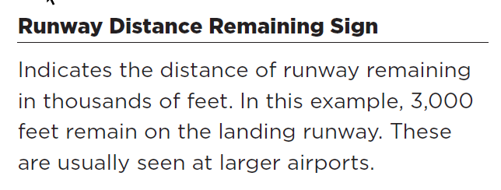
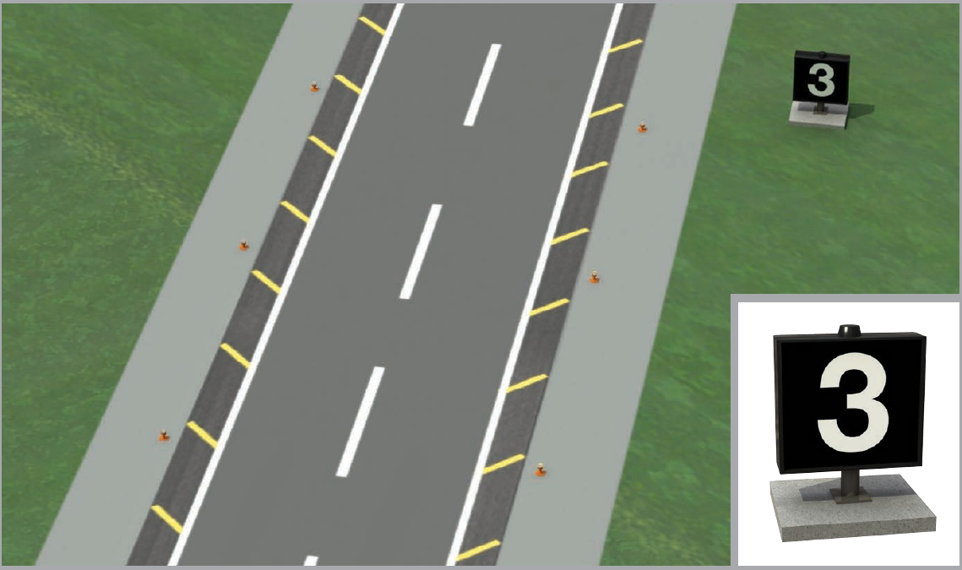

Slide 27
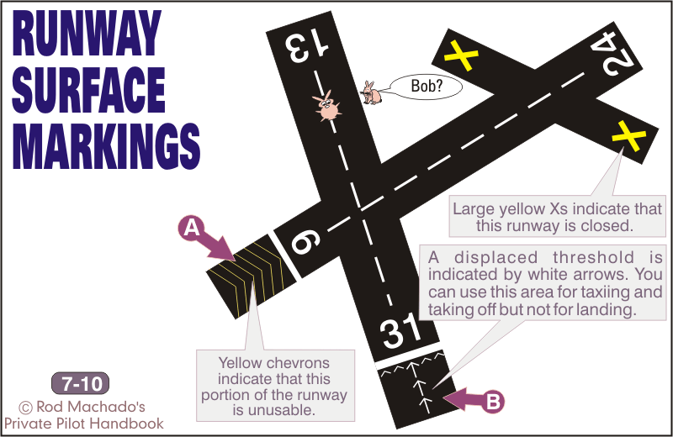

Slide 28
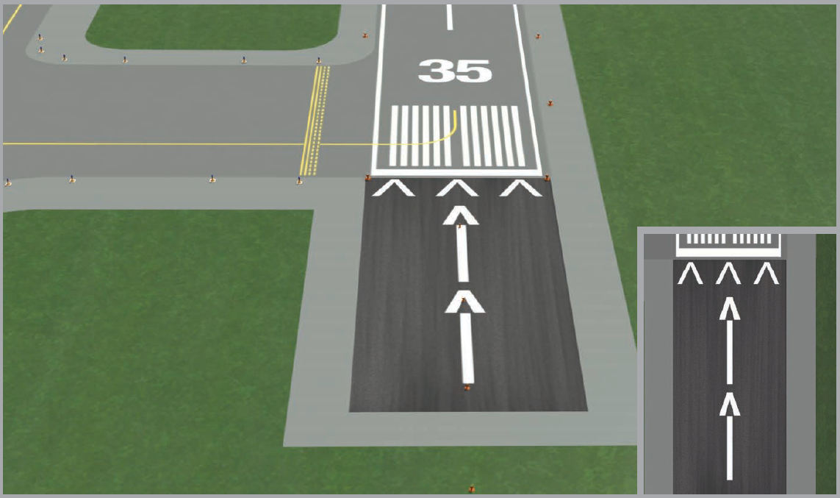
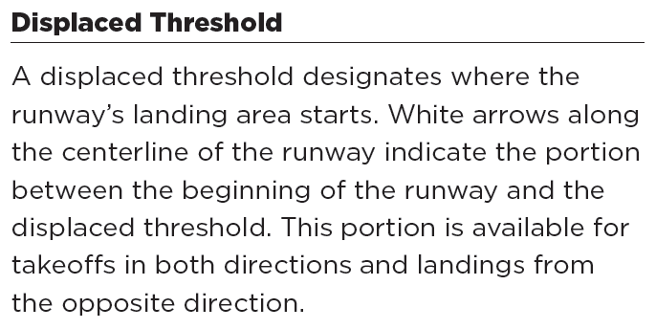

Slide 29
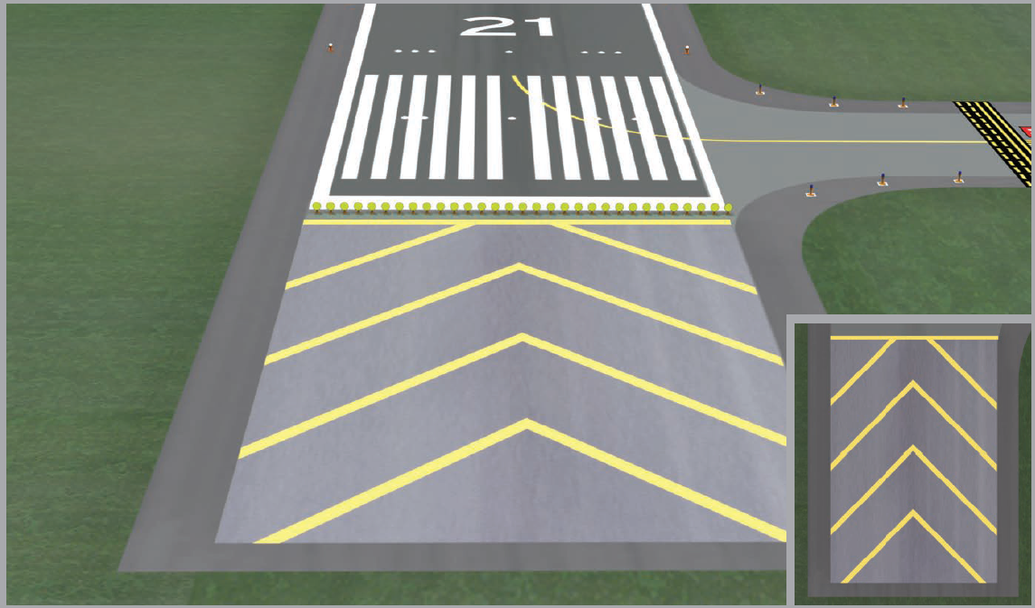
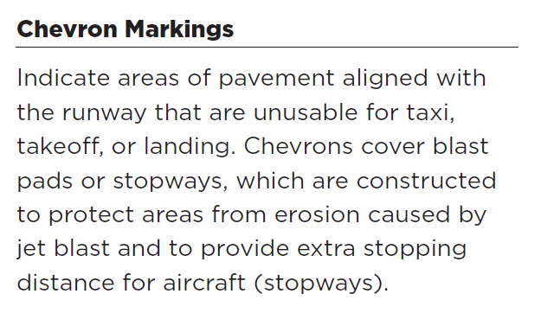

Slide 30
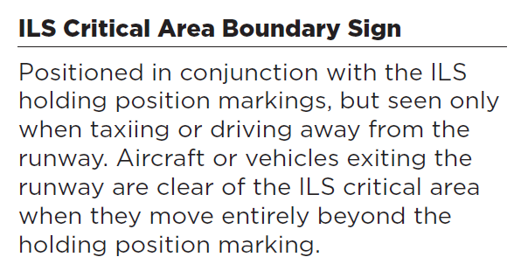
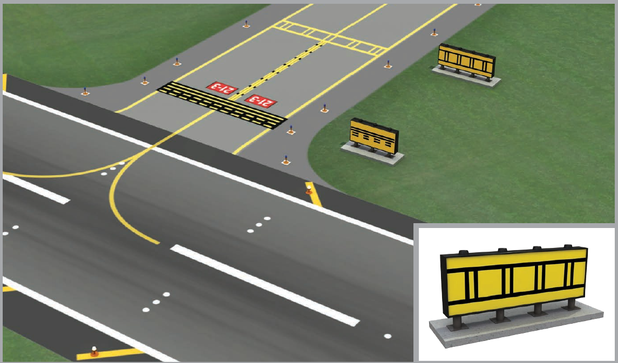
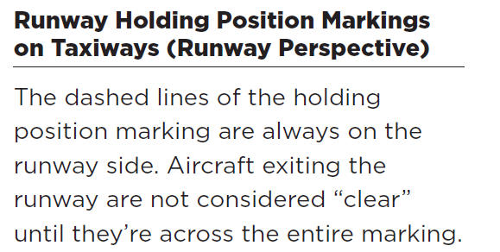

Slide 31
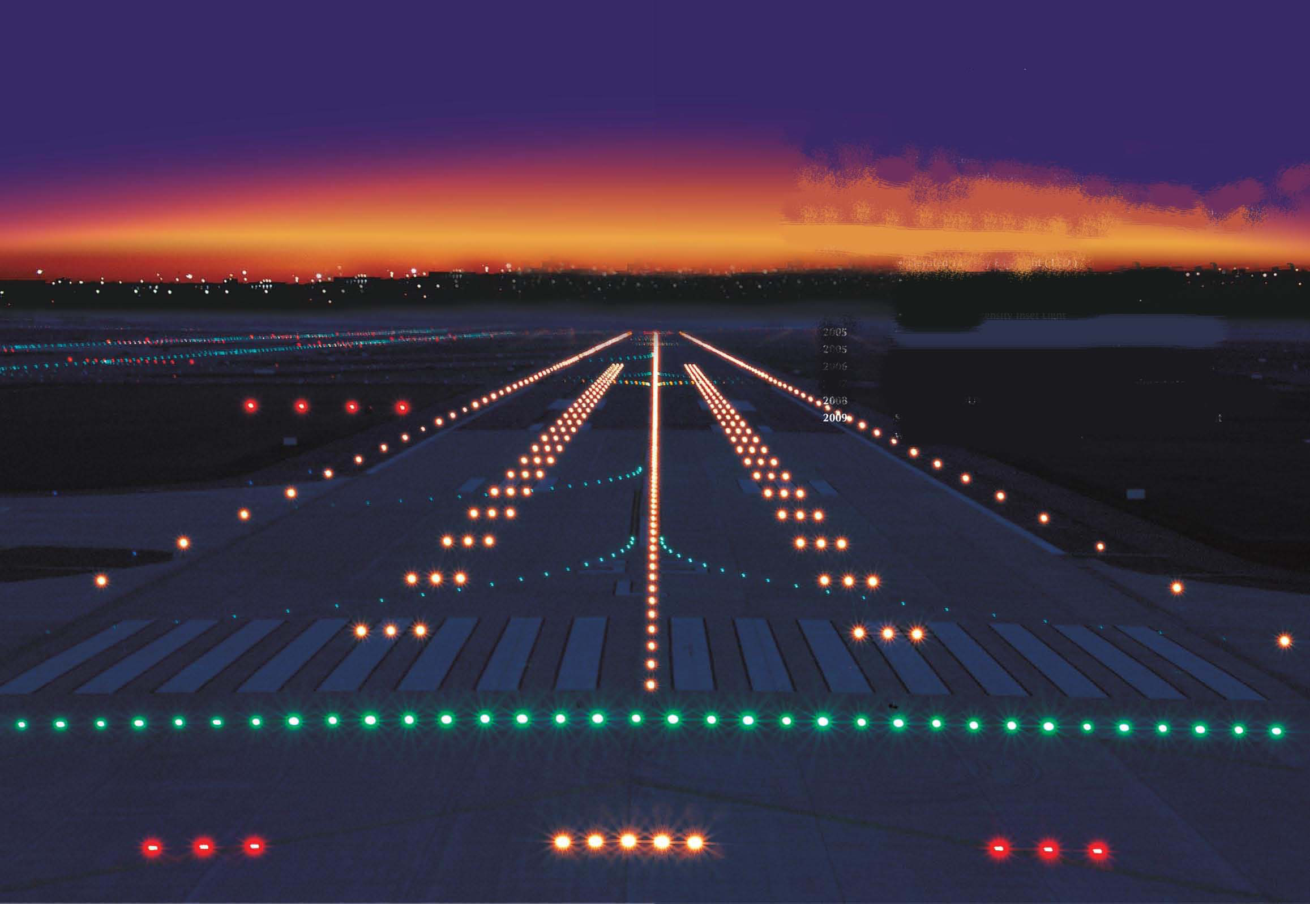
Airport Lighting

Slide 32
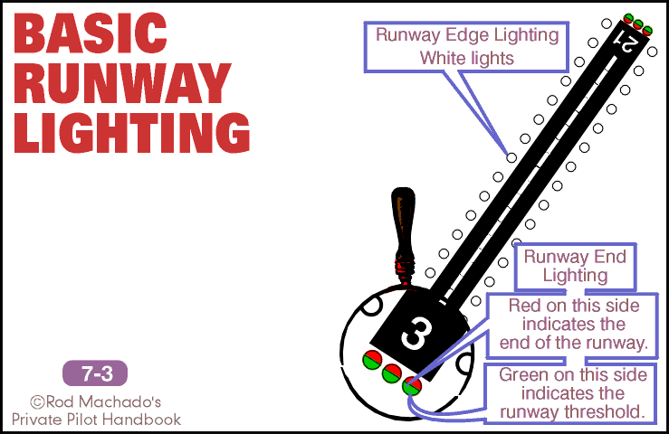

Slide 33
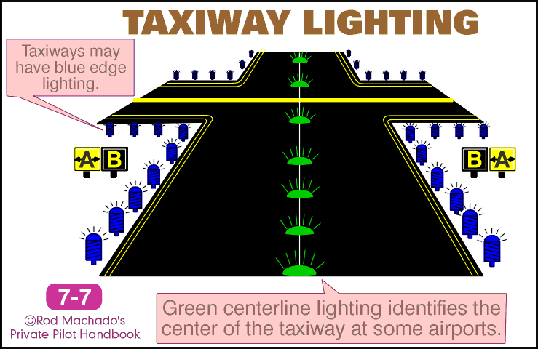

Slide 34
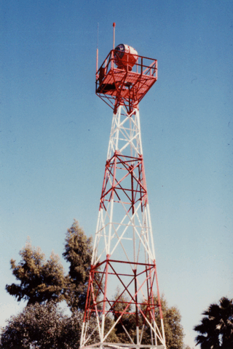
Airport Beacons
Civilian Airports
green + white
Military Airports
white + white + green
Heliport
Green + yellow + white

Slide 35
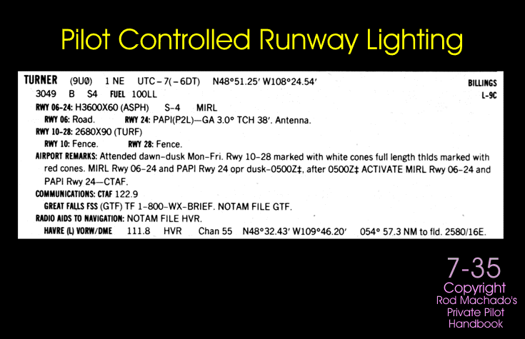

Slide 36


Cambridge (CGE)

Slide 37

Traffic Pattern Procedures

Slide 38


Slide 39


Slide 40


Slide 41

Wind & Traffic Pattern Directional Indicators

Slide 42


Slide 43


Slide 44


Slide 45


Slide 46

The Segmented Circle

Slide 47


Slide 48


Slide 49


Slide 50


Slide 51

Approach Indicating Systems

Slide 52


Slide 53


Slide 54

VASI in Flight

Slide 55


Slide 56


Slide 57


Slide 58


Slide 59
VASI in Flight

Slide 60
Right of Way
When weather conditions permit, regardless of whether an operation is conducted under IFR or VFR, vigilance shall be maintained by each person operating an aircraft so as to see-and-avoid other aircraft
When a rule of this section gives another aircraft the right-of-way, the pilot shall give way to that aircraft and may not pass over, under, or ahead of it unless well clear

Slide 61
Right of Way Rules
When aircraft of the same category are converging at approximately the same altitude, the aircraft to the others right has the right of way
If the aircraft are of different categories, refer to the “BIG R” (BGAAR) list for right of way precedence
    Balloons
    Gliders
    Airship
    Airplanes/Rotorcraft

Slide 62
Right of Way Rules
When approaching head-on each pilot shall alter course to the right
An aircraft being overtaken has the right of way. The pilot of an overtaking aircraft shall alter course to the right to pass well clear
An aircraft towing or refueling other aircraft has the right-of-way over all other engine-driven aircraft
An aircraft in distress has the right-of-way over all other traffic

Slide 63



An aircraft that is being overtaken has the right of way.
When aircraft of the same category are converging at approximately the same altitude, the aircraft to the others right has the right of way
When approaching head-on or near head-on each pilot shall alter course to the right

Slide 64
Right of Way when Landing
Aircraft, while on final to land or while landing have the right of way
  This does not mean a landing aircraft can force a plane that just landed and is rolling out towards a taxiway to hasten its exit. The plane on final should go around
When two or more aircraft are on final approach, the lowest aircraft has the right of way
  This rule is not to be taken advantage of to cut in front of or overtake another aircraft

Slide 65
Next Session: Feb 19
Quiz: Flight Instruments
Presentation: Aviation Charts
Reading:
  Machado Chapter 10
  Pilot’s Handbook Chapter 16
  FAA Chart User Guide

