Slide 1
Aviation Charts

Slide 2
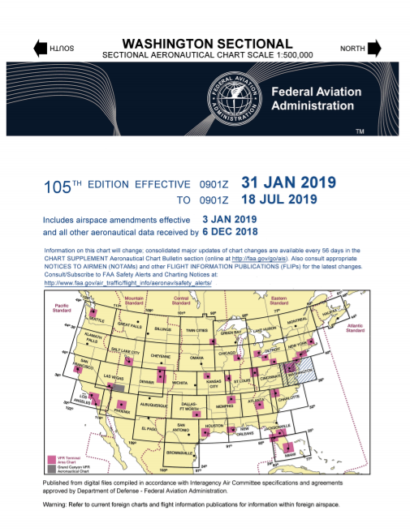
Sectional Chart

Slide 3
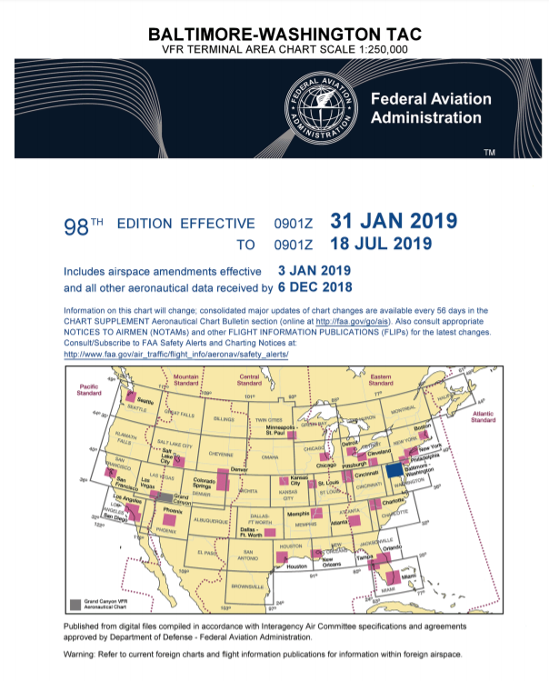
Terminal Area Chart (TAC)

Slide 4
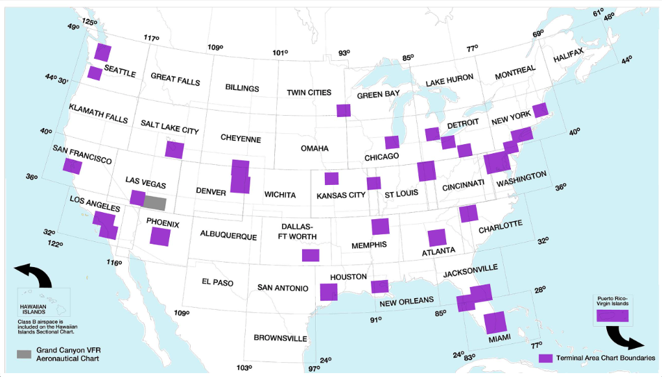

Slide 5
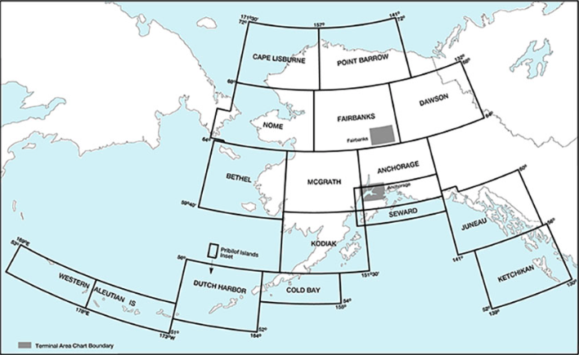

Slide 6
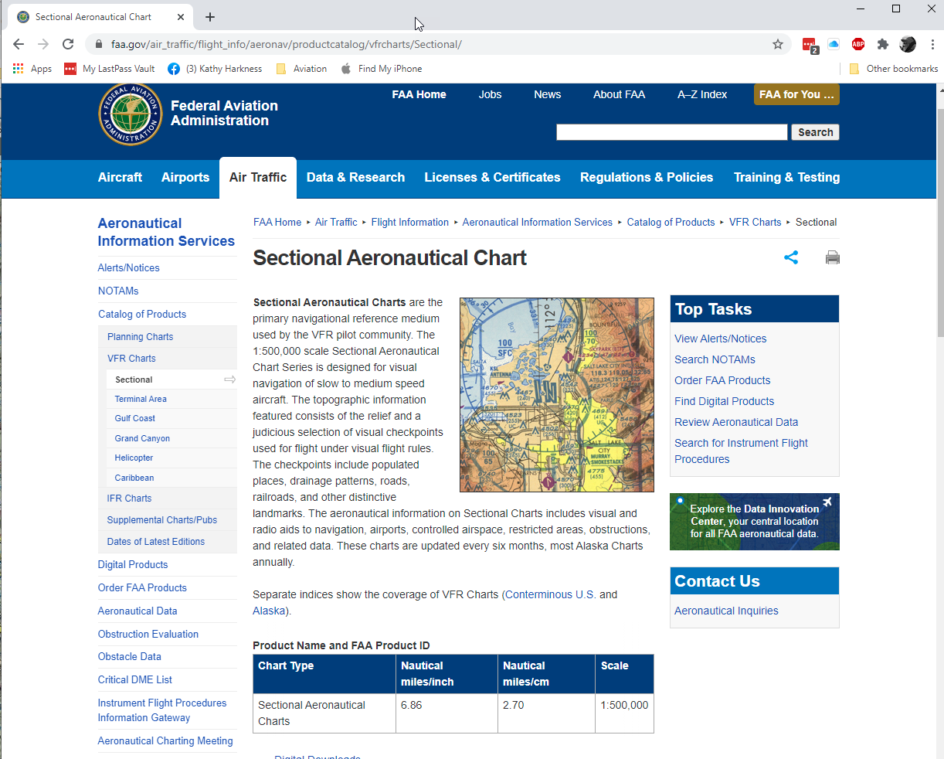

Slide 7
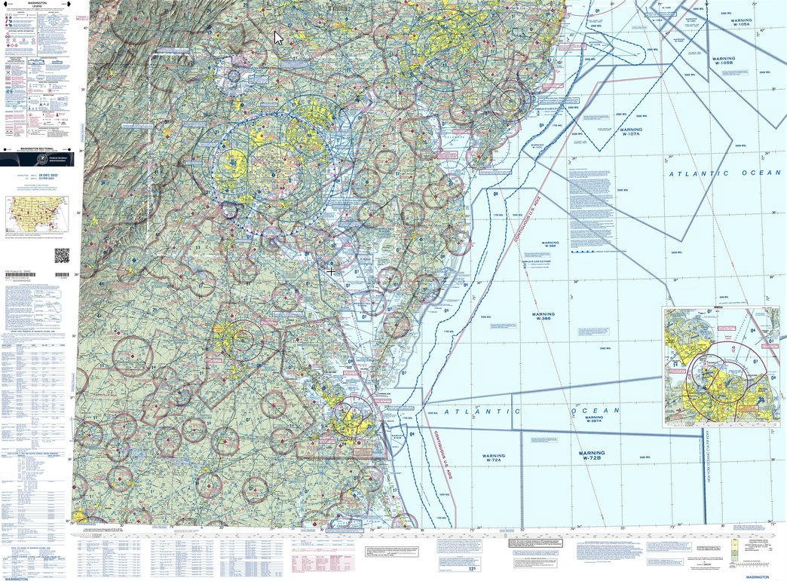

Slide 8
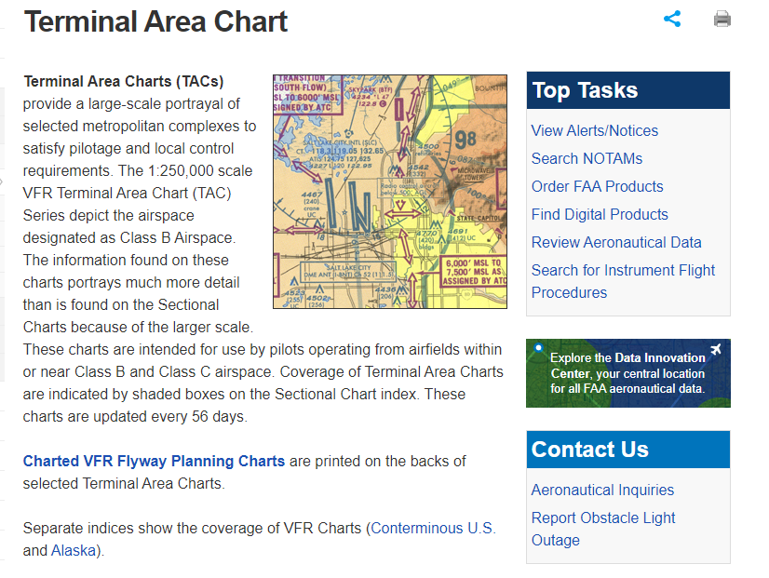

Slide 9
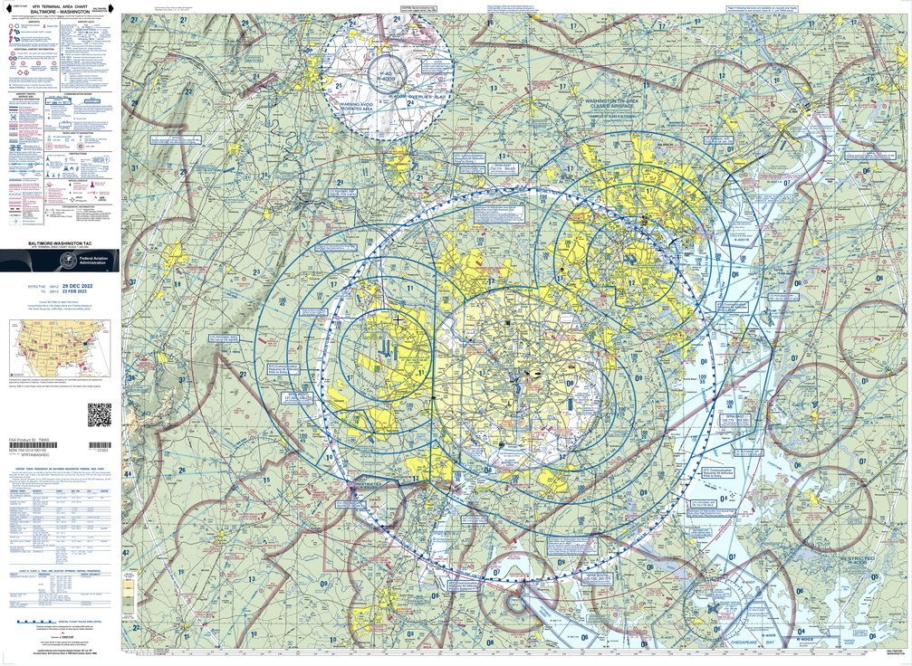

Slide 10
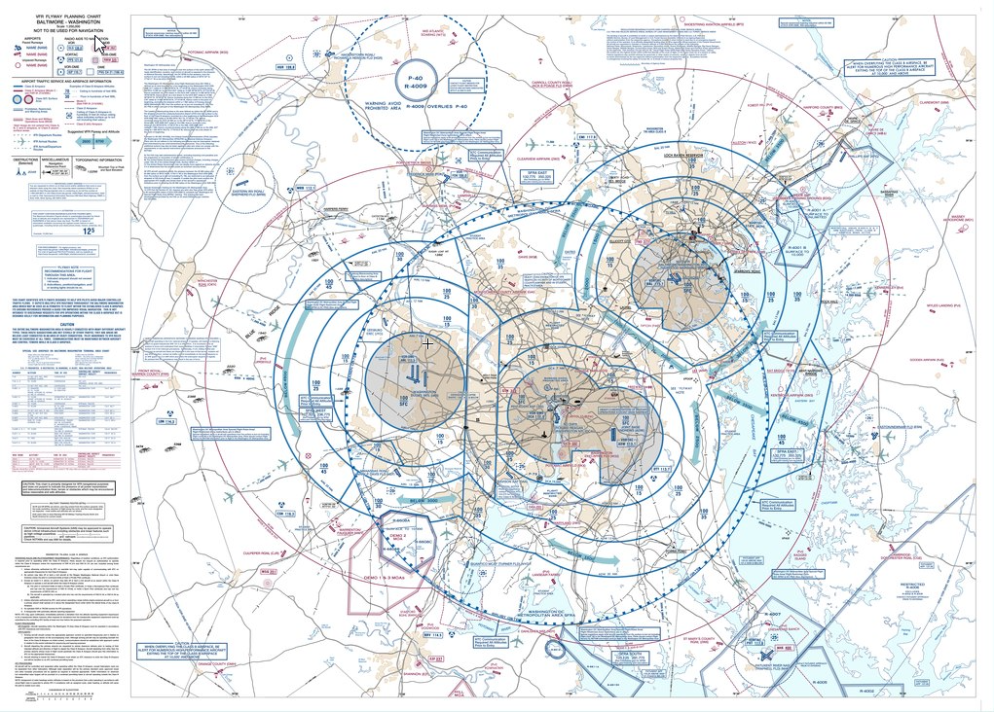

Slide 11
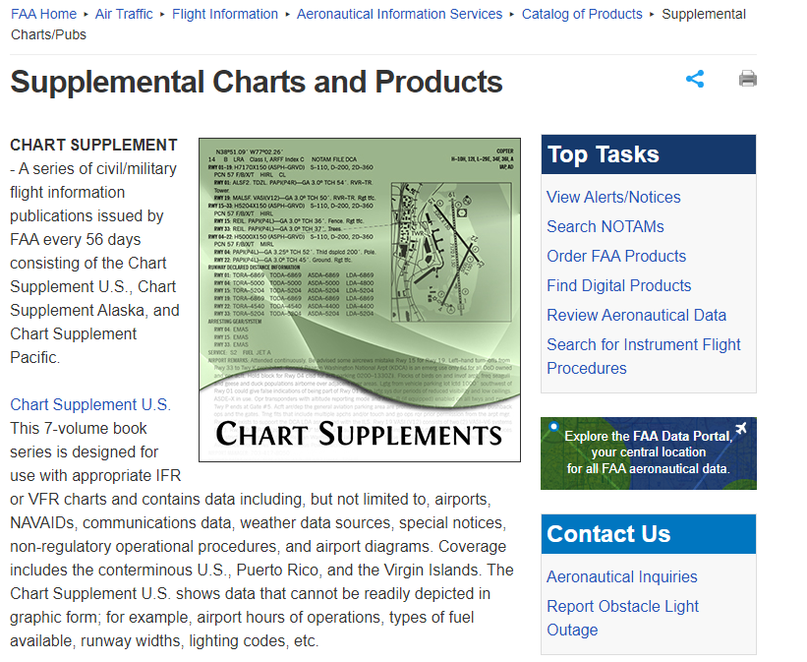

Slide 12
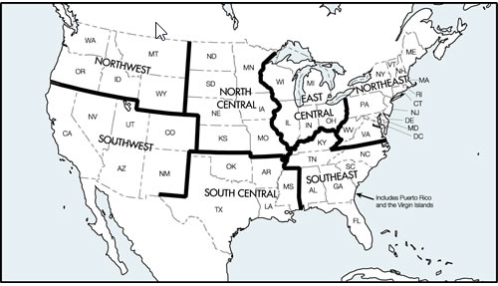
Lower 48 Chart Supplements

Slide 13
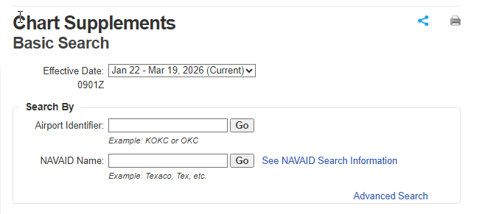
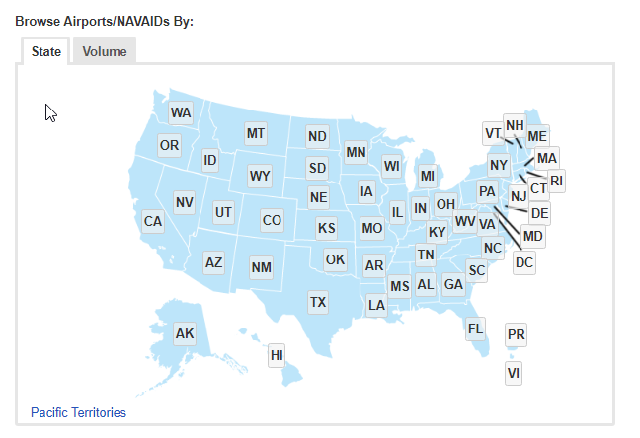
Online Browse/Search

Slide 14
Online Browse/Search

Slide 15
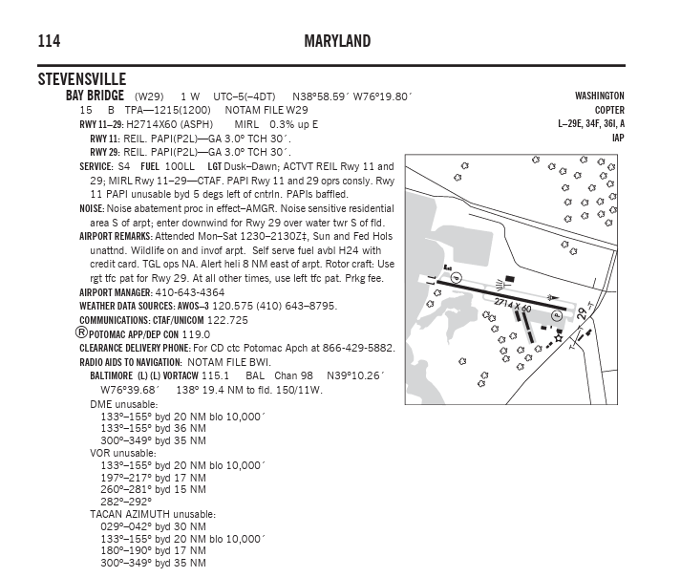

Slide 16
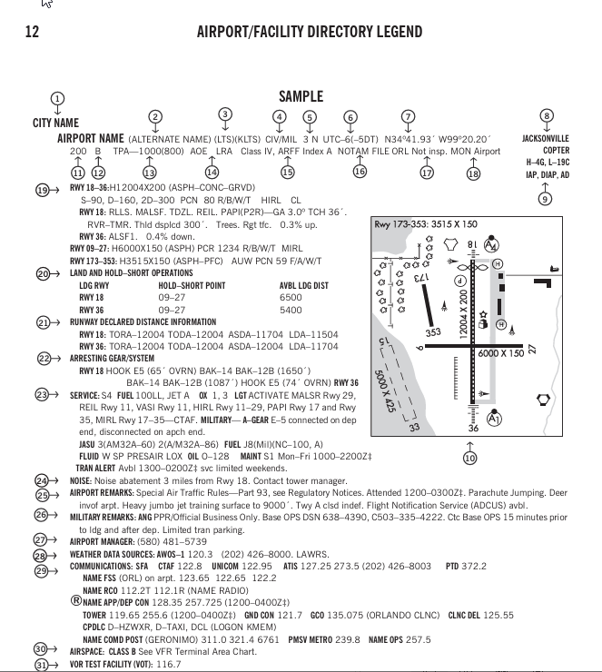

Slide 17
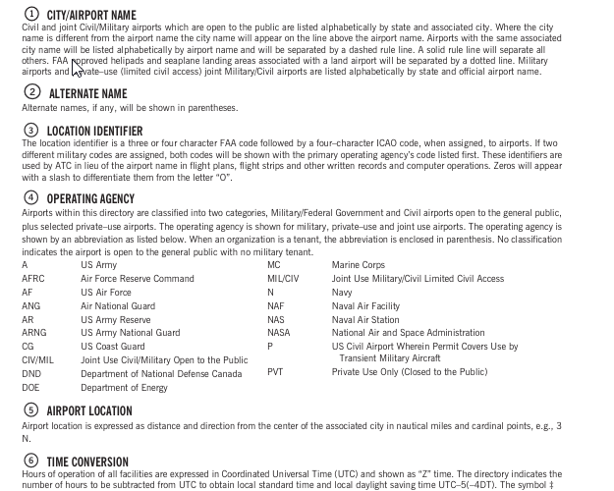

Slide 18
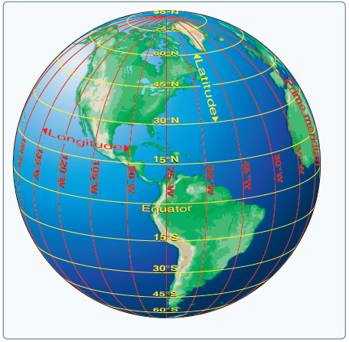
Round to Flat

Slide 19
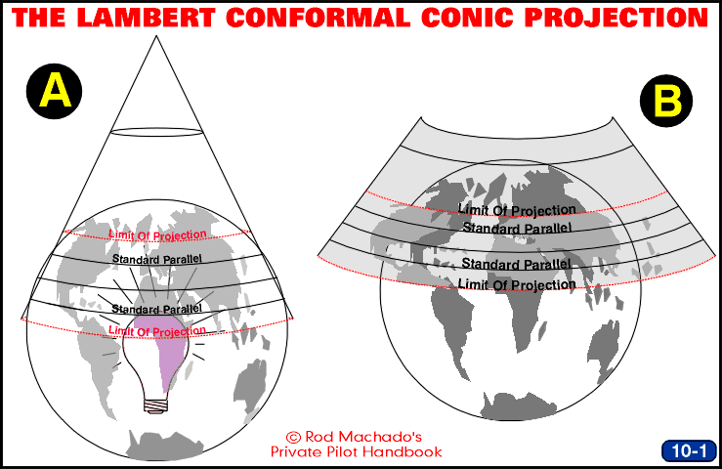

Slide 20
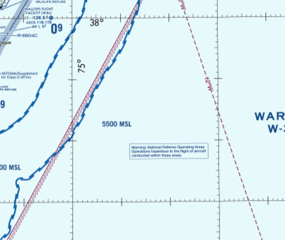
Latitude and Longitude

Slide 22
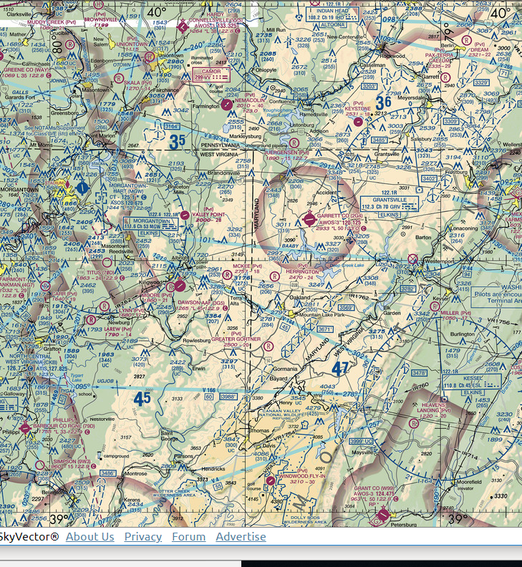
Latitude and Longitude

Slide 23
Latitude and Longitude

Slide 24
Latitude and Longitude

Slide 25
Quadrangles

Slide 26
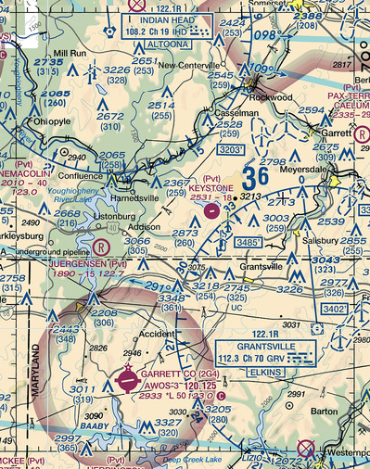
Maximum Elevation Figure (MEF)
MEFs are determined by taking the highest of the following:
The point of highest terrain within a quadrangle, adding 200 ft for obstacles which are not required to be portrayed, and then adding 100 feet for vertical error and then rounding up to the next hundred feet;
or
The height of the highest manmade obstacle in the quadrangle, adding 100 feet for vertical error and then rounding up to the next hundred feet.

Slide 27
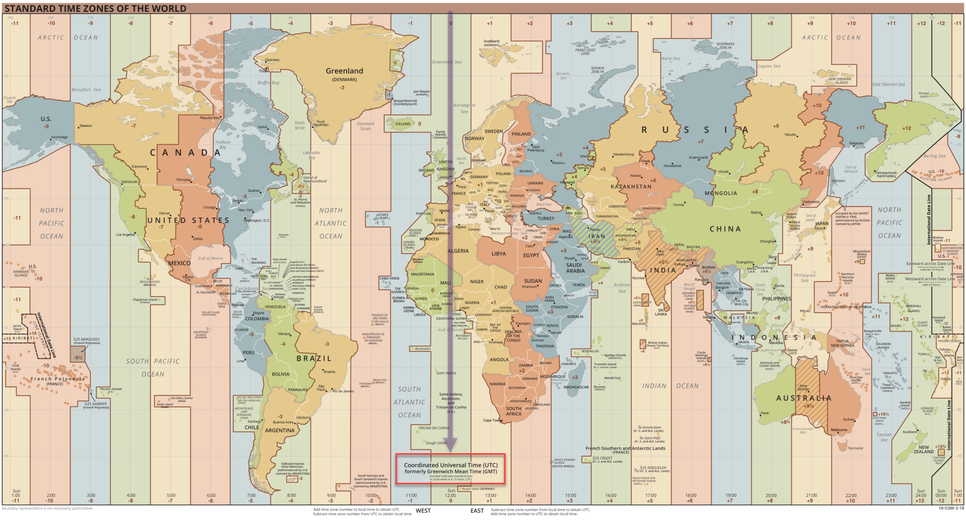
World Time Zones

Slide 28
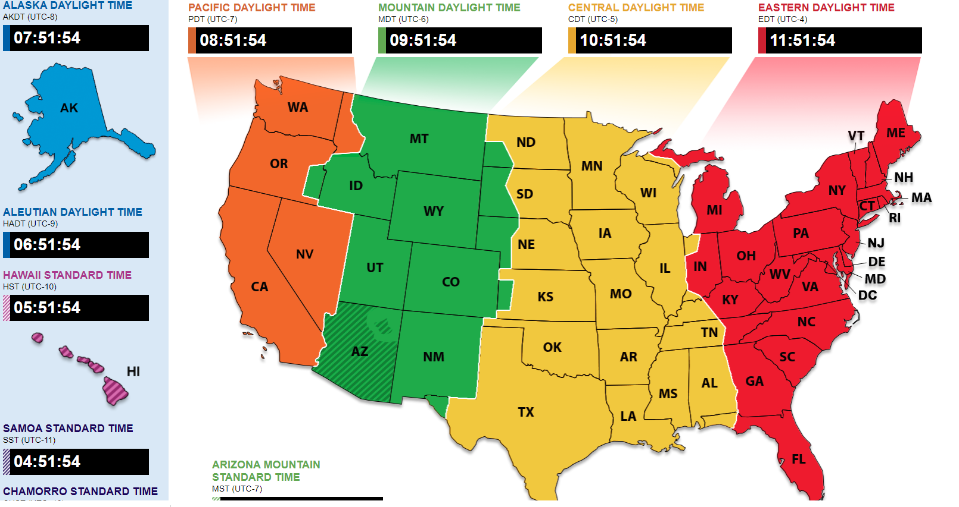
United States Time Zones

Slide 29
Where am I? (Visual) | Where am I? (Radio) | What should I avoid? | Where am I going?
land features | Radio aids to navigation | terrain | airports
water | RNAV waypoints | obstructions | beacons
populated places |  | airspace | VFR flyways
roads/rail track/power lines

Slide 30
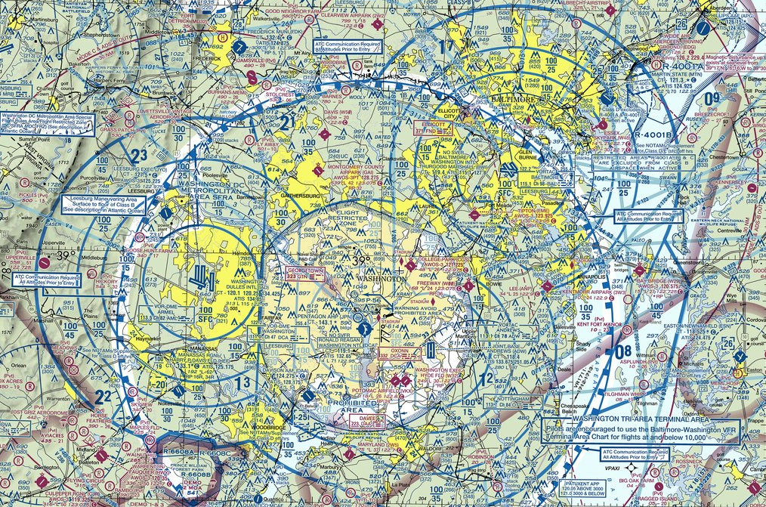
Sectional

Slide 31
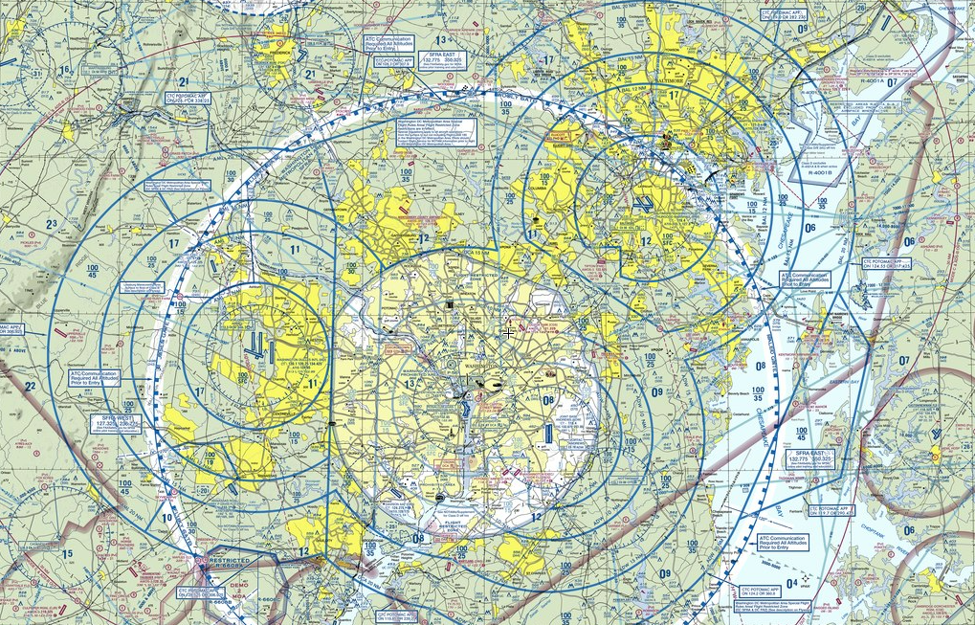
Terminal Area Chart

Slide 32
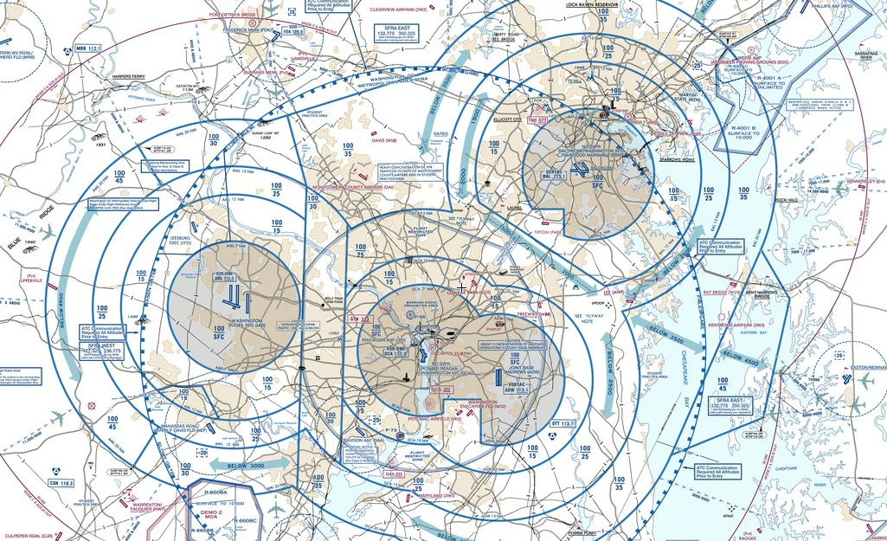
VFR Flyway Chart

Slide 33
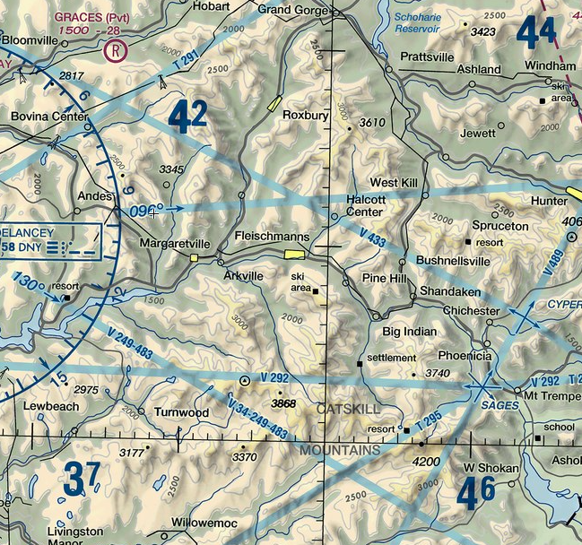
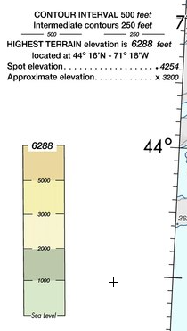
Land Features: Contour Lines, Shaded Relief, Color Tints
 | Contour lines mark out 500’ elevation changes Relief shading as if light is coming from northwest

Slide 34
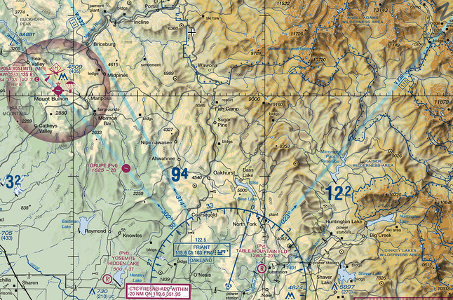
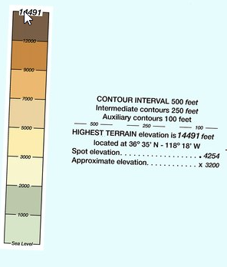
Land Features: Contour Lines, Shaded Relief, Color Tints
 | Contour lines mark out 500’ elevation changes Relief shading as if light is coming from northwest

Slide 35
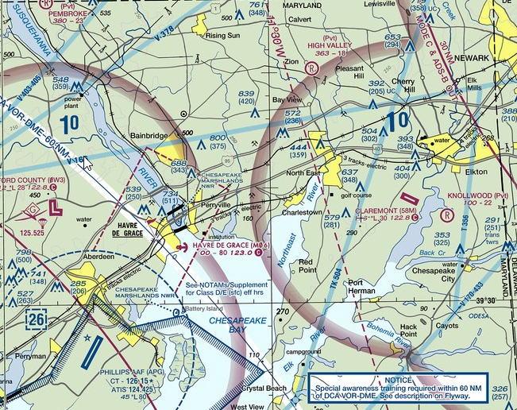
Water
 | Water features are depicted using two tones of blue. “Open water” is lighter blue and “Inland water” a darker blue. Open water locates the shoreline limit of coastal waters at the mean high water level.

Slide 36
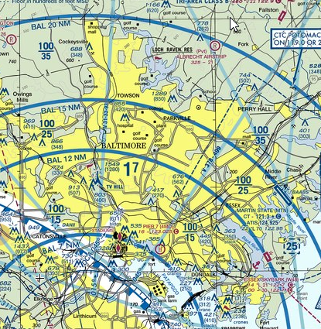
Populated Places
 | Yellow tinted areas indicate populated places. Small circles indicate an area too small to depict using yellow tint.
 | Font style and size indicates category of populated area. BALTIMORE PERRY HALL Cockeysville

Slide 37
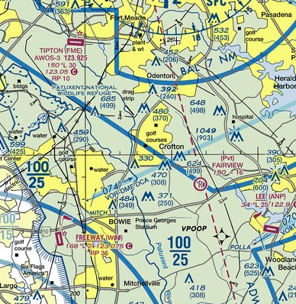
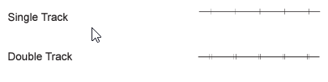
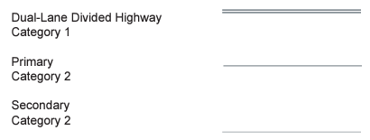

Roads, Rail Track, Power Lines
 | Railroads: Roads:
 | Power lines:

Slide 38
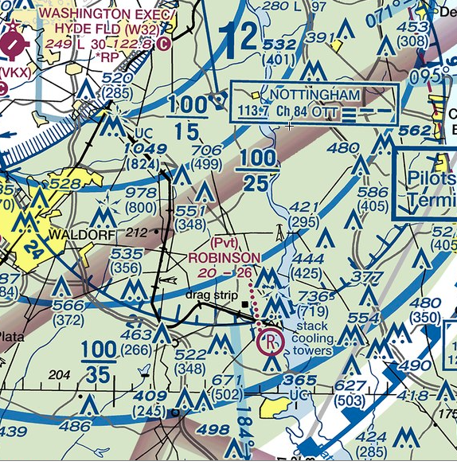
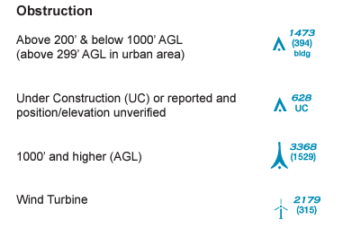
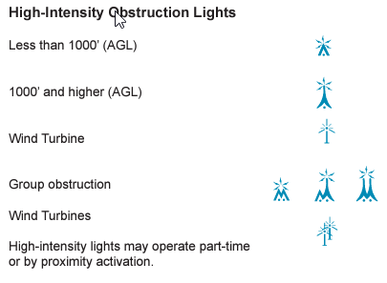
Obstructions
 | Obstruction heights: MSL (AGL)

Slide 39
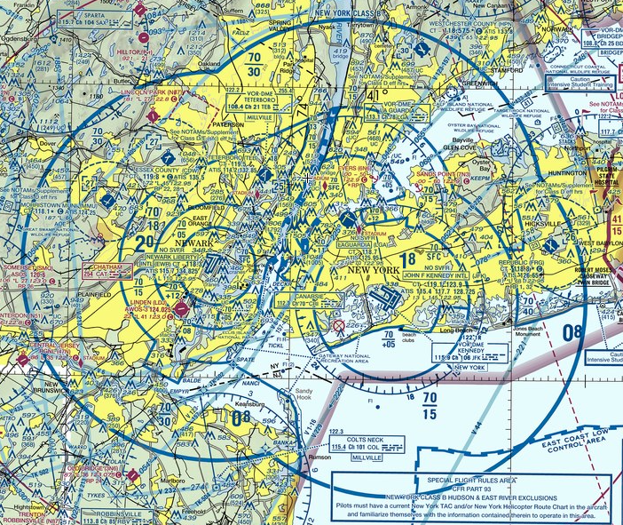
Airspace: Class B (Sectional Chart)

Slide 40
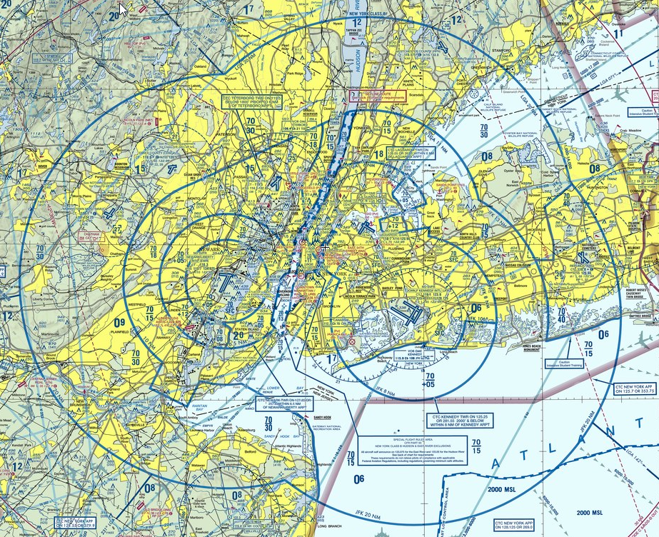
Airspace: Class B (TAC)

Slide 41
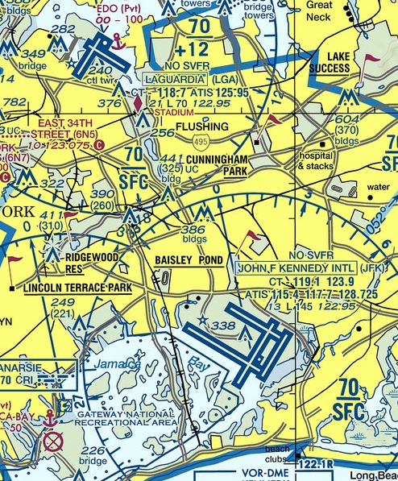
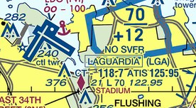
Airspace: Class B (Data Block)
 | ID: LGA CT freq: 118.7 ATIS: 125.95 Field Elev: 21 ft L: lighted dusk to dawn Longest runway: 7000 ft Unicom: 122.95 NO SVFR

Slide 42
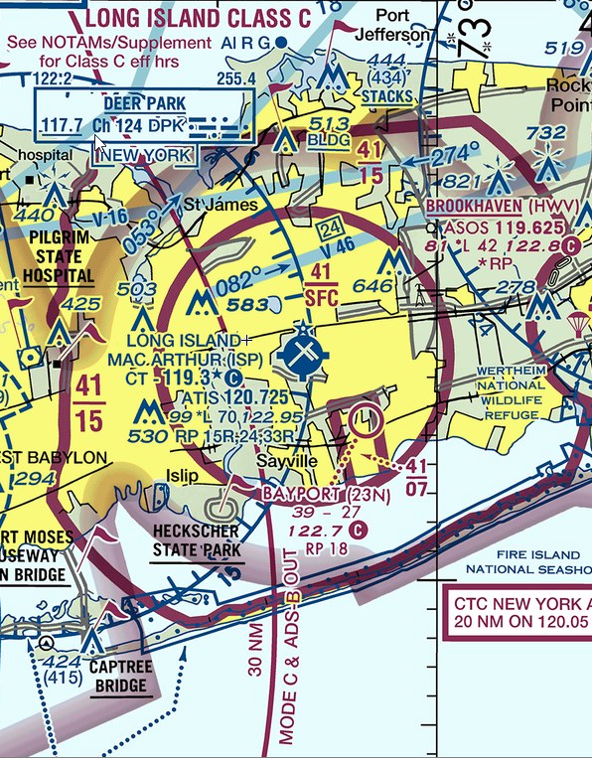
Airspace: Class C
 | Note that even though the circles are red, the airport is depicted as blue. (All airports with CTs are blue on the sectional)

Slide 43
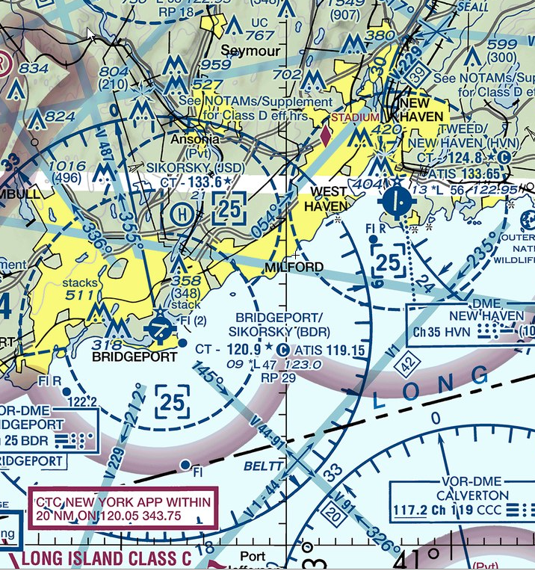
Airspace: Class D

Slide 44
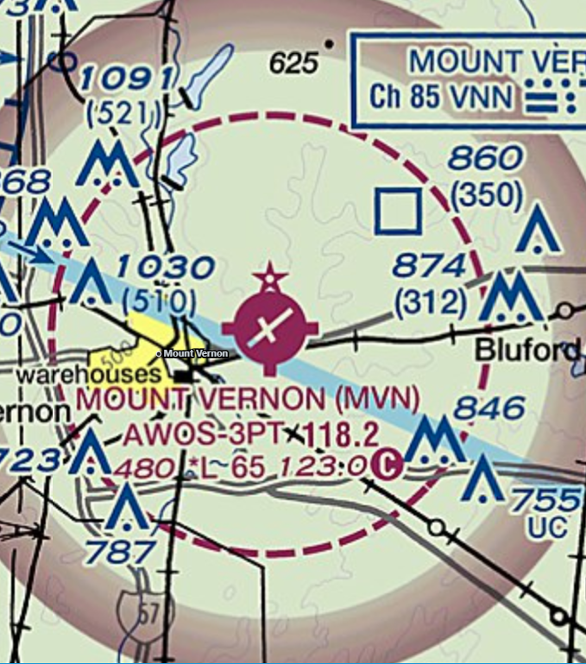
Airspace: Class E to Surface
 | Note that the airport is depicted in magenta: E is controlled airspace but MVN does not have a control tower.

Slide 45
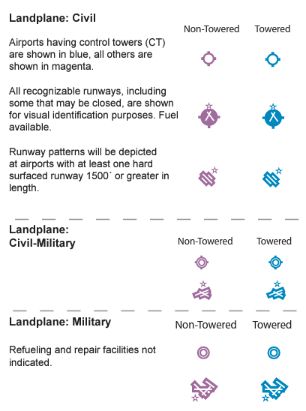
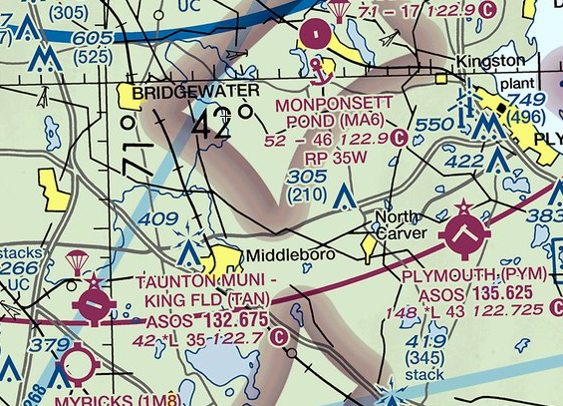
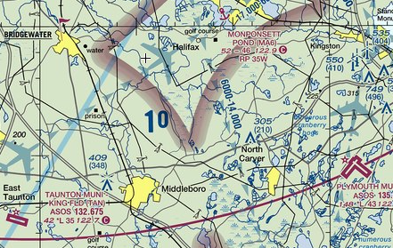
Airports
 | Sectional:
 | TAC:

Slide 46
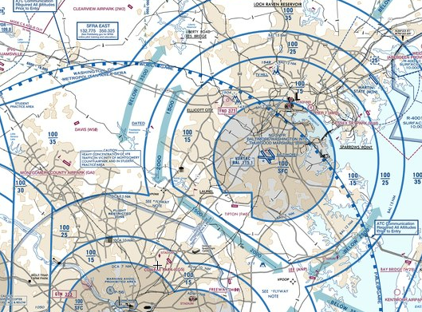
VFR Flyways

Slide 47
Tour of SkyVector
www.skyvector.com

