Slide 1
Electrical Systems

Slide 2
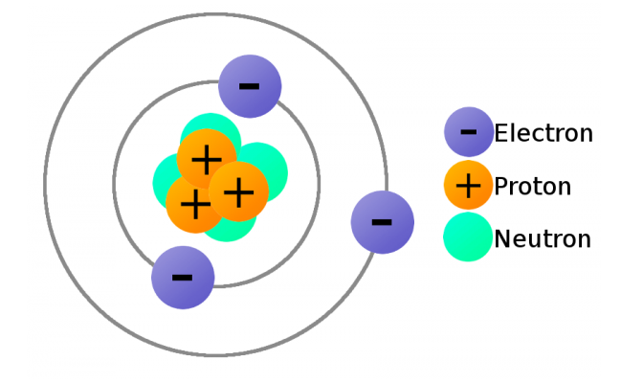
Atomic basis of electricity

Slide 3
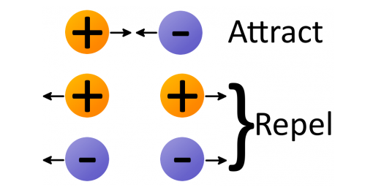
Law of attraction

Slide 4
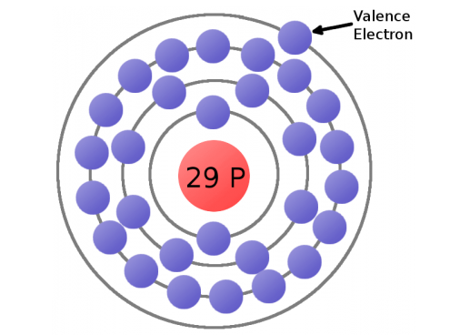
Outer shell is loosely bound

Slide 5
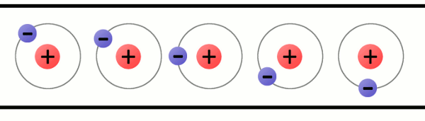
In material that is “conductive” electrons are free to flow – this is electricity

Slide 6
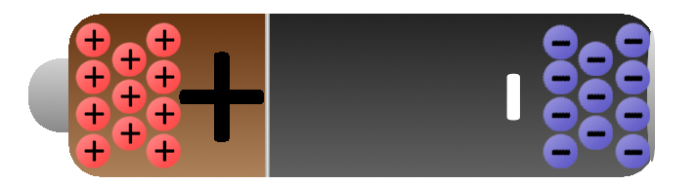
Battery
Electrical energy storage device with segregated + and – poles
Provides large energy burst to start engine turning
Receives and stores energy from generator/alternator in excess of needs of aircraft’s running electrical devices
Provides power reserve in case alternator/generator fails

Slide 7
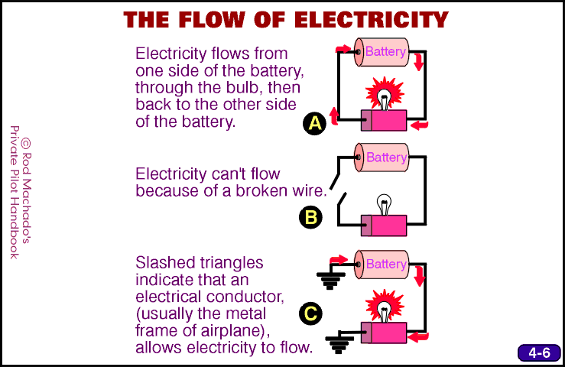

Slide 8
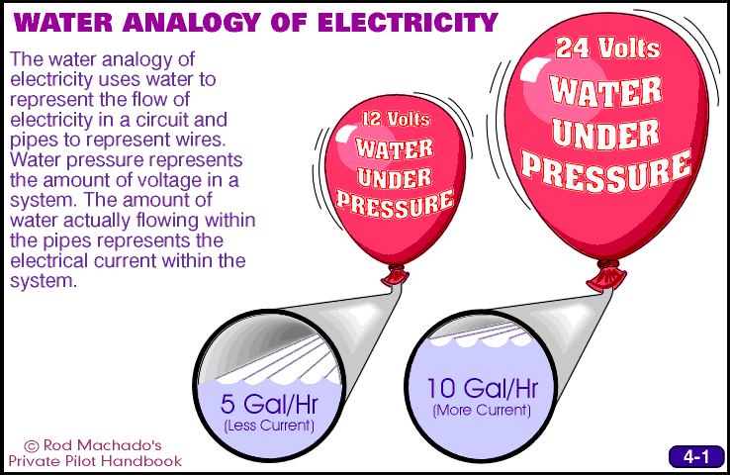

Slide 9
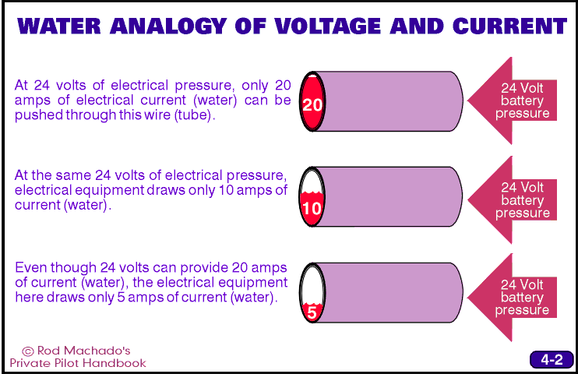

Slide 10
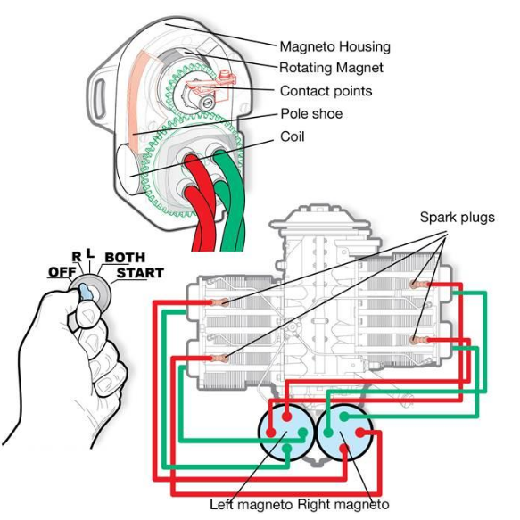
Starting the engine:
Magnetos

Slide 11
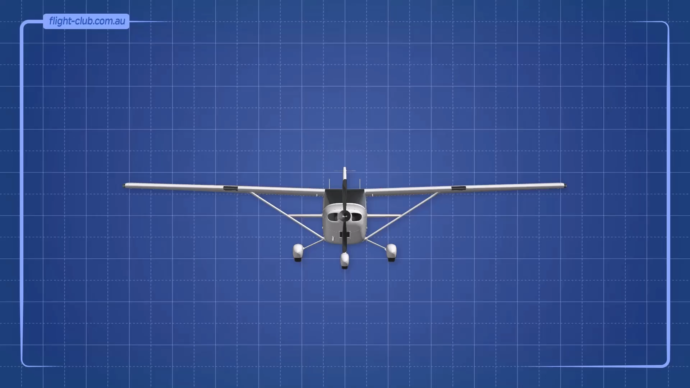
How magnetos work

Slide 12
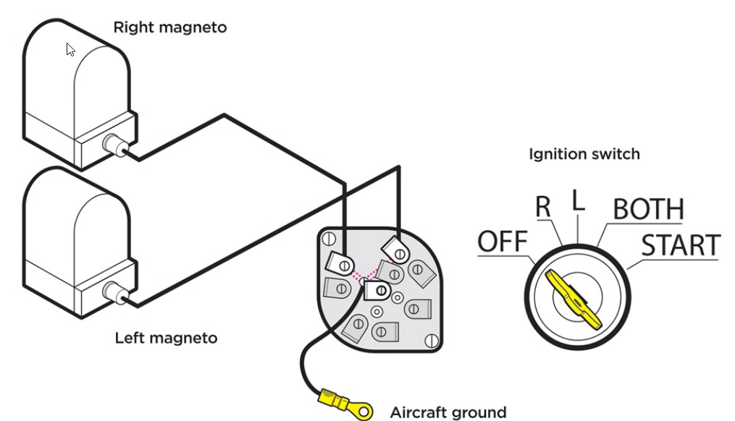
P-Leads and Grounding

Slide 13
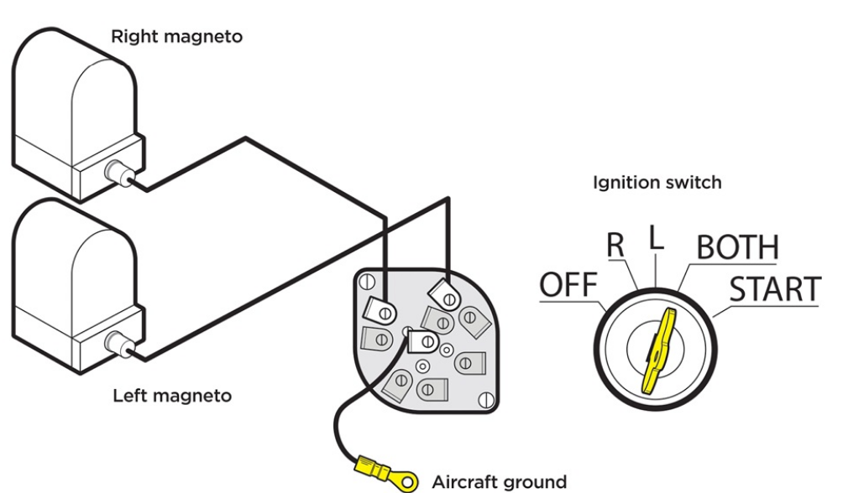
P-Leads and Grounding

Slide 14
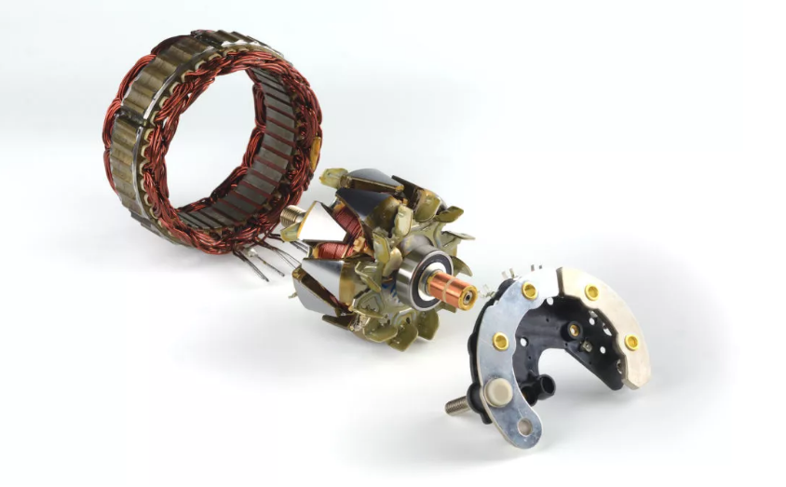
Replenishing the battery: generators and alternators

Slide 15
Alternators vs. Generators
An alternator is a device that converts mechanical energy into alternating current electrical energy.
A generator is a mechanical device that converts mechanical energy to either alternating or direct current electrical energy.
Therefore: all generators are alternators, but not all alternators are generators.
From a pilot’s point of view, think of them as the same thing: an engine-driven accessory which converts rotational energy from the crankshaft into electricity to both power electrical components in the airplane and to recharge the battery.

Slide 16
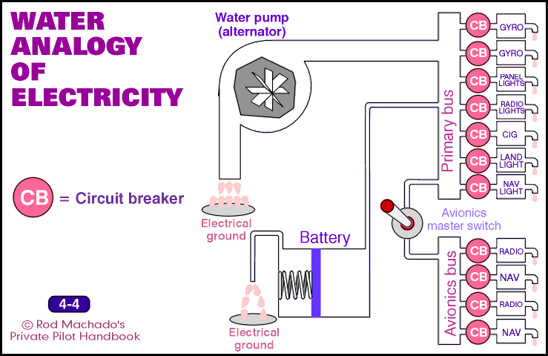

Slide 17
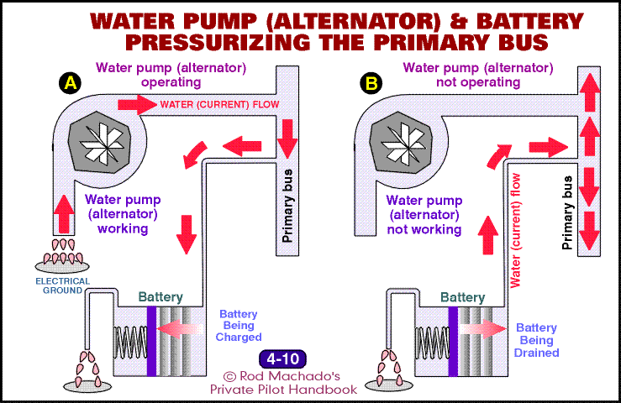

Slide 18
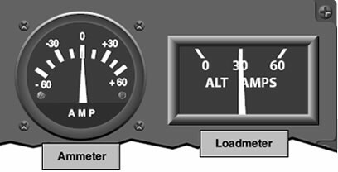
Ammeter vs Loadmeter

Slide 19
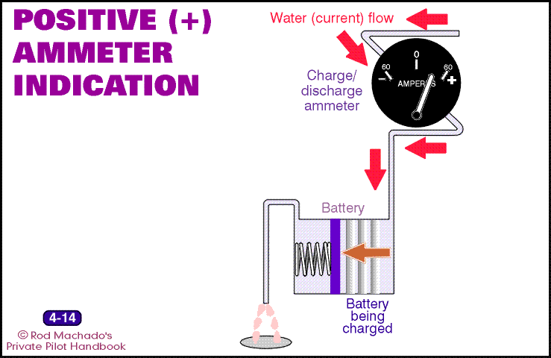

Slide 20
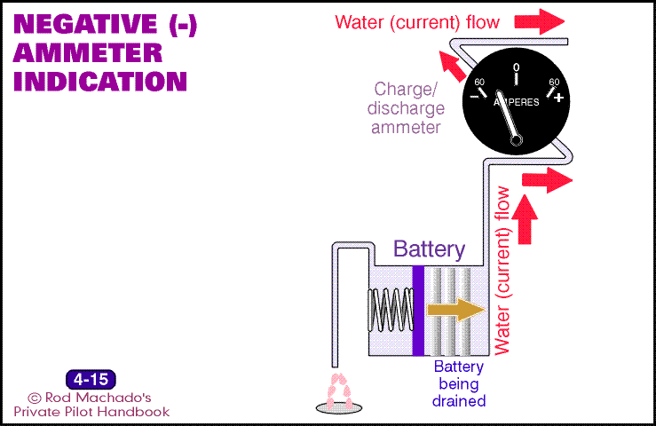

Slide 21
Voltage Regulation
Unregulated, the flow back to the battery after electricity is siphoned to run the electrical components in the panel could potentially “cook” the battery resulting in permanent damage and electrical system failure
Alternators/generators incorporate a component called a “voltage regulator” to ensure that no more energy is delivered back to the battery than can be stored
If the voltage regulator fails, the alternator/generator must be shut down to prevent damage to the battery and potential electrical fires

Slide 22
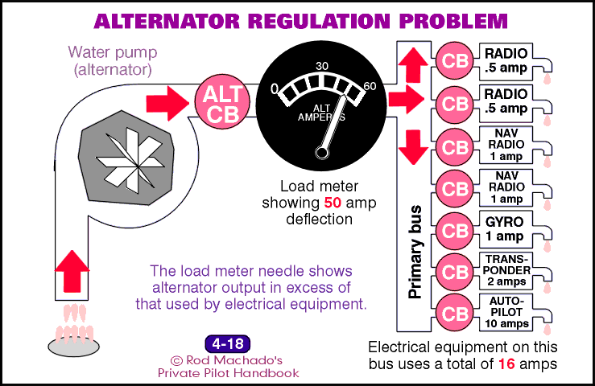
Faulty Voltage Regulator

Slide 23
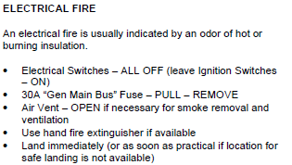
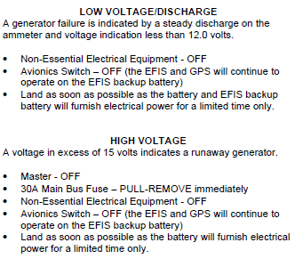
Emergency Electrical Procedures

Slide 24
Next time:
Aeronautical Decision-Making
  PHAK Chapter 2
  Machado Chapter 17
Aeromedical Factors
  PHAK Chapter 17
  Machado Chapter 17
Quiz:
  Engines
  Electrical

