Slide 1
Engines

Slide 2

Reciprocating Engines

Slide 3
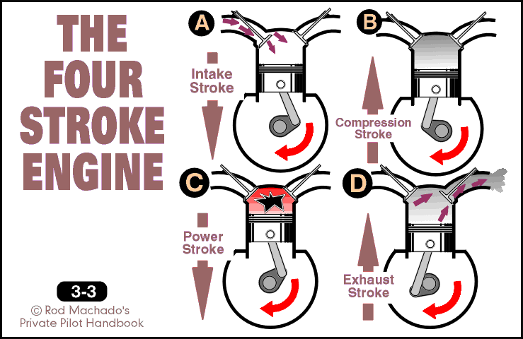

Slide 4
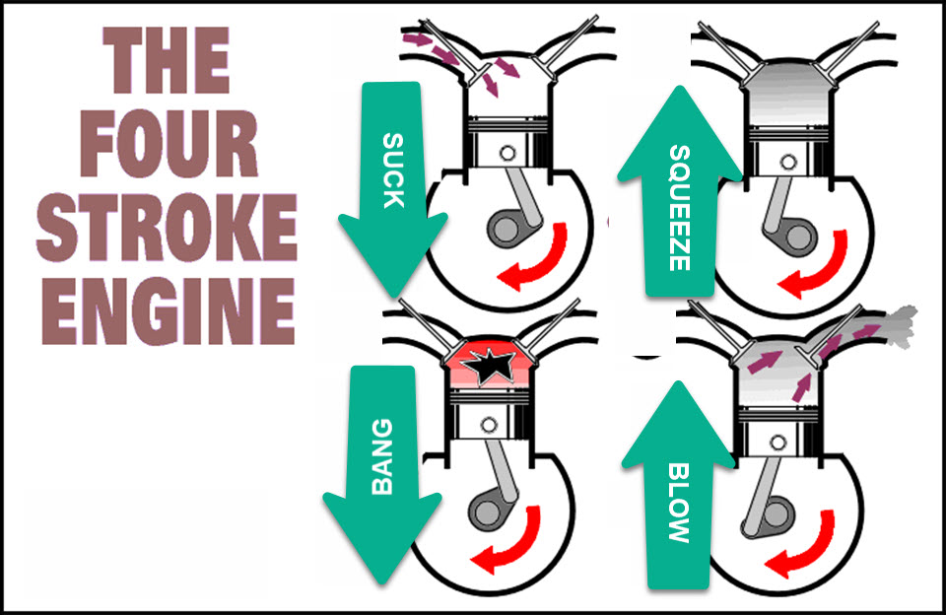

Slide 5
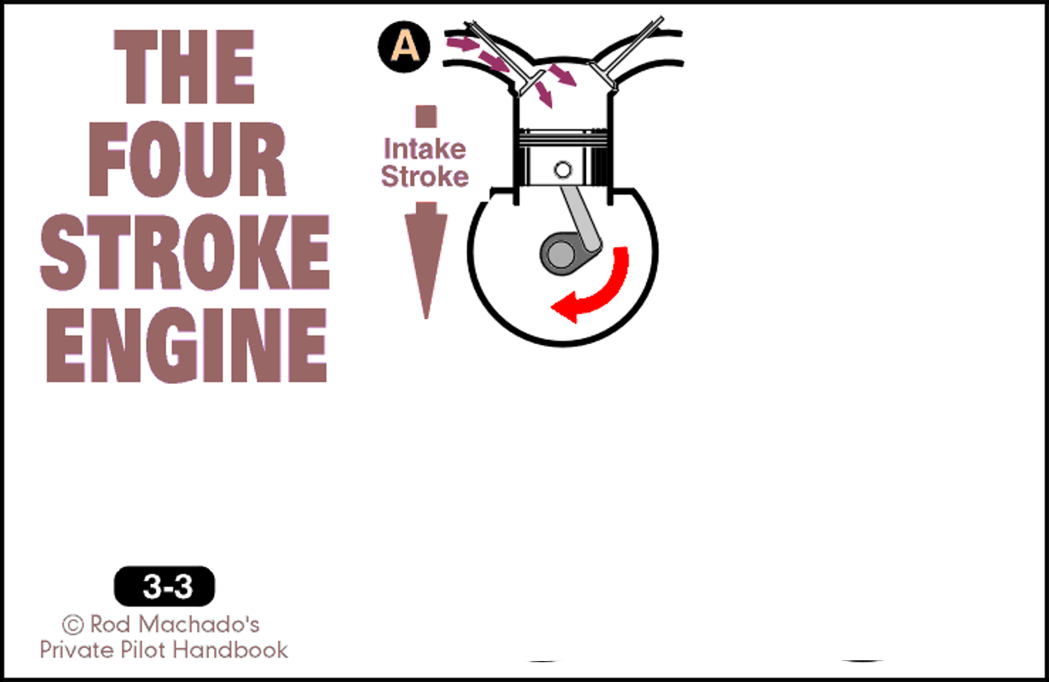
Suck
A normally aspirated engine sucks
fuel
air

Slide 6

Fuel and Air

Slide 7
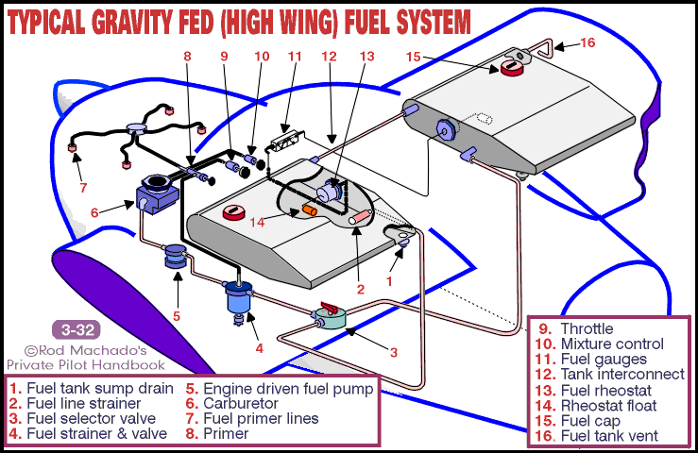

Slide 8
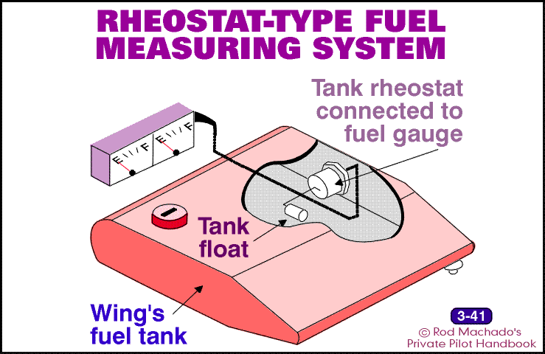

Slide 9
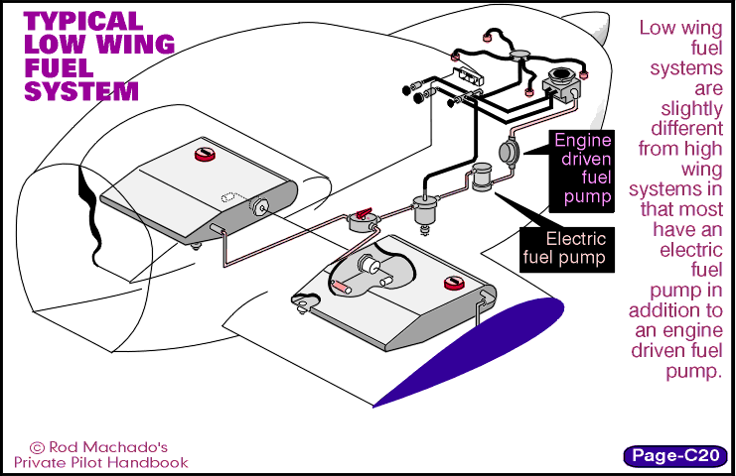

Slide 10
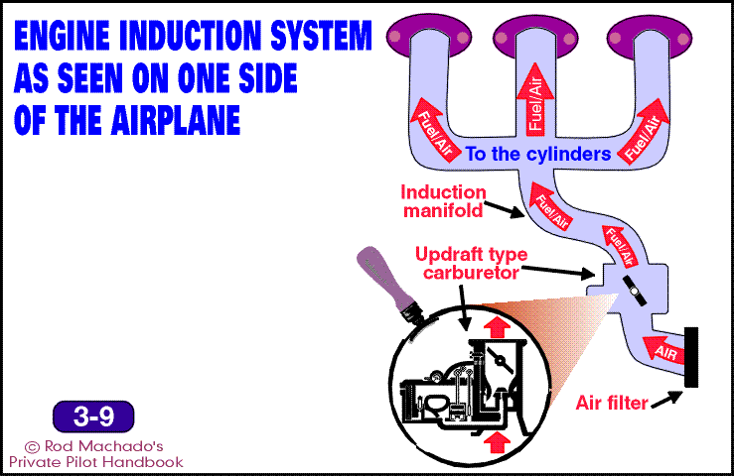

Slide 11
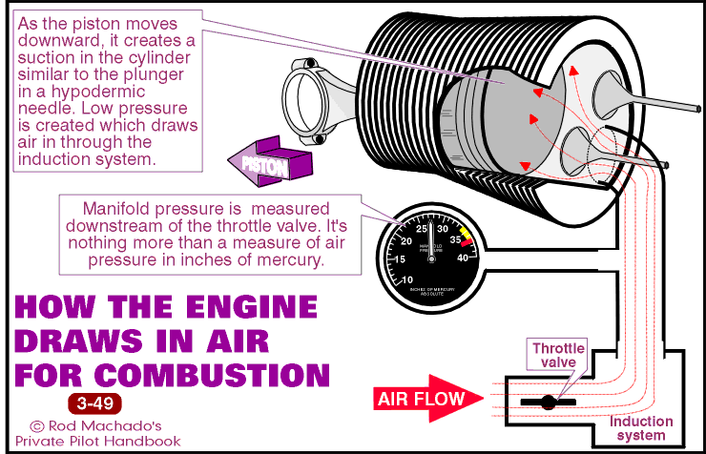

Slide 12
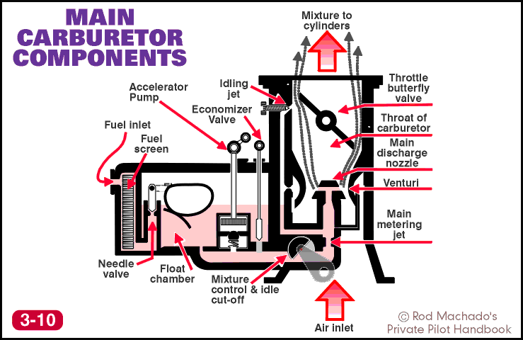

Slide 13
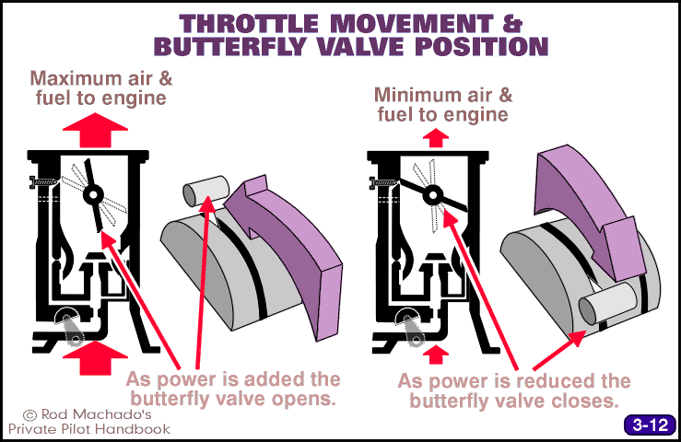

Slide 14
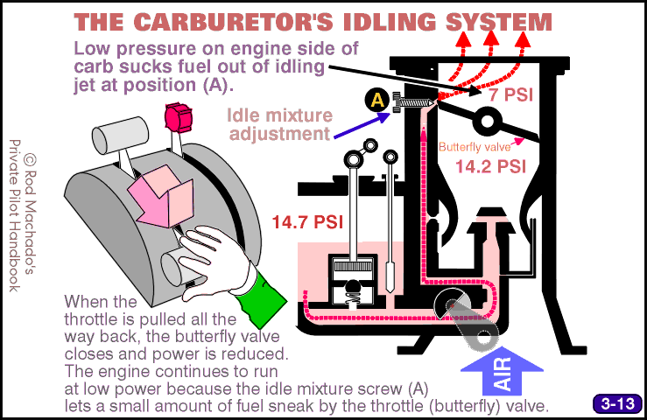

Slide 15
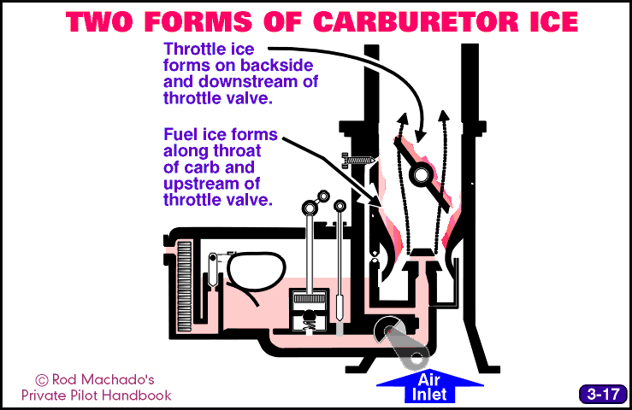

Slide 16
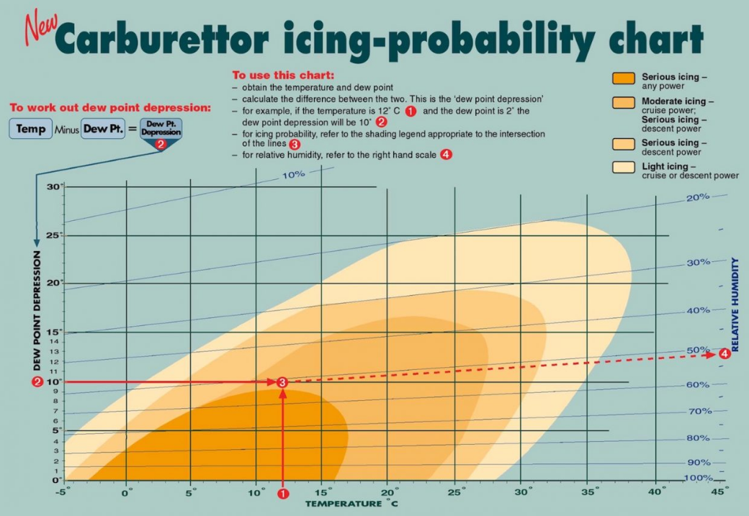

Slide 17
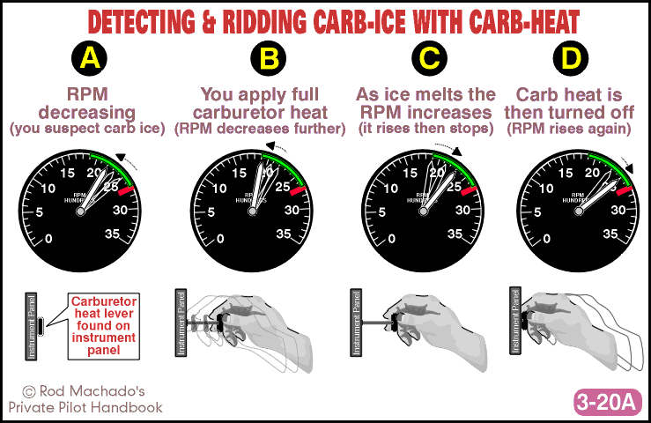

Slide 18
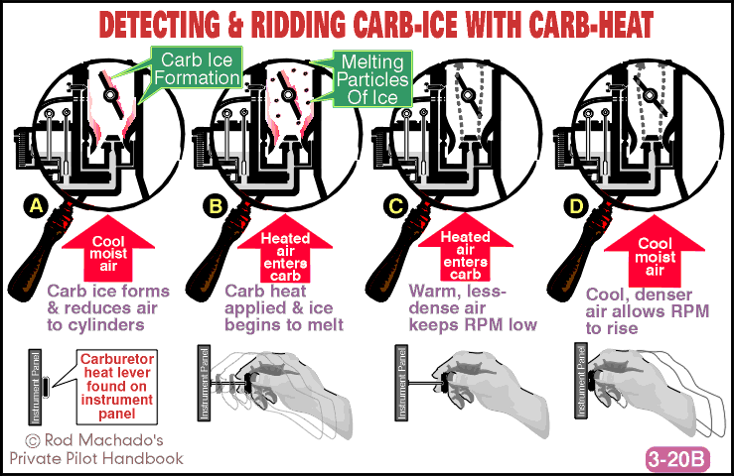

Slide 19

Throttle and Mixture Control

Slide 20
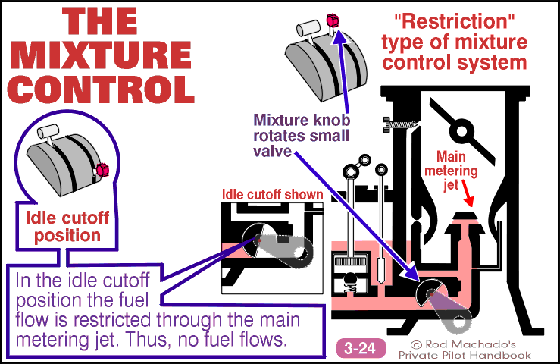

Slide 21
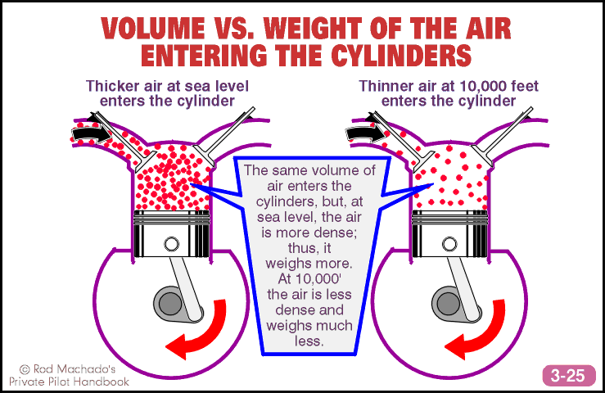

Slide 22
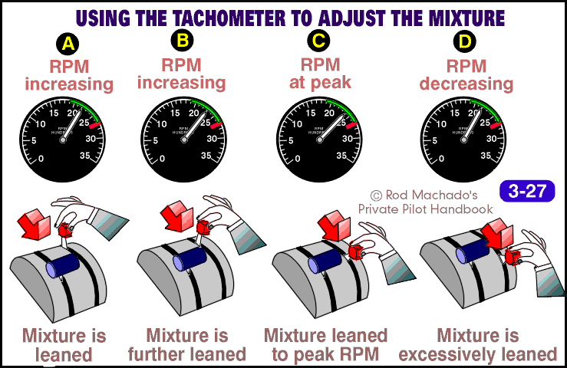

Slide 23
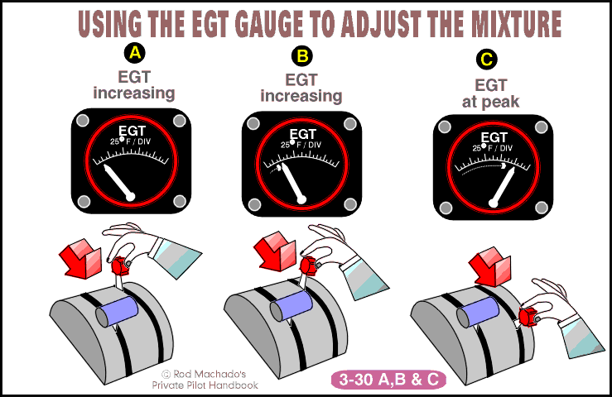

Slide 24
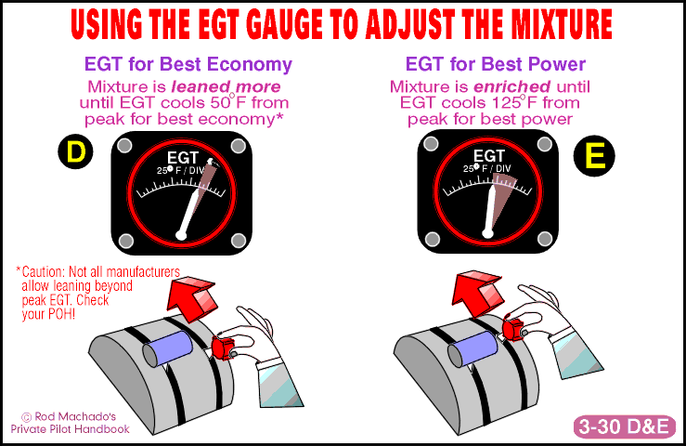

Slide 25
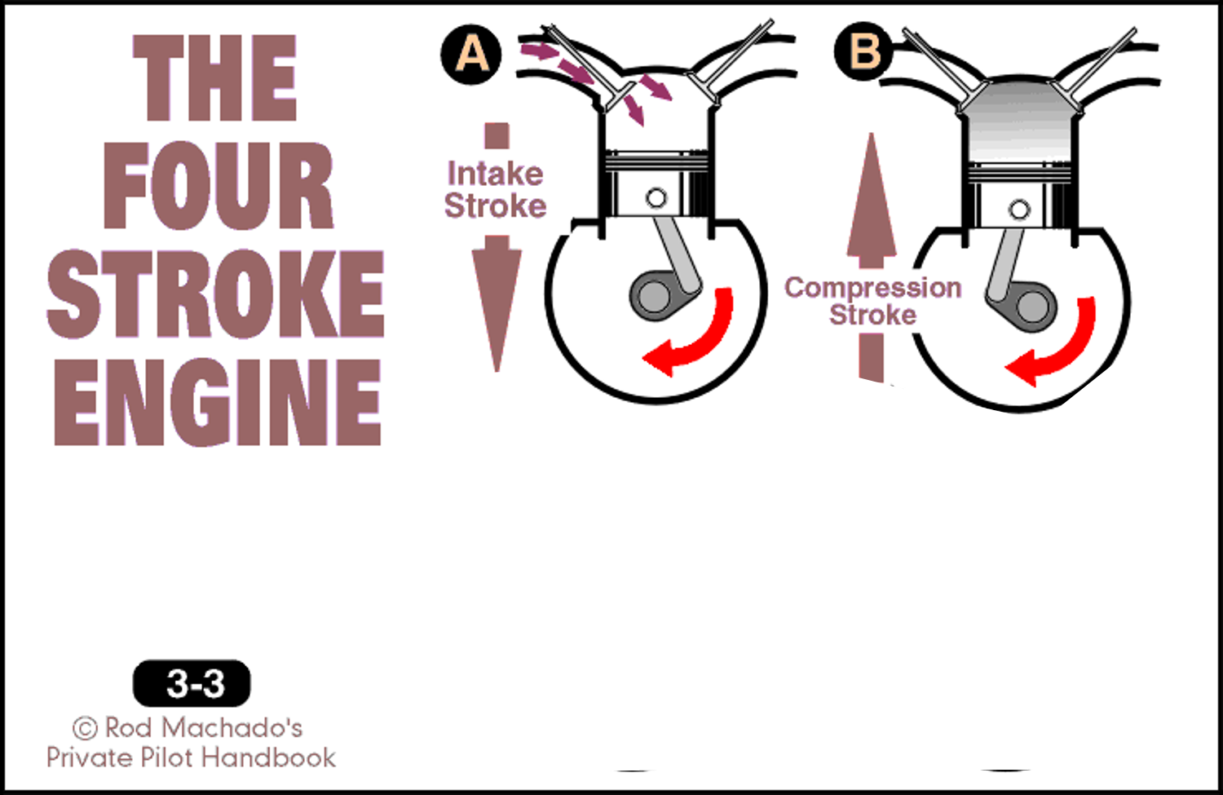
Squeeze

Slide 26
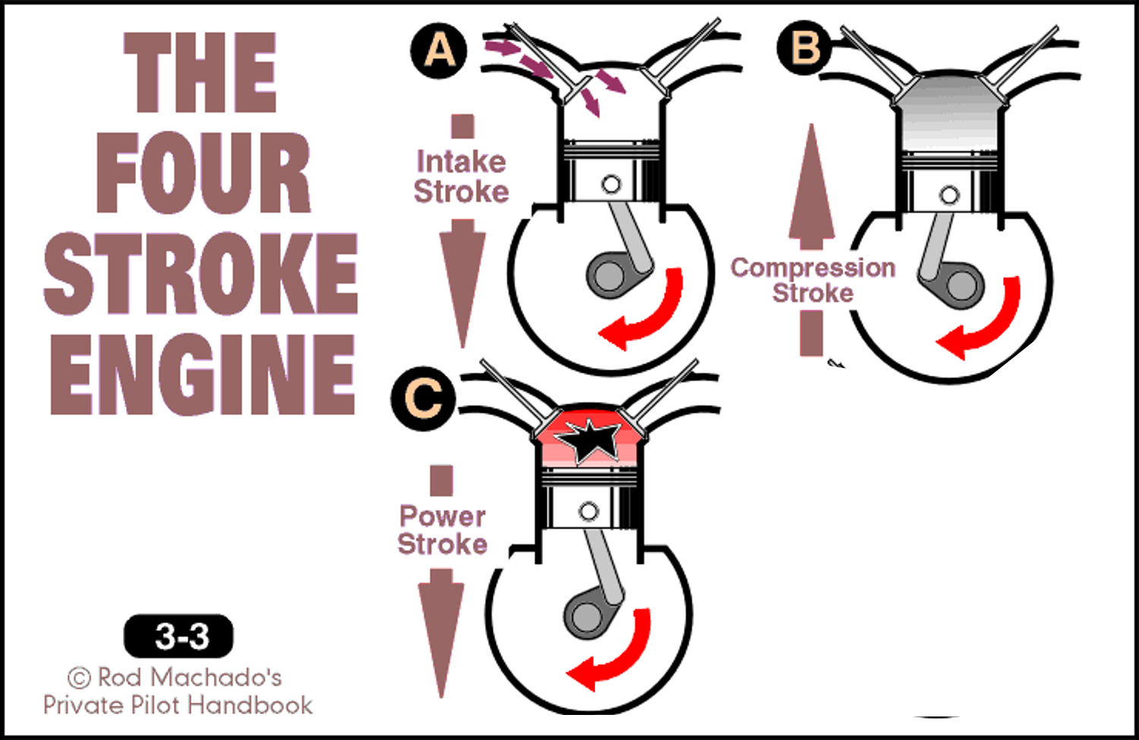
Bang

Slide 27

Ignition System

Slide 28
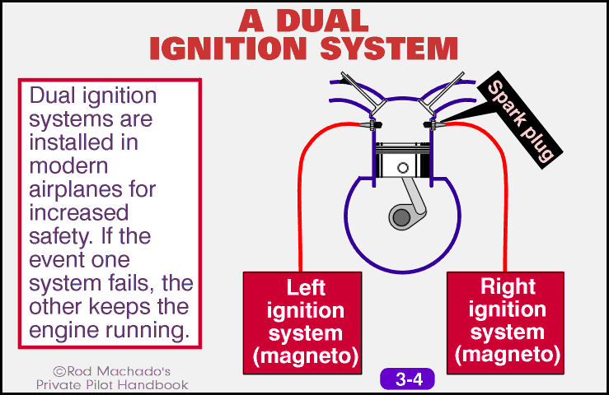

Slide 29
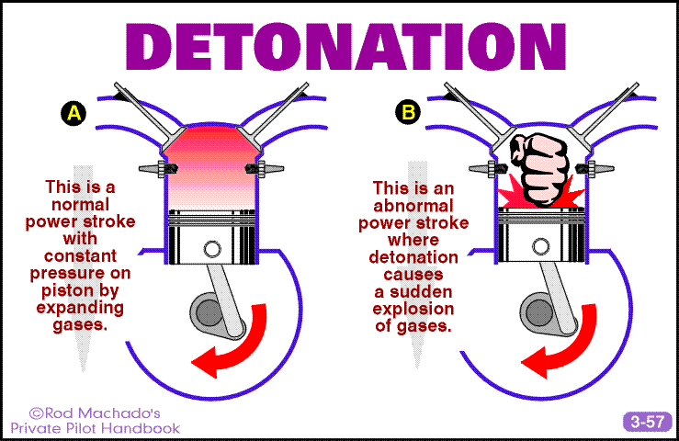

Slide 30
Blow

Slide 31

Exhaust Cycle

Slide 32

Engine Cooling

Slide 33
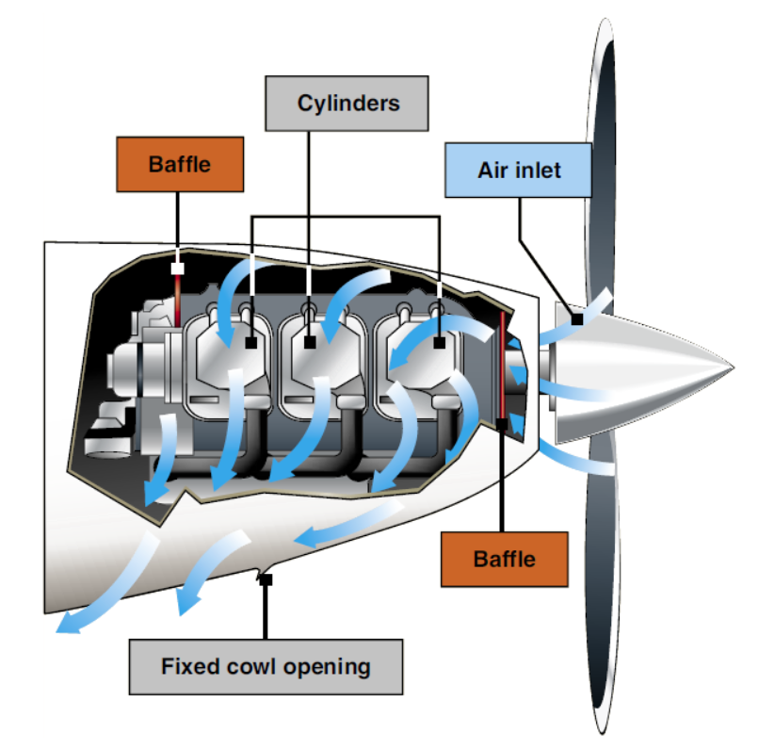

Slide 34
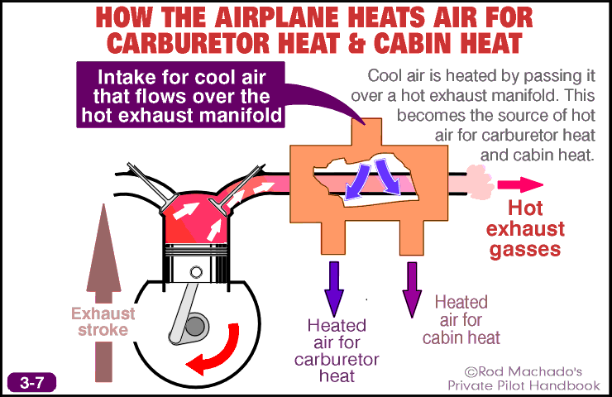

Slide 35
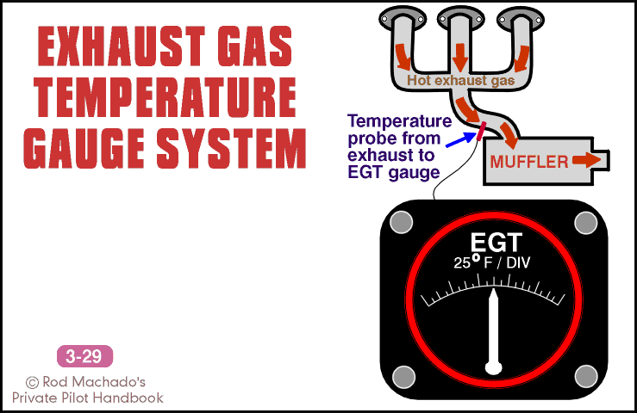

Slide 36
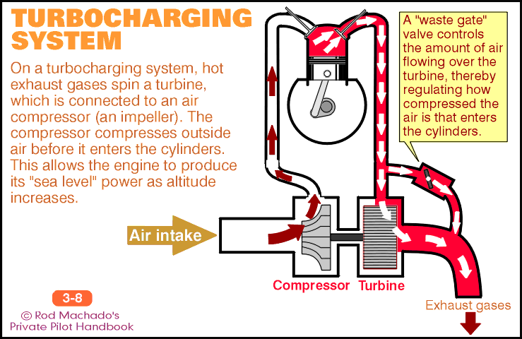

Slide 37

Engine Lubrication

Slide 38

Constant Speed Propellers

Slide 39
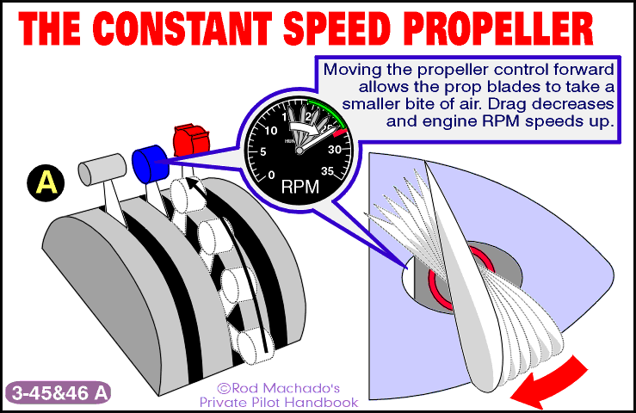

Slide 40
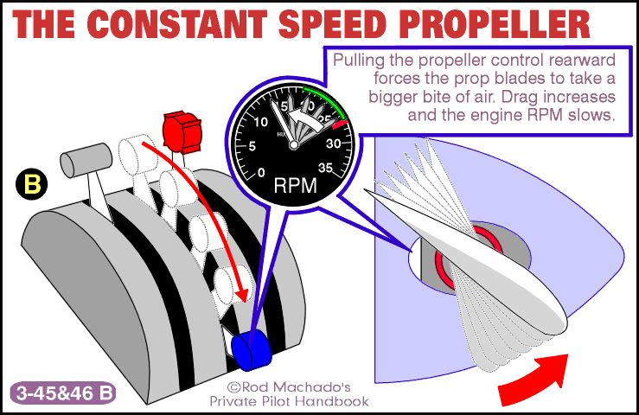

Slide 41
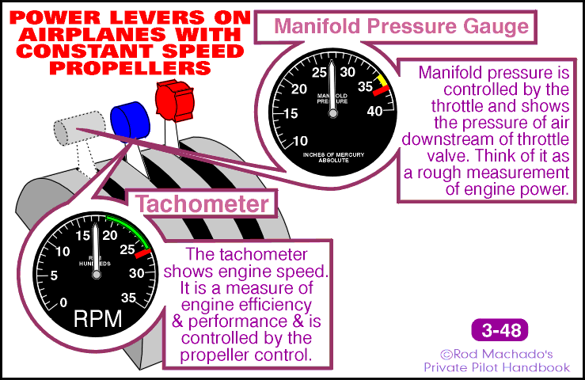

Slide 42
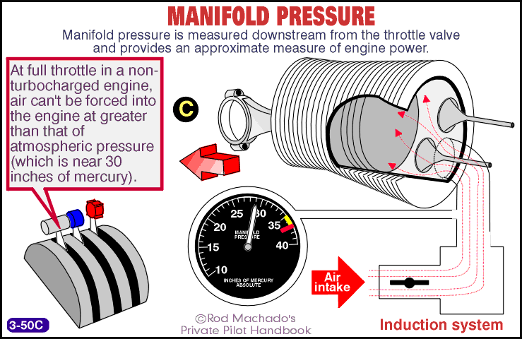

Slide 43
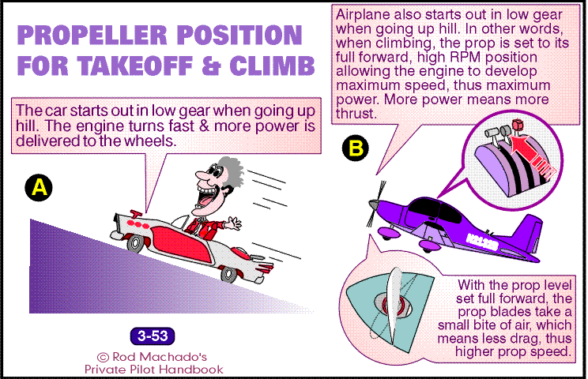

Slide 44
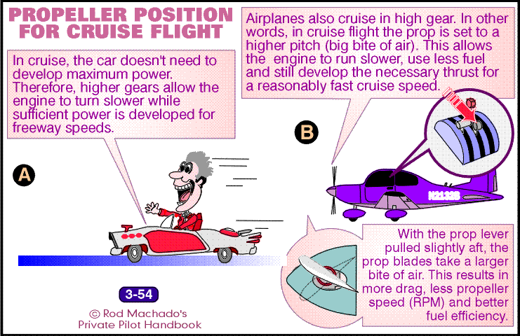

Slide 45
  Excessive manifold pressure raises cylinder compression temperatures – high engine stress
  A combination of high manifold pressure and low RPM can induce damaging detonation
To avoid, follow this sequence for changes:
When increasing power, increase RPM first, then manifold pressure
When decreasing power, decrease manifold pressure first, then RPM
PROP ON TOP

