Slide 1
Aviation Regulation in the US

Slide 2
The Federal Aviation Administration
Is a unit of the US Department of Transportation
Is responsible for overseeing the safe and efficient operation of the American aerospace system.
Controls the certification standards for both aircraft and airmen.

Slide 3
Regulatory Documents
Code of Federal Regulations (CFRs):
Colloquially referred to as “FARs” (Federal Aviation Regulations)
Title 14: Aeronautics and Space
Title 49: Transportation

Slide 4
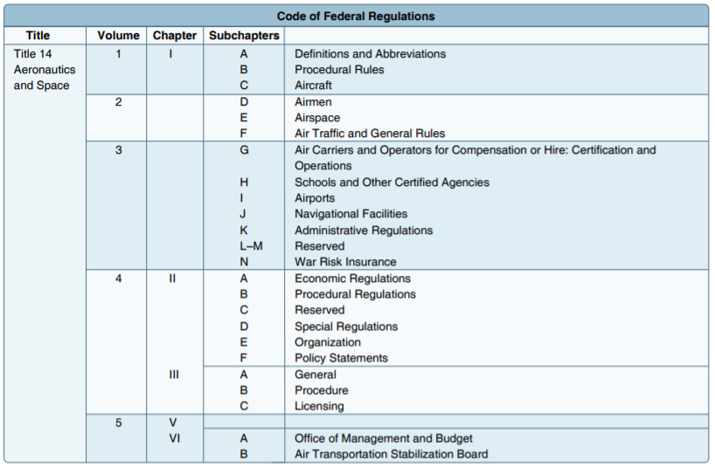
Code of Federal Regulations (CFRs):
Colloquially referred to as “FARs” (Federal Aviation Regulations)
Title 14: Aeronautics and Space
Title 49: Transportation

Slide 5
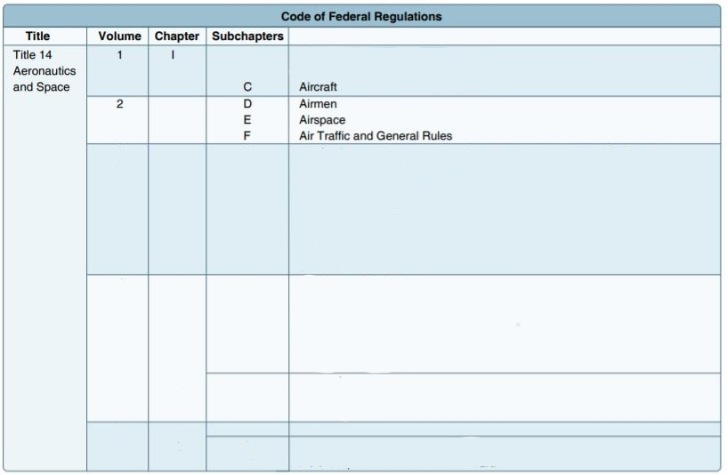
Code of Federal Regulations (CFRs):
Colloquially referred to as “FARs” (Federal Aviation Regulations)
Title 14: Aeronautics and Space
Title 49: Transportation

Slide 6
“Regulatory” Documents
Aeronautical Information Manual (AIM):
Basic flight information and ATC procedures
“Pilot-Controller Glossary”

Slide 7
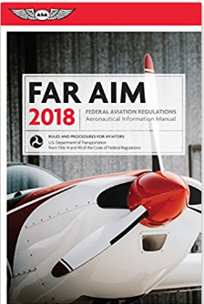
Regulatory Documents

Slide 8
Definitions
Categories and Classes of Aircraft:
The certification of airmen
The certification of aircraft

Slide 9
For Certification of Airmen
Category represents something flyable having similar operating characteristics:
  Airplane
  Glider
  Rotorcraft
  Lighter-than-air
  Powered-lift
  Powered-parachute
  Weight-shift-control

Slide 10
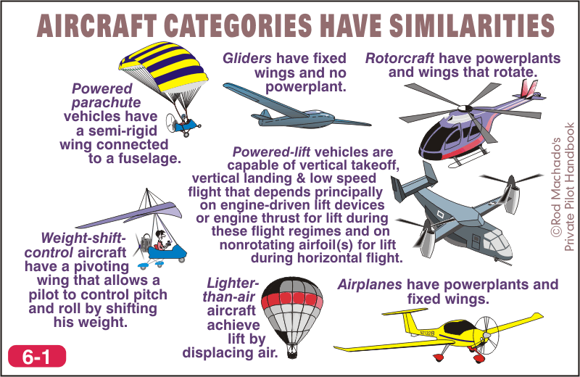

Slide 11
For Certification of Airmen
The term class represents a subdivision within a category.
Airplanes, for example, are divided into four classes:
  single-engine land (SEL)
  single-engine sea (SES)
  multi-engine land (MEL)
  multi-engine sea (MES)

Slide 12
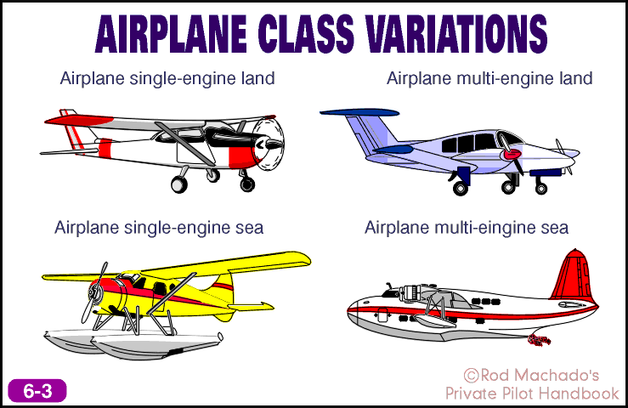
Certification of Airmen

Slide 13
Certification of Airmen
Make and Model
This can be an A36 Beechcraft Bonanza, a Cessna 152, or a Piper Malibu.
  According to the FAA, once you have your pilot’s certificate, you can legally fly any specific make and model of aircraft within the category and class for which you are rated
  Certain makes/models require additional “type” ratings

Slide 14
Certification of Aircraft
The term category, as used with respect to aircraft certification, means a grouping of aircraft based on intended use or operating limitations.
These categories are further divided according to whether their airworthiness certificates are “Standard” or “Special.”

Slide 15
Certification of Aircraft
Standard | Special
Acrobatic | Experimental
Commuter | Light Sport
Normal | Limited
Transport | Primary
Utility | Provisional
 | Restricted

Slide 16
Certification of Aircraft
The term class, as used with respect to aircraft certification, means a broad grouping of aircraft having similar propulsion, flight or landing characteristics (e.g., airplane, rotorcraft, glider, balloon, landplane, seaplane).
The salient characteristics of an aircraft certification class are what structural characteristics it possesses.

Slide 17
More Definitions: Night
Night time is officially defined as the time between the end of evening civil twilight and the beginning of morning civil twilight.
Some regulations deal with the hours of darkness by referencing the time from sunset to sunrise.
There is yet a different definition for the currency requirements for carrying passengers at night.

Slide 18
Twilight (from the Air Almanac)
Civil twilight is defined to begin in the morning, and to end in the evening, when the center of the Sun is geometrically 6 degrees below the horizon.
This is the limit at which twilight illumination is sufficient, under good weather conditions, for terrestrial objects to be clearly distinguished.
At the beginning of morning civil twilight, or end of evening civil twilight, the horizon is clearly defined and the brightest stars are visible under good atmospheric conditions in the absence of moonlight or other illumination.
In the morning before the beginning of civil twilight and in the evening after the end of civil twilight, artificial illumination is normally required to carry on ordinary outdoor activities.

Slide 19
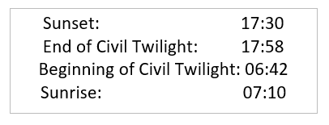
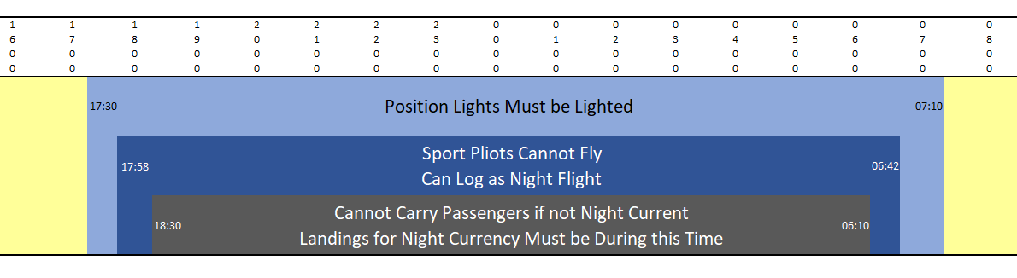

Slide 20
More Definitions: PIC
Pilot in Command: The person who
has final authority and responsibility for the operation and safety of the flight;
has been designated as PIC before or during the flight; and
holds the appropriate category, class and type rating, if appropriate, for the conduct of the flight.

Slide 21
14 CFR Part 61
Airmen

Slide 22
Now On to the Actual FARs: Part 61
Two basic categories of regulations regarding airmen:
Paperwork requirements
Skill certifications and recency of experience

Slide 23
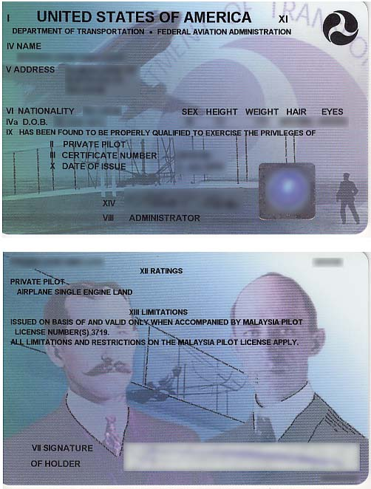
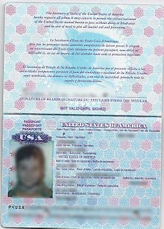
Airmen Regulations: Identification
To act as pilot in command you must have your pilot certificate and photo identification (a driver’s license or passport, for example). [14 CFR 61.3]

Slide 24
Airmen Regulations: Identification
Change of Address: In order to exercise your privilege to fly as PIC, you must notify the FAA when you change your address within thirty days of the move. [14 CFR 61.60]

Slide 25
Airmen Regulations:
Medical Certificates
If you are exercising your pilot privileges on the basis of an FAA medical exam you must have your medical certificate in your physical possession or readily accessible in the aircraft. [14 CFR 61.23]
If you are exercising the privileges of a private pilot under BasicMed you must have a copy of your medical paperwork stored with your logbook (which you are not required to carry in flight). [14 CFR 61.68]

Slide 26
Airmen Regulations:
Medical Certificates
If you are exercising the privileges of a sport pilot you must have a copy of your medical paperwork stored with your logbook. [14 CFR 68.3.b]
Sport pilots are supposed to carry logbooks if they contain specialized endorsements
You must also have your US drivers license

Slide 27
Airmen Regulations:
Medical Standards
The greater the passenger carrying responsibility you have, the more stringent the medical exam and the shorter the duration of the medical certificate. [14 CFR 61.23]
ATP | Commercial | Private |  | Sport
1st Class | 2nd Class | Third Class | BasicMed | No Medical
6 months (40+) 1 year (<40) | 1 year | 2 years (40+) 5 years (<40) | 4 years (exam) 2 years (course)

Slide 28
Airmen Regulations:
Medical Standards
The terms of all medical certificates are calculated in calendar months. In other words, the clock starts ticking on the first day of the month after the month in which you get your exam.
If you obtain your medical in January, the monthly count starts the following month (or February)

Slide 29
Airmen Regulations: Medical Standards
Assume an FAA medical administered today (1/26/2026)
 | Privileges | Age < 40 | Age >= 40
First Class | Airline Transport Pilot | 12 months 1/31/2027 | 6 months 7/31/2026
Second Class | Commercial | 12 months 1/31/2027 | 12 months 1/31/2027
Third Class | Private | 60 months 1/31/2031 | 24 months 1/31/2028
Basic Med | Private | Physical exam 48 months (1/31/2030) Online course 24 months (1/31/2028)

Slide 30
Additional Training Requirements
(Private Pilot)
Additional training and endorsements are necessary to fly four different varieties of airplanes:
high performance airplanes,
complex airplanes,
pressurized airplanes capable of operating at high altitudes and
tailwheel airplanes.
[14 CFR 61.31]

Slide 31
Additional Training Requirements
High Performance Airplane
To act as pilot in command of a high performance airplane (an airplane having more than 200 horsepower) you must have received and logged ground and flight training in such an airplane from an authorized instructor.
Your instructor must also make a one-time endorsement in your logbook certifying that you are proficient to operate a high performance airplane.

Slide 32
Additional Training Requirements
Complex Airplane
A complex airplane is an airplane having retractable landing gear, flaps, and a controllable propeller (regardless of the horsepower).
To act as pilot in command of a complex airplane also requires ground and flight training from an authorized instructor and a one-time endorsement in your logbook

Slide 33
Additional Training Requirements
Pressurized Airplanes Capable of
Operating at High Altitudes
The rule states that you may not act as PIC of a pressurized airplane capable of operating above 25,000 feet MSL unless you’ve received and logged ground training from an authorized instructor as well as flight training in a pressurized aircraft.
Both the ground and flight training require separate logbook endorsements

Slide 34
Additional Training Requirements
Tailwheel Airplanes
To act as PIC of a tailwheel airplane, you must have received and logged flight training from an authorized instructor in a tailwheel airplane (authorized means the instructor is qualified in the plane in which he or she is providing instruction). The instructor must find you proficient in the operation of a tailwheel airplane including at least normal and crosswind takeoffs and landings, wheel landings (unless prohibited by the manufacturer) and go-around procedures.
The instructor must place a one-time endorsement in your logbook.

Slide 35
Additional Training Requirements
(Sport Pilot)
Additional training and endorsements are available to extend the privileges of sport pilots:
Retractable gear
Constant speed propellers
Night VFR

Slide 36
Recurring Training
61.56 Flight Review
To act as PIC, you must have had a flight review within the preceding 24 calendar months.
Just as with the medical, the clock starts on the month following the month in which the review takes place. If you take a flight review on January 27, 2025, this review is valid until February 1, 2027

Slide 37
Recent Flight Experience
Pilot In Command
The FAA states that, to act as PIC while carrying passengers, you must have made, within the preceding 90 days, at least three takeoffs and three landings as the sole manipulator of the controls in the same category and class of aircraft you intend to fly. [14 CFR 61.57]
If you are carrying passengers in a tailwheel airplane, the landings must be full stop. Otherwise, touch-and-goes are permitted.

Slide 38
Recent Flight Experience
Recent Flight Experience: PIC at Night
There is a separate recency rule if you want to carry passengers on night flights. Night time, for the purpose of passenger currency, begins one hour after sunset and ends one hour before sunrise.

Slide 39
Recent Flight Experience
Recent Flight Experience: PIC at Night
If you desire to carry passengers during this time, you must have made three night takeoffs and three night landings within the preceding 90 days.
Once again, this must be done in the same category and class of aircraft in which you intend to carry passengers.
Landings for the purpose of night currency must be to a full stop.

Slide 40
No “Flying for Hire”
A private pilot may not pay less than the pro rata share of the operating expenses of a flight with the passengers, providing the expenses involve only fuel, oil, airport expenditures or rental fees.
The only exception to this rule is if a pilot provides a ride in exchange for a donation to a charitable organization, with advance notification to the FAA. [FAR 61.113]

Slide 41
Drugs and Alcohol
The Bottle to Throttle Rule
Regulations require you to avoid acting as pilot in command or as a required crewmember for 8 hours after consuming alcohol.
Another part of this rule states that you may not act as PIC if you have blood alcohol content of .04% or more (by weight). (This is half the legal limit for operating a motor vehicle.)

Slide 42
Drugs and Alcohol
Notification of “Motor Vehicle Action”
The FAA must be notified within 60 days if action is taken against your driver’s license for an offence involving alcohol or drugs.
Two or more actions within three years are grounds for suspension or revocation of certificates or ratings.
An action within the past year is grounds for denial of an application for a new certificate or rating.

Slide 43
14 CFR Part 91
General Operation and Flight Rules

Slide 44
Now More Actual FARs: Part 91
General operating rules
Flight rules
Equipment, instrument, and certificate requirements
Special flight operations
Maintenance and alterations

Slide 45
General Operating Rules
FAR 91.3 Responsibility and Authority of the Pilot In Command
The regulation states that you, the pilot in command, are directly responsible for, and are the final authority as to the operation of the aircraft. It doesn't get much simpler than that.

Slide 46
General Operating Rules
FAR 91.7 Civil Aircraft Airworthiness
This regulation states you may not operate an aircraft unless it's in an airworthy condition.
It also makes you, as PIC, responsible for terminating a flight any time you believe the airplane is not airworthy due to the failure of a mechanical, electrical, or structural component.

Slide 47
General Operating Rules
FAR 91.9 Civil Aircraft Flight Manual, Markings and Placard Requirements.
Airplane operating limitations come in the form of color codes, placards, and approved flight manuals.
You, as pilot in command, are required by this regulation to comply with all the operating limitations specified in any of these ways.

Slide 48
General Operating Rules
FAR 91.15 Dropping Objects
According to the regulations, the pilot in command may not drop any object in flight if it creates a hazard to persons or property.

Slide 49
General Flight Rules
91.103 Preflight Action
Before you begin any flight you are required to become familiar with all the available information concerning that flight.
For a flight not in the vicinity of the departure airport, you must check the weather reports and forecasts, fuel requirements, alternatives available if the flight cannot be completed, and any known traffic delays advised by ATC.
You are also required to check the runway lengths at the airport you'll use.

Slide 50
General Flight Rules
FAR 91.105 Flight Crewmembers at Stations
During takeoff, landing, and while en route, you, the pilot in command, shall be in your seat (sometimes called a station).
You are required to keep your safety belt fastened while seated, and if your airplane is equipped with a shoulder harness and wearing it doesn't interfere with your duties, it must be kept fastened during takeoff and landing.

Slide 51
General Flight Rules
FAR 91.107 Use of Safety Belts
What about passengers and seatbelts? Prior to takeoff, the PIC is required to brief each passenger on how to fasten and unfasten their seatbelt & shoulder harness.

Slide 52
General Flight Rules
FAR 91.111 Operating Near Other Aircraft
No person may operate an aircraft so close to another aircraft as to create a collision hazard.
No person may operate an aircraft in formation flight except by prior arrangement with the pilot in command of each aircraft in the formation.

Slide 53
General Flight Rules
FAR 91.123 Compliance with ATC Clearances and Instructions
This regulation also states that, except in an emergency, no person may operate an aircraft contrary to an ATC instruction in an area in which air traffic control is exercised. All this statement does is clarify that an emergency situation allows deviation from an ATC clearance.

Slide 54
General Flight Rules
FAR 91.123 Compliance with ATC Clearances and Instructions
Each pilot in command who, in an emergency, deviates from an ATC clearance or instruction is obligated to notify ATC of that deviation as soon as possible.

Slide 55
Equipment, Instrument, Certifications
FAR 91.203 Civil Aircraft: Certifications Required
There are four items that must be on board the aircraft at all times when it’s being operated:
Airworthiness certificate
Registration certificate
Operating limitations
Weight and balance information

Slide 56
Equipment, Instrument, Certifications
FAR 91.207 Emergency Locator Transmitters
The batteries must be replaced or recharged if the device has been in use for more than one cumulative hour, or when 50% of their useful life has expired.
You may manually test the airplane’s ELT on the ground during the first five minutes past the hour.
Each ELT must be inspected within 12 calendar months after the last inspection for proper operation and battery expiration dates.

Slide 57
Equipment, Instrument, Certifications
FAR 91.209 Aircraft Lights
Official night time for airplanes is from sunset to sunrise. No person may operate an aircraft during this period unless it has lighted position lights.
Airplanes with an anti-collision light system must have these lights on at all times when the airplane is in operation. This typically consists of white strobe lights or a red rotating beacon.
Pilots are allowed to turn off the anti-collision lighting system if the pilot in command determines, because of the operating conditions, it is unsafe.

Slide 58
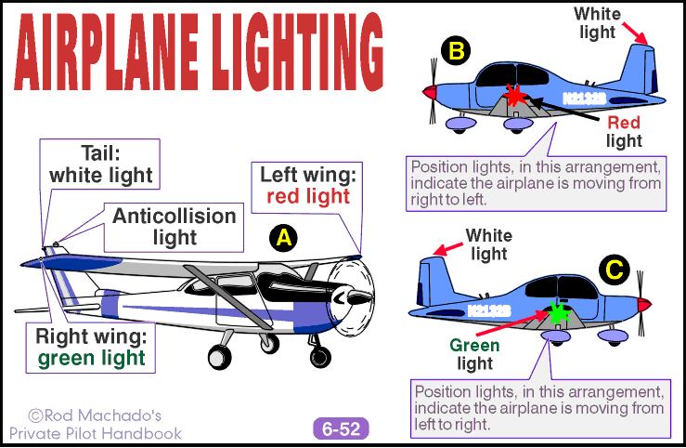
Federal Aviation Regulations

Slide 59
Federal Aviation Regulations
FAR 91.211 Use of Supplemental Oxygen
The regulations require the PIC (and any required flight crewmembers) to use supplemental oxygen when flying for more than 30 minutes above 12,500 feet up to and including 14,000 feet. If you go above 14,000 feet, you must use oxygen from the moment you exceed that altitude.

Slide 60
Equipment, Instrument, Certifications
FAR 91.211 Use of Supplemental Oxygen
The pilot in command is required to provide each occupant of the aircraft with supplemental oxygen when operating at altitudes above 15,000 foot MSL.

Slide 61
Special Flight Rules
FAR 91.313 Restricted Category Civil Aircraft: Operating Limitations
A restricted category aircraft (such as a cropduster) can only be used for the special purpose for which it was certificated. It cannot be used for flight involving compensation or hire when a passenger is being carried.
Restricted category aircraft cannot be operated over a densely populated area, on a congested airway or near a busy airport where the airlines fly.

Slide 62
Special Flight Rules
FAR 91.319 Aircraft Having Experimental Certificates: Operating Limitations
Until it’s proven to the FAA that a homebuilt aircraft is safe to fly, no person can operate that aircraft outside a designated area.
Passengers may be carried but passengers and property can’t be carried for compensation or hire. The pilot is required to advise each person carried of the nature of the aircraft.

Slide 63
Maintenance and Alterations
FAR 91.403 Aircraft Maintenance: General
Regulations place primary responsibility for maintaining an aircraft in an airworthy condition on the owner or operator.
The owner is the person who has legal title to the aircraft. But this isn't always the person in charge of its maintenance. When an airplane is leased back to a flight school, the legal responsibility for maintaining airworthiness passes to the operator of the school.

Slide 64
49 CFR Part 830
NTSB Reporting Requirements

Slide 65
The Last FARs: 49 CFR 830
Title 49: Transportation
  Chapter VIII: National Transportation Safety Board
    Part 830: Notification and Reporting of Aircraft Accidents or Incidents and Overdue Aircraft, and Preservation of Aircraft Wreckage, Mail, Cargo, and Records

Slide 66
Definitions
Aircraft Accident
An occurrence associated with the operation of an aircraft which takes place between the time any person boards the aircraft with the intention of flight and all such persons have disembarked, and in which any person suffers death or serious injury, or in which the aircraft receives substantial damage.

Slide 67
Definitions
Serious Injury
Requires hospitalization for more than 48 hours, commencing within 7 days from the date the injury was received.
Results in the fracture of a bone (except simple fractures of the fingers, toes or nose).
Causes severe hemorrhages, nerve, muscle, or tendon damage.
Involves any internal organ.
Involves second- or third-degree burns, or any burns affecting more than 5 percent of the body surface.

Slide 68
Definitions
Substantial Damage
Damage or failure which adversely affects the structural strength, performance, or flight characteristics of the aircraft and which would normally require major repair or replacement of the affected component. The following are NOT considered to be substantial damage for the purposes of this part:
Engine failure or damage limited to an engine if only one engine fails or is damaged.
Bent fairings or cowling, dented skin, small puncture holes in the skin or fabric.
Ground damage to rotor or propeller blades and damage to landing gear, wheels, tires, flaps, engine accessories, brakes, or wingtips.

Slide 69
Definitions
Serious Incident (Partial List)
(1) Flight control system malfunction or failure;
(2) Inability of any required flight crewmember to perform normal flight duties as a result of injury or illness;
(3) Failure of any internal turbine engine component that results in the escape of debris other than out the exhaust path;
(4) In-flight fire;

Slide 70
Definitions
Serious Incident (Partial List)
(5) Aircraft collision in flight;
(6) Damage to property, other than the aircraft, estimated to exceed $25,000
(7) Release of all or a portion of a propeller blade from an aircraft, excluding release caused solely by ground contact;
(8) A complete loss of information, excluding flickering, from more than 50 percent of an aircraft's cockpit displays;

Slide 71
Definitions
Serious Incident (Partial List)
(9) Damage to helicopter tail or main rotor blades, including ground damage, that requires major repair or replacement of the blade(s);
OR
An aircraft is overdue and is believed to have been involved in an accident

Slide 72
Immediate Notification
“The operator of any civil aircraft, or any public aircraft not operated by the Armed Forces or an intelligence agency of the United States, or any foreign aircraft shall immediately, and by the most expeditious means available, notify the nearest National Transportation Safety Board (NTSB) office in case of….”

Slide 73
Notification and Reporting
 | Notification | Report
Accident | immediate | 10 days
Serious Incident | immediate | When requested
Overdue Aircraft | immediate | 7 days

Slide 74
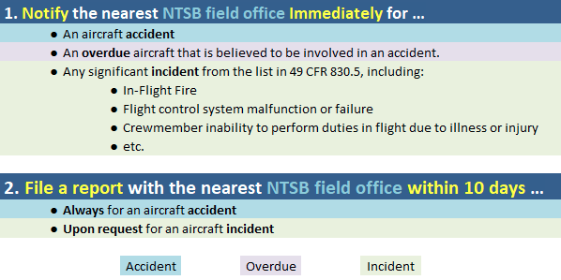
Notification and Reporting

Slide 75
Preservation of Wreckage
If you are the operator of an aircraft involved in an accident or incident it’s your job to protect the wreckage and everything associated with that wreckage until the NTSB arrives and assumes responsibility.
Move or disturb only if it’s necessary to help persons injured or trapped, to protect the wreckage from further damage, or protect the public from injury.

Slide 76
Preservation of Wreckage
If you need to move the wreckage or anything associated with it, make notes, take photographs, or draw sketches to detail its original condition.

