Slide 1
Flight Planning Tools

Slide 2
Determine true course with sectional and plotter
Determine true heading with wind-side E6B
Convert to magnetic heading
Calculate and record ground speed and time en route on a navlog

Slide 3
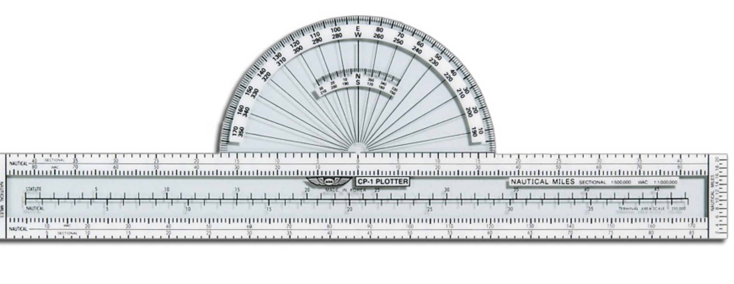
Typical fixed plotter

Slide 4
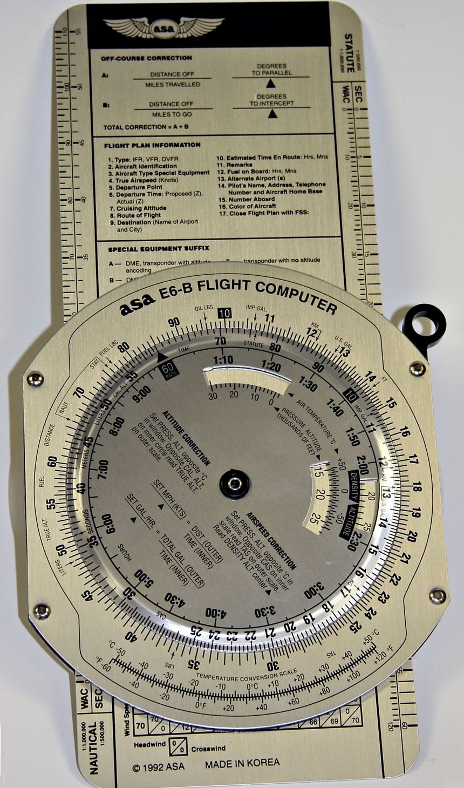
E6B Flight Computer

Slide 5
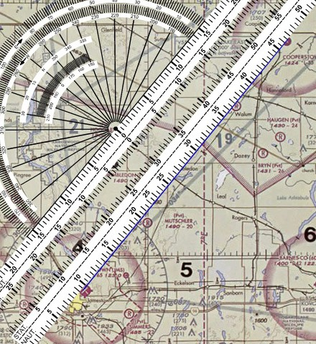
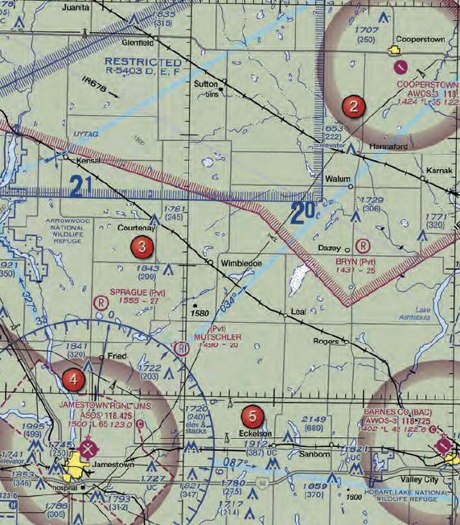
Sectional and Plotter

Slide 6
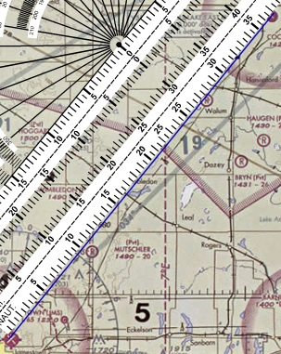
Measure distance along line

Slide 7
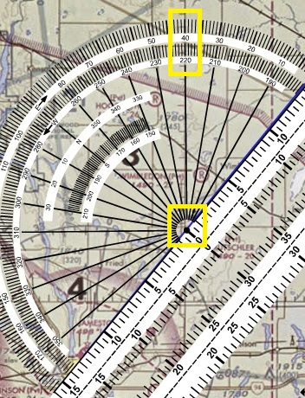
Center hole on a line of longitude that intersects your course.
Read true course from protractor.

Slide 8
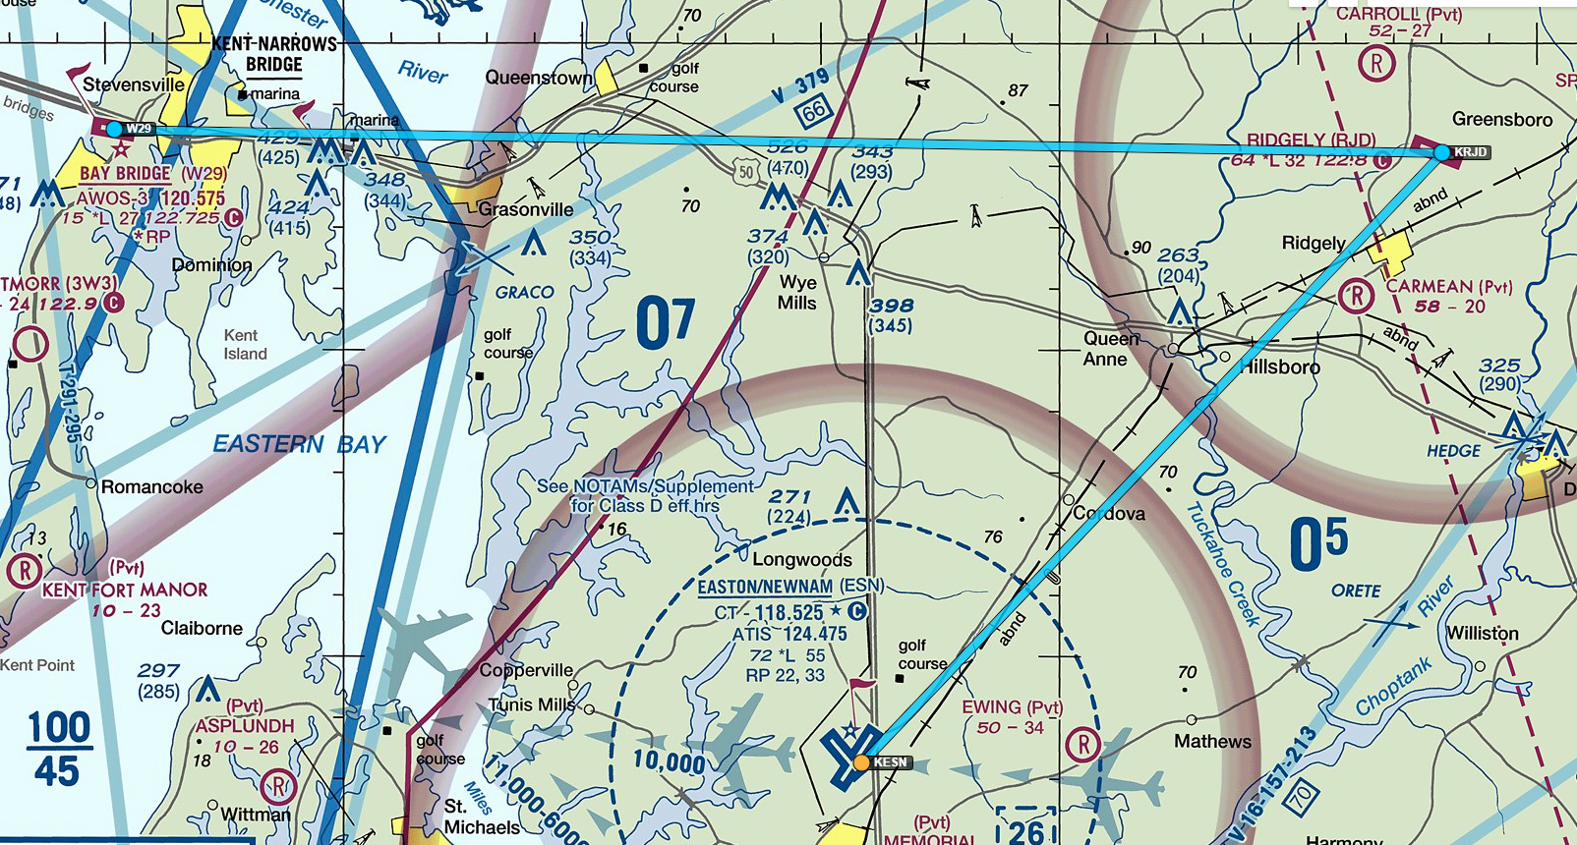
Another example:
ESN – RJD – W29

Slide 9
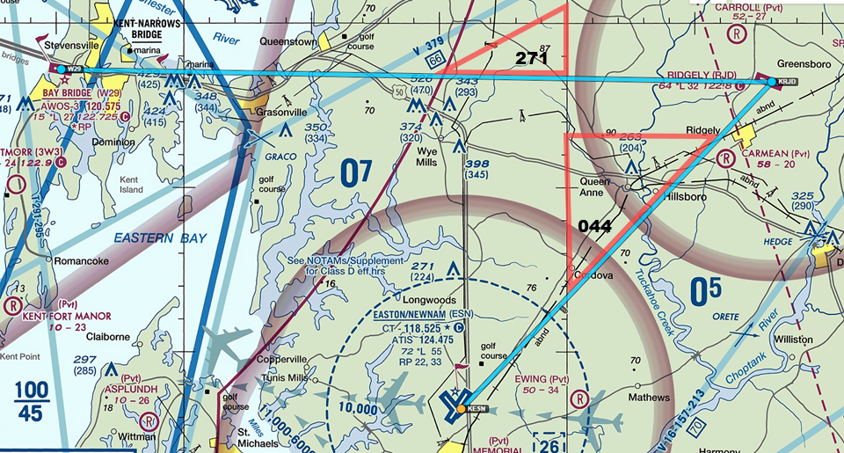
Another example:
ESN – RJD – W29

Slide 10
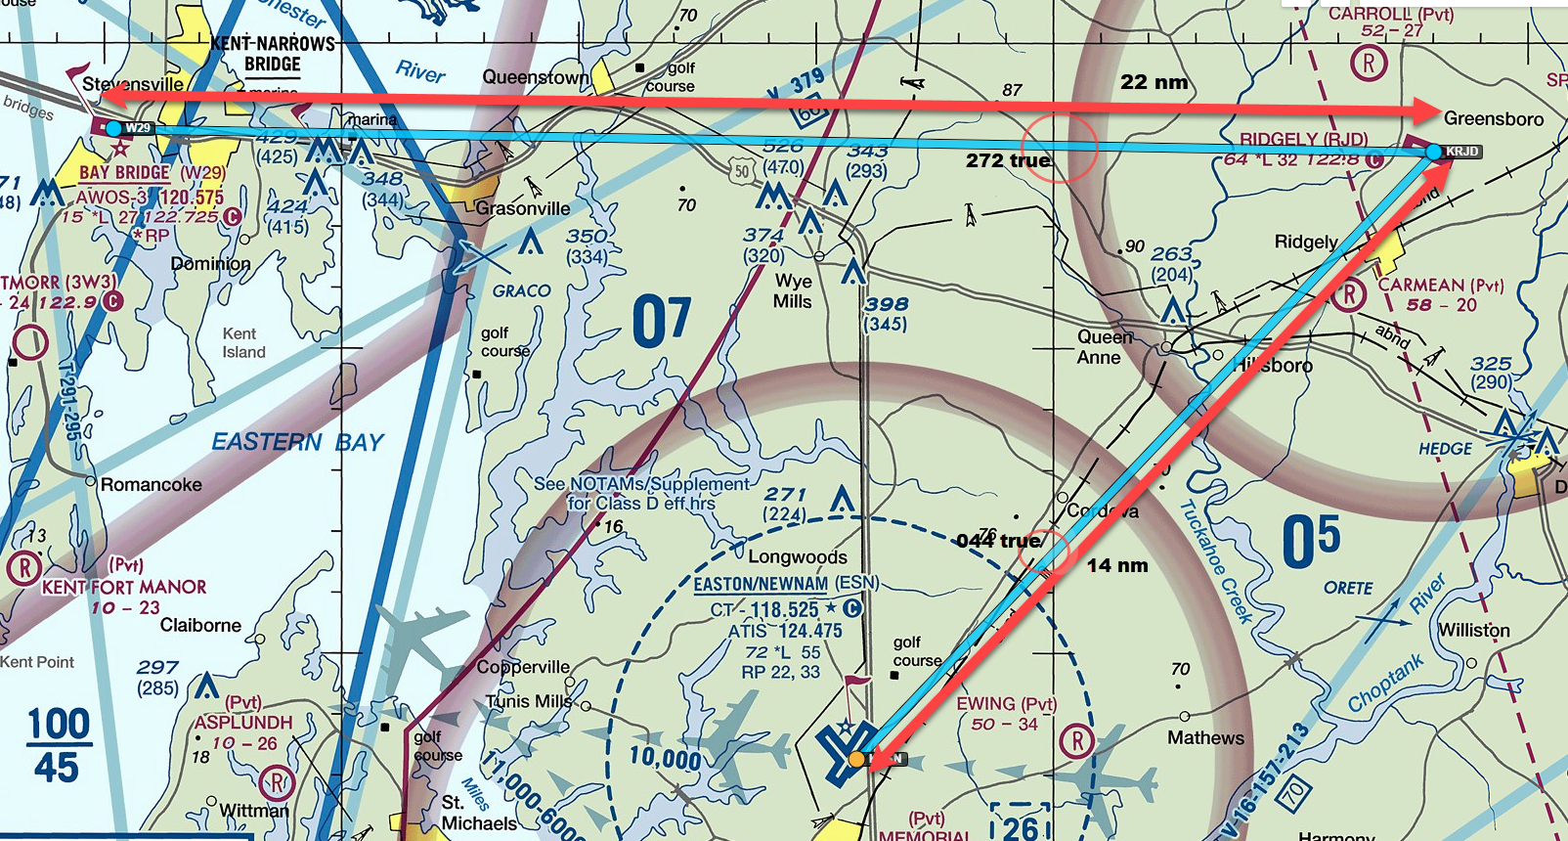
Calculating true heading

Slide 11
Calculating true heading
True heading is true course (determined from sectional and plotter) corrected for wind
It is calculated using the wind side of an E6B

Slide 12

Calculating true heading
Calculating true heading in space. Note that the slide rule portion is facing us, which means Spock is correcting for space winds.
Fascinating.
True heading is true course (determined from sectional and plotter) corrected for wind
It is calculated using the wind side of an E6B

Slide 13
Fun with Your E6B

Slide 14
True Heading and Ground Speed
Check winds aloft forecast: wind = 20 kt from 210°
Our aircraft’s cruise airspeed is 110kt
Leg | True Course | True Heading | Indicated Airspeed | Ground speed
ESN – RJD | 044
RJD – W29 | 272

Slide 15
True Heading and Ground Speed
Check winds aloft forecast: wind = 20 kt from 210°
Our aircraft’s cruise airspeed is 110kt
Leg | True Course | True Heading | Indicated Airspeed | Ground speed
ESN – RJD | 044 | 046 | 110 | 130
RJD – W29 | 272

Slide 16
True Heading and Ground Speed
Check winds aloft forecast: wind = 20 kt from 210°
Our aircraft’s cruise airspeed is 110kt
Leg | True Course | True Heading | Indicated Airspeed | Ground speed
ESN – RJD | 044 | 046 | 110 | 130
RJD – W29 | 272 | 262 | 110 | 98

Slide 17
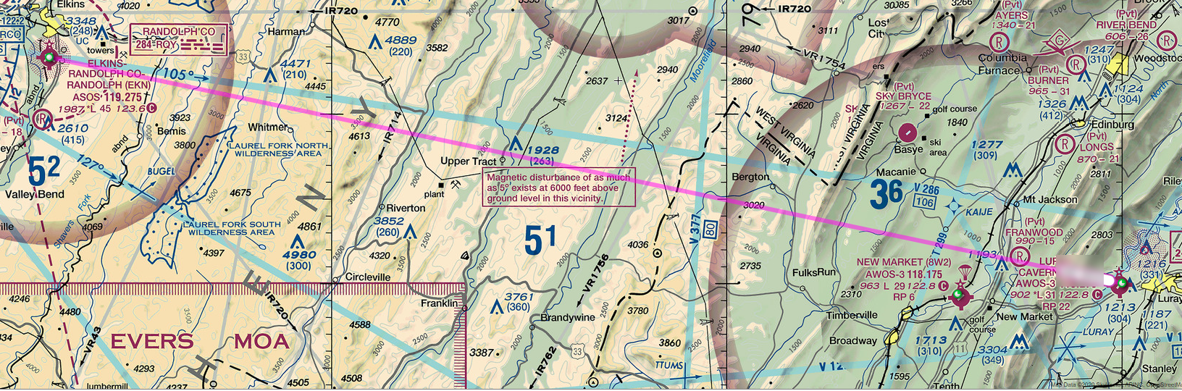
Creating a NavLog

Slide 18
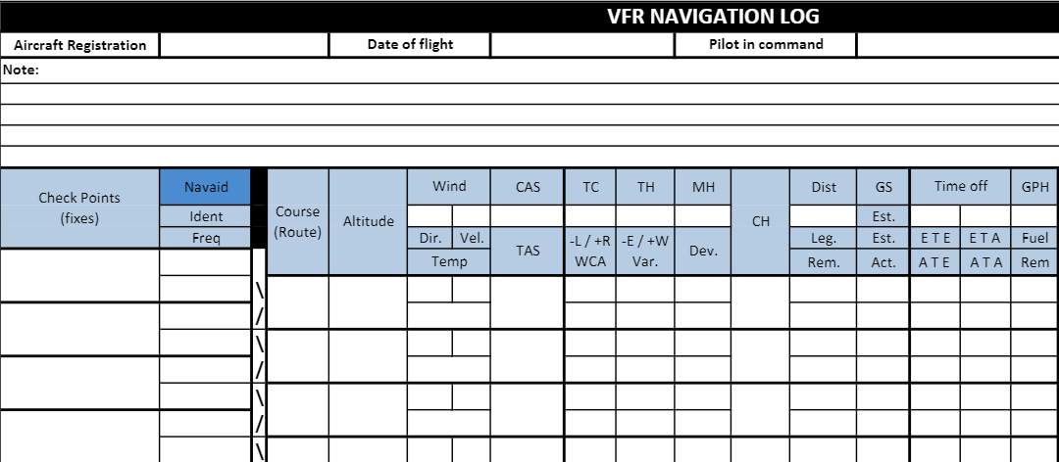
Creating a NavLog

Slide 19
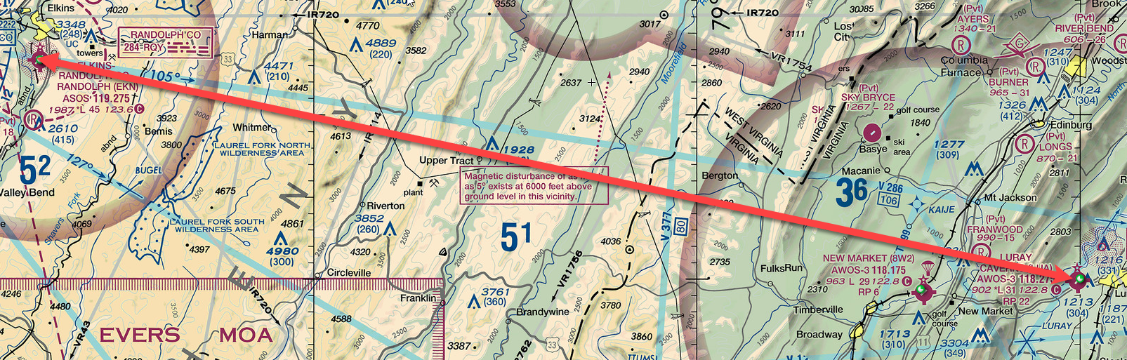
Creating a NavLog

Slide 20
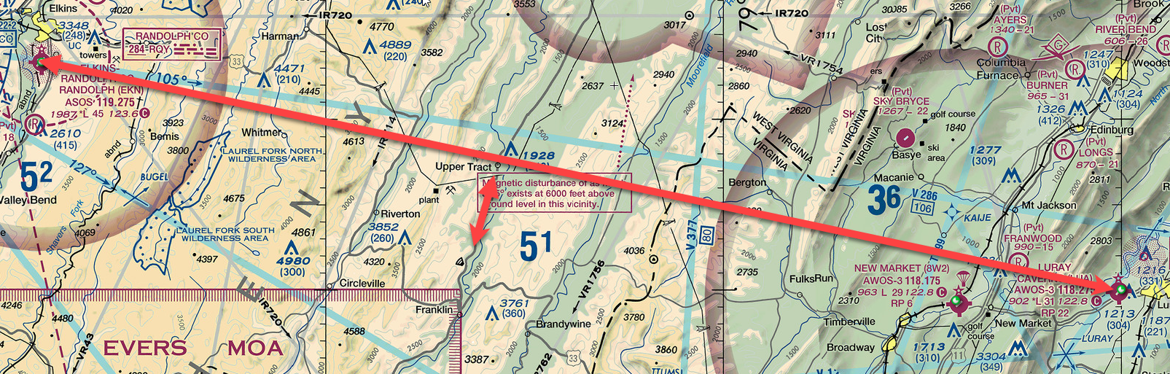
Creating a NavLog

Slide 21
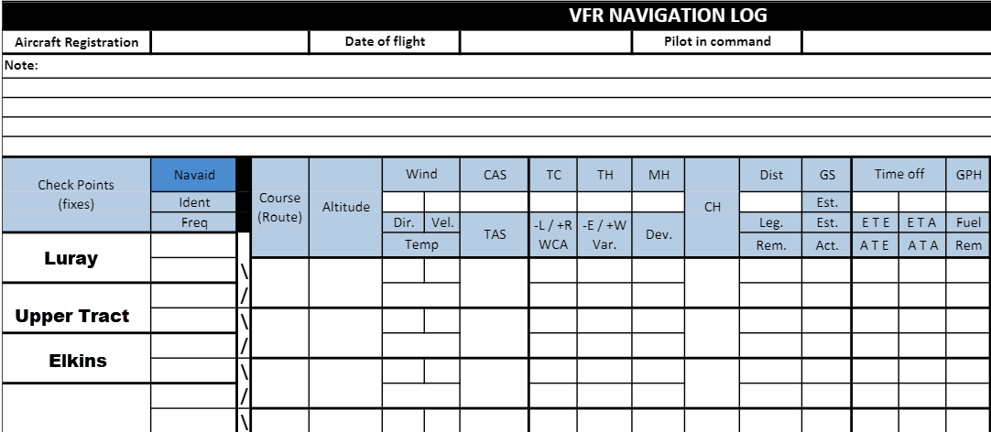
Creating a NavLog

Slide 22
What altitude to fly?
Avoid terrain/obstructions
Fly the prescribed VFR default altitude.

Slide 23
FAR 91.159
Each person operating an aircraft under VFR in level cruising flight more than 3,000 feet AGL shall maintain the appropriate altitude prescribed below, unless otherwise authorized by ATC.
On a magnetic course of 0° through 179° any odd thousand foot MSL altitude + 500 feet (3,500, 5,500, 7,500…)
On a magnetic course of 180° through 359°, any even thousand foot MSL altitude + 500 feet (4,500, 6,500, 8,500…)

Slide 24
Memory aid:
East is odd
But West is even odder
(IFR traffic is typically assigned the 1000s altitudes, i.e. eastbound IFR flies 5000, 7000, 9000 MSL and westbound flies 6000, 8000, 10000)

Slide 25
Creating a NavLog

Slide 26
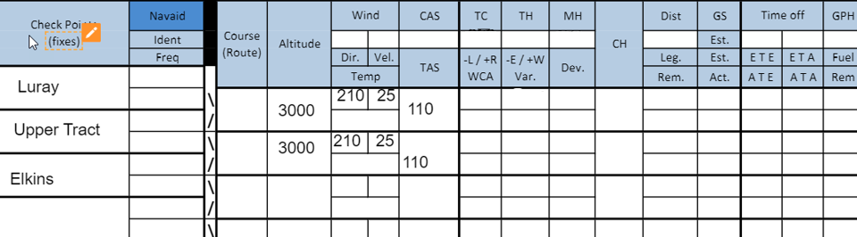
Creating a NavLog

Slide 27
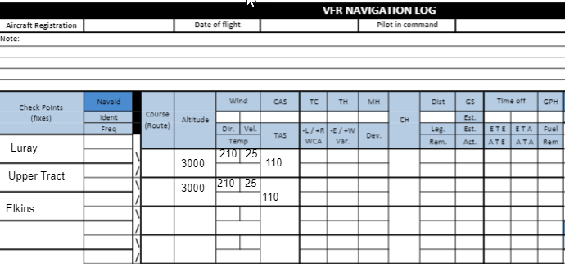
Creating a NavLog

Slide 28
Creating a NavLog

Slide 29
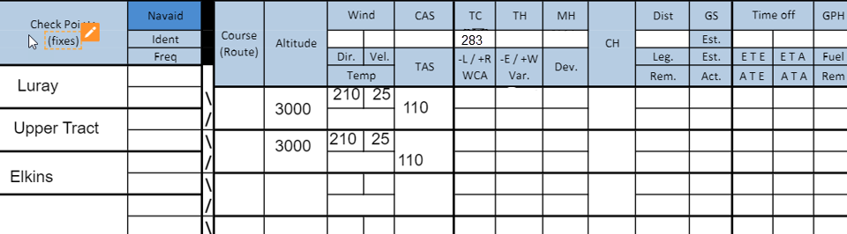
Creating a NavLog

Slide 30
Creating a NavLog

Slide 31
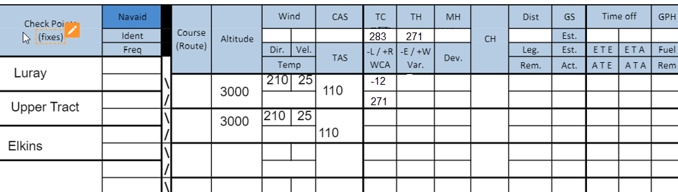
Creating a NavLog

Slide 32
Creating a NavLog

Slide 33
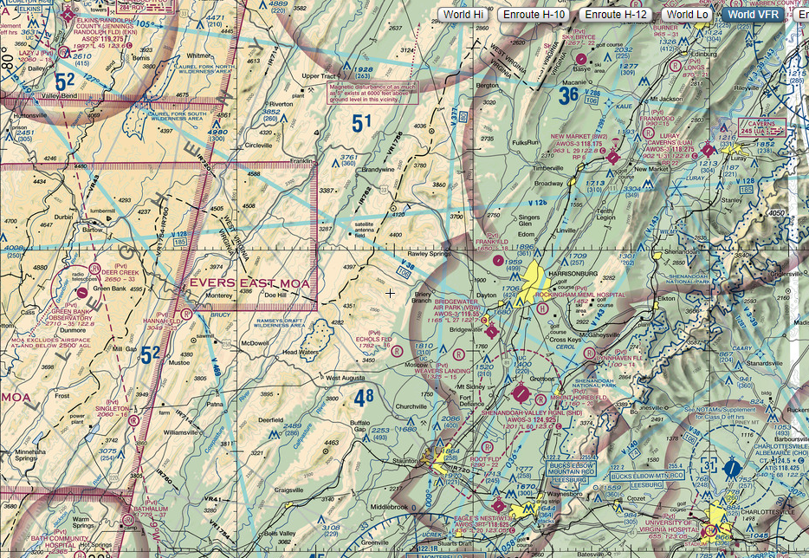
Magnetic Variation

Slide 34
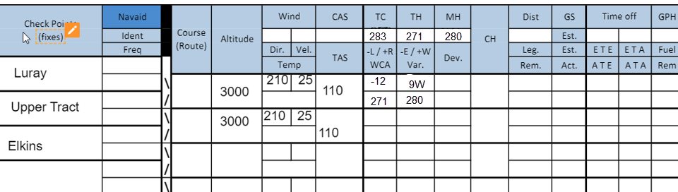
Creating a NavLog

Slide 35
Creating a NavLog

Slide 36
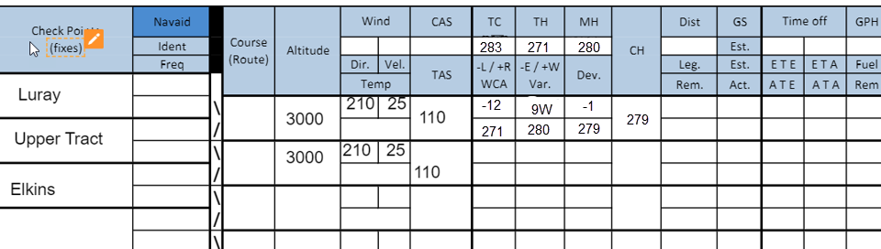
Creating a NavLog

Slide 37
Creating a NavLog

Slide 38
Creating a NavLog: Distance
65
38
27
27
0

Slide 39
Creating a NavLog: Ground Speed
65
38
100
27
27
0

Slide 40
Creating a NavLog: Time En Route
65
38
100
27
27
0

Slide 41
Creating a NavLog: Time En Route
65
38
100
23
27
27
0

Slide 42
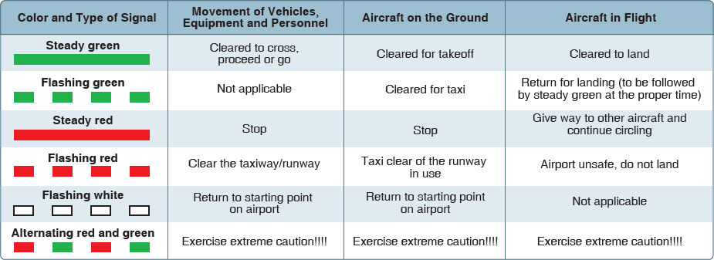
Light Gun Signals
Used at towered fields when radio communication is lost

Slide 43
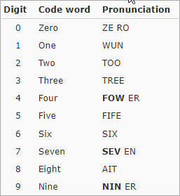
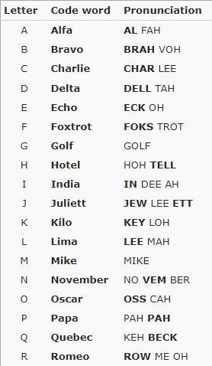
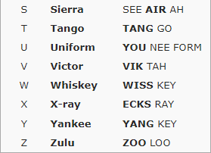
Phonetic Alphabet

