Slide 1
Ground School:
What, How, and Why

Slide 2
Four Uses for this Material
Pass your written exam(s)
Pass the oral portion of your checkride
Supplement the skills needed for the practical portion of your checkride
Keep you alive and out of trouble

Slide 3
Your Pilot Certification is:
A License to Learn
  Book learning
  Experience
  Hangar flying
  Additional ratings
A License to Have Fun
  Fly-Ins
  Cross Countries
  $100 Hamburgers
A License to Challenge Yourself

Slide 4
Instructional Resources
Rod Machado “Private/Commerical Pilot Handbook”
Test Prep Books or Software
AOPA Flight Training Magazine
Web Resources
YouTube
FAA Website

Slide 5
Rod Machado Textbook
In depth presentation of essential topics
In some cases, too much detail
Skim in conjunction with test prep resources
Return to this resource as your knowledge and experience increase

Slide 6

Rod Machado Textbook
https://rodmachado.com/products/rod-machados-private-commercial-pilot-handbook

Slide 7
Free from FAA (pdf)
Hard copies from third parties https://www.faa.gov/regulations_policies/handbooks_manuals/aviation
Pilot’s Handbook of Aeronautical Knowledge
Aeronautical Chart User’s Guide
Aeronautical Information Manual (AIM)
Airplane Flying Handbook
Aviation Weather Handbook
Risk Management Handbook
Weight & Balance Handbook

Slide 8
Test Preparation Aids
Summarized presentation of key topics
Best way to prepare for written test
Use as both a study resource and for practice tests
Find one that is relatively up-to-date or that is periodically updated
  Gleim Aviation
  ASA
  Dauntless
  Sporty’s
  King Schools

Slide 9
AOPA Flight Training
AOPA membership entitles you to access to all back digital issues.
https://www.aopa.org/news-and-media/flight-training-magazine-archive
If you are not already a member you can get a three-month trial subscription for free:
https://www.aopa.org/account/flighttrainingjoinform

Slide 10
Web Resources
Too many to list on one slide, but some of my favorites are:
“See How It Flies”
  http://www.av8n.com/how/
Live ATC (listen and learn)
  https://www.liveatc.net/
Winds and Weather Patterns
  https://windy.com

Slide 11
Videos
Air Safety Institute
MzeroA
BoldMethod

Slide 12
More FAA
  Airman Testing Documents
  (https://www.faa.gov/training_testing/testing/)

Slide 13
FAA Safety Team
https://www.faasafety.gov/
  In-Person Seminars (usually at airports)
  Online Courses
  WINGS credit

Slide 14
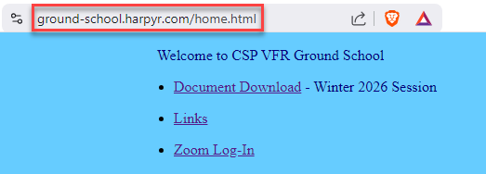
CSP Ground School Web
Ground-school.harpyr.com/home.html

Slide 15
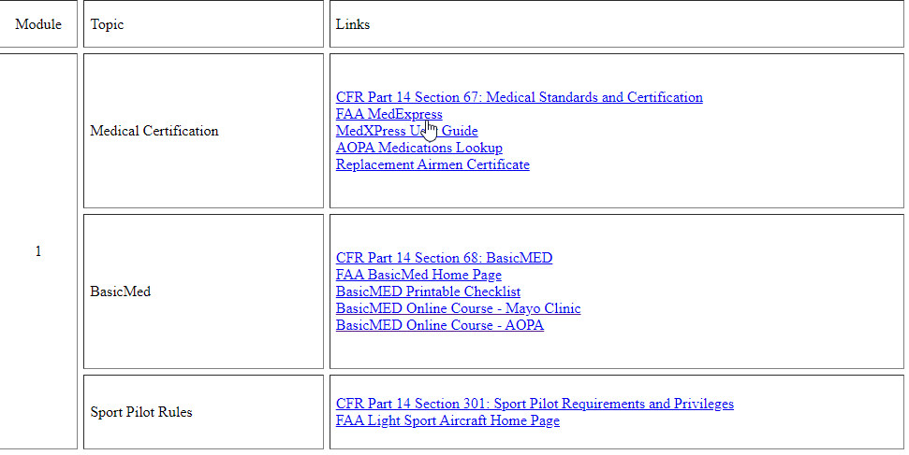
Rusty Pilot Links
harpyr.com/Rusty_Pilot/links.html

