Slide 1
Principles of Flight
What Makes it Stay Up?

Slide 2
Physical Laws
Make flight possible
Make flight more difficult
Are both predictable and changeable

Slide 3
The Nature of Air

Slide 4
Aircraft “Swim” in Air
Air is a fluid
The science of aerodynamics grew out of the already well-developed field of hydrodynamics
The word “propeller” is borrowed directly from marine engineering
Early aerodynamics relied heavily on well-understood principles concerning the physics of water – some translate well, some not so much….

Slide 5
Characteristics of Fluids
They take on the shape of their containers
If they resist “deformation” it is only slightly
The resistance of a fluid to deformation is called “viscosity”
Fluids flow
The difference between water and air is that air is less dense. But air does have density, and that density changes. Changes in air density affect all aspects of flight

Slide 6
Viscosity
Is the property of a fluid that causes it to resist flowing
Oil is highly viscous, water less so. Air is less viscous still
Viscosity is caused by the fluid’s constituent molecules ‘sticking’ to each other

Slide 7
Friction
Viscosity is the tendency of a fluid to stick to itself. Friction, on the other hand, is the tendency of a fluid to ‘stick’ to another surface
When an aircraft moves through the air, all its surfaces create friction with the air

Slide 8
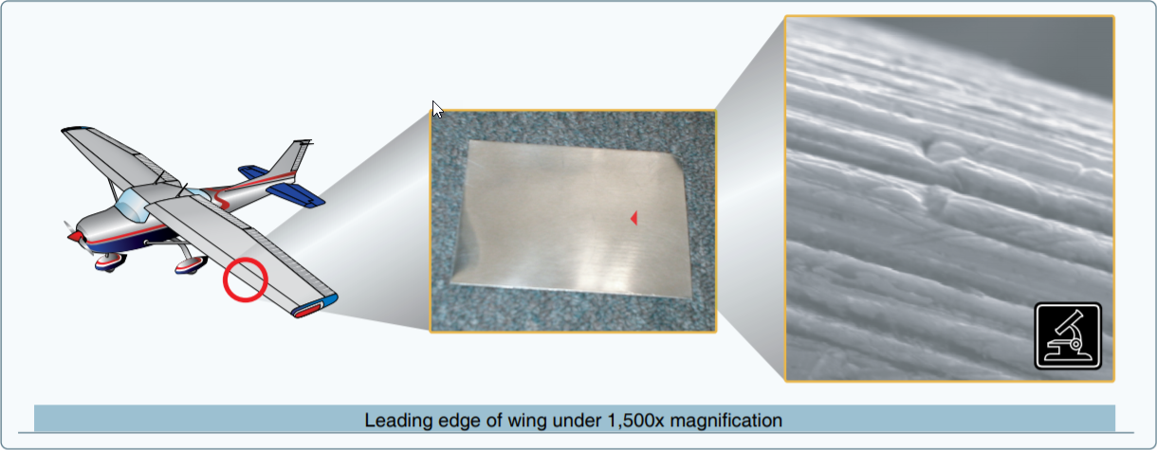
Even a surface that looks and feels completely smooth has rough texture at a microscopic level
Aircraft designers attempt to create aerodynamically efficient shapes that reduce friction, but it can never be completely eliminated

Slide 9
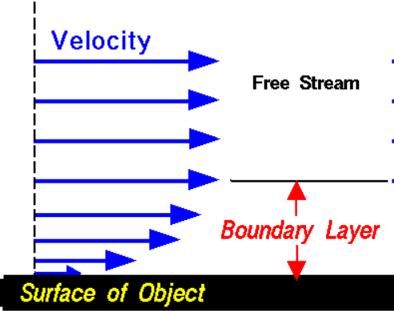
Molecules of air close to the wing surface adhere and move very slowly
This is called the boundary layer

Slide 10
The layers of air above that are slowed because of viscosity
The molecules of air in contact with the wing surface are almost motionless due to friction

Slide 11
Structure of the Atmosphere

Slide 12
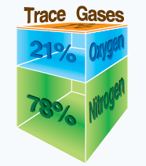
Atmospheric Gases
Nitrogen : 78%
Oxygen: 21%
Trace gases (mainly argon and carbon dioxide): 1%
These fractions refer to dry air and are more or less constant across the surface of the earth and regardless of altitude.

Slide 13
Atmospheric Pressure
Air is light, but not weightless. It possesses mass in proportion to the number of molecules of its constituent elements
The weight of the column of air above a spot on the earth is air pressure

Slide 14
Why Do Pilots Care about Air Pressure?
Air pressure affects how airplanes behave
Air pressure affects how we measure altitude

Slide 15
Pressure and Altitude
Altitude, in concept, is vertical distance above some point or level used as a reference
In aviation, the measurement of altitude(s) is intimately connected with the prevailing atmospheric pressure, and its relation to ‘standard’ pressure

Slide 16
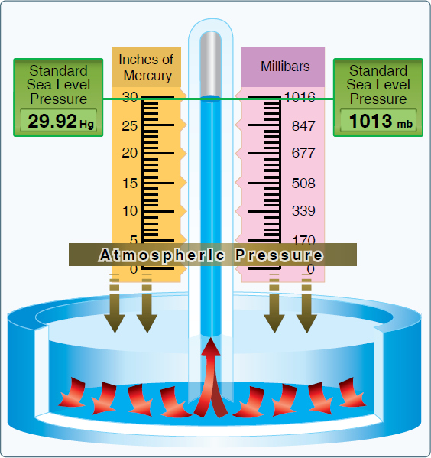

Slide 17
Aviation Altitudes
TRUE altitude: the vertical distance above mean sea level
PRESSURE altitude: the altitude you would have to be at for pressure to be standard
INDICATED altitude: the altitude reported on the altimeter when it is correctly adjusted for standard conditions (air pressure and temperature)
DENSITY altitude: PRESSURE altitude corrected for non-standard temperature

Slide 18
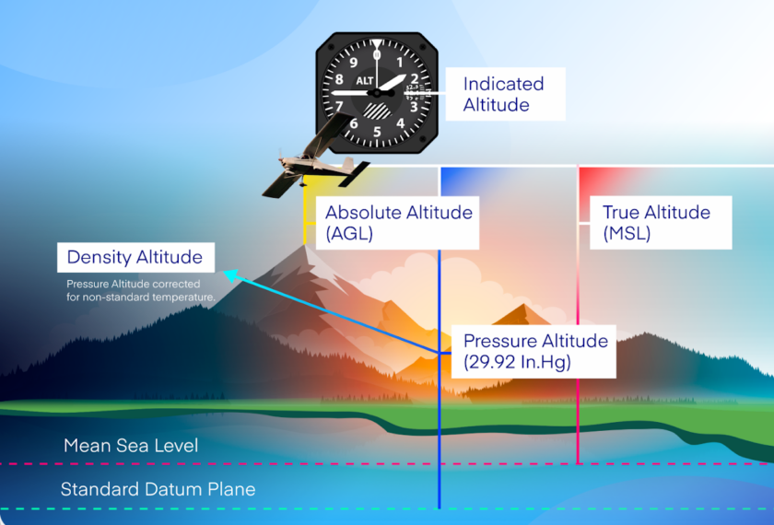

Slide 19
True Altitude
This is the altitude you are really interested in as a pilot – measurements like field elevation, the height of obstacles, and the vertical dimensions of controlled airspace are all defined with respect to mean sea level
But traditional aviation altimeters have no way to measure true altitude; they must estimate by measuring the weight of ambient air

Slide 20
Pressure Altitude
Pressure altitude is the vertical distance a pressure sensing device – such as an altimeter –would believe you to be if conditions were “standard”
  atmospheric pressure =29.92” Hg
  Temperature 59 ° F or 15 ° C
You can obtain pressure altitude from an altimeter by adjusting its pressure window to 29.92” Hg and reading the resulting altitude

Slide 21
Density Altitude
Pressure altitude refers to standard conditions, which are both air pressure (29.92” Hg) AND temperature (59°F) at sea level
Both temperature and pressure decrease as elevation above sea level increases. The standard “lapse rate” is 1 inch of mercury per 1000 feet and 2°C/3.5°F per 1000 feet

Slide 22
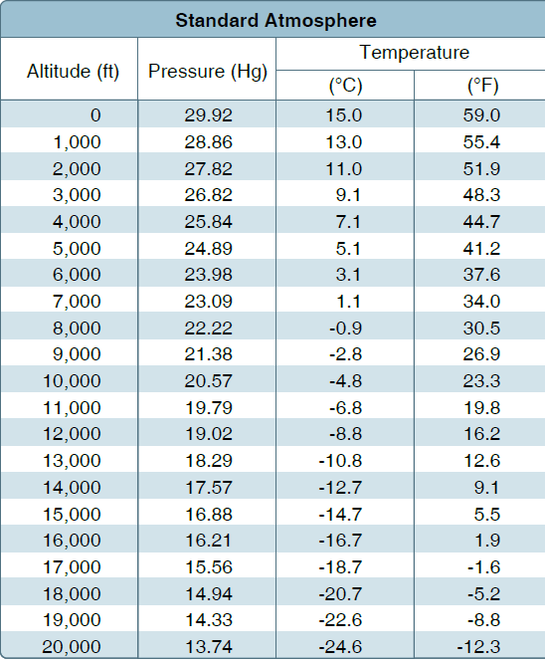

Slide 23
Density Altitude
Density altitude is pressure altitude *corrected* for non-standard temperature
It is not directly observable in the way pressure altitude can be observed
It is calculated measure and is typically either read from a chart or calculated using a standard E6B
It is often included as additional information on AWOS/METAR reports

Slide 24
How Does a Wing Fly?

Slide 25
Lift
The force that overcomes gravity and allows an aircraft to fly is lift
In a heavier-than-air craft, lift must be produced by manipulating the laws of the physics of motion
Contrary to popular opinion, aircraft do not fly because you open the window and throw money out as fast as you can

Slide 26
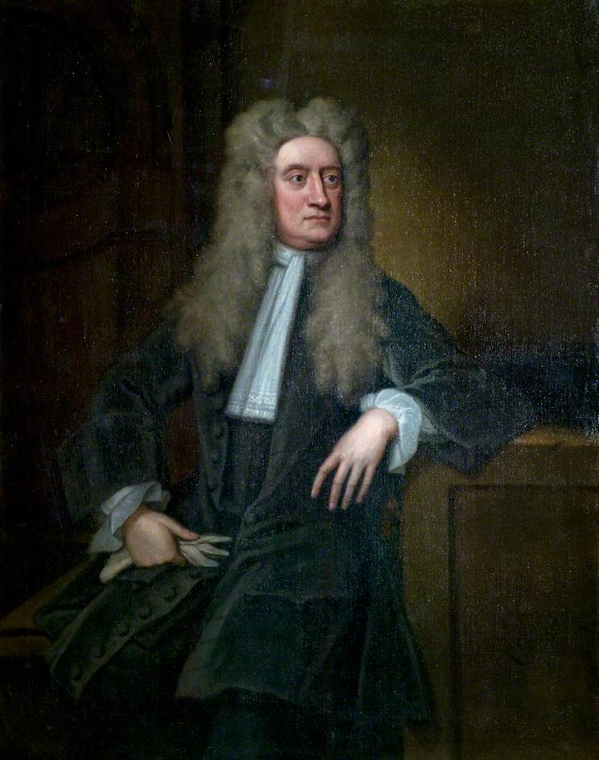
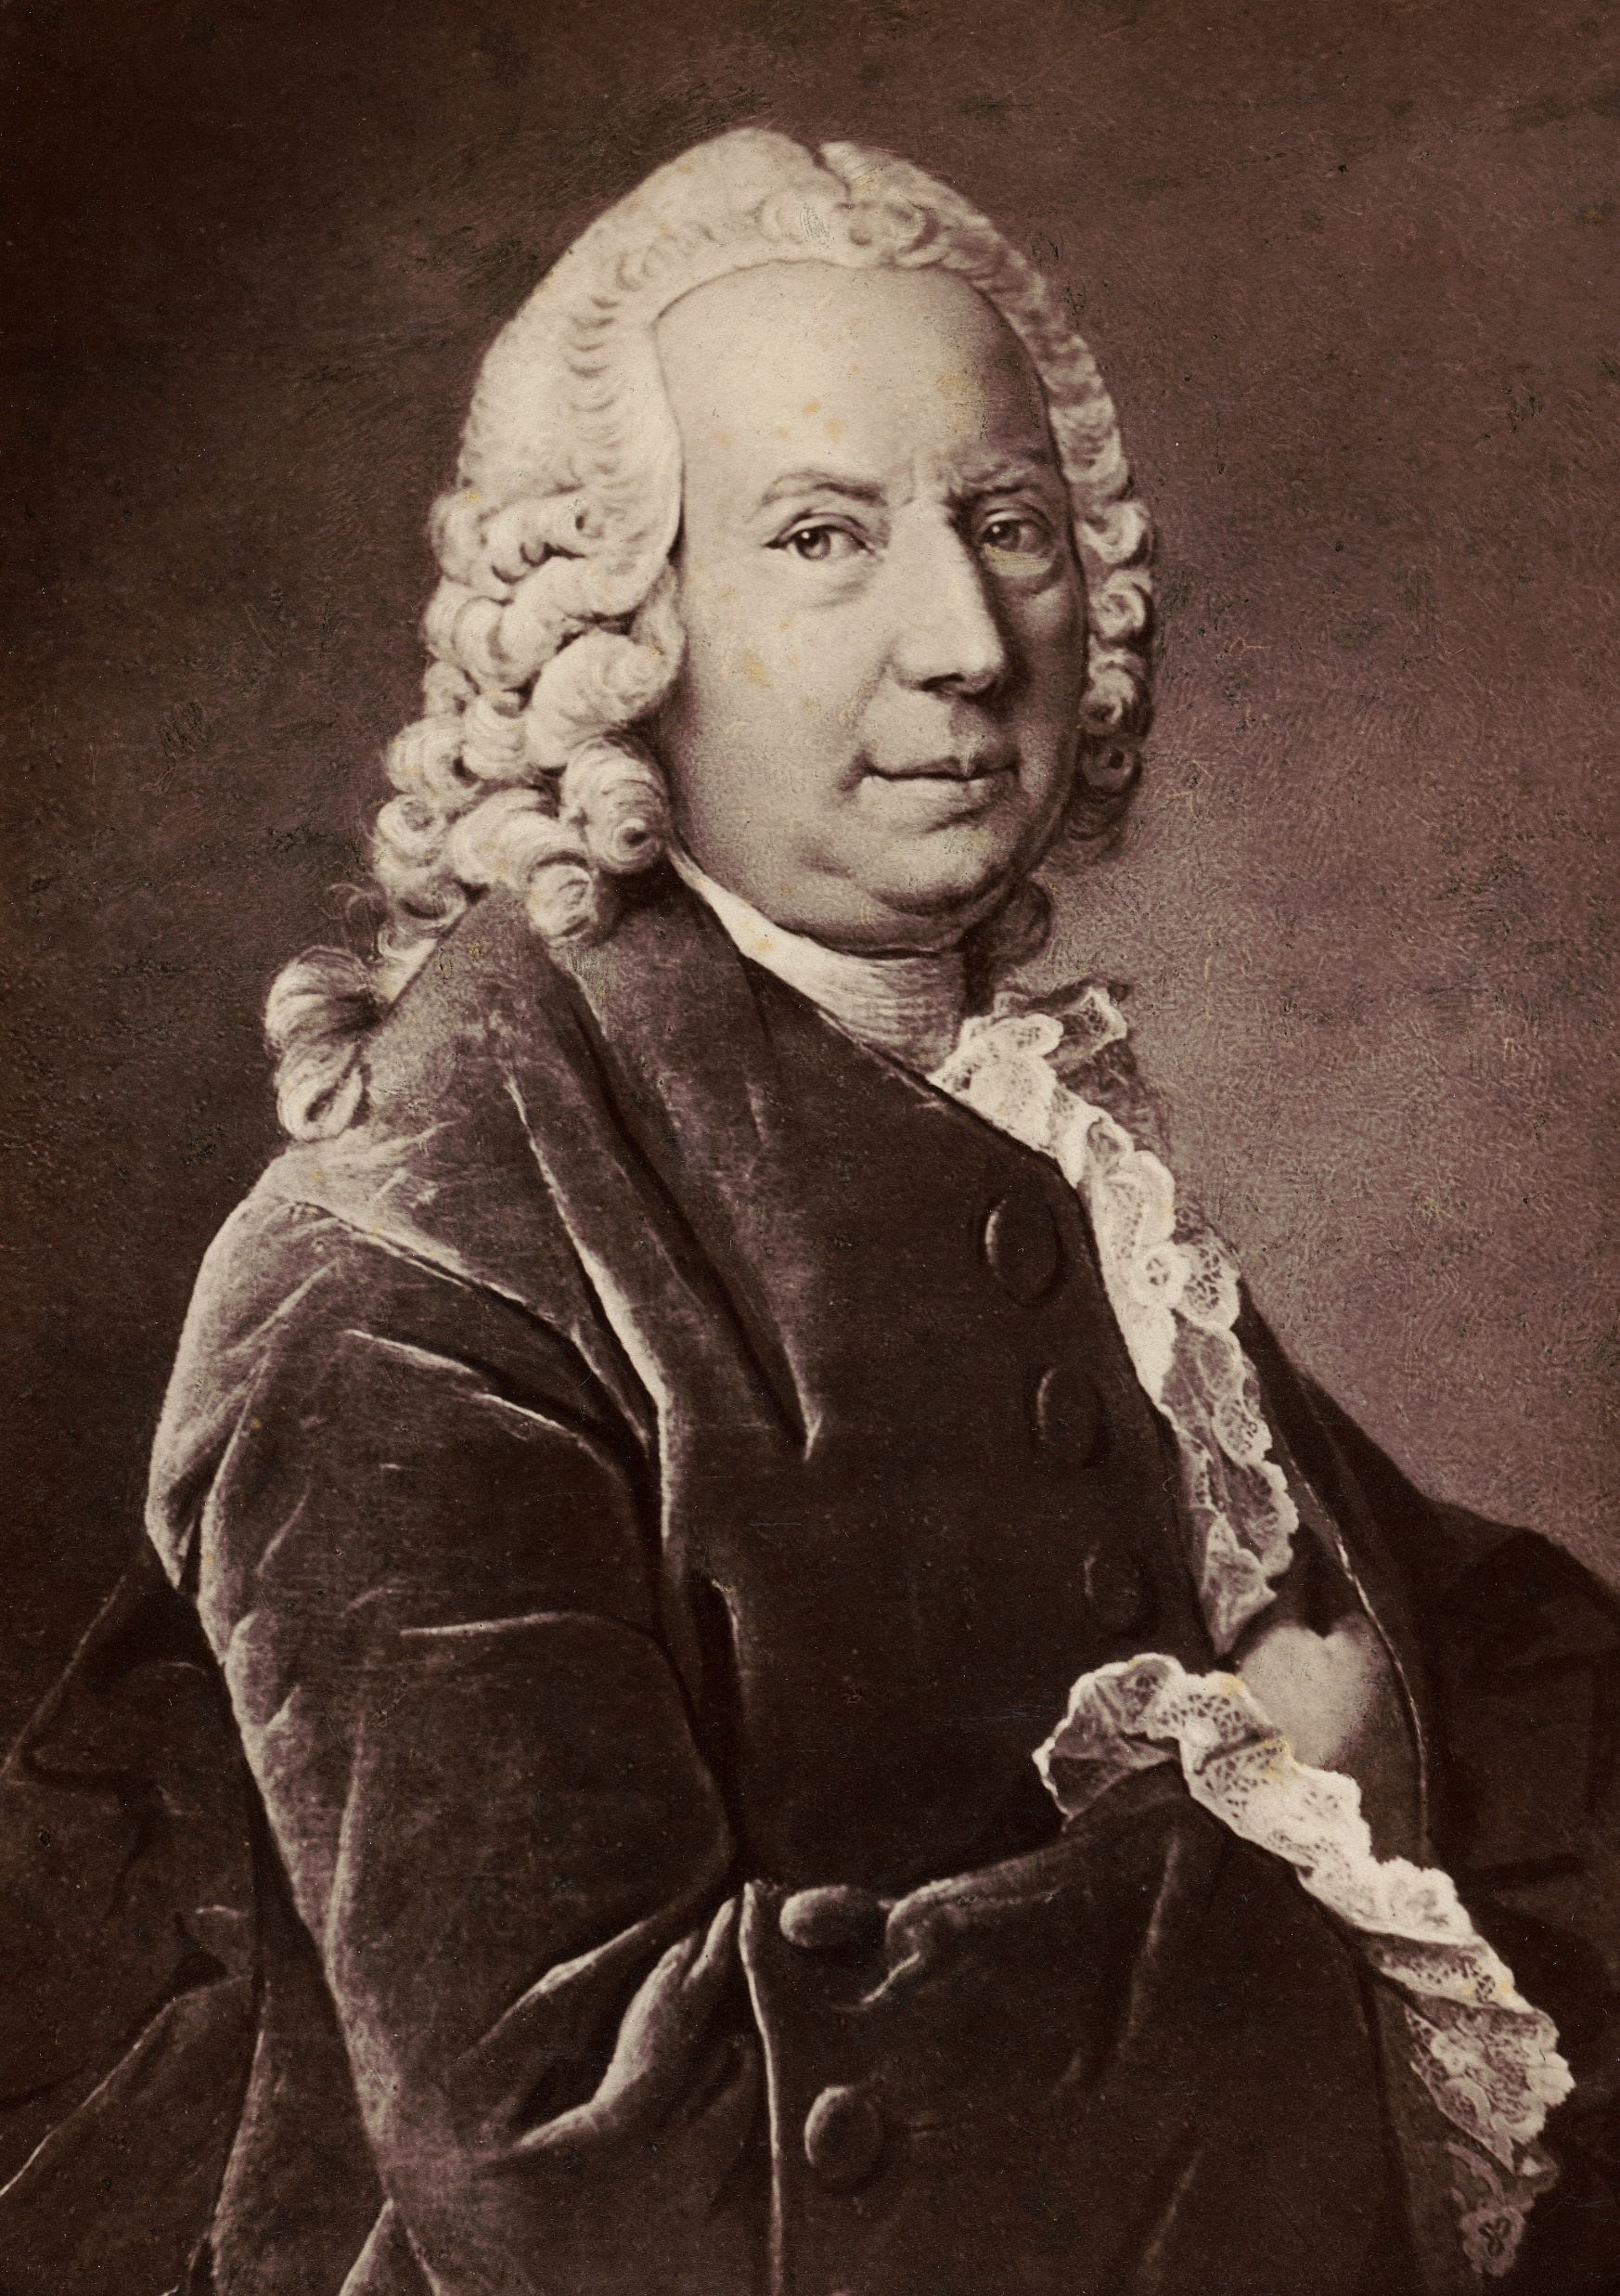
Newton vs. Bernoulli ?

Slide 27
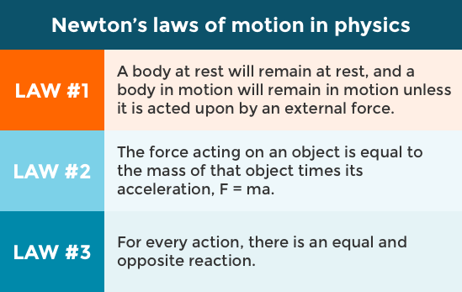

Slide 29
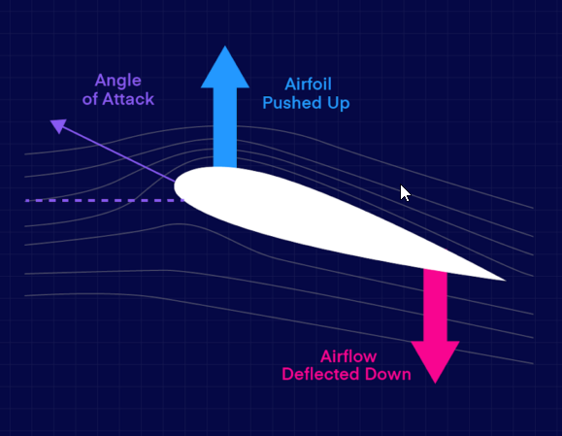
Newtonian Lift: Pushing Back

Slide 30
Bernoulli: Differential Pressure
Bernoulli’s insight was that air pressure varies with the velocity with which the air is moving: slower air is denser than faster air

Slide 31
Bernoulli: Differential Pressure
Faster air = lower pressure
Airfoil shapes are constructed so that the air moving over the top of the wing is going faster.
Lower pressure = lift

Slide 32
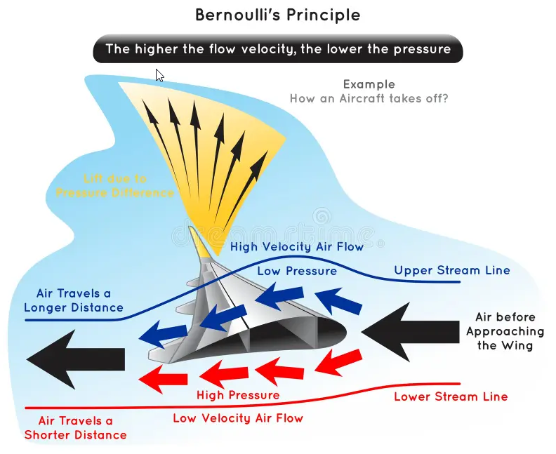

Slide 33

Newton AND Bernoulli
Both effects are at work when a wing develops lift, and the physics is extremely complex.
The FAA test question bank tends to emphasize Bernoulli, and understanding the concept of differential pressure will enable you to answer these questions correctly.

Slide 34
The Four Forces of Flight

Slide 35
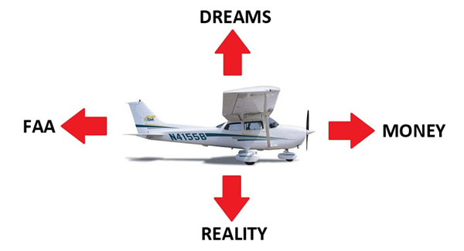

Slide 36
