Slide 1
Radio Navigation

Slide 2
Uses of Radio Navigation Aids for VFR
Supplement navigation by visual reference to ground
Determine position by triangulating
Answer questions on PPA written test

Slide 3
Types of Radio Navigation Aids
NDB: Non-Directional Beacon
DME: Distance Measuring Equipment
TACAN: Tactical Air Navigation System (Military)
VOR: VHF (Very High Frequency) Omnidirection Range
VOR-DME: VOR + DME
VORTAC: VOR + TACAN
GPS

Slide 4
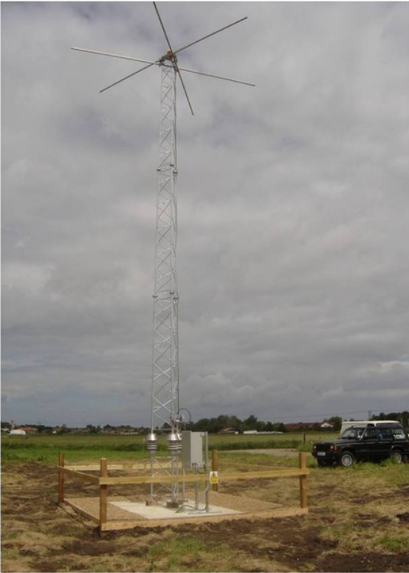

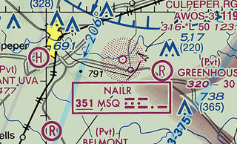
Non-Directional Beacon (NDB)
Really just a radio antenna
First NDBs in the US were AM radio stations
Today they transmit just
below the audio AM band (190-535 kH)

Slide 5
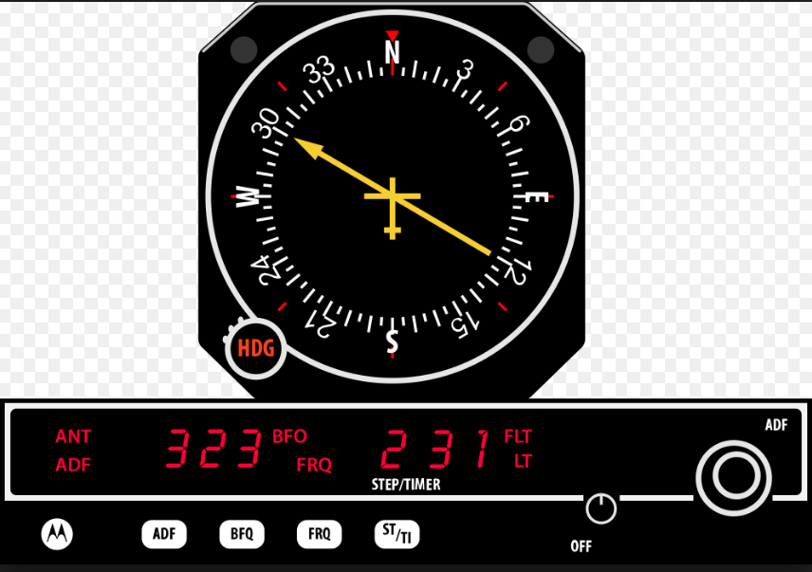
Automatic Direction Finder

Slide 6
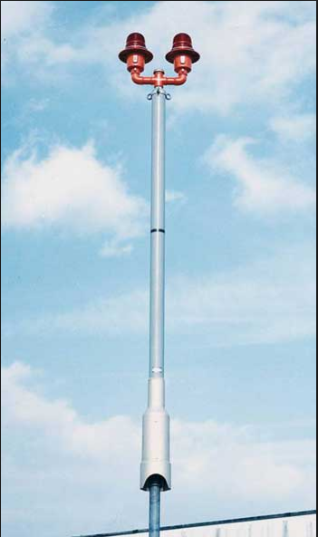
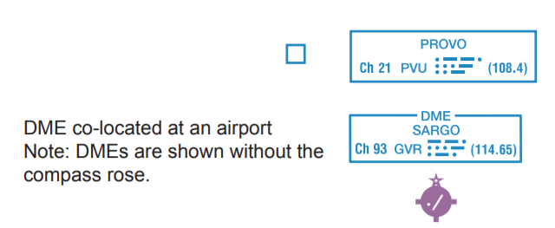
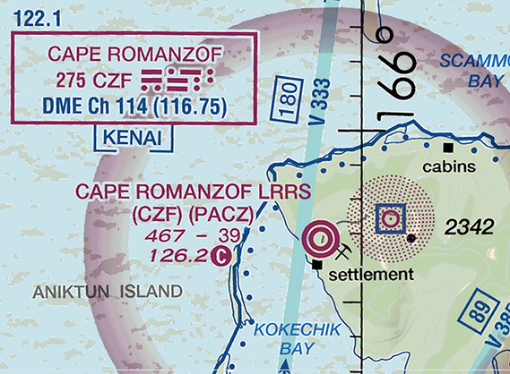
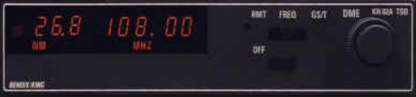
DME: Distance Measuring Equipment

Slide 7
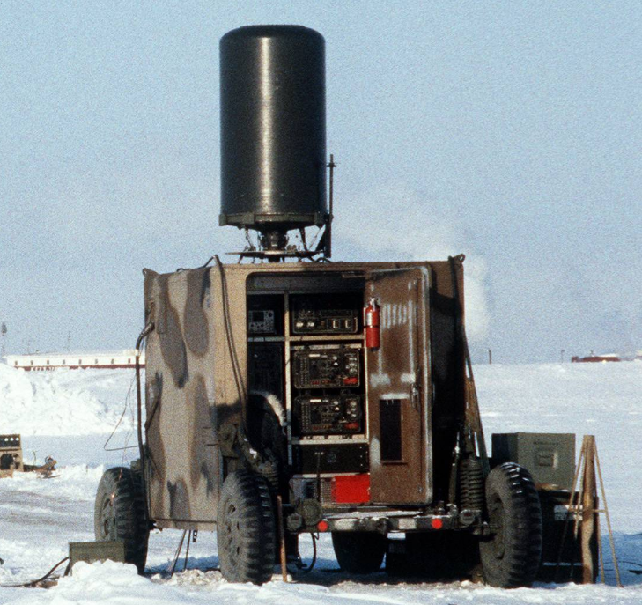
TACAN: Tactical Air Navigation System
Military use
Not charted on civilian sectionals/TACs
Small; may be mobile (as seen) or on ships
Combines position and distance measuring
Distance measuring element available for civilian use.

Slide 8


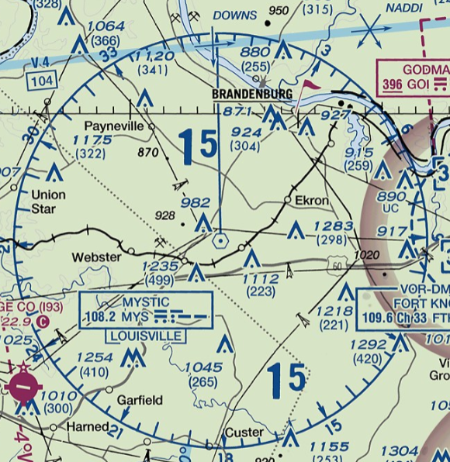
VOR: VHF Omnidirectional Range

Slide 9


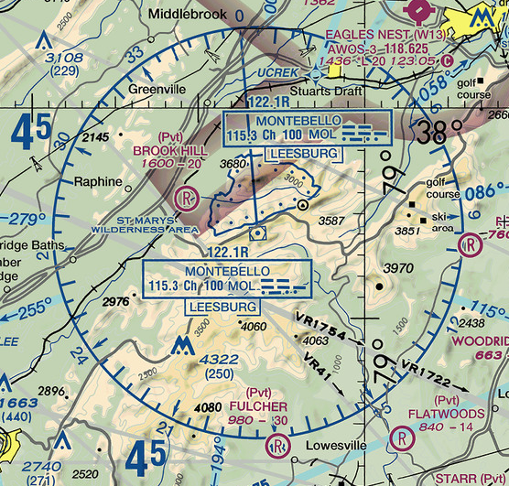
VOR-DME

Slide 10
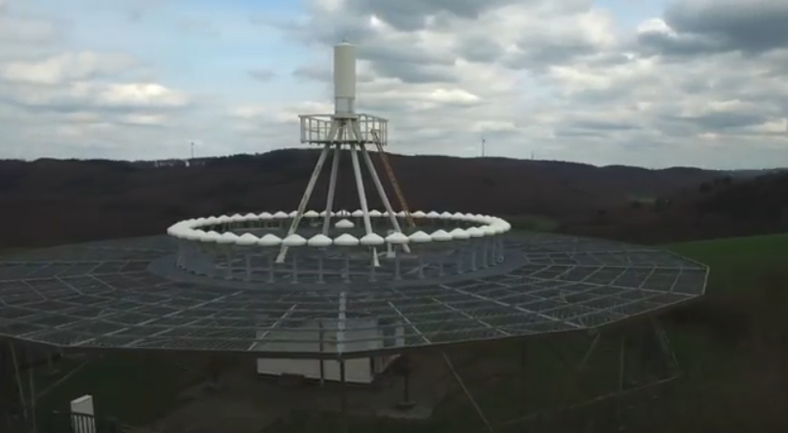

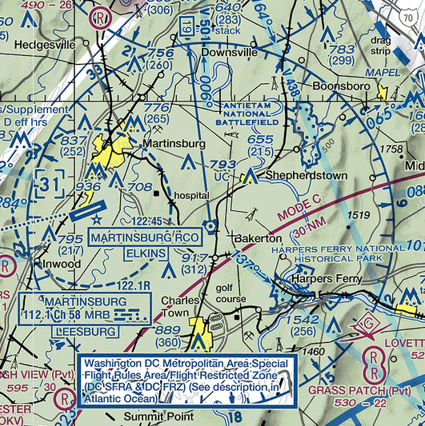
VORTAC

Slide 11
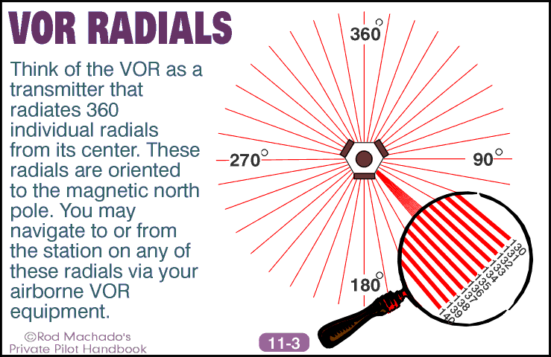

Slide 12
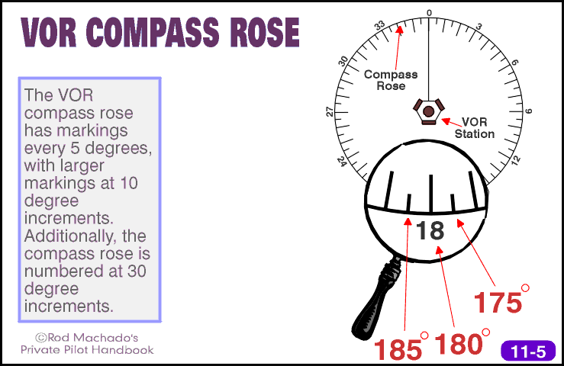

Slide 13
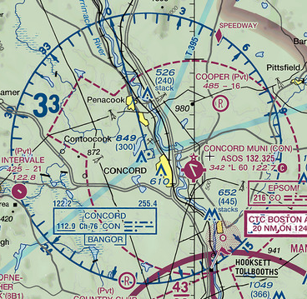
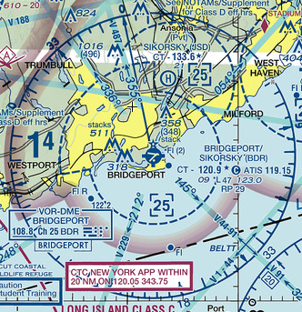
Co-located
with airport
Standalone
VOR

Slide 14
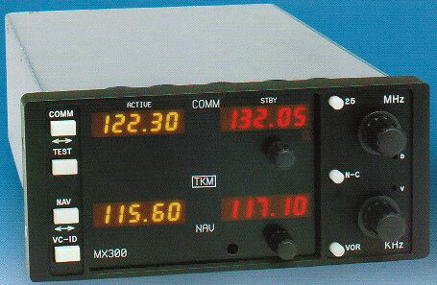
Dual NAV-COMM Stack

Slide 15
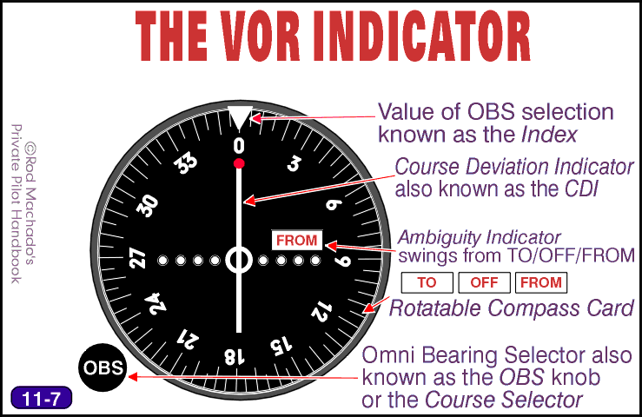

Slide 16
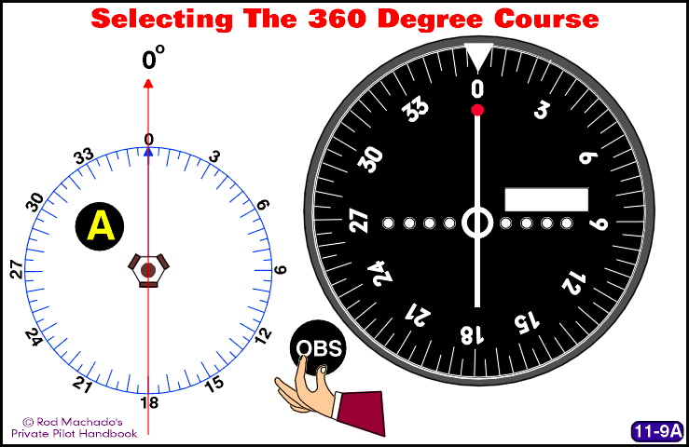
Rotate the “OBS” knob to orient the movable compass card, aligning the desired course with the index bug (0°/360°).

Slide 17
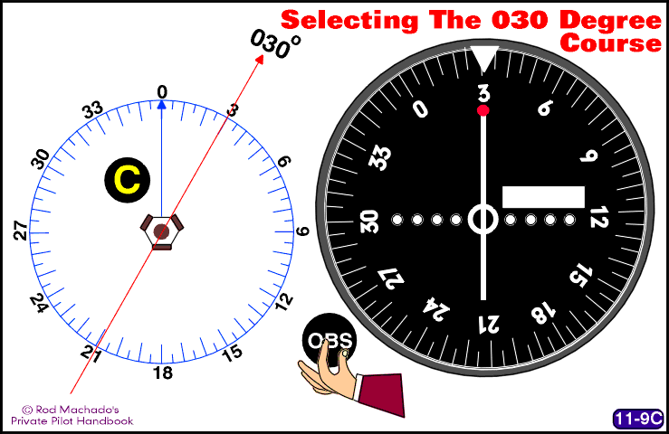
Rotate the “OBS” knob to orient the movable compass card, aligning the desired course with the index bug (030°).

Slide 18
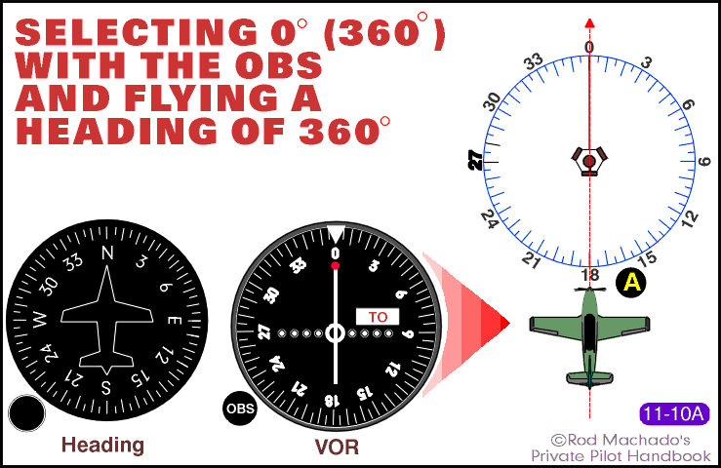
Flying Heading 0°/360° TO the VOR

Slide 19
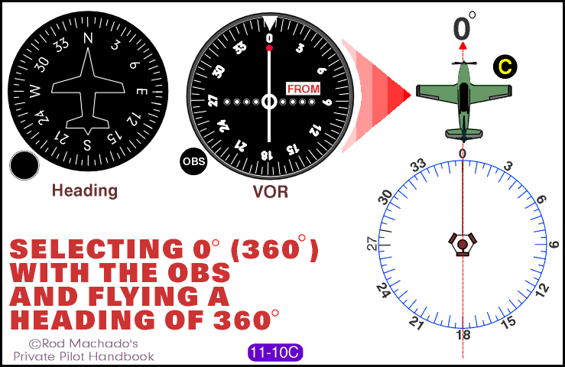
Flying Heading 360 FROM the VOR

Slide 20
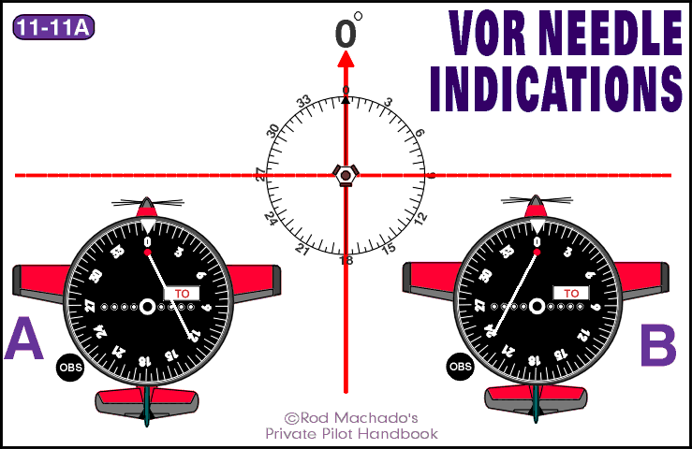
What happens if you are flying the right heading, but off course?

Slide 21
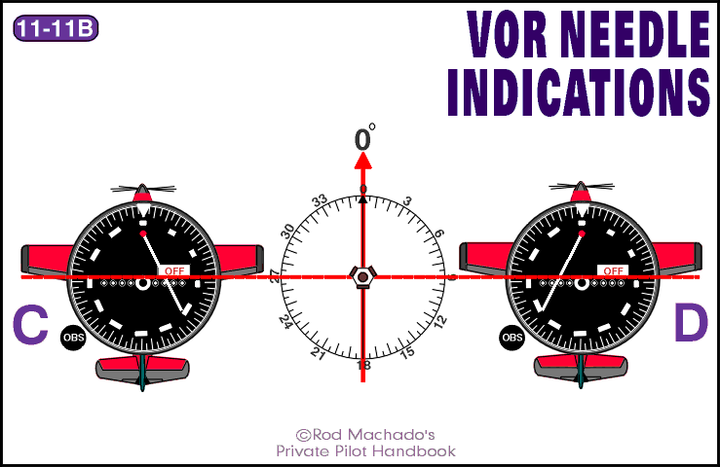
As you pass the VOR, the ambiguity indicator switches from TO to OFF

Slide 22
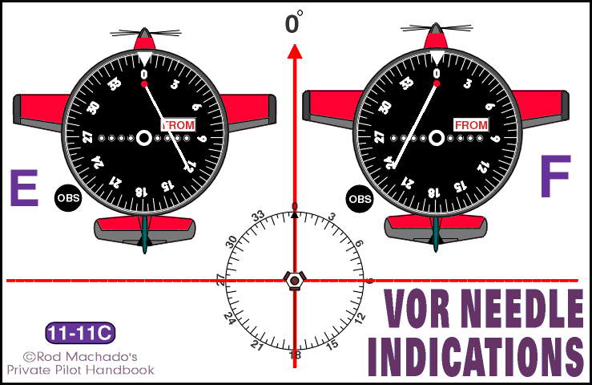
You are now flying away from the VOR; the indicator reads FROM

Slide 23
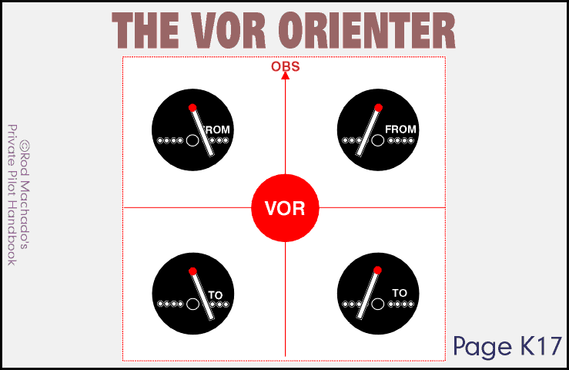
Knowing where you are in relation to the VOR

Slide 24
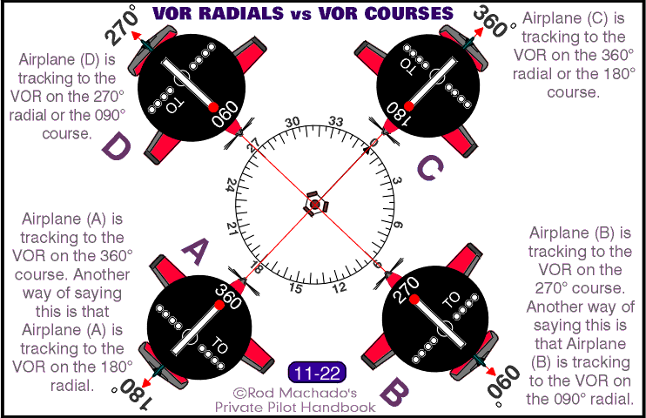
Radials and Courses

Slide 25
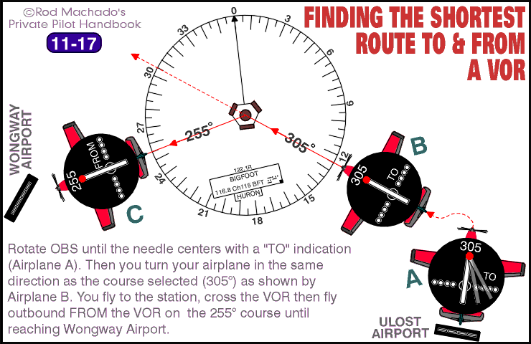
Finding the Bigfoot VOR and flying to it

Slide 26
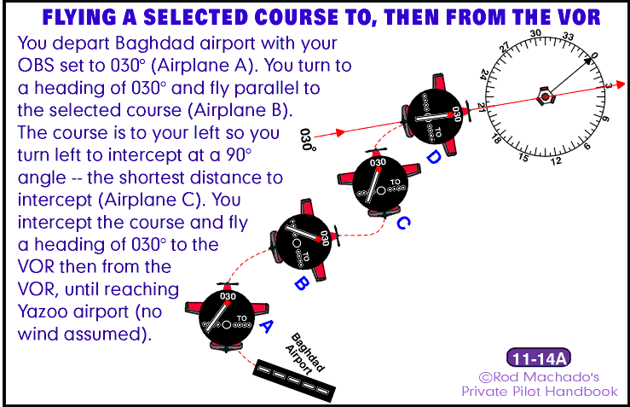
You want to fly from Baghdad to Yazoo. Yazoo is located on the 030° radial of the depicted VOR.

Slide 27
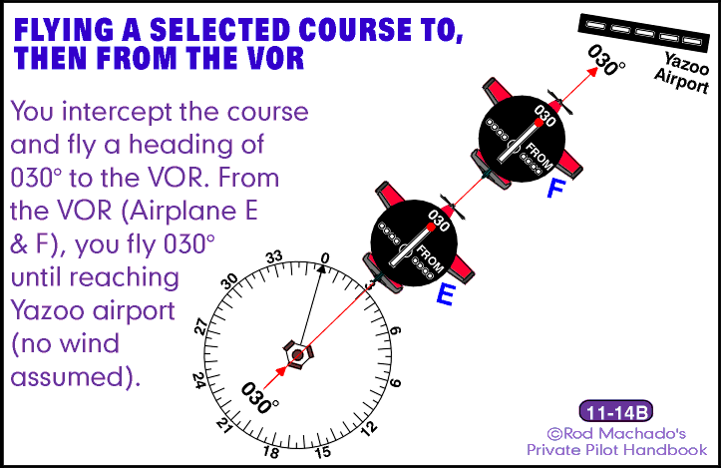
As you pass over the VOR, the indicator flips from TO to FROM

Slide 28
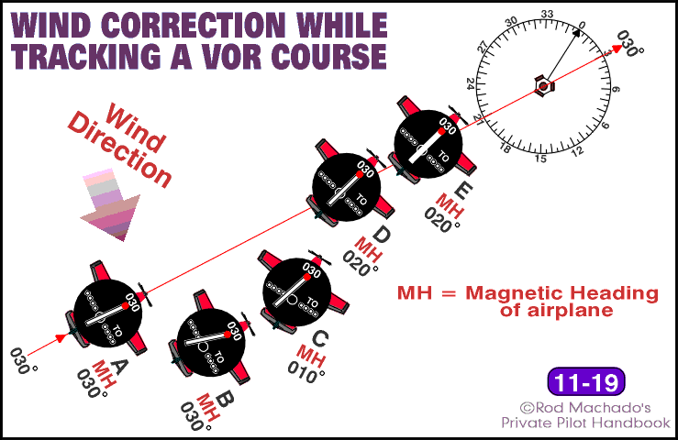
What if there is wind?
(And there’s always wind.)

Slide 29
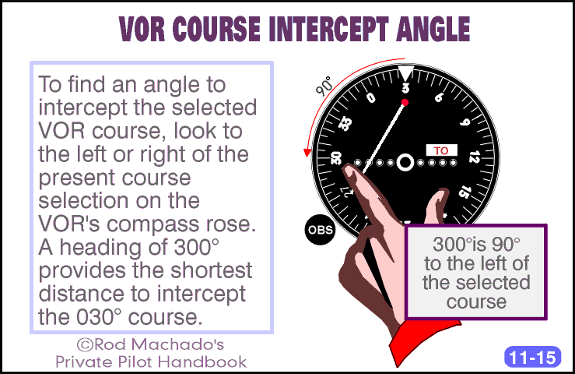
Intercepting a VOR course

Slide 30
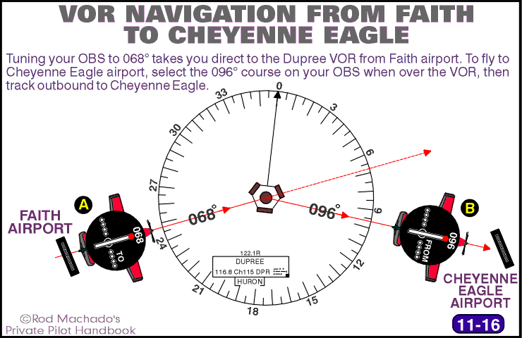
You have determined the angles from Faith to Dupree and from Dupree to Cheyenne with your sectional and a straightedge.

Slide 31
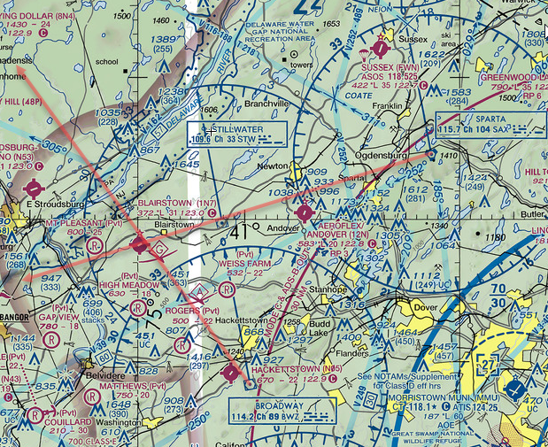
Using two VORs to determine position

Slide 32
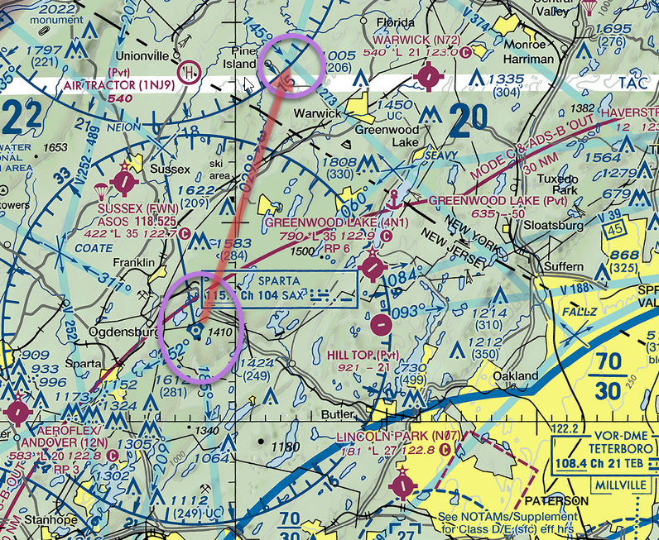
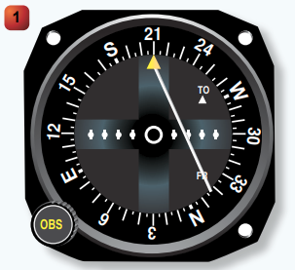
Where am I in relation to the VOR?

Slide 33
Where am I in relation to the VOR?

Slide 34
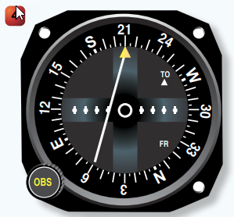
Where am I in relation to the VOR?

Slide 35
Where am I in relation to the VOR?

Slide 36
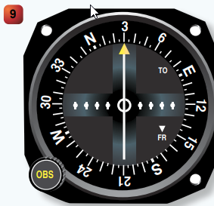
Where am I in relation to the VOR?

Slide 37
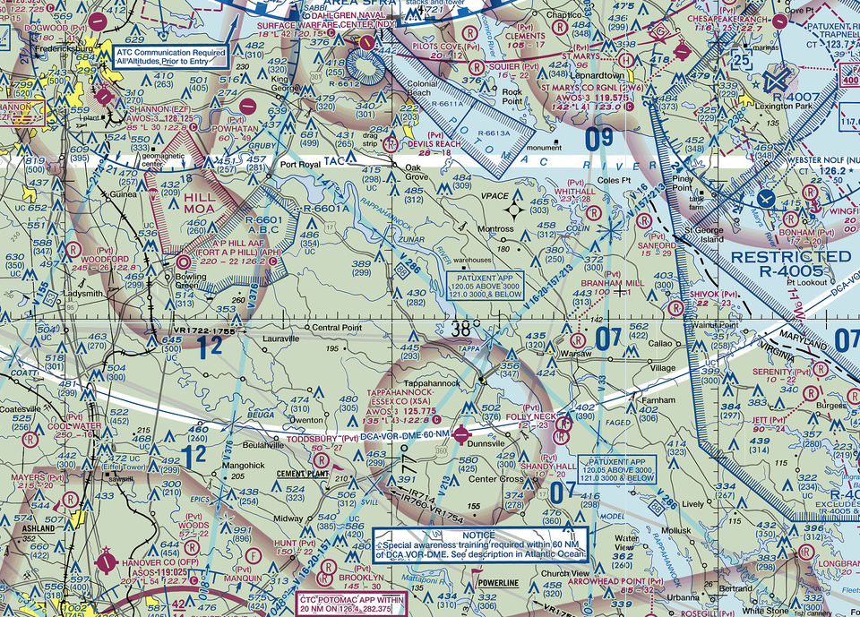
VOR (Victor) Airways: pathways between VORs

Slide 38
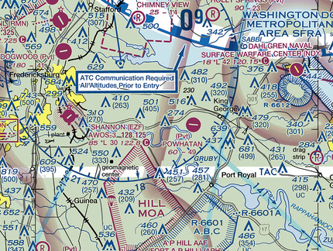
VOR Airways: closer look

Slide 39
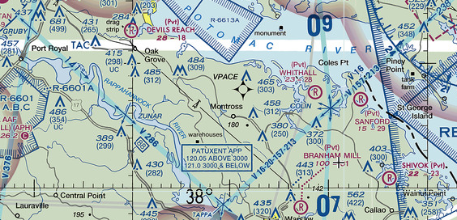
VOR Airway Intersections
Victor Airways and intersections are very busy places. Use caution when approaching. If climbing or descending on an airway, execute shallow S-turns to improve your traffic scans.

Slide 40
GPS
Satellite based
Accurate and reliable for aviation
Most common NAVAID in use today
Not subject to line-of-sight limitations
Are not affected by electrical interference

Slide 41
GPS
Developed and operated by DOD
Civilian interface managed by USCG
VFR pilots need to understand limitations of equipment in use

Slide 42
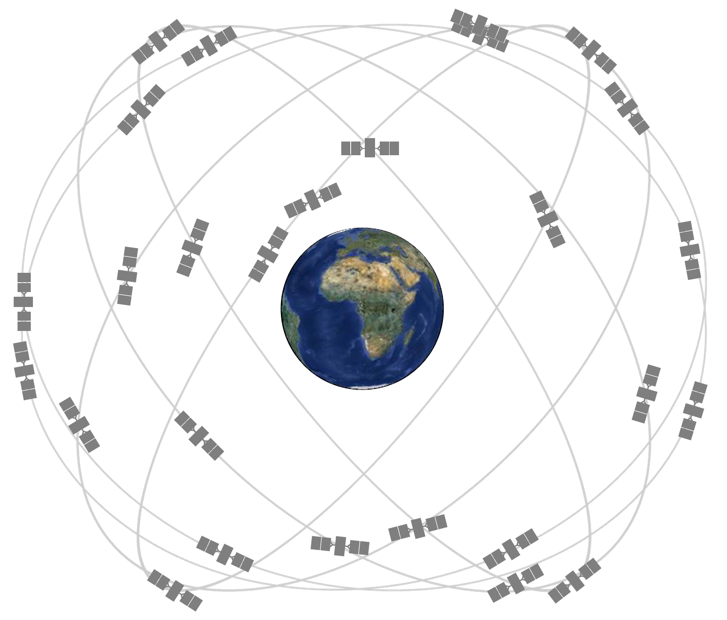

Slide 43
GPS Space Component
Original Constellation Design
  Medium Earth Orbit (MEO)~12,550 mi
  6 equally spaced orbital planes
  4 baseline “slots” per plane
Current Coverage
  24 baseline satellites + 7 “expandables”
  At least 4 satellites visible from any position on Earth’s surface

Slide 44
GPS Satellite Constellation
Orbital period = 0.5 sideral day = 11:58 hours
Nearly circular orbits
Equally spaced around equator

Slide 46
GPS Control Component
Global network of ground facilities that
  Track GPS satellites
  Monitor transmissions
  Perform analyses
  Transmit commands and data to constellation

Slide 47
How GPS Works
Each of the 31 satellites emits a signal that is picked up by GPS receivers
GPS satellites carry atomic clocks that insert extremely accurate timestamps into the broadcast signal
The receiver uses the time difference when the signal was broadcast and received to compute the distance from the receiver to the satellite.
With information about the ranges to three satellites and the location of the satellite when the signal was sent, the receiver can compute its own three-dimensional position.

Slide 48
How GPS Works
By taking a measurement from a fourth satellite, the receiver also knows the exact time without the need to carry its own synchronized atomic clock
Thus, the receiver uses four satellites to compute latitude, longitude, altitude, and time
Adding a fifth satellite allows measurement of signal integrity (Receiver Autonomous Integrity Monitoring, or RAIM). This is important in safety-critical applications such as IFR-certified GPS systems

Slide 49
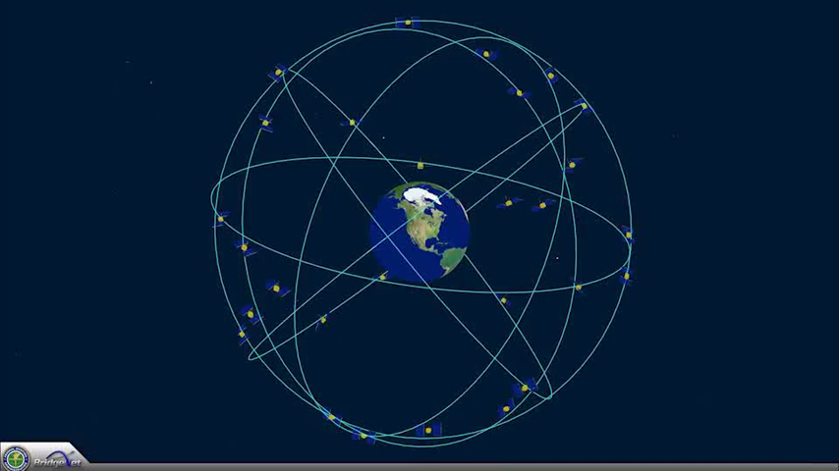
GPS Animation

Slide 50
RAIM Capability
IFR-certificated GPS receivers include an alert mode in case minimum satellite connectivity or signal quality is degraded
Panel-mounted GPS units in VFR aircraft and handheld units may not provide RAIM alerting

Slide 51
RAIM Capability
A minimum of 3 satellites in view is required for 2-dimensional positioning; 4 satellites for 3-dimensional
At least 1 additional satellite is required to perform RAIM checks
Five satellites required to detect an integrity anomaly
An additional satellite (so we’re now up to 6!) is required to isolate which satellite is faulty and remove it from the navigation solution

Slide 52
GPS Databases
Usually update-able
Must be maintained
If outdated, can lead to embarrassing and potentially expensive pilot errors

Slide 53
GPS Checklist
Check to see if unit has RAIM capability. If it does not, be suspicious of a displayed GPS position if it does not agree with other navigation evidence
Check currency of database. If expired, update if possible; if not, do not rely on moving map displays for any critical navigation decisions
Named waypoints may no longer exist or may have moved since the last update
Enter any user-defined waypoints prior to flight

Slide 54
VFR Waypoints
Supplementary tool to aid VFR pilots
  Nav aids for pilots unfamiliar with an area
  Waypoint definition of existing visual waypoints
  Enhanced navigation in/around Class B and C
  Assists around Special Use Airspace
Unlike most GPS waypoints, these are charted on VFR sectionals, TACs, and VFR Flyway charts
Five letters beginning with “VP”

Slide 55
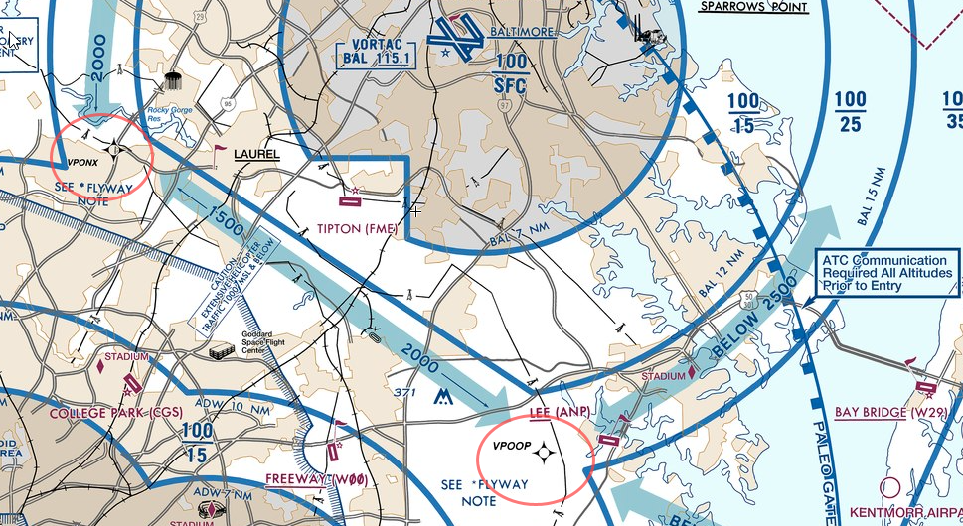
W29’s Favorite VFR Waypoints

Slide 56
Transponders
Aviation transponders are transmitters that send a signal in response to a request (“interrogation”) from an ATC ground station
The type of signal sent depends on the degree of sophistication of the transponder unit
  A: four digit squawk code: identity + position
  C: A + pressure altitude: identity + position + altitude
  S: C + additional data: identity + position + altitude + speed + heading
MODE C is the minimum transponder requirement for flight in Bravo, Charlie, and “Mode C Veil”

Slide 57
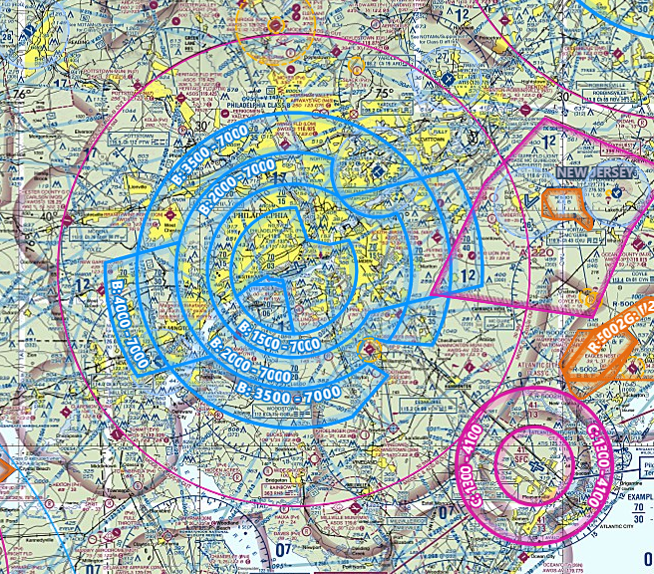

Slide 58
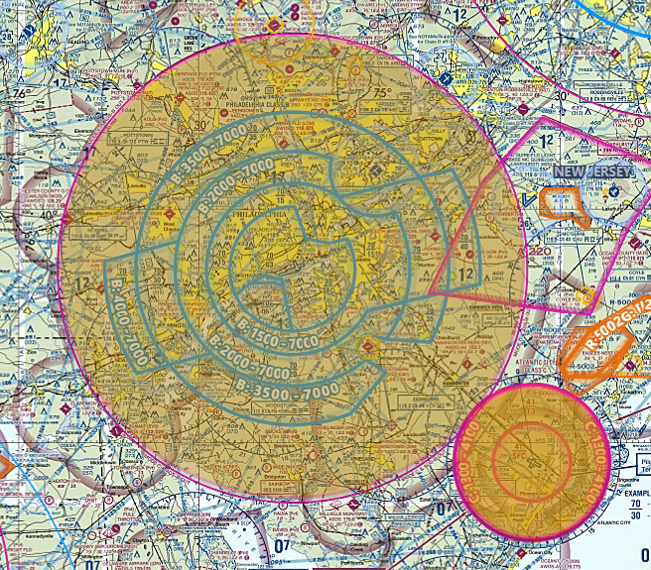

Slide 59
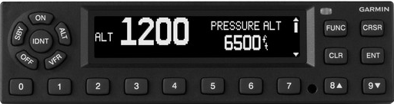
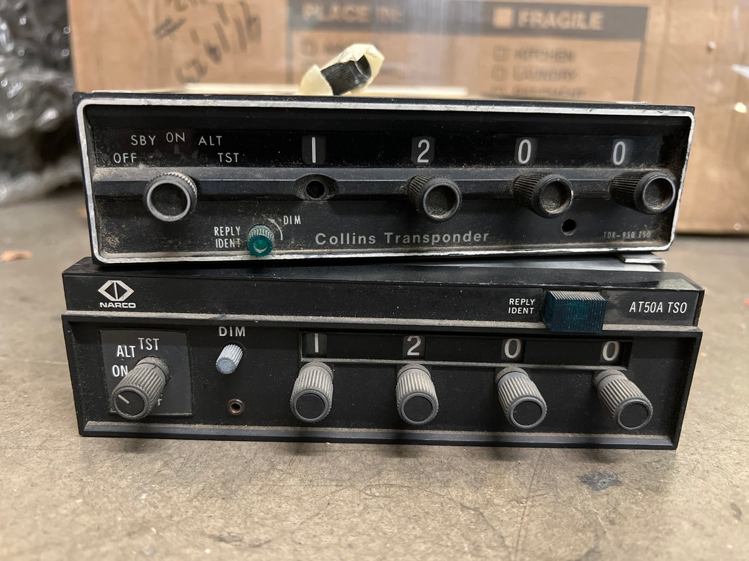
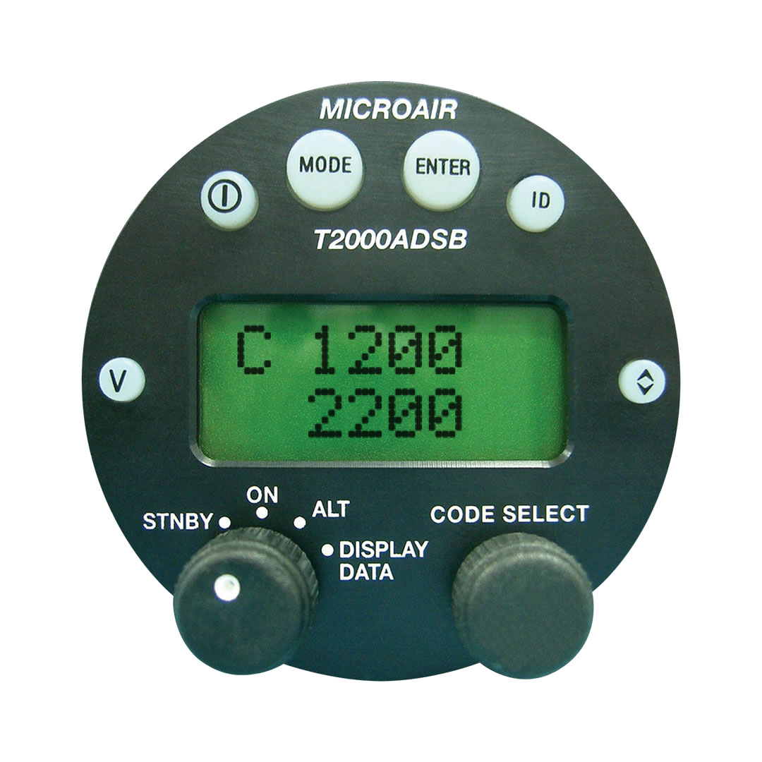
Transponder Models

Slide 60
Squawk Codes
4-digit octal numeric system: numbers range 0 – 7
Ordinary VFR = “1200”
ATC assigns a code when opening a flight plan
Special transponder codes:
  7500 = Hijacking
    “Seven Five I’ve Been Taken Alive”
  7600 = Communication Failure
    “Seven Six Need a Radio Fix”
  7700 = Mayday
    “Seven Seven I’m Going to Heaven”
    This code is also used to acknowledge you are complying if intercepted by military aircraft

Slide 61


Fun Fact: Why Squawk Code?
Transponder technology originated with the WWII era “Identification Friend or Foe” system that was used by the Allies to distinguish their own aircraft from the enemy
Great Britain’s IFF system was code-named “PARROT”
When British bombers returned from runs over Europe, the radar operators would request “Squawk Your Parrot”
(The corresponding order to silence the transponder was “Strangle Your Parrot”)

Slide 62
ADS-B
(Automatic Dependent Surveillance Broadcast)
Automatic: properly-equipped aircraft automatically report their position, without need for a radar interrogation
Dependent: ADS-B depends on aircraft having an approved GPS on board and an ADS-B Out transmitter
Surveillance: it is a surveillance technology that allows ATC to watch airplanes move around (like radar)
Broadcast: aircraft broadcast their position information to airplanes and ATC

Slide 63
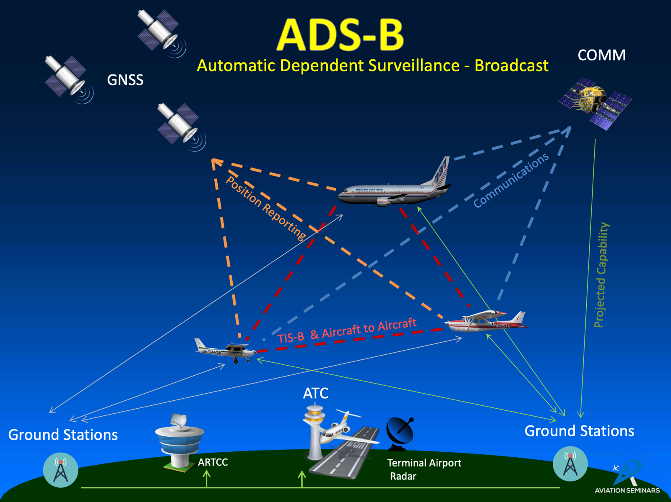

Slide 64

ADS-B Out Requirements

