Slide 1
Weather Products and Briefings

Slide 2
Types of Weather Info
Real time (or nearly so) observations – text products
  METARs
  ASOS/AWOS
  ATIS
  PIREPs
Current Condition Charts
  Surface Analysis Charts
  Weather Depiction Charts
Forecasts
  TAFs
  Graphical Area Forecasts
  Outlook (Prog) Charts
  Winds Aloft
Hazards to Aviation: SIGMets and AIRMets

Slide 3
METAR
METerological Aerodrome Report
KESN 242345Z 32005KT 10SM CLR 07/M06 A3047
KBWI 242354Z 32007KT 10SM FEW150 SCT200 SCT250 07/M08 A3044 RMK AO2 SLP308 T00721083 10122 20072 53026
KLTS 261955Z AUTO 13024G30KT 7SM OVC004 11/11 A2963 RMK AO2 PK WND 12032/53 PRESFR SLP034 T01130111
KHMN 262014Z AUTO 24035G50KT 3/4SM R16/2200V4500FT HZ VV013 15/M02 A2979 RMK AO2 CIG 002 RWY34 SLP044
SPECI KHIE 262008Z AUTO 00000KT 1 1/4SM -SN BR OVC021 M08/M10 A2964 RMK AO2 P0000 T10781100

Slide 4
Airport ID and time of observation
Time = day of month + hh:mm Zulu
SPECI = observation outside usual schedule
KESN 242345Z 32005KT 10SM CLR 07/M06 A3047
KBWI 242354Z 32007KT 10SM FEW150 SCT200 SCT250 07/M08 A3044 RMK AO2 SLP308 T00721083 10122 20072 53026
KLTS 261955Z AUTO 13024G30KT 7SM OVC004 11/11 A2963 RMK AO2 PK WND 12032/53 PRESFR SLP034 T01130111
KHMN 262014Z AUTO 24035G50KT 3/4SM R16/2200V4500FT HZ VV013 15/M02 A2979 RMK AO2 CIG 002 RWY34 SLP044
SPECI KHIE 262008Z AUTO 00000KT 1 1/4SM -SN BR OVC021 M08/M10 A2964 RMK AO2 P0000 T10781100

Slide 5
AUTO
If the observation was recorded from an automated
weather station, AUTO will appear here
KESN 242345Z 32005KT 10SM CLR 07/M06 A3047
KBWI 242354Z 32007KT 10SM FEW150 SCT200 SCT250 07/M08 A3044 RMK AO2 SLP308 T00721083 10122 20072 53026
KLTS 261955Z AUTO 13024G30KT 7SM OVC004 11/11 A2963 RMK AO2 PK WND 12032/53 PRESFR SLP034 T01130111
KHMN 262014Z AUTO 24035G50KT 3/4SM R16/2200V4500FT HZ VV013 15/M02 A2979 RMK AO2 CIG 002 RWY34 SLP044
SPECI KHIE 262008Z AUTO 00000KT 1 1/4SM -SN BR OVC021 M08/M10 A2964 RMK AO2 P0000 T10781100

Slide 6
Winds nnn° true direction wind is blowing from
(d)ddKT: wind speed in knots ddGddKT means base wind + gusts (>10kt between lull and peak) over last 10 minutes
VRB < 6KT or direction changes +/- 60°
KESN 242345Z 32005KT 10SM CLR 07/M06 A3047
KBWI 242354Z 32007KT 10SM FEW150 SCT200 SCT250 07/M08 A3044 RMK AO2 SLP308 T00721083 10122 20072 53026
KLTS 261955Z AUTO 13024G30KT 7SM OVC004 11/11 A2963 RMK AO2 PK WND 12032/53 PRESFR SLP034 T01130111
KHMN 262014Z AUTO 24035G50KT 3/4SM R16/2200V4500FT HZ VV013 15/M02 A2979 RMK AO2 CIG 002 RWY34 SLP044
SPECI KHIE 262008Z AUTO 00000KT 1 1/4SM -SN BR OVC021 M08/M10 A2964 RMK AO2 P0000 T10781100

Slide 7
Visibility/Runway Visual Range
Greatest horizontal distance at which selected objects can be seen and identified in statute miles (SM)
10 means “10 or greater”; M means “less than”
KESN 242345Z 32005KT 10SM CLR 07/M06 A3047
KBWI 242354Z 32007KT 10SM FEW150 SCT200 SCT250 07/M08 A3044 RMK AO2 SLP308 T00721083 10122 20072 53026
KLTS 261955Z AUTO 13024G30KT 7SM OVC004 11/11 A2963 RMK AO2 PK WND 12032/53 PRESFR SLP034 T01130111
KHMN 262014Z AUTO 24035G50KT 3/4SM R16/2200V4500FT HZ VV013 15/M02 A2979 RMK AO2 CIG 002 RWY34 SLP044
SPECI KHIE 262008Z AUTO 00000KT 1 1/4SM -SN BR OVC021 M08/M10 A2964 RMK AO2 P0000 T10781100

Slide 8
Present Weather (Precipitation, Obscuration, etc)
2 letter codes with modifiers; can be combined
KESN 242345Z 32005KT 10SM CLR 07/M06 A3047
KBWI 242354Z 32007KT 10SM FEW150 SCT200 SCT250 07/M08 A3044 RMK AO2 SLP308 T00721083 10122 20072 53026
KLTS 261955Z AUTO 13024G30KT 7SM OVC004 11/11 A2963 RMK AO2 PK WND 12032/53 PRESFR SLP034 T01130111
KHMN 262014Z AUTO 24035G50KT 3/4SM R16/2200V4500FT HZ VV013 15/M02 A2979 RMK AO2 CIG 002 RWY34 SLP044
SPECI KHIE 262008Z AUTO 00000KT 1 1/4SM -SN BR OVC021 M08/M10 A2964 RMK AO2 P0000 T10781100

Slide 9
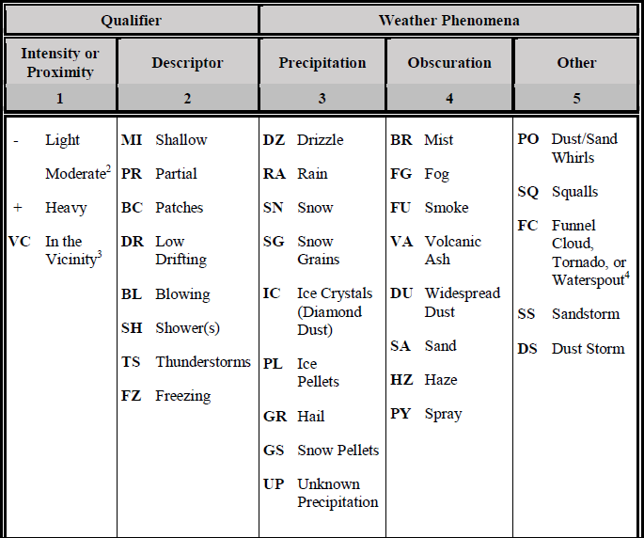
Present Weather (Precipitation, Obscuration, etc)

Slide 10
Present Weather (Precipitation, Obscuration, etc)

Slide 11
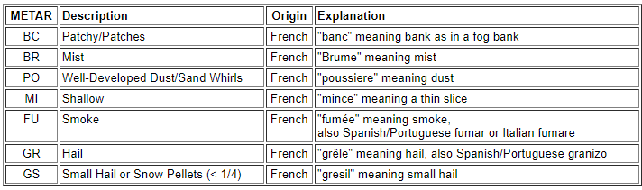

Slide 12
Sky condition/ceilings condition 1 of 6 codes; ceilings in 00s feet AGL
KESN 242345Z 32005KT 10SM CLR 07/M06 A3047
KBWI 242354Z 32007KT 10SM FEW150 SCT200 SCT250 07/M08 A3044 RMK AO2 SLP308 T00721083 10122 20072 53026
KLTS 261955Z AUTO 13024G30KT 7SM OVC004 11/11 A2963 RMK AO2 PK WND 12032/53 PRESFR SLP034 T01130111
KHMN 262014Z AUTO 24035G50KT 3/4SM R16/2200V4500FT HZ VV013 15/M02 A2979 RMK AO2 CIG 002 RWY34 SLP044
SPECI KHIE 262008Z AUTO 00000KT 1 1/4SM -SN BR OVC021 M08/M10 A2964 RMK AO2 P0000 T10781100

Slide 13
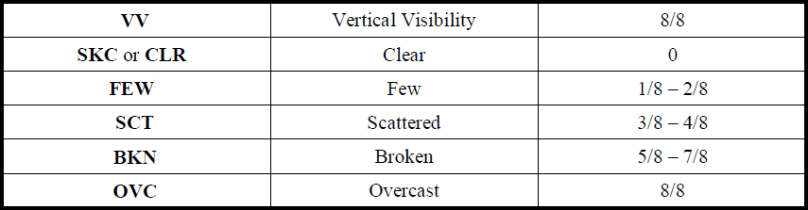
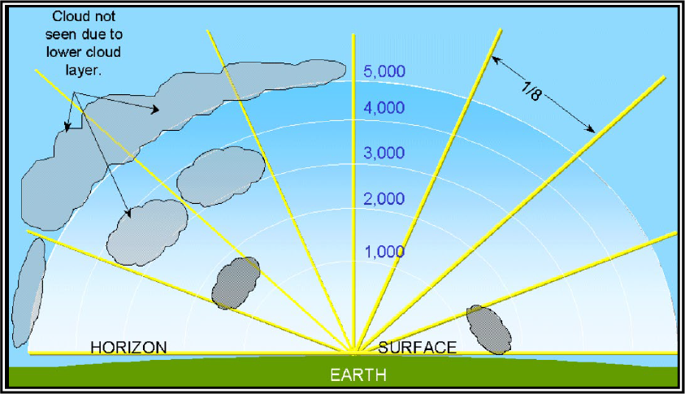

Slide 14

FEW012 SCT030 BKN050

Slide 15
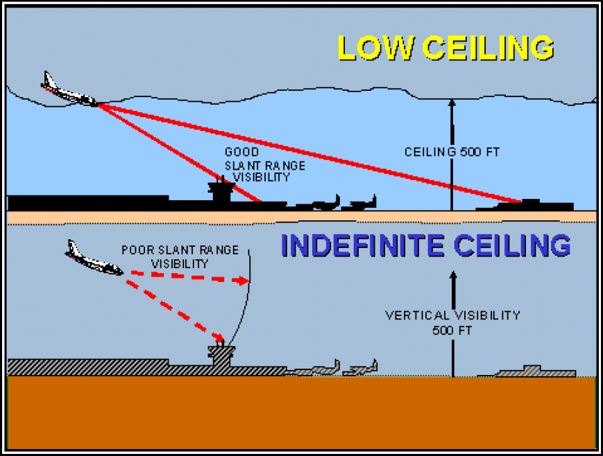
Vertical Visibility
KHMN 262014Z AUTO 24035G50KT 3/4SM R16/2200V4500FT HZ VV005 15/M02 A2979 RMK AO2 CIG 002 RWY34 SLP044

Slide 16
Temperature/Dewpoint rounded to nearest whole degree Celsius
KESN 242345Z 32005KT 10SM CLR 07/M06 A3047
KBWI 242354Z 32007KT 10SM FEW150 SCT200 SCT250 07/M08 A3044 RMK AO2 SLP308 T00721083 10122 20072 53026
KLTS 261955Z AUTO 13024G30KT 7SM OVC004 11/11 A2963 RMK AO2 PK WND 12032/53 PRESFR SLP034 T01130111
KHMN 262014Z AUTO 24035G50KT 3/4SM R16/2200V4500FT HZ VV013 15/M02 A2979 RMK AO2 CIG 002 RWY34 SLP044
SPECI KHIE 262008Z AUTO 00000KT 1 1/4SM -SN BR OVC021 M08/M10 A2964 RMK AO2 P0000 T10781100

Slide 17
Altimeter current pressure at altitude; no decimal point
KESN 242345Z 32005KT 10SM CLR 07/M06 A3047
KBWI 242354Z 32007KT 10SM FEW150 SCT200 SCT250 07/M08 A3044 RMK AO2 SLP308 T00721083 10122 20072 53026
KLTS 261955Z AUTO 13024G30KT 7SM OVC004 11/11 A2963 RMK AO2 PK WND 12032/53 PRESFR SLP034 T01130111
KHMN 262014Z AUTO 24035G50KT 3/4SM R16/2200V4500FT HZ VV013 15/M02 A2979 RMK AO2 CIG 002 RWY34 SLP044
SPECI KHIE 262008Z AUTO 00000KT 1 1/4SM -SN BR OVC021 M08/M10 A2964 RMK AO2 P0000 T10781100

Slide 18
Remarks
KESN 242345Z 32005KT 10SM CLR 07/M06 A3047
KBWI 242354Z 32007KT 10SM FEW150 SCT200 SCT250 07/M08 A3044 RMK AO2 SLP308 T00721083 10122 20072 53026
KLTS 261955Z AUTO 13024G30KT 7SM OVC004 11/11 A2963 RMK AO2 PK WND 12032/53 PRESFR SLP034 T01130111
KHMN 262014Z AUTO 24035G50KT 3/4SM R16/2200V4500FT HZ VV013 15/M02 A2979 RMK AO2 CIG 002 RWY34 SLP044
SPECI KHIE 262008Z AUTO 00000KT 1 1/4SM -SN BR OVC021 M08/M10 A2964 RMK AO2 P0000 T10781100

Slide 19
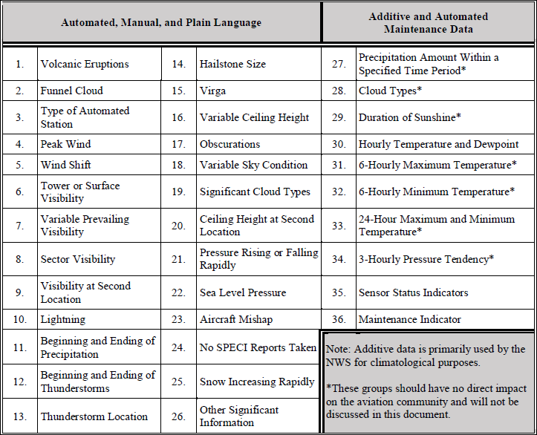
Remarks

Slide 20
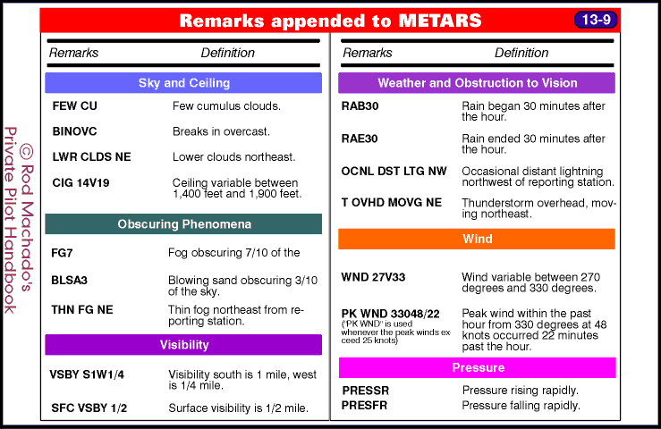

Slide 21
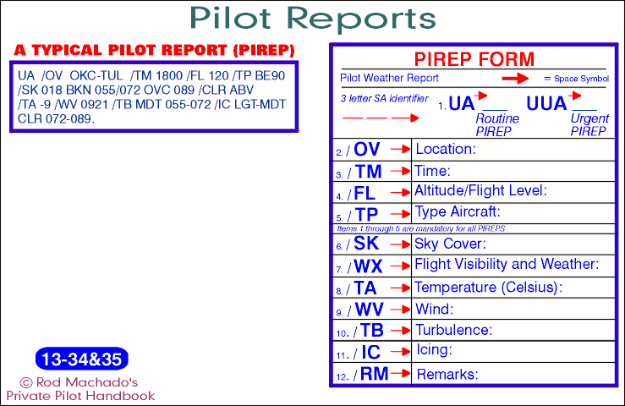
PIREPs (Pilot Reports)

Slide 22
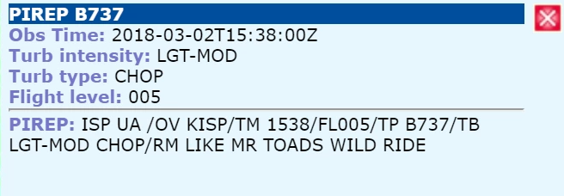

Slide 23
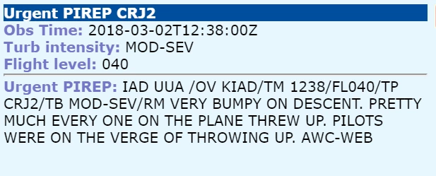

Slide 24
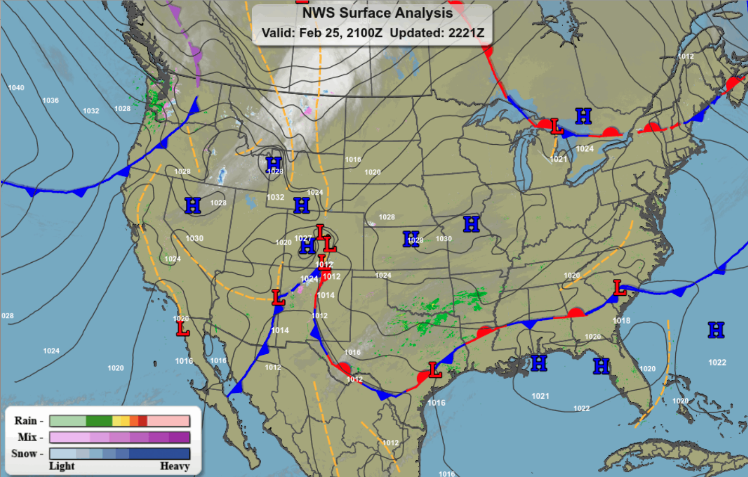
Current Conditions: Surface Analysis Chart

Slide 25
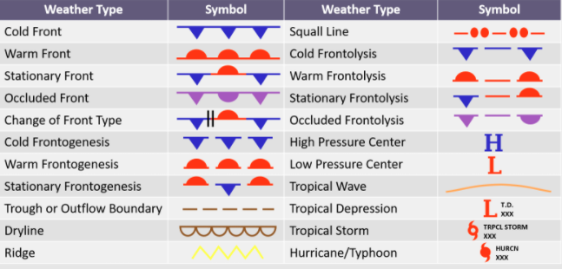
Surface Analysis Chart

Slide 26
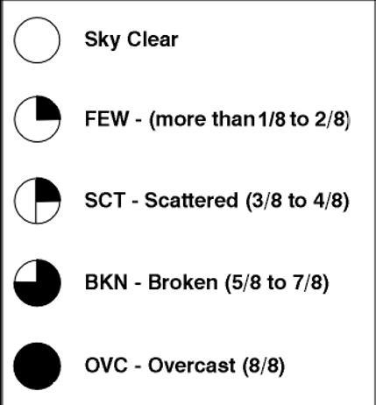
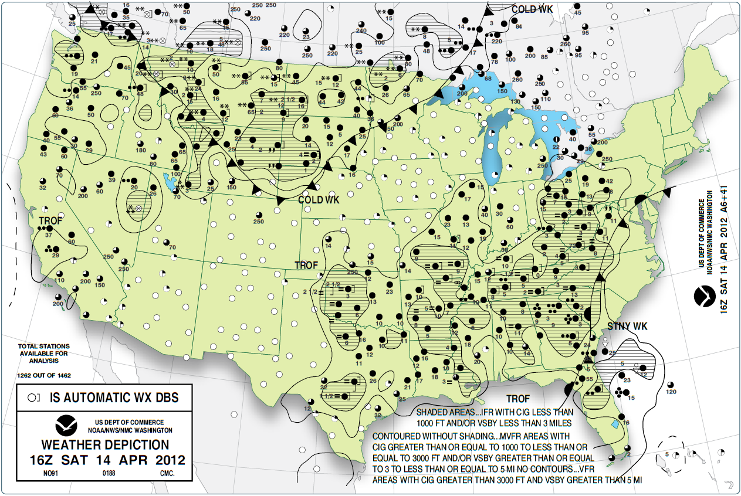
Weather Depiction Chart

Slide 27
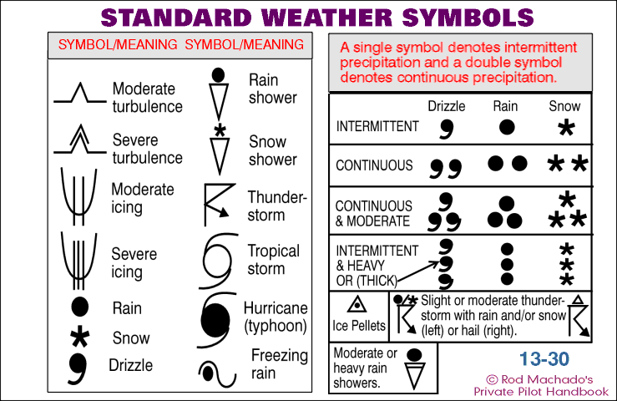

Slide 28
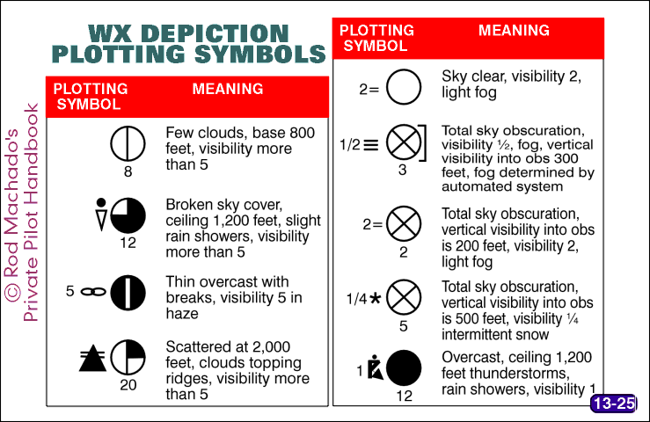
Weather Depiction Chart

Slide 29
Terminal
Aerodrome
Forecast

Slide 30
Expected meteorological conditions at an airport during a specified period
Issued by the National Weather Service
TAFs are valid for 24 to 30 hours
Wind, visibility, cloud cover, and expected precipitation within a 5-statute-mile radius of the airport center
Issued at designated weather service forecast offices (WFOs)
Available in both text and graphical formats via aviationweather.gov

Slide 31
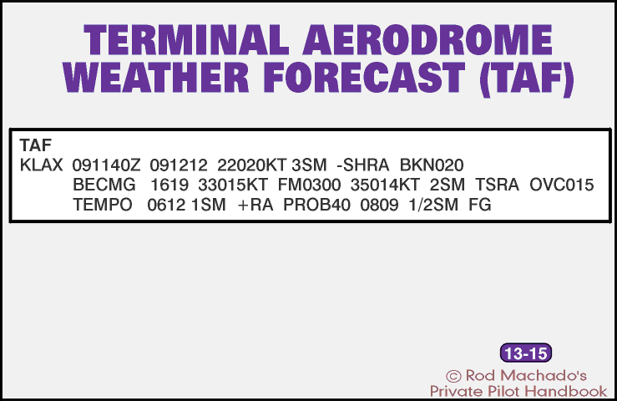

Slide 32
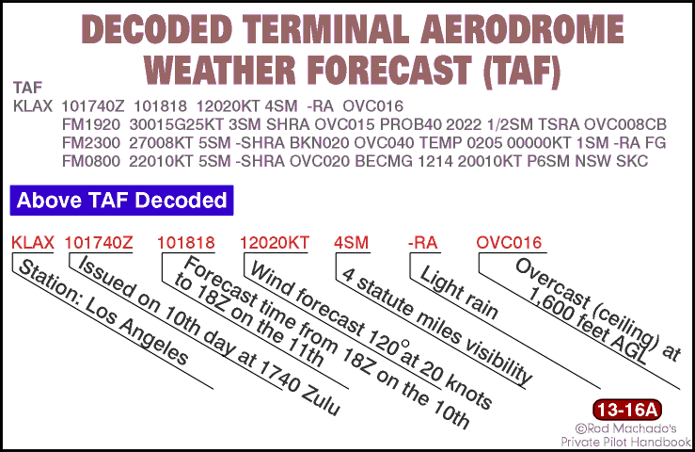

Slide 33
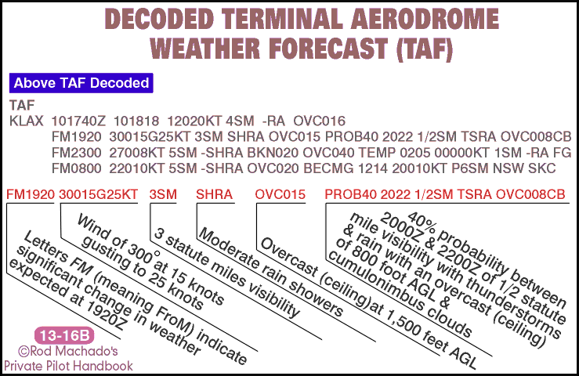

Slide 34
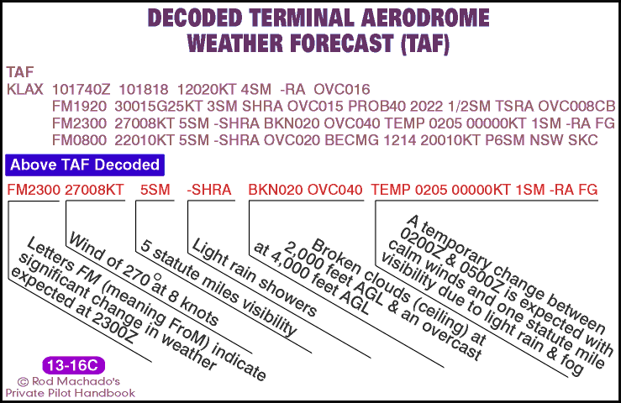

Slide 35
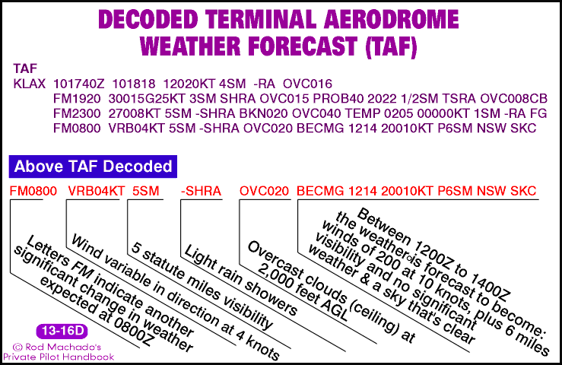

Slide 36
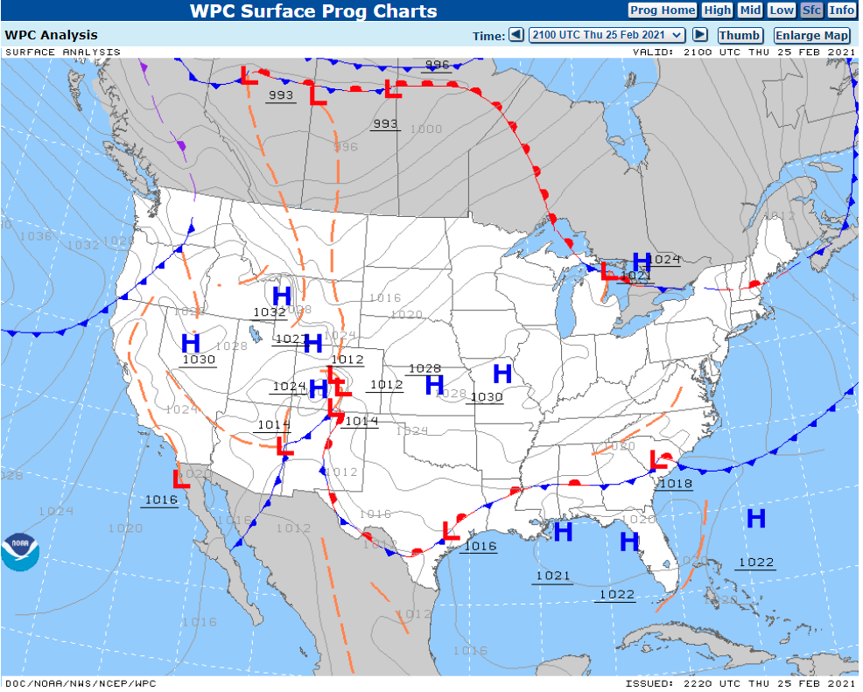

Slide 37
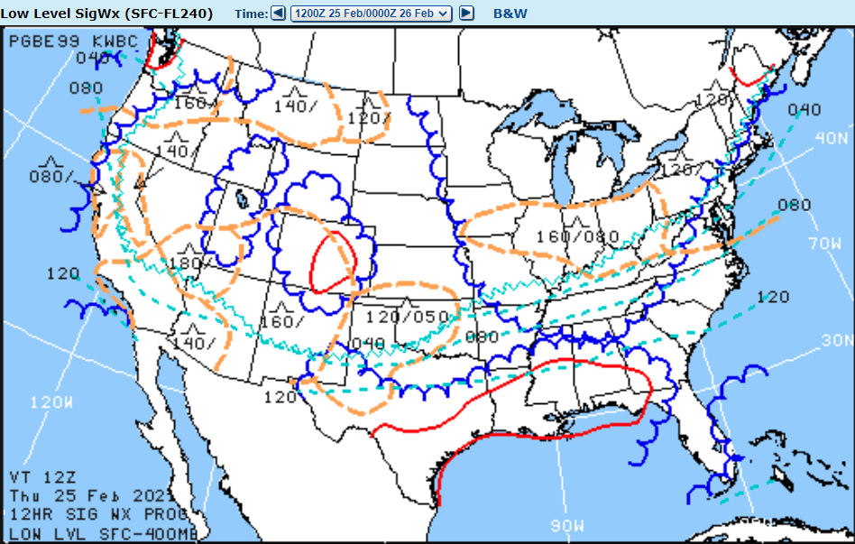

Slide 38
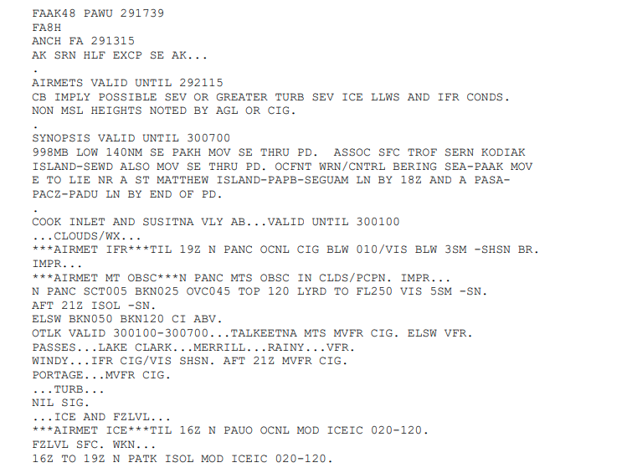
Old-Style Area Forecast (FA)

Slide 39
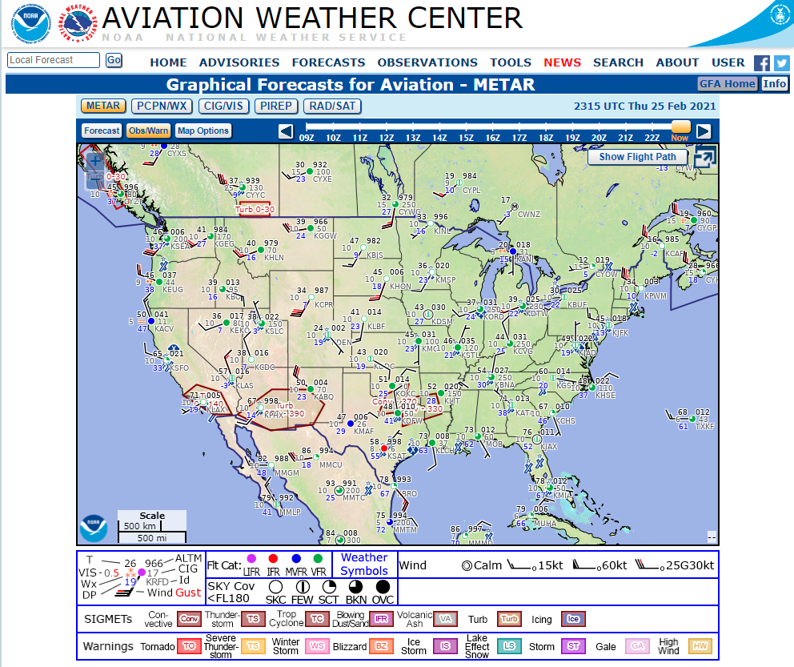
Graphical Area Forecast

Slide 40
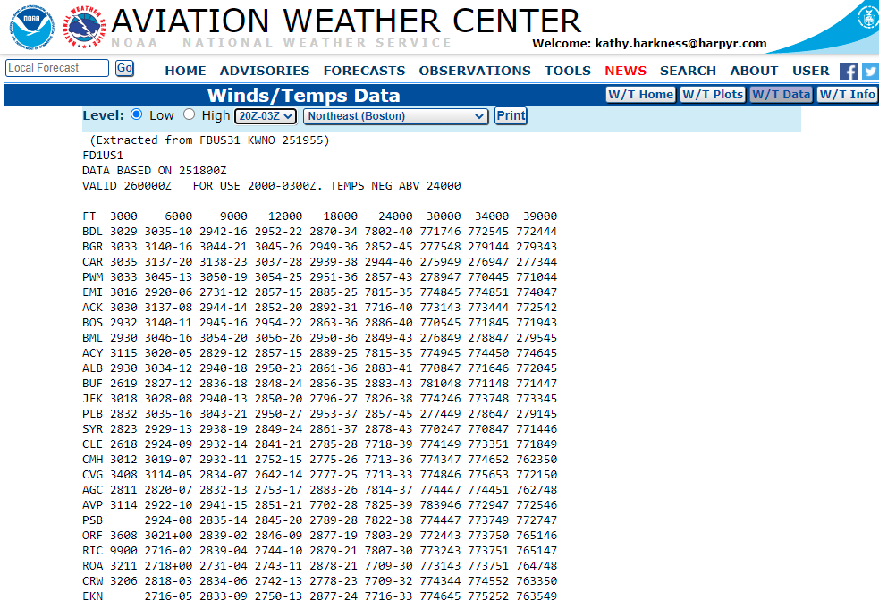

Slide 44


Slide 45
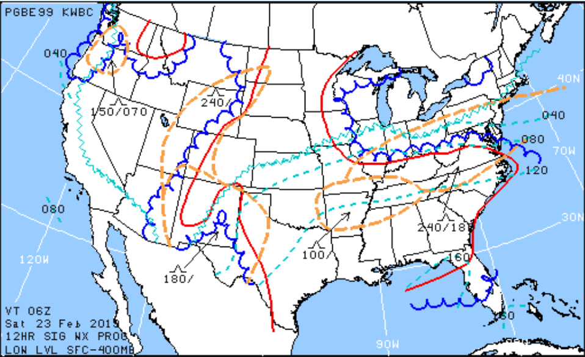
Low Level Prog Chart – 12H

Slide 46
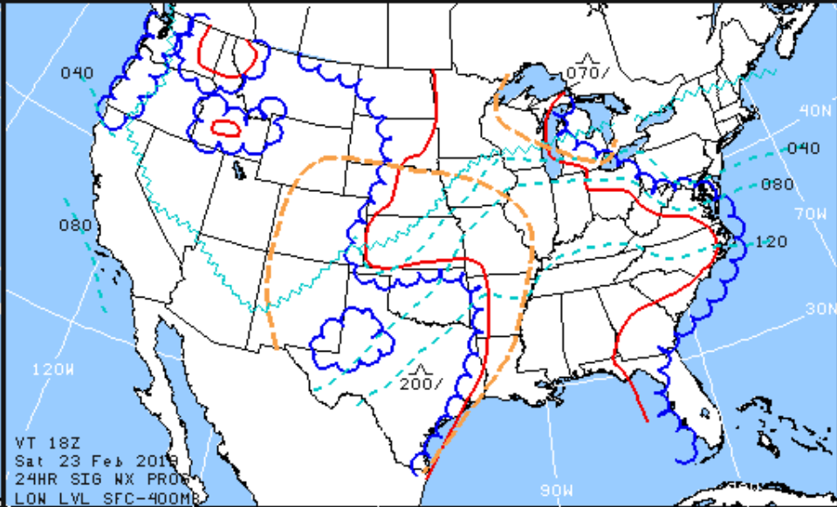
Low Level Prog Chart – 24H

Slide 47
AIRMETs (Airmen's Meteorological Information)
Description of weather phenomena that may affect aircraft safety.
Compared to SIGMETs, AIRMETs cover less severe weather
  moderate turbulence and icing
  sustained surface winds of 30 knots or more
  restricted visibility over an area at least 3000 square miles.

Slide 48
AIRMETs (Airmen's Meteorological Information)
AIRMET SIERRA (mountain obscuration or IFR)
    ceilings less than 1000 feet and/or
    visibility less than 3 miles
    affecting over 50% of the area at one time
    extensive mountain obscuration
AIRMET TANGO (turbulence)
    moderate turbulence
    sustained surface winds of 30 knots or greater
    non convective low−level wind shear.
AIRMET ZULU (icing)
    Moderate icing and provides freezing level heights

Slide 49
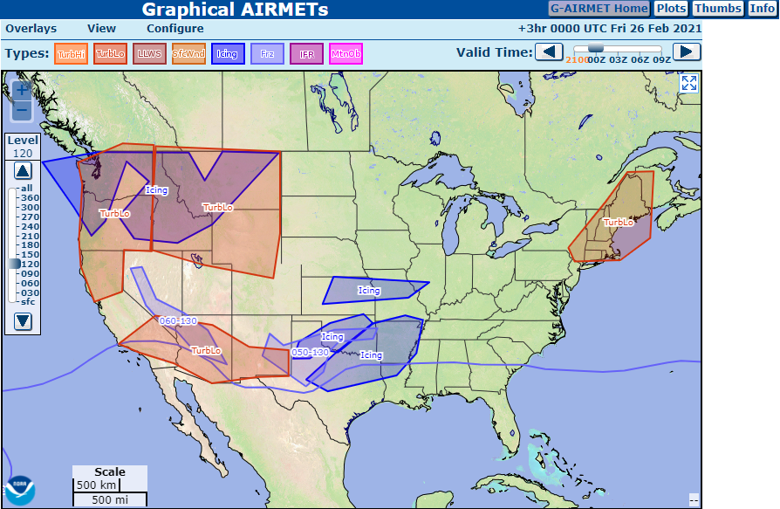

Slide 50
SIGMETs (Airmen's Meteorological Information):
Weather advisories concerning safety of all aircraft
Convective
    embedded thunderstorms
    line of thunderstorms
    thunderstorms level 4 or higher
    surface winds > 49 knots
    hail >= 3/4 inches
    Tornadoes
  Non-Convective (turbulence, icing, etc)

Slide 51
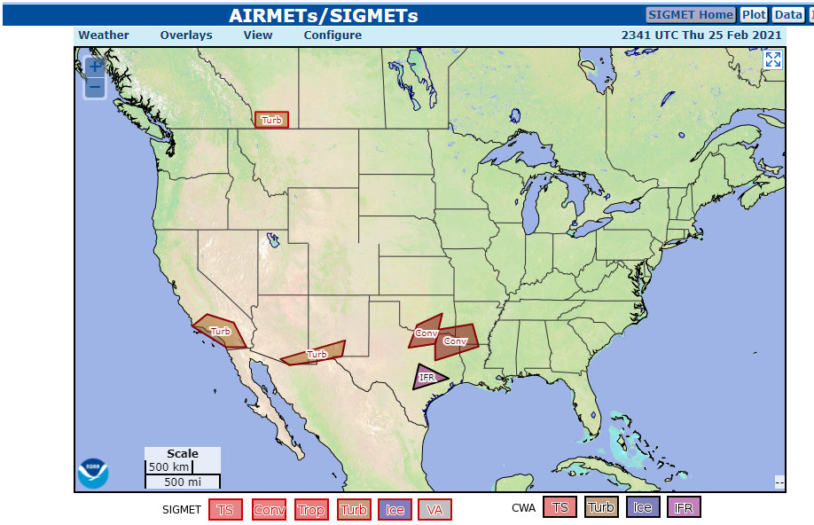
SigMets

Slide 52
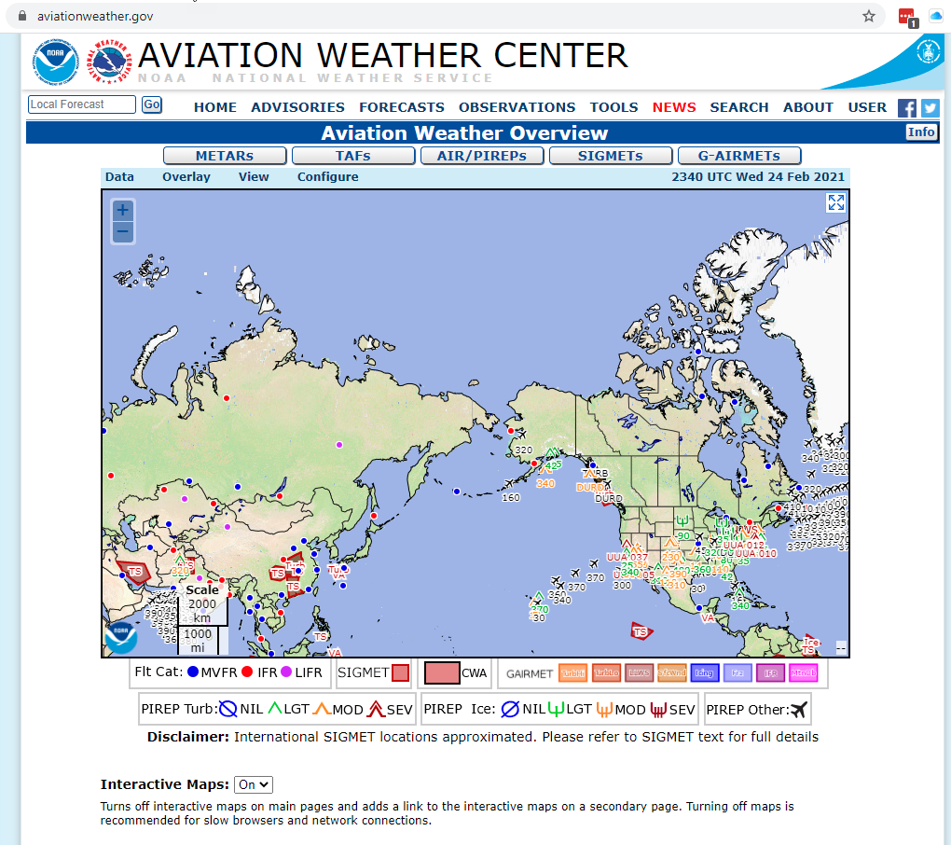

Slide 53
