Slide 1
Weight and Balance

Slide 2
Weight Watchers: Performance
Longer takeoff run
Reduced rate & angle of climb
Lower maximum altitude
Reduced maneuverability
Longer landing roll
Excess weight on nose/tailwheel

Slide 3
Weight Watchers: Speed
Higher takeoff speed
Reduced cruising speed
Higher stalling speed
Higher approach and landing speed

Slide 4
Ways to change weight
Short term:
  Fuel
  Baggage
Long term
  Installed equipment

Slide 5
Determining Empty Weight
Initially done by manufacturer
Must be recalculated if weight changes by
  > 1 lb (if empty weight < 5,000 lb)
  > 2 lb (empty weight 5,000-50,000 lb)
  > 5 lb (empty weight > 50,000 lb)

Slide 6
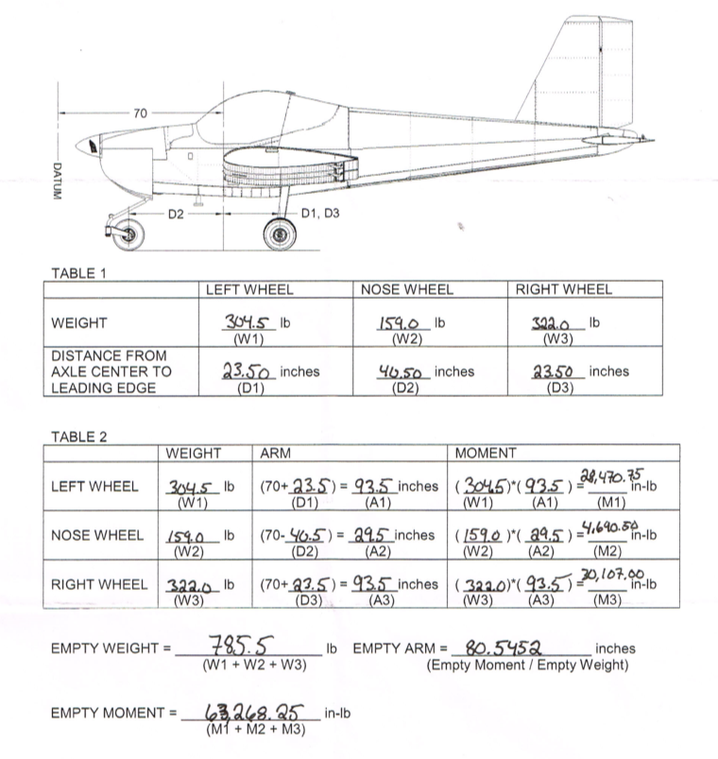

Slide 8
What is included in empty weight?
Airframe
Engine
Equipment as specified in list
Unusable fuel
Undrainable oil
Other items as noted on loading chart

Slide 9
Load:
Pilot plus
other occupants –plus-
baggage –plus-
usable fuel –plus-
drainable oil
Maximum takeoff weight –minus-
Empty weight
Useful Load:

Slide 10
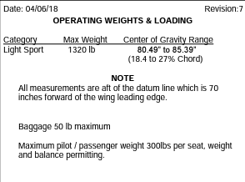
MTOW = 1320
Empty weight = 785.5
Useful load = 534.5

Slide 11
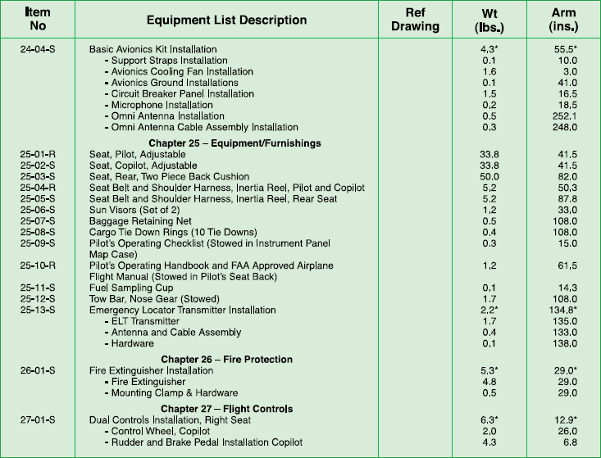

Slide 12
Balance and CG
Balance of an aircraft refers to the location of its center of gravity (CG)
Definition: CG is that point about which an aircraft would balance if it were possible to suspend it there
The theoretical point at which the entire weight of the aircraft is assumed to be concentrated

Slide 13
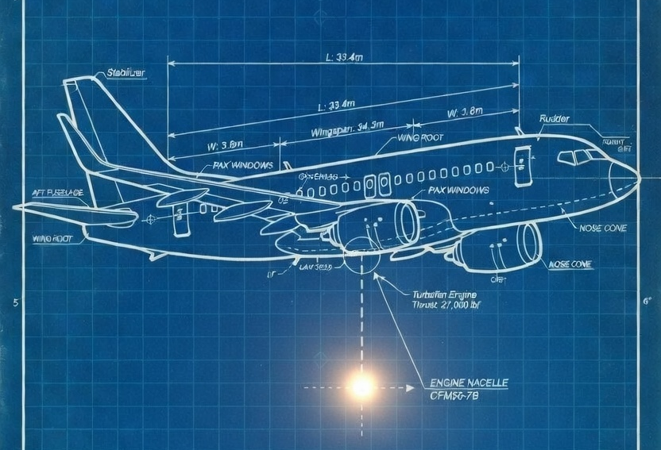

Slide 14
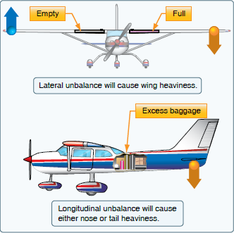


Slide 15
Lateral balance
Not always computed
Methods of control
  Aileron trim (if so equipped)
  Constant control pressure on yoke/stick
Reduces operating efficiency
  Aircraft is “out-of-streamline”
  Increased drag

Slide 17
Longitudinal balance
More consequential
Computed for each flight
Controlled by loading decisions
Limits are established for both forward and aft CG

Slide 18
Forward (“nose heavy”) CG
Difficult to raise nose sufficiently for takeoff/landing
Excessive load on nosewheel
Higher stalling speed
Higher control forces

Slide 19
Aft (“tail heavy”) CG
Difficult to recover from stalls/spins
Produces very light control forces, making it easy to overstress
Decreases stability (tendency of plane to right itself after a disturbance)

Slide 20
Law of the lever
A lever is balanced when the weight on one side of the fulcrum times its arm is equal to the weight on the opposite side times its arm.

Slide 21
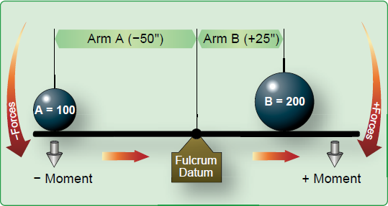
Fulcrum: the point on which the lever pivots
Datum: the reference point from which the arm is measured
Weight = lbs
Arm: distance from datum to the weight (usually measured in inches)
Moment: the downward force resulting from the weight at its position. This is calculated as arm x weight and denominated in inch-pounds

Slide 22
Side A: | Side B:
Weight = 100 lb | Weight = 200 lb
Arm = –50 inches | Arm = 25 inches
Moment = 100 x –50 = –5000 in lbs | Moment = 200 x 25 = 5000 in lbs
This lever is balanced about its fulcrum

Slide 23
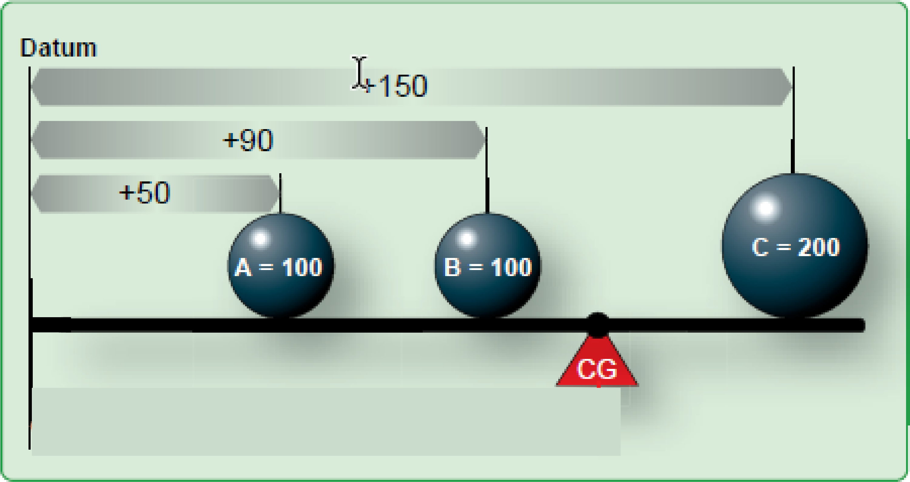
There is no requirement that the fulcrum and the datum be in the same place. We can solve this for where to place the fulcrum so that it becomes the center of gravity.

Slide 24
Item | Weight | * | Arm | = | Moment | CG
A | 100 |  | +50
B | 100 |  | +90
C | 200 |  | +150
∑ items

Slide 25
Item | Weight | * | Arm | = | Moment | CG
A | 100 |  | +50 |  | 5,000
B | 100 |  | +90 |  | 9,000
C | 200 |  | +150 |  | 30,000
∑ items | 400 |  |  |  | 44,000 | ∑ Moment ∑ Weight

Slide 26
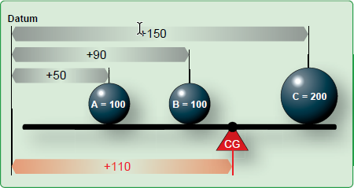
Item | Weight | * | Arm | = | Moment | CG
A | 100 |  | +50 |  | 5,000
B | 100 |  | +90 |  | 9,000
C | 200 |  | +150 |  | 30,000
∑ items | 400 |  |  |  | 44,000 | +110

Slide 27
Proof: the moments cancel out on each side of the fulcrum:
Left: A (100 lbs) + B (100 lbs) | Right: C (200 lbs)
[– (110” – 50”) x 100 lbs] + [– (110” – 90”) x 100 lbs] | (150” –110”) x 200 lbs
(–60” x 100 lbs) + (–20” x 100 lbs) | (40” x 200 lbs)
(– 6000 inch-lbs) + (– 2000 inch-lbs)
– 8000 inch-lbs | 8000 inch-lbs

Slide 28
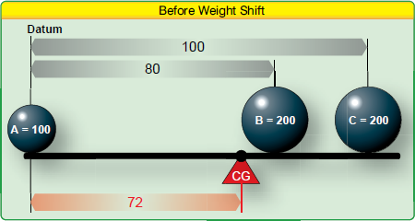
Here we have a plank of length 100”. As currently distributed, the CG is 72” aft of the datum. How could we redistribute the weight (move Ball “B”) so that the CG coincided with the midpoint of the plank (50” aft of datum)?

Slide 29
Let’s start by demonstrating that the current CG is at 72”:
Item | Weight | Arm | Moment | CG
A | 100 | 0 | 0
B | 200 | 80 | 16000
C | 200 | 100 | 20000
Sum | 500 |  | 36000 | 72

Slide 30
Basic Weight and Balance Equation
Weight to be shifted |  | Change in CG
────────────── | = | ─────────────────
Total weight |  | Distance weight is shifted
** move “B” so that new CG = 50” aft of datum

Slide 31

Weight to be shifted |  | Change in CG
__________________ | = | _________________________
Total weight |  | Distance weight is shifted

Slide 32
Weight to be shifted |  | Change in CG
__________________ | = | _________________________
Total weight |  | Distance weight is shifted

Slide 33
200 lbs |  | – 22 inches
__________________ | = | _________________________
500 lbs |  | Distance weight is shifted
50

Slide 34

200 lbs |  | – 22 inches
__________________ | = | _________________________
500 lbs |  | Distance weight is shifted
$$\frac{200 }{500} = \frac{−22}{X}$$
** move “B” so that new CG = 50” aft of datum

Slide 35

200 lbs |  | – 22 inches
__________________ | = | _________________________
500 lbs |  | Distance weight is shifted
$$\frac{200 }{500} = \frac{−22}{X}$$
$$200= \frac{(−22 × 500)}{X}$$
** move “B” so that new CG = 50” aft of datum

Slide 36

200 lbs |  | – 22 inches
__________________ | = | _________________________
500 lbs |  | Distance weight is shifted
$$\frac{200 }{500} = \frac{−22}{X}$$
$$200= \frac{(−22 × 500)}{X}$$
$$200X=(−22 ×500)$$
** move “B” so that new CG = 50” aft of datum

Slide 37

200 lbs |  | – 22 inches
__________________ | = | _________________________
500 lbs |  | Distance weight is shifted
$$\frac{200 }{500} = \frac{−22}{X}$$
$$200= \frac{(−22 × 500)}{X}$$
$$200X=(−22 ×500)$$
$$X= \frac{(−22 ×500)}{200}$$
** move “B” so that new CG = 50” aft of datum

Slide 38

200 lbs |  | – 22 inches
__________________ | = | _________________________
500 lbs |  | Distance weight is shifted
$$\frac{200 }{500} = \frac{−22}{X}$$
$$200= \frac{(−22 × 500)}{X}$$
$$200X=(−22 ×500)$$
$$X= \frac{(−22 ×500)}{200}$$
$$X=−55 inches$$
** move “B” so that new CG = 50” aft of datum

Slide 39
Item | Weight | Arm | Moment
A | 100 | 0 | 0
B
C | 200 | 100 | 20,000

Slide 40
Moves 55” to left
Item | Weight | Arm | Moment
A | 100 | 0 | 0
B | 200 | 80 – 55 = 25 | 5,000
C | 200 | 100 | 20,000
Sum | 500 |  | 25,000
New CG:
25000/500=
50!

Slide 41
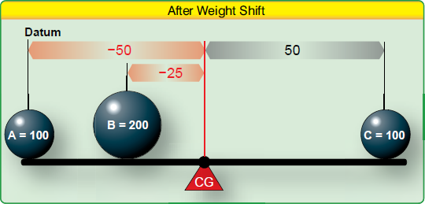
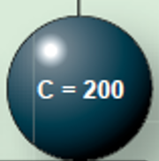
Item | Weight | Distance from Fulcrum | Moment
A | 100 | – 50 | – 5000
B | 200 | – 25 | – 5000
C | 200 | + 50 | + 10000
Sum |  |  | 0

Slide 42
Applying to Aircraft

Slide 43
Some parameters
Maximum takeoff weight (MTOW)
Empty weight
Number and position of seats
Maximum baggage
Fuel capacity
Usable fuel in gallons
Oil capacity in quarts (usually)

Slide 44
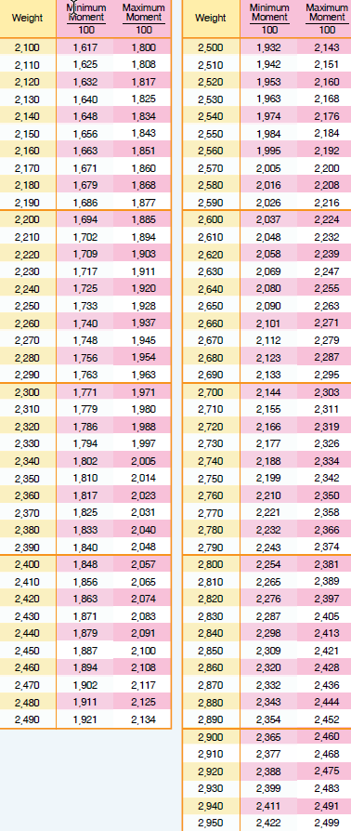

Slide 46
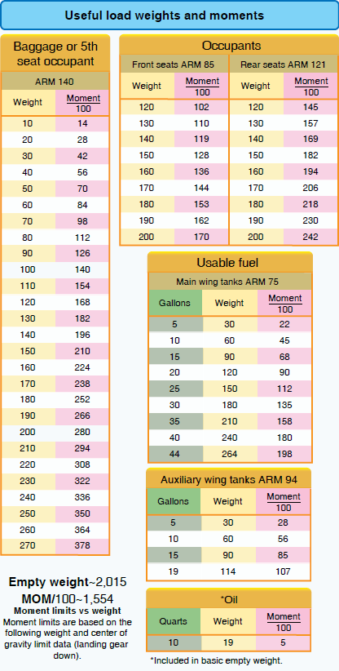
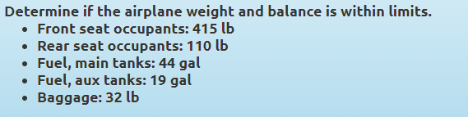

Slide 47
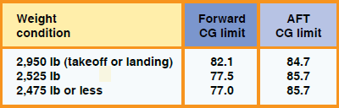
Answer weight question first because it is easier; if it’s too heavy you’ll have to remove some weight before you calculate the balance anyway.
Maximum take off weight (MTOW) will be indicated in the Pilot’s Operating Handbook/Operating Limitations.

Slide 48
Front seat occupants | 415
Rear seat occupants | 110
Fuel main tanks 44 gal | ?
Fuel aux tanks 19 gal | ?
Baggage | 32

Slide 49
Front seat occupants | 415
Rear seat occupants | 110
Fuel main tanks 44 gal | 264
Fuel aux tanks 19 gal | 114
Baggage | 32
Fuel weighs 6 lbs per gallon

Slide 50
Front seat occupants | 415
Rear seat occupants | 110
Fuel main tanks 44 gal | 264
Fuel aux tanks 19 gal | 114
Baggage | 32
What about oil?
Sometimes it is included in empty weight, sometimes not. This will be indicated on the chart. In this case, it is included.

Slide 51
Front seat occupants | 415
Rear seat occupants | 110
Fuel main tanks 44 gal | 264
Fuel aux tanks 19 gal | 114
Baggage | 32
Empty weight | 2015
Total weight

Slide 52
Front seat occupants | 415
Rear seat occupants | 110
Fuel main tanks 44 gal | 264
Fuel aux tanks 19 gal | 114
Baggage | 32
Empty weight | 2015
Total weight | 2950

Slide 53
 | Lbs | Arm | Moment
Front seat occupants | 415
Rear seat occupants | 110
Fuel main tanks 44 gal | 264 |  | 198
Fuel aux tanks 19 gal | 114 |  | 107
Baggage | 32
Empty weight | 2015 |  | 1554
Total weight | 2950

Slide 54
 | Lbs | Arm | Moment
Front seat occupants | 415 | 85
Rear seat occupants | 110 | 121
Fuel main tanks 44 gal | 264 |  | 198
Fuel aux tanks 19 gal | 114 |  | 107
Baggage | 32 | 140
Empty weight | 2015 |  | 1554
Total weight | 2950

Slide 55
 | Lbs | Arm | Moment
Front seat occupants | 415 | 85 | 353
Rear seat occupants | 110 | 121 | 133
Fuel main tanks 44 gal | 264 |  | 198
Fuel aux tanks 19 gal | 114 |  | 107
Baggage | 32 | 140 | 45
Empty weight | 2015 |  | 1554
Total weight | 2950

Slide 56
 | Lbs | Arm | Moment
Front seat occupants | 415 | 85 | 353
Rear seat occupants | 110 | 121 | 133
Fuel main tanks 44 gal | 264 |  | 198
Fuel aux tanks 19 gal | 114 |  | 107
Baggage | 32 | 140 | 45
Empty weight | 2015 |  | 1554
Total weight | 2950 |  | 2390

Slide 57
 | Lbs | Arm | Moment
Front seat occupants | 415 | 85 | 353
Rear seat occupants | 110 | 121 | 133
Fuel main tanks 44 gal | 264 |  | 198
Fuel aux tanks 19 gal | 114 |  | 107
Baggage | 32 | 140 | 45
Empty weight | 2015 |  | 1554
Total weight | 2950 |  | 2390
CG = Moment/Weight |  |  | 81.01

Slide 58
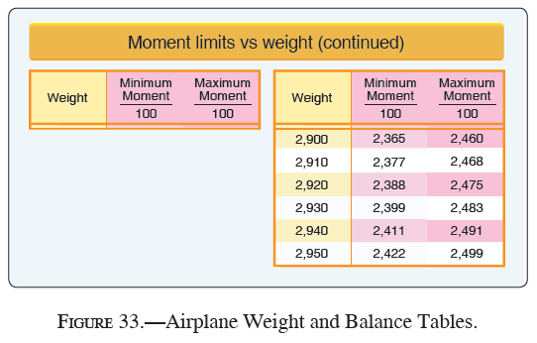
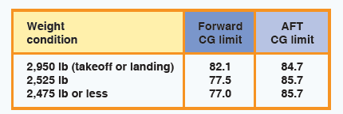
 | Lbs | Arm | Moment
Front seat occupants | 415 | 85 | 353
Rear seat occupants | 110 | 121 | 133
Fuel main tanks 44 gal | 264 |  | 198
Fuel aux tanks 19 gal | 114 |  | 107
Baggage | 32 | 140 | 45
Empty weight | 2015 |  | 1554
Total weight | 2950 |  | 2390
CG = Moment/Weight |  |  | 81.01
At current weight, this aircraft is not within CG limits – it is too far forward.

Slide 59
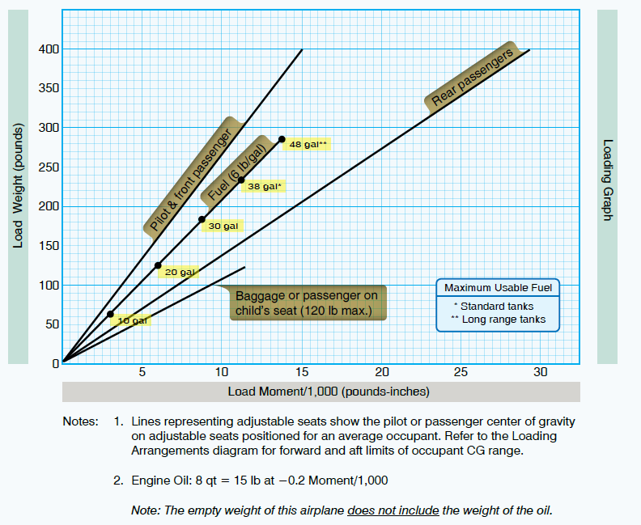

Slide 60
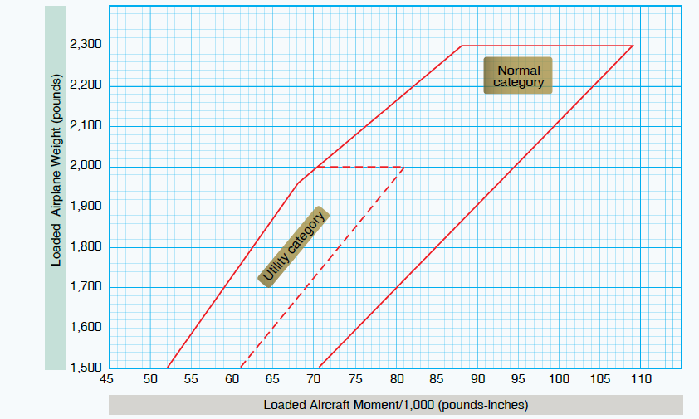

Slide 61
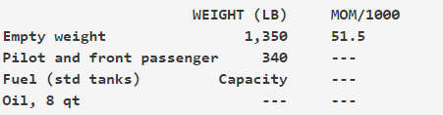

Slide 63
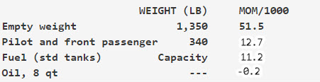

Slide 64
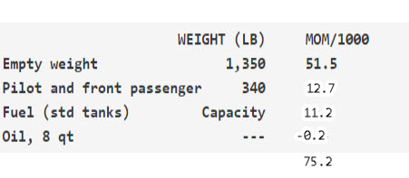

Slide 65
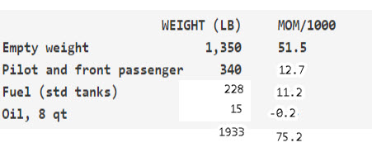

Slide 67
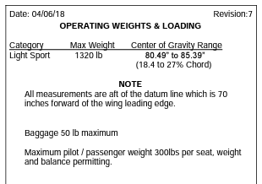
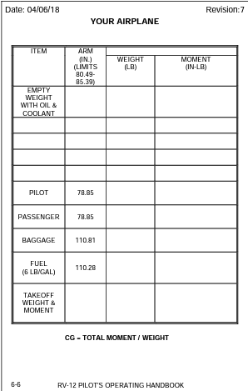

Slide 68
Van’s RV-12 W&B worksheet

Slide 69
Next time: cross country flight planning
Machado Chapter 14
Pilot’s Handbook Chapter 16
Homework: work on aircraft performance and weight and balance problems. We will go over these next Monday (3/16)

